Slide 1

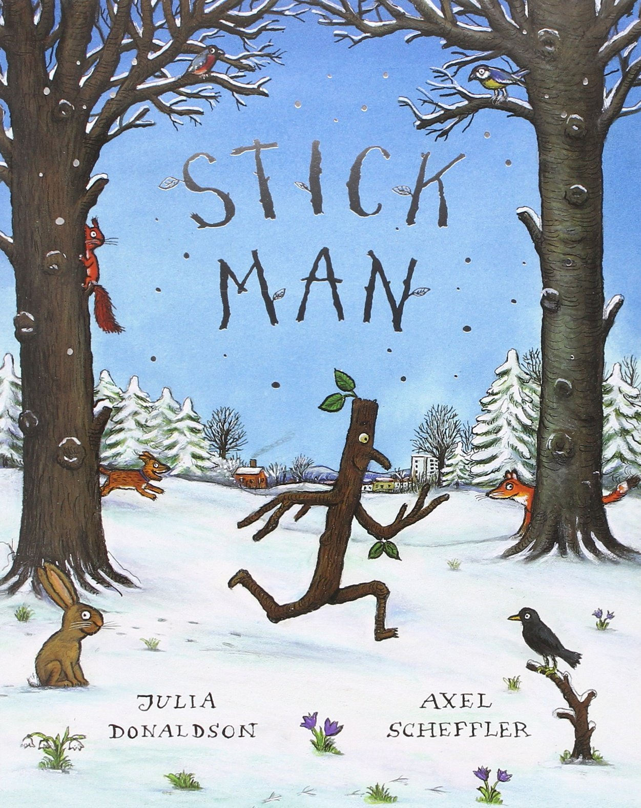

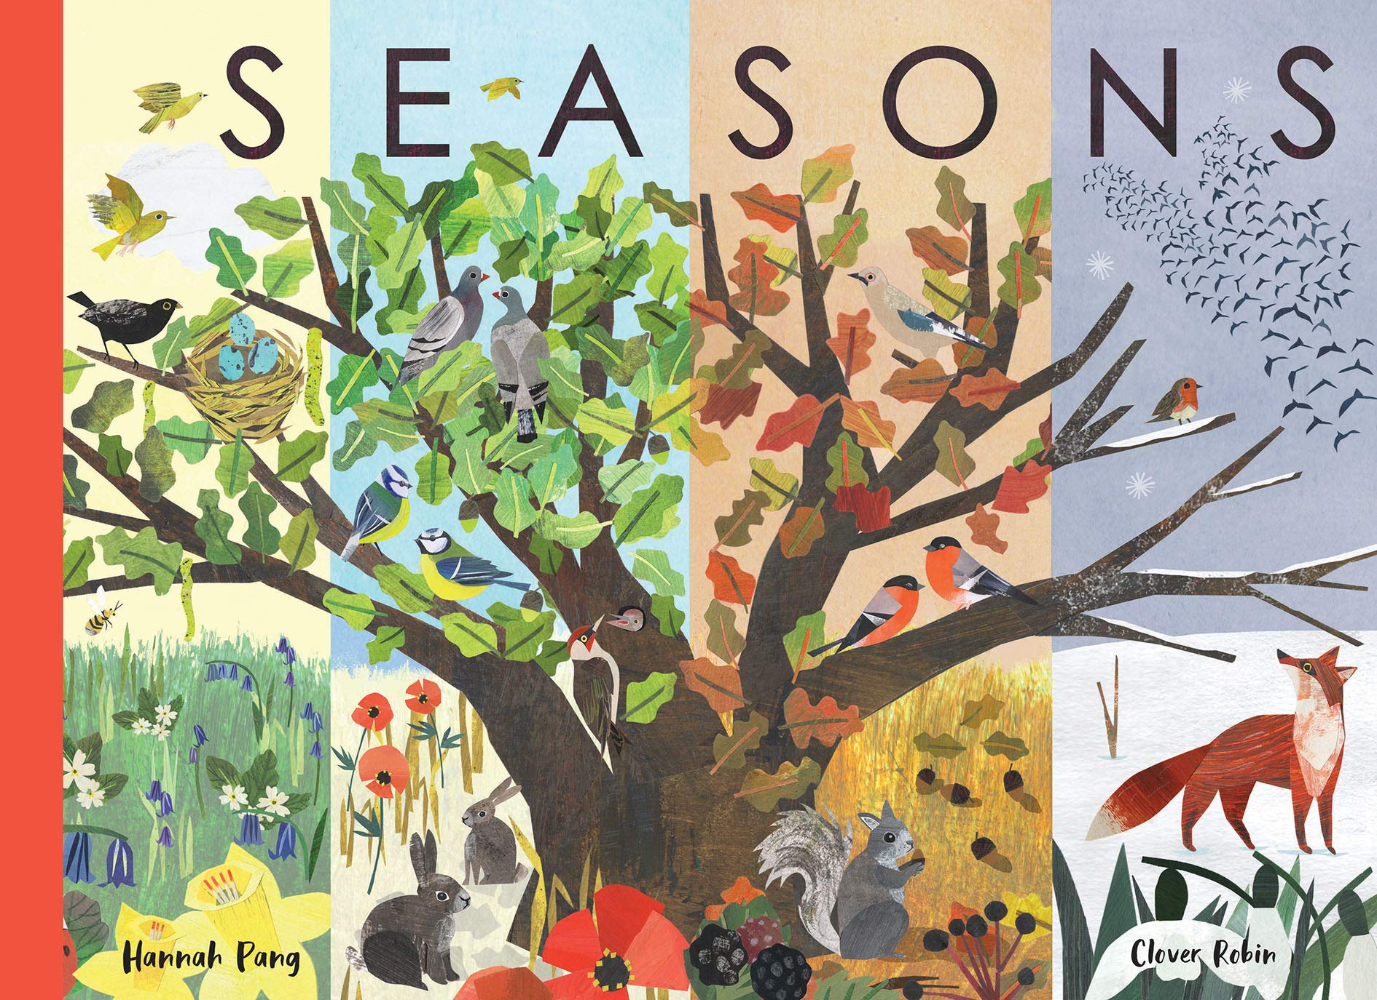



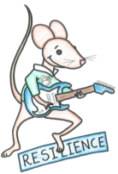

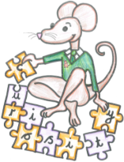
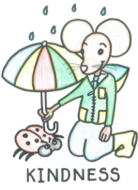
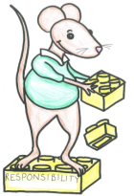
Autumn term
2
Ready Respectful Safe
Science: Seasons
PE: Gym and moving a ball.
DT: making and evaluating products
Music: responding to music
PSHE: Who is special to us?
English
Recognising non-fiction texts, using ‘and’ to combine information, identifying nouns and verbs and writing sentences with finger spaces, capital letters and full stops.
How you can help at home:
Practice your handwriting and spelling words at home.
Count out the sounds in words and use the grow your code sheet to help find the sounds in spellings.
Maths
Numbers to 20, adding and subtracting within 20, shape, finding 1 more and 1 less and position.
How you can help at home:
Counting games.
Counting in 10s
Using objects to add and take away within 20.
Finding 1 more and 1 less than numbers to 20.
What do you think about the main character?
What is your favourite part of the story?
Which fairytale is your favourite?
Key Text
Which Muscliff values do the characters demonstrate?
Other information: PE is Monday and Wednesday. Our Christmas Concert is on 15th and 16th of December. More information will be sent out in a separate letter. | Homework: Regular reading each week using you Little Wandle book. Weekly handwriting and spelling practice. Use of maths fluency homework to consolidate maths skills.

