Slide 1


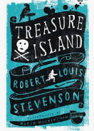
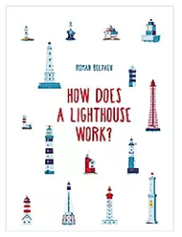
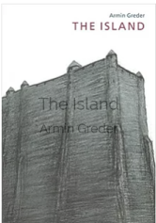
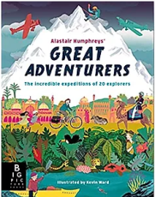
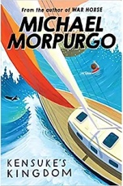

Autumn term
1
Ready Respectful Safe
Geography: Coasts
Computing: Multi-media presentation
RE:
Why do people worship?
History: study of the local area (smugglers)
French: Phonics and School
PE:
fitness, handball, football
English
Explaining word classes
Verbs and verb tenses
Identifying adverbials and phrases
Sentence manipulation
How you can help at home:
Gather leaflets or an information.
Keep a daily reading diary.
Times table Rockstars
Maths
Comparing Numbers to 10 Million
Mixed operations
Multiplying and dividing 2d numbers
Factors and multiples
Other information:
PE days – Tuesday and Friday
Homework due – Monday
Key Text
What suggests that Jim Hawkins is the hero of the story?
How is the idea of ‘greed’ developed throughout the text?
Explain how trust is integral to the story.
Other information: Pirate Day Magical Starter (4th September) Year 6 Curriculum Evening (15th September) School trip: Lulworth cove (2nd October) | Homework: Reading (5 times per week) Spellings and handwriting (joined) English and maths tasks

Slide 2
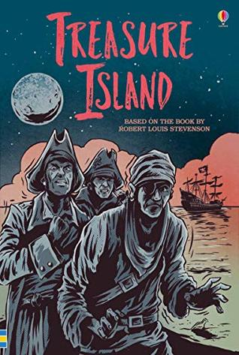
Year 6
Autumn term
1
Ready Respectful Safe
Treasure Island
Why this particular book and not something else?
We have carefully chosen this book as our lead text because Treasure Island is an excellent model of a quest story, crafted to keep children on the edge of their seats. Like all adventure stories, there is a certain format and there are key ingredients which Y6 replicate in their own writing. Robert Louis Stevenson even wrote this book whilst gazing at Brownsea Island from his holiday house in Poole! He’s an author who is special to our locality.
This text is also a good way to tackle the theme of healthy and unhealthy relationships and to show our oldest learners an example of when all is not what it seems in a relationship when there is an imbalance of power. We can not over emphasise what a beautiful book this is!
School values this book reinforces:
Treasure Island is a wonderful way to help children to understand ASPIRATION. As Y6 are our oldest children, they appreciate that in real life there may be barriers and conflict to achieving a target and sometimes it is just not enough to hope and dream – one has to prepare to dig deep and toil. Our lead character doesn’t find success easily despite his dreams.
Extended Writing in school:
Children will develop skills in extended story writing with a focus on how authors use clause construction to add detail; little added details help to engage their reader. We will also aim to enrich the children’s vocabulary so that their written language sounds correct to the task and the genre. It sounds so much better to say, ‘Jim heaved himself up the rigging,’ than ‘Jim went up the rope’!
A diary extract will be written by the children to show the correct use of tenses. Diaries are naturally written in different tenses, including past, present and conditional tenses and this task presents the perfect opportunity to unpick our use of verbs.
Skills that will be developed through this unit:
Identifying, replicating and exploring the author’s use of clause structure (main clause, subordinate clause, relative clause) is helpful to develop Y6 sentence construction. You will see your child’s work becoming more complex and adventurous over the half term as they build extra clauses into individual sentences. The children will also learn to ‘play’ with their sentences by moving the order of clauses. What difference does moving a clause make to the reader’s experience? We want our children to develop control over their sentences. On top of all of this, you will see your child become even more secure with their sentence punctuation.
Modal verbs (and auxiliary verbs) are discussed when we learn about simple and progressive tenses as well as sentences of possibility using modal verbs (would, could, should, might, must…)
Spelling patterns focus on _Ible/_able, _Ibly/_ably and spellings containing _fer

Slide 3
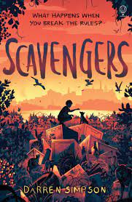
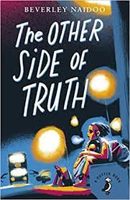
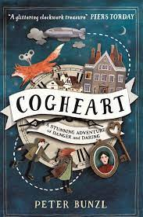
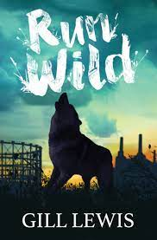
Year 6
Autumn term
1
Ready Respectful Safe
Writing Homework
Here is an overview of each written task for this half term. Over this half term, your child should aim to complete some writing at home each week. The time they invest in their written homework will vary from child to child – parental discretion is advised. Alternatively, you may wish to focus on just one or two of these activities and develop them over several weeks with your child.
A diary of your weekend/week would be an excellent homework task. To make this more challenging, consider if you have used a range of different tenses, including past simple, past progressive, present simple and present progressive. Have you used any conditional sentences using would/could/should/might?
As adventure stories are our focus, rewrite an adventure story that you already know in your own words.
Try writing a paragraph that demands very specific vocabulary. A weather forecast, a science report or recipe would be good examples that would demand writing using unfamiliar language. This is a very challenging task and the starting point might be a list of key words associated with that chosen topic.
A character profile of Long John Silver would present the opportunity to present contrasting arguments. At a basic level, describe his appearance. On a deeper level, discuss how he uses his charisma to gain trust and manipulate others.
To show that you have understood both the text and our topic, recreate this document! How is Treasure Island full of learning opportunities?
Our Extended Book Spine
To complement Treasure Island, our school can thoroughly recommend these texts for this half term:
Please turn over to find out more about these recommended books.
Reading any of these books will contribute towards a new reading star!

Slide 4
Year 6
Autumn term
1
Ready Respectful Safe
Our Extended Book Spine
To complement Treasure Island, our school can thoroughly recommend these texts for this half term:
Book Title | What is it about? | What your teachers think about this book…
Scavengers (Darren Simpson) | Landfill has lived his whole life as a scavenger, running with wooflers, swimming with turtles and feasting on fresh gull. Old Babagoo has always looked after him, on one condition – follow his rules. Never come looking Outside. Never rise above the wall. But despite the dangers, Landfill longs to see Outside. And some rules are made to be broken. | We really liked this book ourselves after hearing about it from another Y6 teacher in a different school, who recommended it to us. We instantly liked the style of writing which is not too dissimilar to Morpurgo. We particularly liked the messages in the story.
The other side of the truth (Beverley Naidoo) | This is the story of 12 year-old Sade and her brother Femi who flee to Britain from Nigeria. Their father is a political journalist who refuses to stop criticising the military rulers in Nigeria. Their mother is killed and they are sent to London, with their father promising to follow. Abandoned at Victoria Station by the woman paid to bring them to England as her children, Sade and Femi find themselves alone in a new, often hostile, environment. Seen through the eyes of Sade, the novel explores what it means to be classified as 'illegal' and the difficulties which come with being a refugee. | Cultural diversity, empathy… The themes in this book might not be for all and the content would suit a more mature reader who is interested in current news and the wider world. It’s not the kind of book we would suggest as a class text as the themes tackled in the book are challenging.
Cogheart(Peter Bunzl) | When 13-year-old Lily's inventor father vanishes on a routine Zeppelin flight, Lily's determined to find out the truth behind his disappearance. But she's not the only one searching for her father; there are silver-eyed men in the shadows who will stop at nothing to find him. With Robert, the local clockmaker's son, Lily travels to London, where they soon discover that she holds the key to the mystery...a mystery closer to Lily's heart than she could have ever imagined. | Mystery adventure, fast-paced. Y6 give it a thumbs up!
Run Wild (Gill Lewis) | Izzy and Asha need a space to call their own, away from difficult families, the Skull brothers and the trouble they bring. But the derelict building site where they stake their claim already belongs to something else, a wilderness they never expected and an injured wolf that desperately needs their help. Can they reconnect to the wild and save the wolf? Or is their pack too weak to fight much stronger powers? A stunning tale of our lost connection to nature and the wild that hides in us all, from renowned storyteller Gill Lewis. | Particularly suitable for reluctant or dyslexic readers, it is accessible and provides a enjoyable tale. Animals, thought-provoking

