Slide 1

Welcome to Year 2

Slide 2
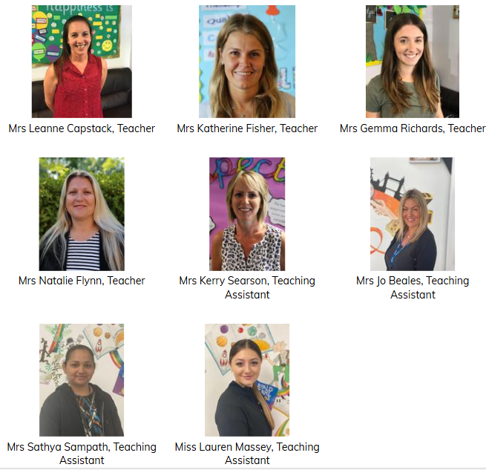
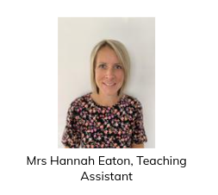
A warm welcome from us all:

Slide 3
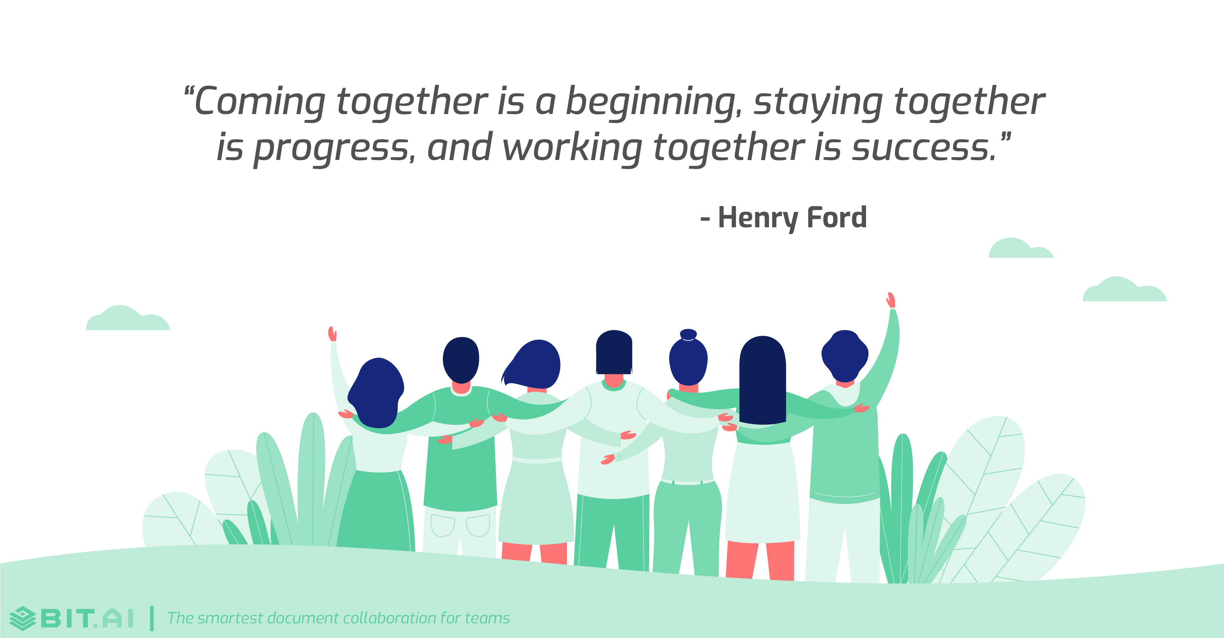
We want the same outcomes for your child.

Slide 4
Aims of the evening:
To help parents understand the bigger picture of what we will be learning this year (and why).
To provide parents with information on the things that are most important to the year (and how you can help at home).

Slide 5

The impact will be that...
You are in a better, more informed, place to help your child thrive.

Slide 6
But just before we get started...
Website is in process of being updated – launch on 1st Oct
Switch to ‘Arbor’ (parent communication, attendance etc)
Weekly bulletin

Slide 7

School trips, visitors and important dates...
Our provisional activities so far…
Evening campfire and treasure hunt in school
Christmas craft and songs
Great Fire of London workshop (in school)
Wednesday 25th March – trip to Avon Heath with the Urban Heath Partnership (cost approximately £10)
Parks Foundation – activities in the local area (TBC – free)

Slide 8
Terms you’ll hear us say (and what they mean)…
Lead/key text or Beautiful Text
Wider curriculum
Curriculum Drivers
Reading spine

Slide 9




Autumn 1
Beautiful Text
Curriculum Drivers
You need to know
Art - colour and drawing
Science - everyday materials
Geography - oceans and continents
We send home spellings as part of our homework and have a test every Monday.
We also start number bond tests every Friday. This is to aid number fluency in maths.

Slide 10

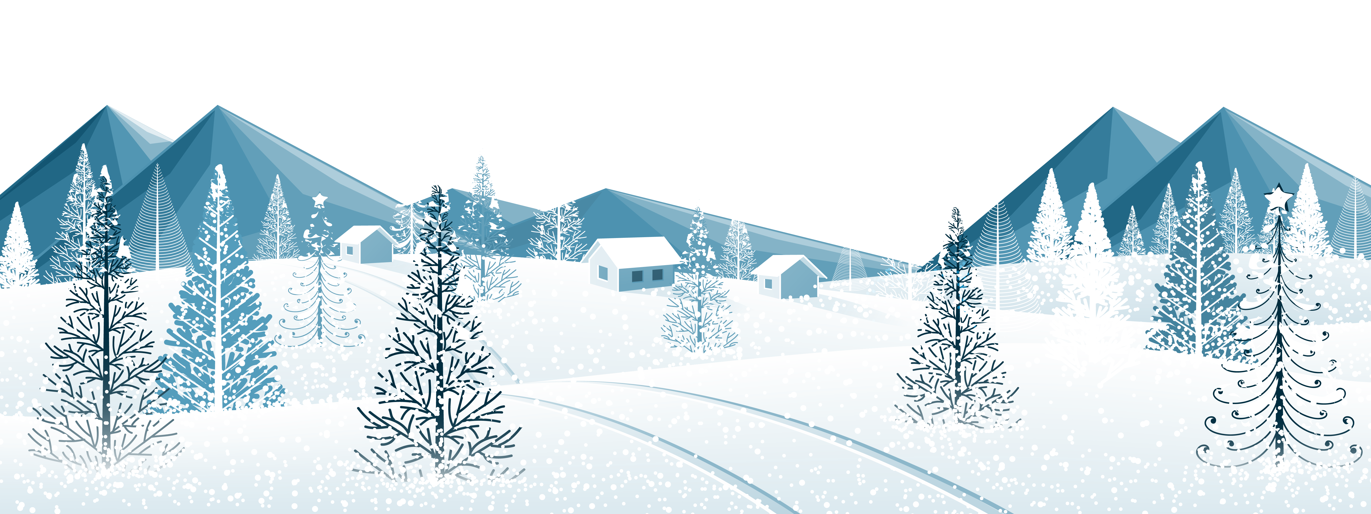
Autumn 2
Beautiful Text
Curriculum Drivers
You need to know
Science - animals, including humans
Music
Computing – mouse bots and algorithms
DT – making an owl
The children will be invited to attend an evening at school with a campfire and a treasure hunt in the dark.
NFER tests.
Christmas craft and songs.

Slide 11


Spring 1
Beautiful Text
Curriculum Drivers
You need to know
History - events beyond living memory
Computing – digital music, digital writing and pictograms
Fire safety talk.
Workshop on Great Fire of London / magical starter day.

Slide 12


Spring 2
Beautiful Text
Curriculum Drivers
You need to know
Science – habitats
Geography - local study
Art – clay skills and observational drawing
Children will be shown how to cross the road safely around Muscliff.
Proposed trip Wednesday 25th March to Avon Heath with Urban Heath Partnership.

Slide 13


Summer 1
Beautiful Text
Curriculum Drivers
You need to know
Science - plants
History – William the Conqueror and the New Forest
Music
A twisted tale allows children to use their own imagination but follow a known structure.
End of year tests.

Slide 14


Summer 2
Beautiful Text
Curriculum Drivers
You need to know
Geography – England to India comparison
History – Mahatma Ghandi and Emmeline Pankhurst
Computing - scratch junior
At the end of the topic, we take part in a magical ending where we immerse ourselves into Indian culture.

Slide 15
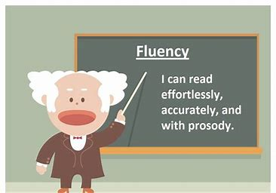
The ONE THING that will support your child this year is reading fluency

Slide 16
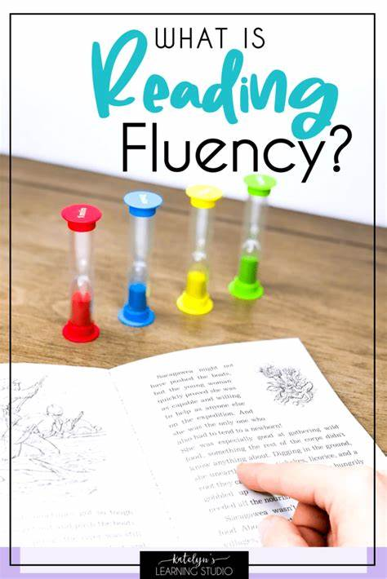
When pupils read fluently, their cognitive resources can be redirected from focusing on decoding and onto comprehending a text. For this reason, fluency is sometimes described as a bridge from word recognition to comprehension.

Slide 17
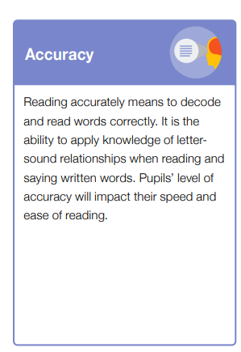

Slide 18
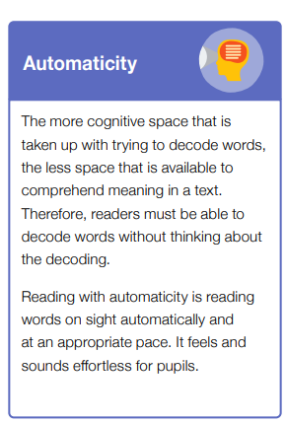

Slide 19
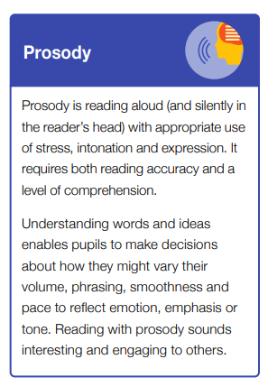

Slide 20
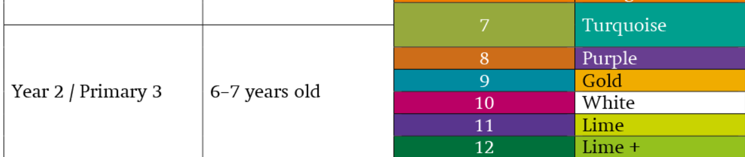
It is important because by the end of the year your child needs to be able to…
Age related expectations at the end of year 2

Slide 21
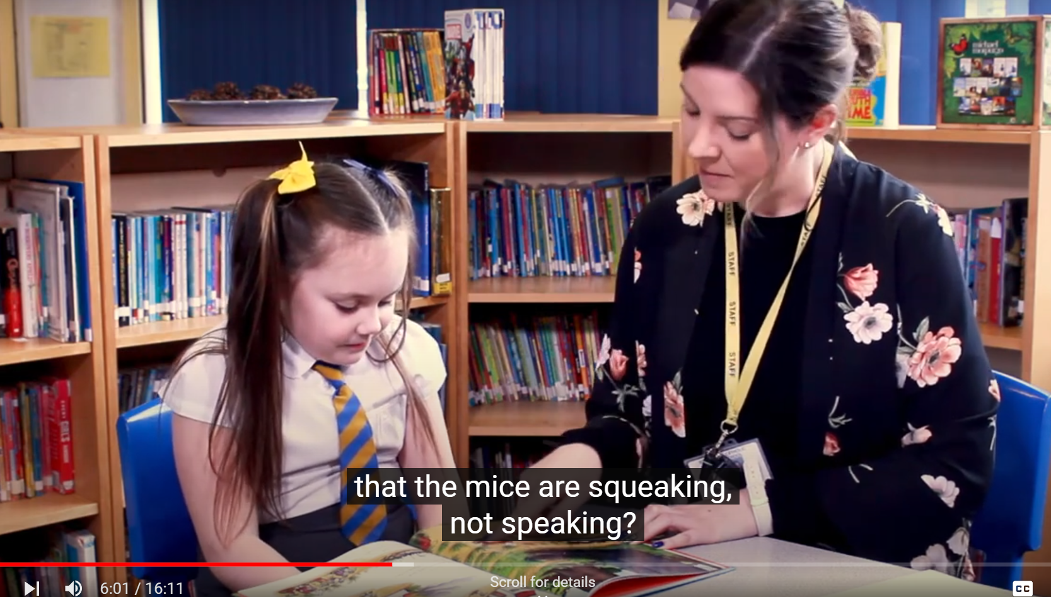
What an average reader sounds like…

Slide 22
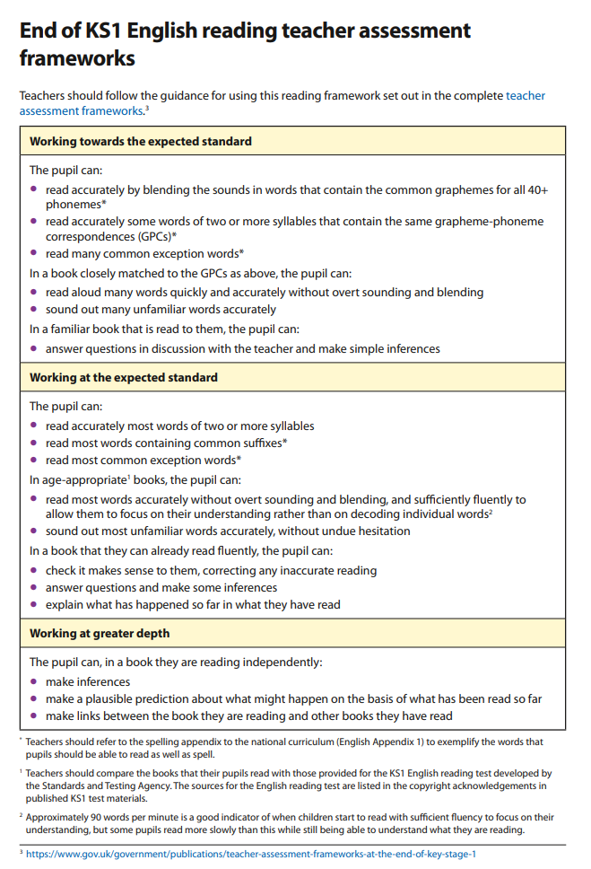

Slide 23
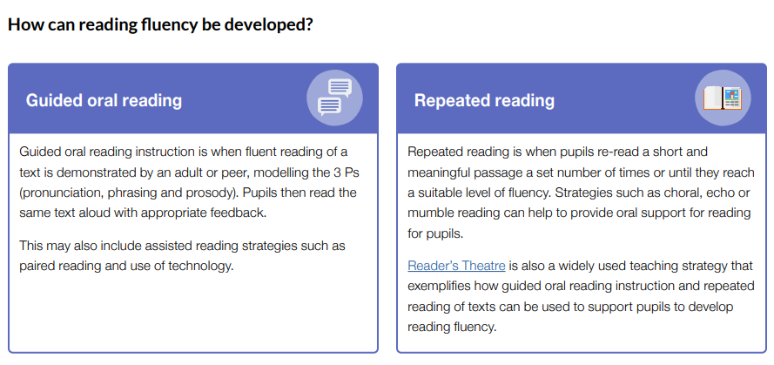
This is how we teach this in school…

Slide 24

And the best way you can help your child is by…
Reading regularly at home
Re-read your home book multiple times
Reading to your child
Being enthusiastic about reading!

Slide 25
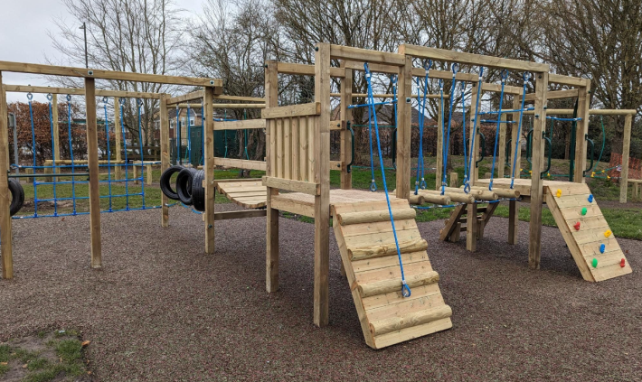

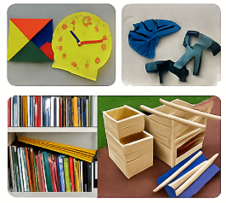
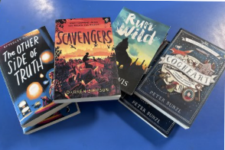
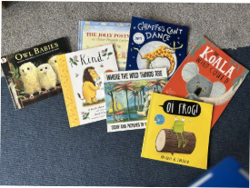
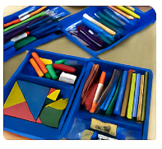
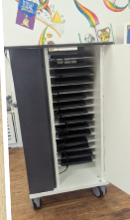
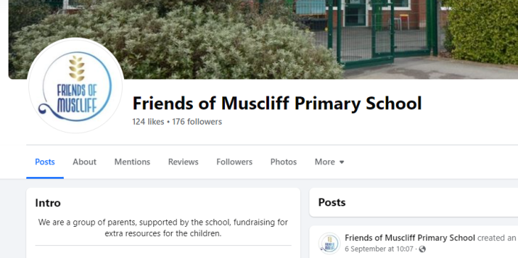
Friends have raised an amazing £12,000+ over the past year... They need your continued support.
Visit the Friends page on the website for more information https://www.muscliffprimary.co.uk/friends/
Email: friends@muscliffprimary.co.uk
Next meeting/AGM – Tuesday 21st Oct, 6pm

Slide 26


