Slide 1

Welcome to Year 1

Slide 2
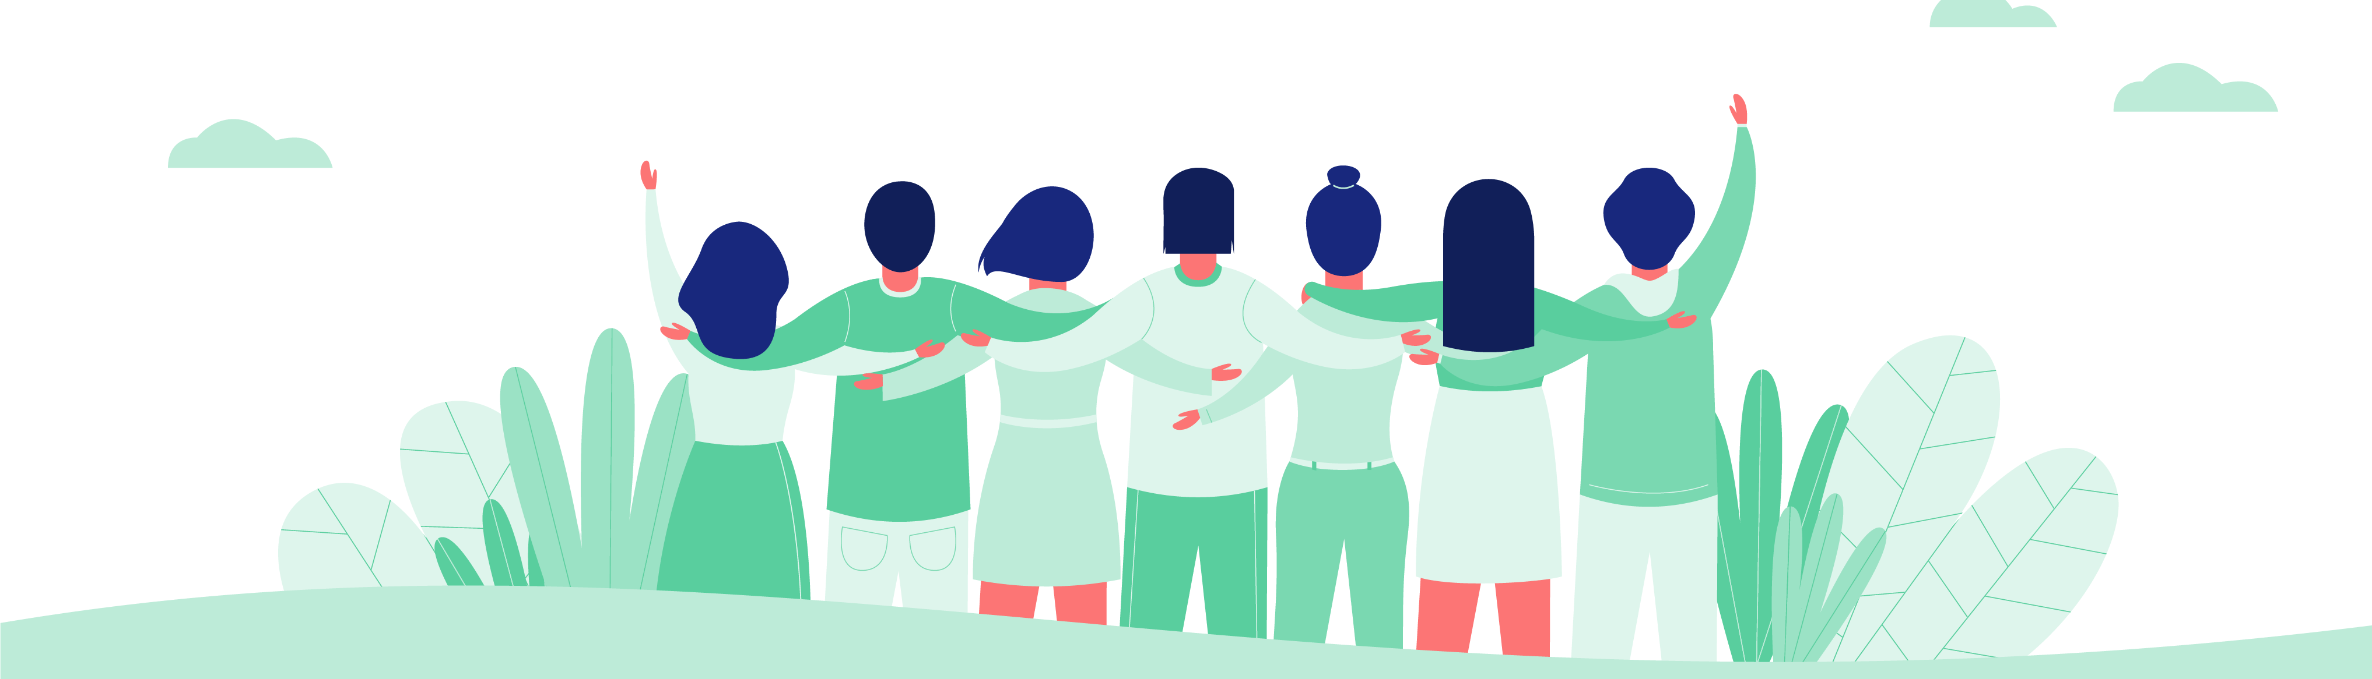
We want the same outcomes for your child.

Slide 3
Aims of the evening:
To help parents understand the bigger picture of what we will be learning this year (and why).
To provide parents with information on the things that are most important to the year (and how you can help at home).

Slide 4
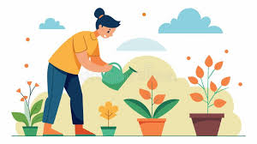
The impact will be that...
You are in a better, more informed, place to help your child thrive.

Slide 5
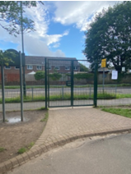
We are committed to supporting children transition into Year 1 successfully and develop independence.

Slide 6
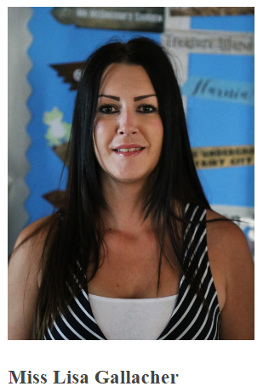
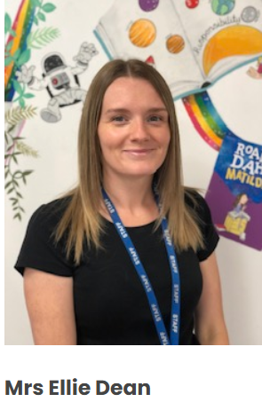
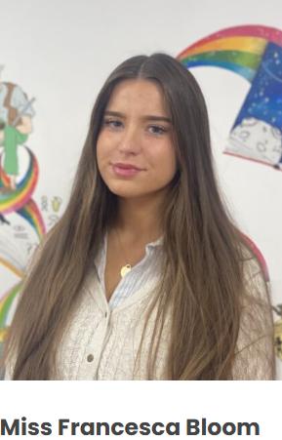
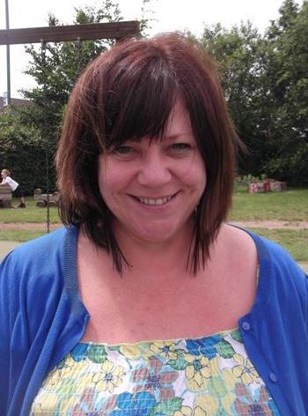
A warm welcome from us ☺
Miss Cross

Slide 7
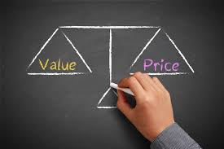
School trips...
Our provisional / planned trips so far…
Friday 25th June – Farmer Palmers

Slide 8

Muscliff Primary School: Year 1 Curriculum Overview
 | Autumn Term |  | Spring Term |  | Summer Term
Value | Aspiration Marvellous Me | Curiosity Seasons and Fairytales | Responsibility Sue Hendra | Kindness Animal Kingdom | Resilience Let’s Grow! | Curiosity Where in the world?
English | Marvellous Me What I Like About Me You choose Feelings What Makes Me Brilliant Bodies Funny Bones | Seasons Stick Man The Three Little Pigs Goldilocks and the Three Bears The Snowman | Sue Hendra Supertato Supertato Carnival Catastro-pea Barry the Fish with Fingers Norman the Snail with the Silly Shell | Animal Kingdom The Ugly Duckling If I had a Dinosaur From Egg to Chick Dinosaur Lady | Let’s Grow! The Little Gardener The Extraordinary Gardener Gruffalo The Wilderness | Where in the world? Poles Apart Coming to England Blown Away Where the Wild Things Are
Science | Animals including humans (body/senses) (3) | Season weather diary lesson (record weather/photos) | Season weather diary lesson (record weather/photos) | Animals including humans (life cycles) Season weather diary lesson (record weather/photos) | Plants: Identify and name parts of plants and trees | Everyday materials (linked to paper planes) Season weather diary lesson (record weather/photos)
History | Changes within living memory: Home Timelines (past and present and personal timeline) (5) |  |  | Mary Anning (study of local person)
Geography |  |  | UK |  | Local Area | Muscliff – link to Yr 2 transition (atlas work & worksheet of UK/capitals/seas labelling)
Art and Design | Self portraits (2) | Decorating angels (cutting and sticking) | Scultpure Printing Texture Colour Artist Study Guiseppe Acrimboldo |  | Observational drawings of plants Drawing Mixing colours
D&T | Playdough (tools) Cardboard tools | Evaluate products Design a product (for outdoor space) | Food and nutrition
Music |  | Round and Round (Christmas Songs) |  | Your imagination | Your imagination
Computing |  |  | Creating Media - Digital Painting | Programming A (Moving a robot) | Technology Around Us | Grouping Data
Internet safety | Self-image and identity Online relationships What is the same and different about us? | Managing information online | Online bullying | Privacy and security How can we look after each other and the world? | Online reputation | Who helps to keep us safe?
PSHE |  | Who is special to us? | How can we make friends? |  | Health and wellbeing Copyright What helps us stay healthy?
 | What is the same/different about us? | Who is special to us? | How can we look after each other and the world? | How can we make friends? | What helps us to stay healthy? | Who helps to keep us safe?
RE | Religion: Christianity/ humanism | Religion: Christianity | Religion: Christianity | Religion: Christianity | Religion: Judaism | Religion: Judaism
PE | Ball-skills / locomotion / dance / health and wellbeing |  | Ball skills / dance / multi-skills / gymnastics |  | Multi-skills / team building / sports day

Slide 9
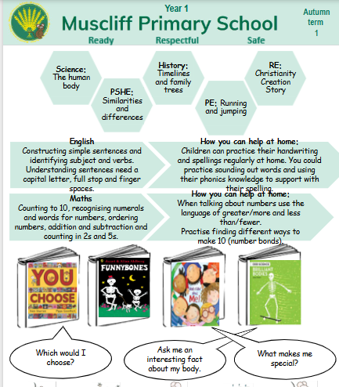

Slide 10
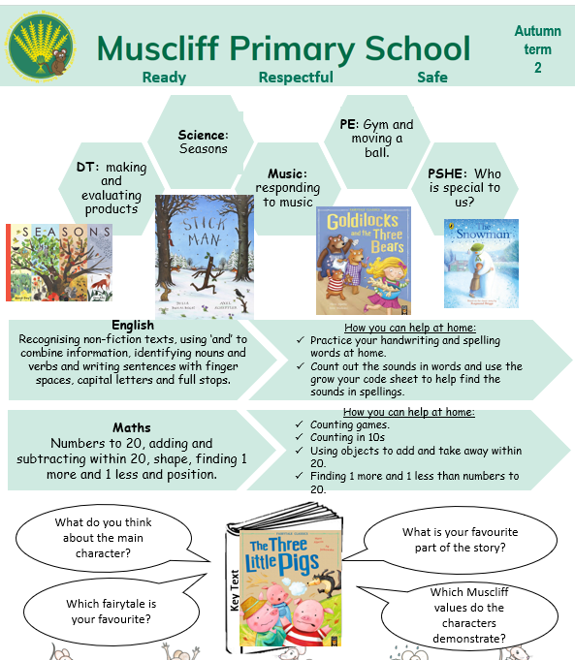

Slide 11
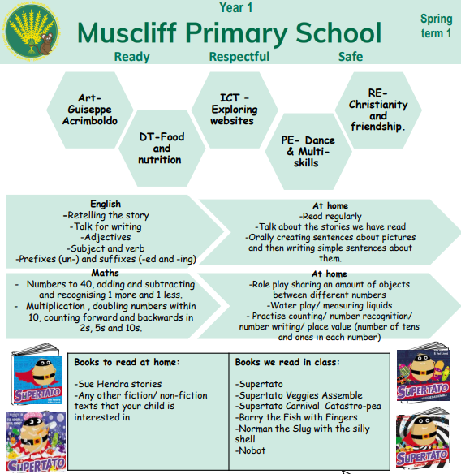

Slide 12
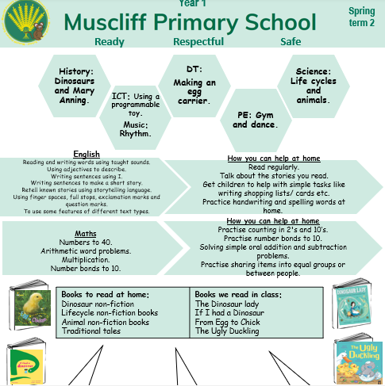

Slide 13
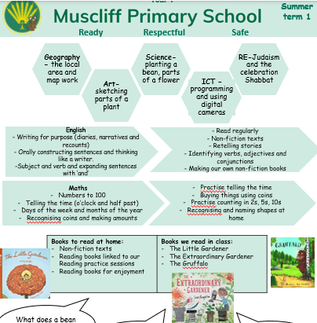

Slide 14


Slide 15
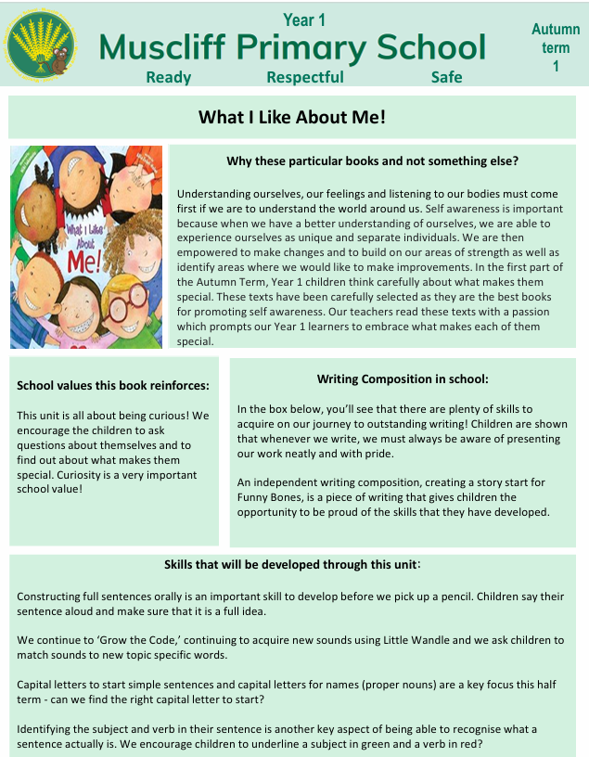
There's also an English overview each half term...

Slide 16
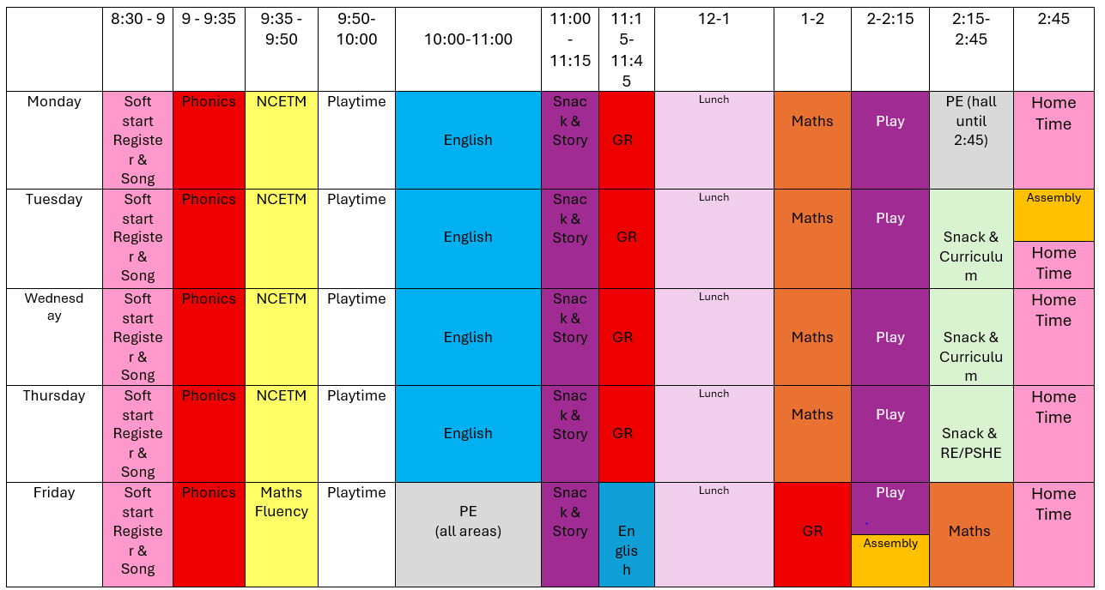

Slide 17
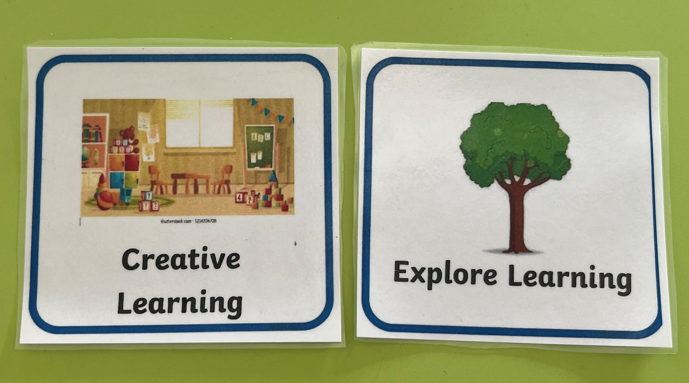

Slide 18
Behaviour | Digging | Molding | Burying/ enclosing | Imprinting/Mark making | Sieving/sifting
Developing | Scoops Short/long handled Spades Regular containers Uses scoops spades to scoop sand up, move sand or dig a hole/space | Cups, pots, irregular and embossed molds Free play with hands - makes shapes, heaps and tunnels Fills moulds and shapes and turns over to make shape Recognises that damp sand holds shape | Free play with hands. Uses hands to cover up objects | Fingers, shells/stones, mashers, fir cones/natural resources, chip fryer baskets Deliberately makes impressions with other objects Talks about the shapes, patterns they are making Starts to explore patterns using imprints | Metal pencil pots, garden sieve, chip fryer baskets Recognises that dry sand falls freely through fingers/ sieve
Exceeding | Serving spoon Slotted spoon Desert/tea/salt spoons Selects the most appropriate tool for digging. Digs with control and accuracy. | Ice-cube trays, ice-cream scoops, small/irregular molds Uses a range of containers/ moulds to create intricate sand creations Uses spades/ scoops/ buckets to make sand into desired shape | Covers their hands and fingers in sand | Paintbrushes, sticks, pencils, lolly sticks, loose parts/toys Uses resources to make a planned pattern in the sand Uses imprints for a purpose to to enhance a creation | Finer sieves, salt/flour shakers, tea strainers Sieves sand for a desired effect Sieves sand for a desired purpose Sieves sand to filter out larger objects
Extension Challenge | Can dig around objects precisely and control the amount of sand that is scooped. Showing awareness of the impact of sand moving and affecting other areas of sand. | Can combine molds together and build structures out of molded sand. Understands the impact of water on sand. |  | Can make repeated patterns out of sand. Can copy patterns and create images in the sand. Can write letters in the sand. Start to use imprints to make more intricate models (e.g. using square imprints for windows) | Can differentiate between which size sieve to use dependent on the effect desired, e.g. larger or smaller holes and the size of objects in the sand to be sieved.

Slide 19

Top Priority

Slide 20
Reading/phonics
Reading with your child has THE biggest impact on your child’s future successes.

Slide 21
Terms you’ll hear us say (and what they mean)…
Little Wandle
Phonics Screening Test
Phase
Digraph/trigraph
Grapheme/phoneme
Sound buttons
Alien words

Slide 22

Little Wandle

Slide 23
Little Wandle lessons
30 minutes every day
GPCs | oa ch ee ai sh igh
Review words | toads chair green shut boats light
Tricky words | no go the into
New GPC | ea /ee/
New words | sea leaf gleam each pea teach
Read the sentence | The sea was gleaming in the moonlight.
New tricky word | there
Spellings | sea there teach

Slide 24
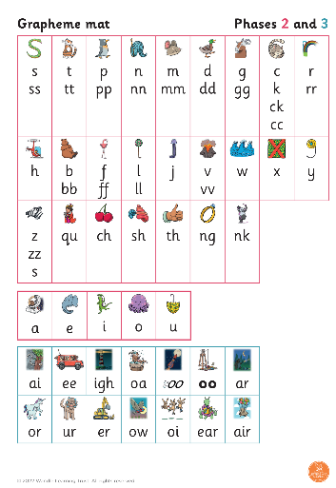
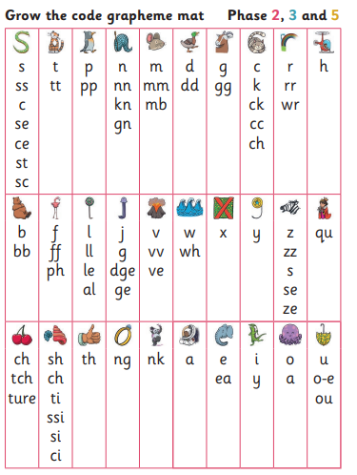
Grow the Code
Reception Year 1

Slide 25

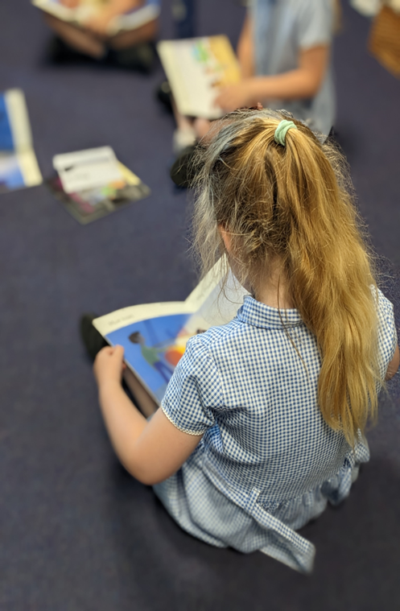
For struggling readers...

Slide 26

Reading Practice
3 x reads per week, then book goes home for 1 week.
Read 1: decoding
Read 2: prosody
Read 3: comprehension

Slide 27
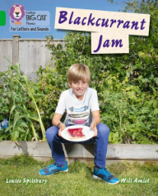


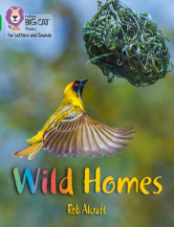

The books we have in school model the writing skills that we want our children to pick up and use. They are excellent examples.

Slide 28
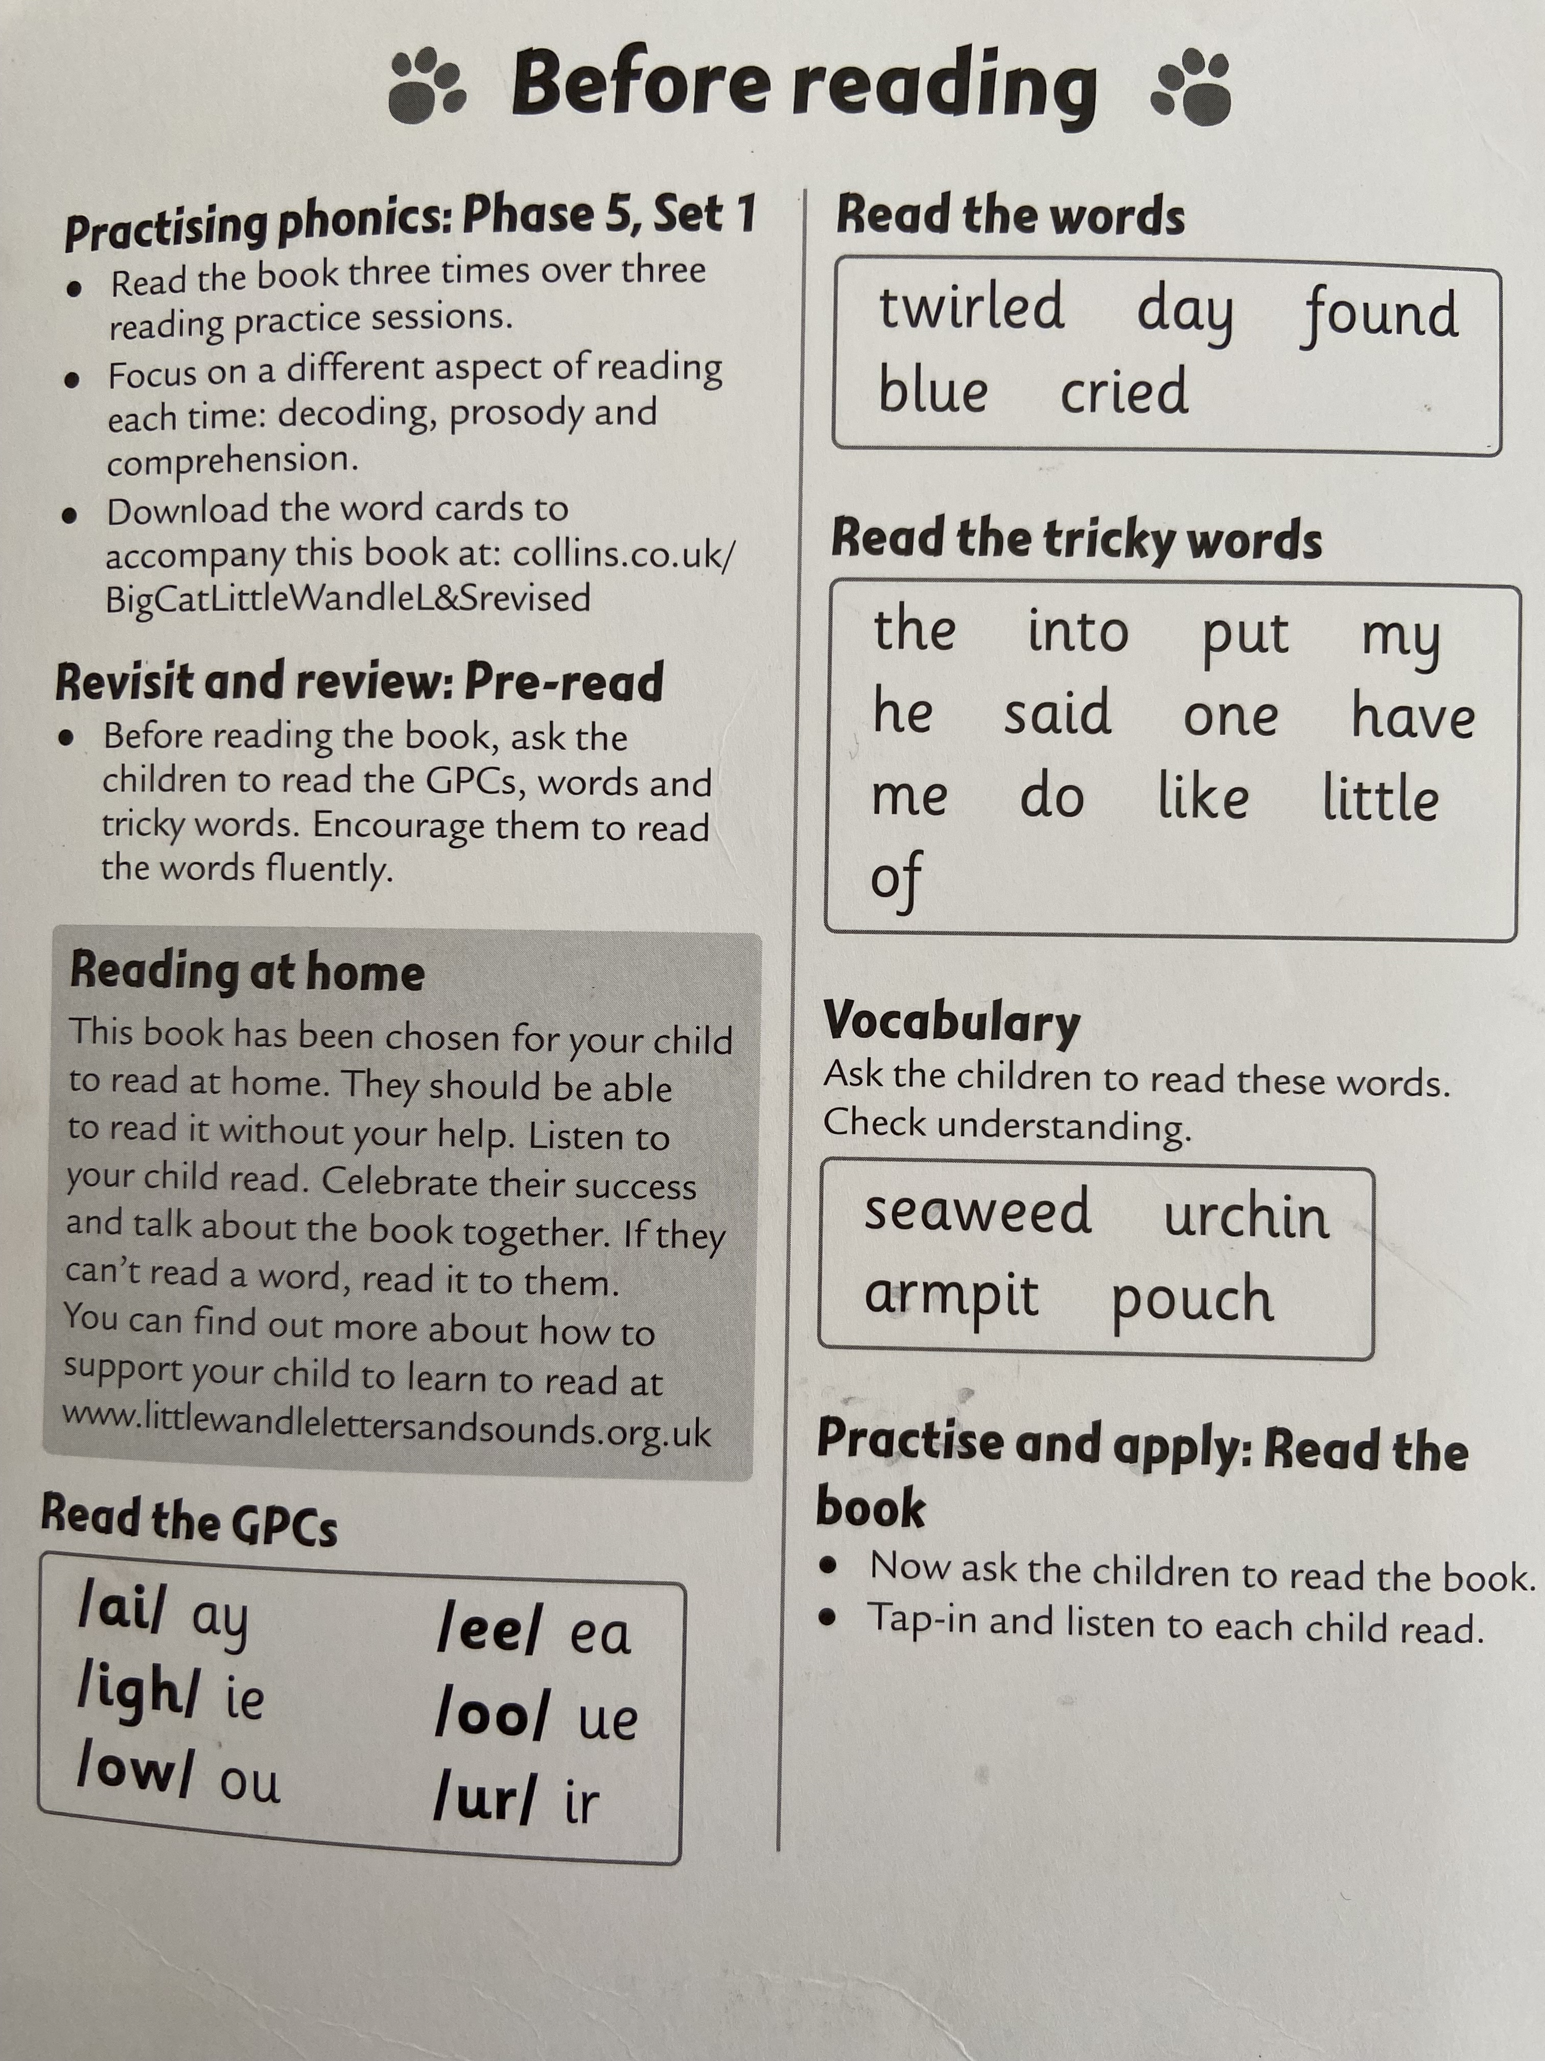
This page is at the start of each book and guides you.

Slide 29
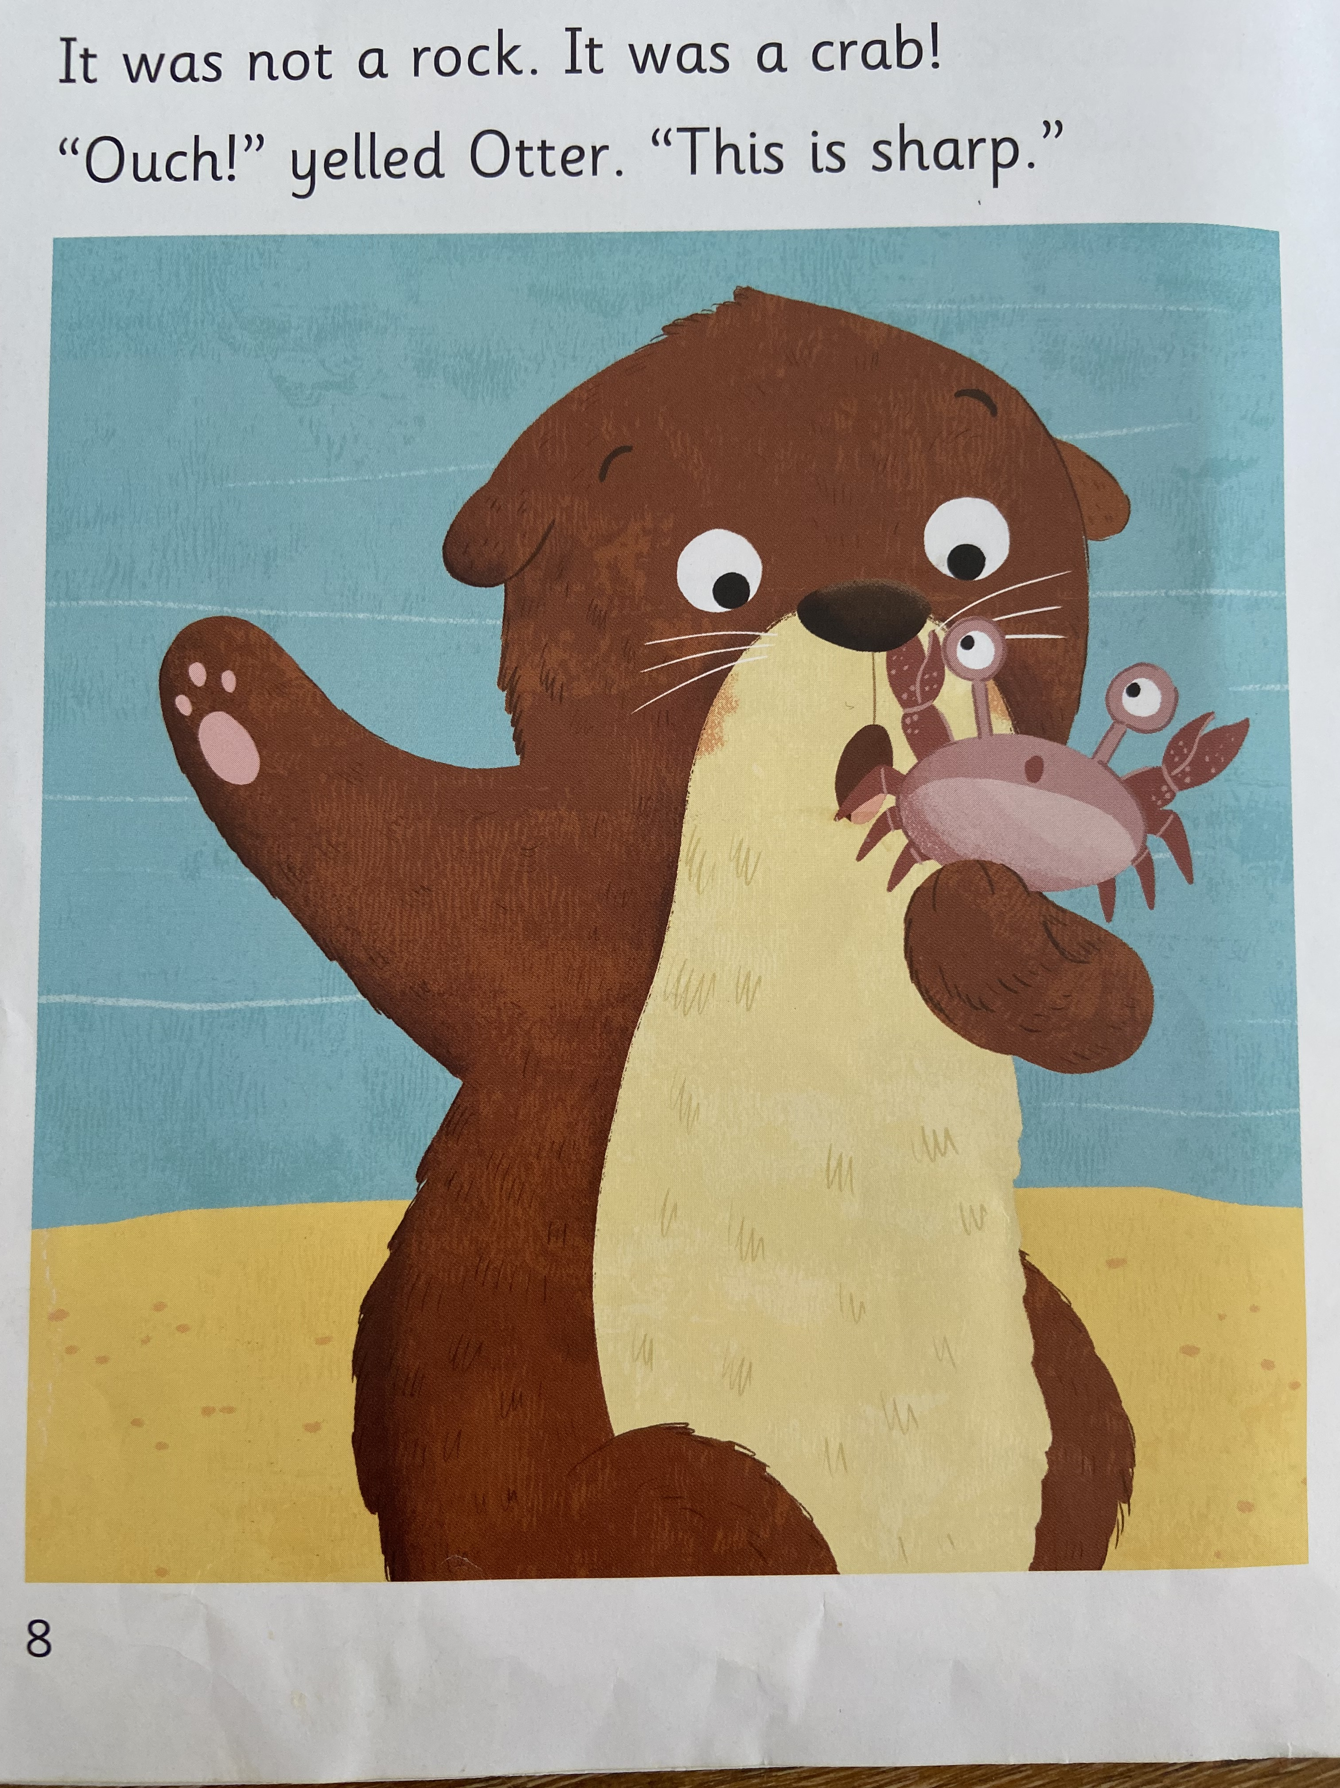
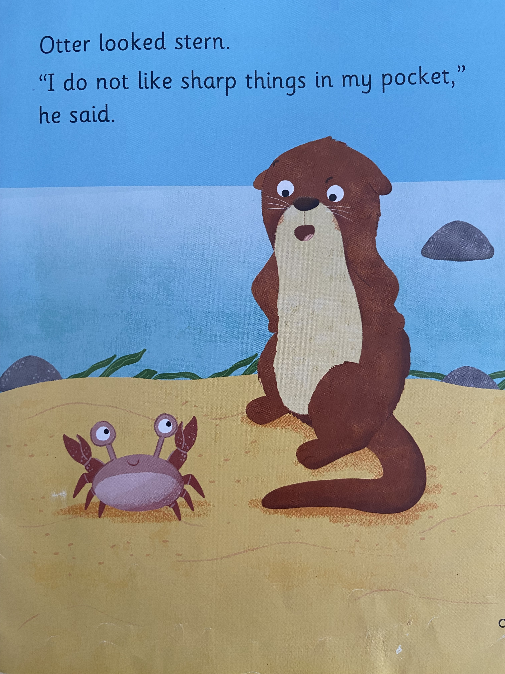
What can we talk about on these pages?

Slide 30
Punctuation: speech marks, exclamation marks.
Expression: How would Otter say these things? Why?
Comprehension: How is Otter feeling? Pictures and words to help.
If in doubt, refer back to the first page of the book.

Slide 31
How can you help your child?

Slide 32

Please sign the reading record each week. Your child can fill in the blanks. Please only sign if you know your child has completed the reading.

Slide 33
Reading books will be changed every Monday.

Slide 34
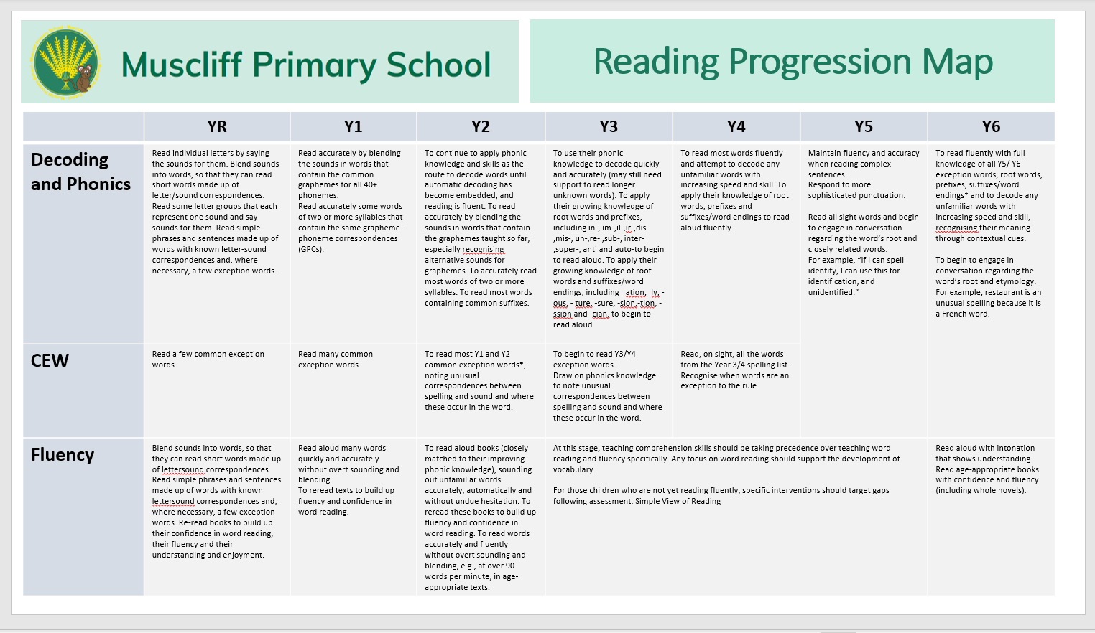
How do we assess the children?
What objectives will my child learn in reading and how do I know they are on track?

Slide 35
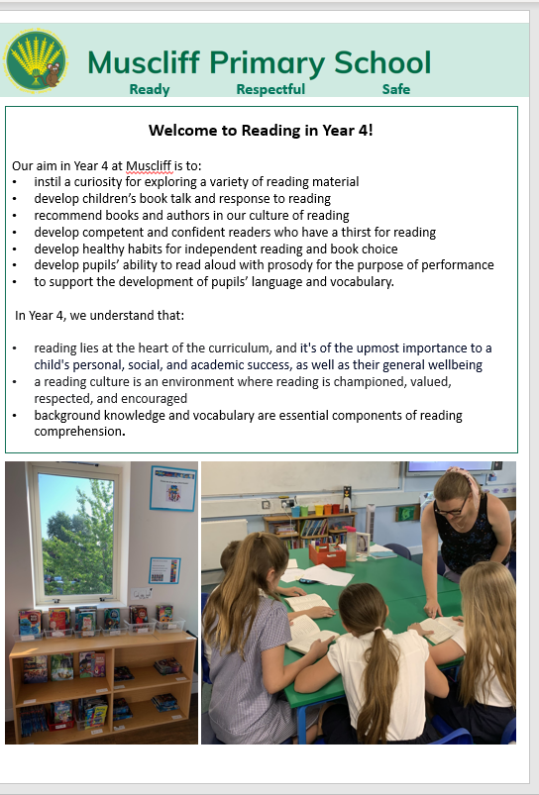
A reading progression map for each year group can be found on the website...
They explain how we teach reading.

Slide 36


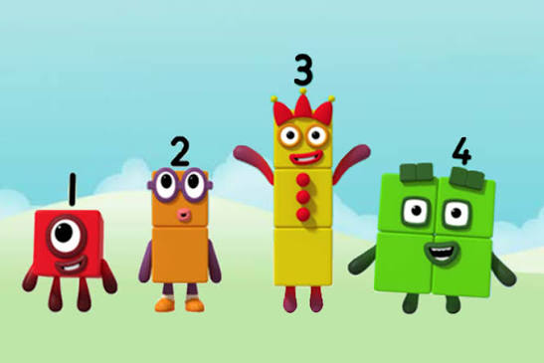

Slide 37

Is your child eligible for pupil premium funding?
The pupil premium fund provides additional funding to schools.
For more information, please read the letter sent earlier this week on Arbor or contact our school office.

Slide 38


