Slide 1

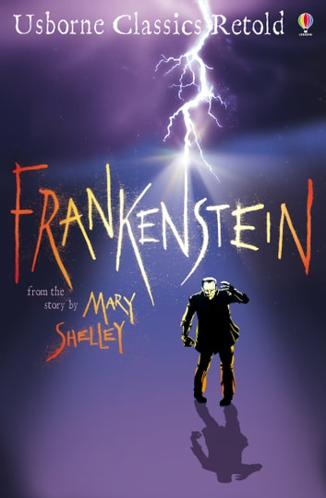





Year 6
Spring term
1
Ready Respectful Safe
Frankenstein
Why this particular book and not something else?
The quality of discussion around the conscience and one’s moral compass is truly amazing in Y6 this half term. This book really gets our Y6 children talking! We know humans need food, water, warmth and shelter to survive, but do we also need love and moral guidance? The focus on this book isn’t horror or gore; no – this book prompts our Y6 children to consider the importance of love and nurture as a key factor in healthy development. Frankenstein opens up the best conversations about our moral responsibilities and illustrates to Y6 that a life without responsibility leads to problems. This is such a great book! On top of this, Frankenstein is just perfect for framing our scientific leaning about the heart and the circulatory system this half term, as well as our research on electricity. Everything fits so well in this unit. And if that wasn’t reason enough to call this book a beautiful Muscliff text, did you know that Mary Shelley is buried here in Bournemouth?
Writing Composition in school:
Y6 will be stretched to apply their writing skills across various tasks and genres. At the end of the half term, they will produce a cross-genre piece: on one side of the page, they will write a non-fiction scientific report about the heart and describe how it functions; on the other side of the page, they will write a very tense narrative that showcases all of their skills and describes how Victor dissected the heart for his scientific experiment as he fights his moral compass with his thirst for knowledge.
English Skills that will be developed through this unit:
Children will develop high quality writing skills that can be applied to both fiction and non-fiction styles of writing.
We consider more advanced punctuation techniques, such as the ellipsis and dash as a way of supporting the intent of our sentence. We will use an ellipsis to trail off but a dash to be more abrupt. These two techniques will certainly enhance children’s direct speech.
We look at what Mary Shelley does well in her sentences and we imitate her style of construction.
We will change the pace of our sentence by controlling clause structure.
Passive voice will be another important skill to add to the repertoire this half term.

Slide 2
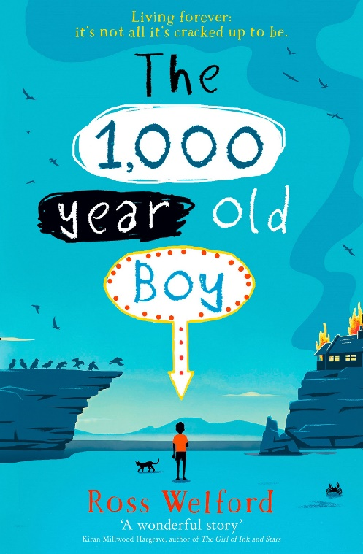
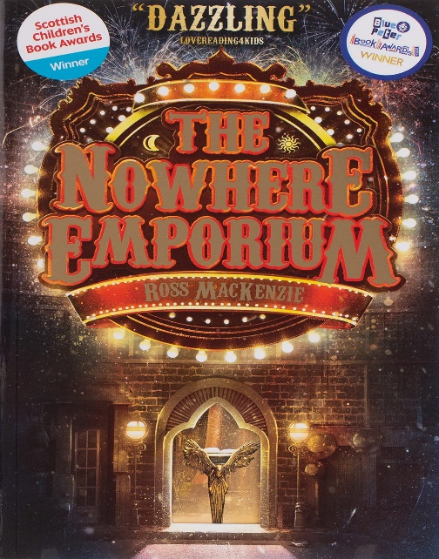
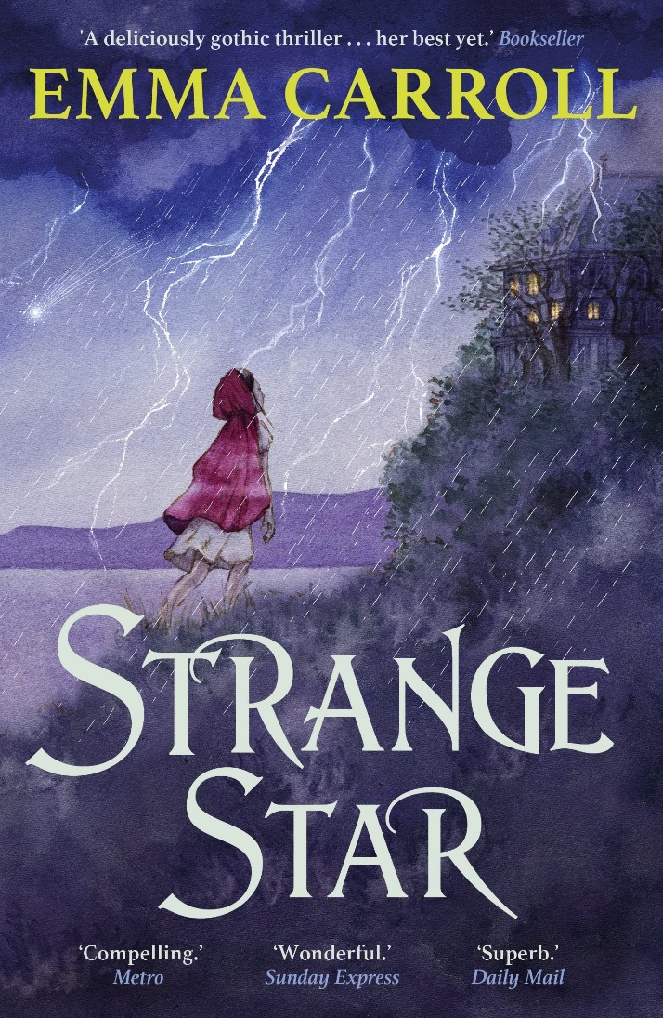
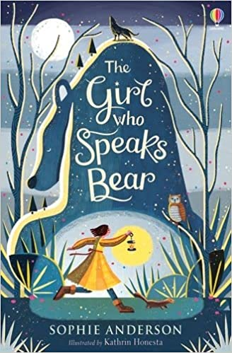
Year 6
Spring term
1
Ready Respectful Safe
Writing Homework
Here are the writing tasks that will appear each week this half term on the homework sheet in the red folder. The tasks here mirror the children’s learning in class. As always, the task is secondary to the conversation you have with your child about their learning. It’s that chat that will support your child most with their progress and understanding!
Research the heart. Look in books or complete an internet search and copy down some key facts or ideas. There is likely to be some challenging scientific vocabulary, such as circulatory system, cardiovascular and capillaries for you to make a note of. Perhaps you should jot down these words specifically.
Create an information sheet about Mary Shelley. How old was she when she wrote Frankenstein and how was she ahead of her time when it came to science?
Write Victor a letter to tell him that you are concerned about his unhealthy work-life balance. Tell him that he is working too much and that he needs to make time to relax before he becomes too stressed.
Draw and label a picture of a science laboratory! Start by finding out about scientific equipment you would find in a lab and build a picture from there. Ask your parents what science lessons were like when they were in secondary school!
Look again at your science lab picture. You can only write 5 sentences. Describe stepping foot inside this laboratory and being amazed by what you see.
By now in the book, you would be just about to start reading The Monster’s Tale which shows his side of the story. Make a bullet point list of all the things Victor has done wrong so far in the story.
Our Extended Book Spine
To complement Frankenstein, our school can thoroughly recommend these texts for this half term:
Please turn over to find out more about these recommended books.

Slide 3
Year 6
Spring term
1
Ready Respectful Safe
Our Extended Book Spine
To complement Treasure Island, our school can thoroughly recommend these texts for this half term:
Book Title | Age Range | What is it about? | Why it’s chosen?
1000 year old boy (Ross Wellford) | 9-11 | Alfie is 1000 years old. He has seen Viking invasions, watched Shakespeare’s plays and experienced the horror of the Second World War. When a tragic fire occurs, Alfie must find a new way of living. With his new friends, Aidan and Roxy, he sets out on an epic, dangerous adventure to find a way to reverse the effect of the magical life-pearls, which have kept him 11 years old for 1000 years. | Action-packed and fast paced. Funny, but tinged with sadness, and good characters. Adventure.
The girl who speaks bear (Sophie Anderson) | 9-12 | They call me Yanka the Bear. Not because of where I was found - only a few people know about that. They call me Yanka the Bear because I am so big and strong. Found abandoned in a bear cave as a baby, Yanka has always wondered about where she is from. She tries to ignore the strange whispers and looks from the villagers, wishing she was as strong on the inside as she is on the outside. But, when she has to flee her house, looking for answers about who she really is, a journey far beyond one that she ever imagined begins: from icy rivers to smouldering mountains meeting an ever-growing herd of extraordinary friends along the way. | Fairy-tale, award-winning book, warm characters
Strange star (Emma Carroll) | 8-12 | They were coming tonight to tell ghost stories. 'A tale to freeze the blood,' was the only rule.Switzerland, 1816. On a stormy summer night, Lord Byron and his guests are gathered round the fire. Felix, their serving boy, can't wait to hear their creepy tales. Yet real life is about to take a chilling turn- more chilling than any tale. Frantic pounding at the front door reveals a stranger, a girl covered in the most unusual scars. She claims to be looking for her sister, supposedly snatched from England by a woman called Mary Shelley. Someone else has followed her here too, she says. And the girl is terrified. | Gothic thriller, key text author, story inspired by Frankenstein,
The Nowhere Emporium (Ross MacKenzie) | 8-12 | When the mysterious Nowhere Emporium arrives in Glasgow, orphan Daniel Holmes stumbles upon it quite by accident. Before long, the 'shop from nowhere' -- and its owner, Mr Silver -- draw Daniel into a breathtaking world of magic and enchantment. Recruited as Mr Silver's apprentice, Daniel learns the secrets of the Emporium's vast labyrinth of passageways and rooms -- rooms that contain wonders beyond anything Daniel has ever imagined. But when Mr Silver disappears, and a shadow from the past threatens everything, the Emporium and all its wonders begin to crumble. Can Daniel save his home, and his new friends, before the Nowhere Emporium is destroyed forever? | magical realm, fantasy, award winning,

