Slide 1

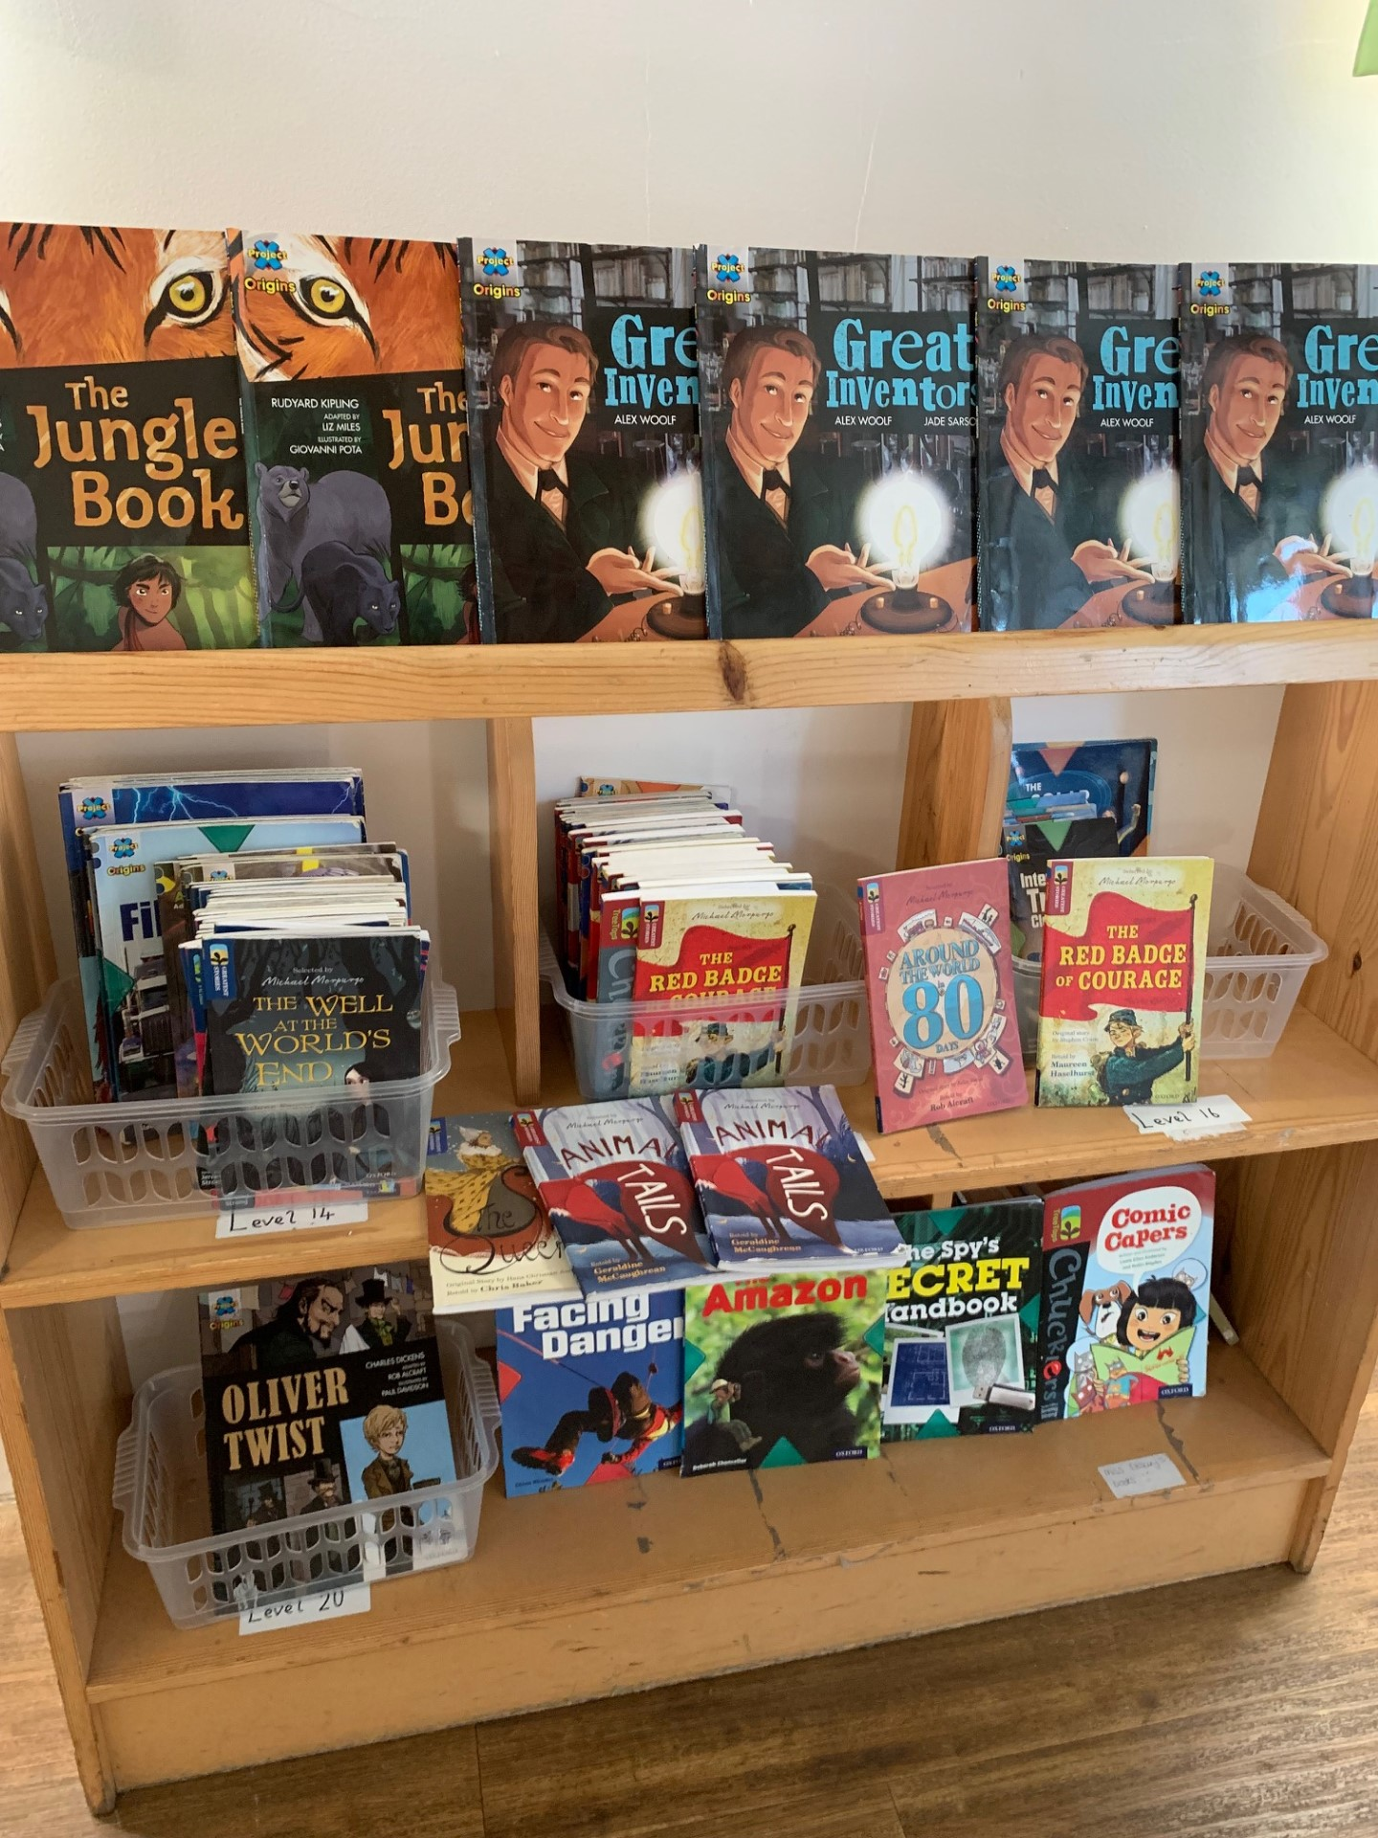
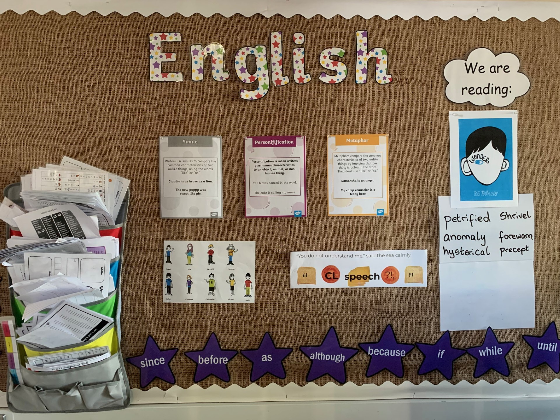
Ready Respectful Safe
Welcome to Reading in Year 5!
Our aim in Year 5 at Muscliff is to:
instil a curiosity for exploring a variety of reading material
develop children’s book talk and response to reading
recommend books and authors in our culture of reading
develop competent and confident readers who have a thirst for reading
develop healthy habits for independent reading and book choice
develop pupils’ ability to read aloud with prosody for the purpose of performance
to support the development of pupils’ language and vocabulary.
In Year 5, we understand that:
reading lies at the heart of the curriculum, and it's of the upmost importance to a child's personal, social, and academic success, as well as their general wellbeing
a reading culture is an environment where reading is championed, valued, respected, and encouraged
background knowledge and vocabulary are essential components of reading comprehension.

Slide 2
Ready Respectful Safe
What does a typical reading session look like in Y5?
Supplemented by Oxford Reading Tree books, our primary source of high-quality guided reading texts is actually our lead English text. In studying our class text thoroughly, children become fully immersed in the style of literature and have the opportunity (and time) to explore the book fully with the supportive discussions led by the teacher. The impact is cohesion; children are able to develop their reading skills whilst also developing high quality book talk. Here’s where the quality book talk really shines through and it is evident the moment you step into a reading session! We spend plenty of time exploring how the author uses key features and the impact it has on us as the reader. We get to grips with characterisation and the devices the author uses to create this. We unpick the language and vocabulary carefully recognising that this is key to children’s development as readers. At Muscliff, we believe that reading should be developed within context.
To develop all strands of reading comprehension (and to successfully meet our Year 5 standards) each session will focus on a specific strand.
Here’s what you would see in a typical lesson:
Drama
Drama activities enable Year 5 children to put themselves into the position of a character. This develops children’s inference skills as they need to interpret what they have read and link this to how a character is feeling.
Language
This session tends to be more adult-led than many of our sessions as it is important that the meaning and context of vocabulary is transferred. Sometimes we record words using a language pyramid as this can be a useful concept.
Debate
Arguments are one of our favourites! This requires a more wholistic understanding of the text. Since structuring lessons using debate, our children have become much more efficient in tackling the infamous 3 mark questions as they are more able to make a point, justify the point with evidence from what they have read but also look for further points to either ‘back up’ their original idea or points in the text that would oppose the original point.
The Author Craft
Here we analyse how and why an author writes a particular word or phrase. We noted from question level analysis that previously our children lacked the ability to answer questions that involved author’s choices. For example, “Why do you think the author choose the word erupted.” In the past, children would have written, “for effect.” Now children are more able to pinpoint what the effect is.
Written Response
And of course, children do need to become familiar with showing their reading comprehension in more formal ways. Teachers create their own questions and activities that support all comprehension skills.

Slide 3
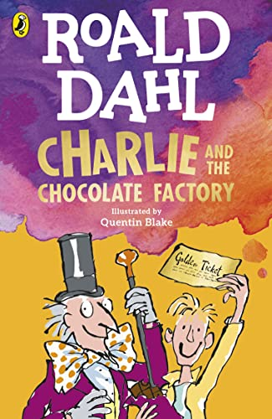



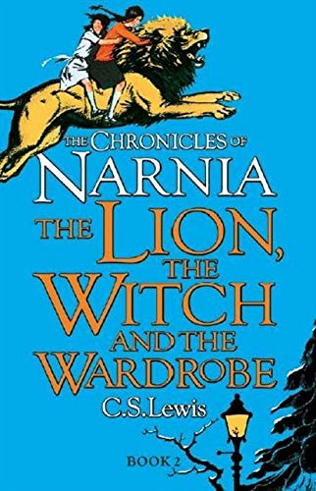
Ready Respectful Safe
Texts
Here is a reminder of our lead texts in Year 5, which we use for guided reading
Year 5 End of Year Expectations Maintain fluency and accuracy when reading complex sentences. Respond to more sophisticated punctuation. Draw information from different parts of the text to infer meaning. Summarise the main ideas drawn from more than one paragraph. Talk about the author’s techniques for describing characters, settings and actions. Understand that texts reflect the time and culture in which they were written.

Slide 4
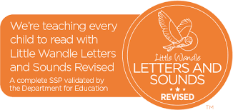
Ready Respectful Safe
Phonics and Intervention in Year 5
Older students struggling with reading may have gaps in their phonics knowledge and it is important to assess and establish what those gaps are. For example, although all of our Year 5 children have had comprehensive teaching of phonics in YR – Y2 following the Little Wandle programme, they may struggle to apply phonic knowledge when decoding new multi-syllable words. Showing them how to find the vowels and then the syllables may enable them to activate their existing phonic knowledge. On the other hand, the difficulties of an older struggling reader may involve the Language Comprehension continuum of the Simple View of Reading (SVoR). Phonics intervention may not be helpful for those students and instead they will need assistance with developing their understanding of vocabulary, how texts work and how to infer.
Year 5 use ongoing-assessment effectively to identify where pupils are struggling in word reading, reading fluency or language comprehension and when pupils require additional targeted support.
Where phonics is identified as the main barrier to progress (and using Year 2 phonics re-set test data), Year 5 use the Little Wandle rapid catch-up programme. This would be delivered as a small group intervention although is more likely to be 1:1 depending on the specific needs of the learners.
Dyslexia Intervention in Year 5
At Muscliff, we use Project X Code (Oxford) to support children with dyslexia. Project X CODE is a proven reading intervention programme and combines phonics and comprehension development. In each book, text 1 is 100% decodable to build confidence and develop vocabulary; Text 2 is 80% decodable to challenge children and deepen comprehension. We chose this intervention programme as is it dove-tailed well into our whole school reading scheme and was selected after teachers conducted research as part of a CPD programme of enquiry. Over the time, we have closely monitored the progress of the children using ‘code’ and their engagement in the books has remained high throughout. Steps of progress have been continually made, which keeps the children enthused and eager to read more. We regularly monitor the progress being made by the children and gain regular feedback from TAs supporting those children. We can see small steps being made daily (this really engaged and enthused the children) which contributes to progress across the year.

Slide 5
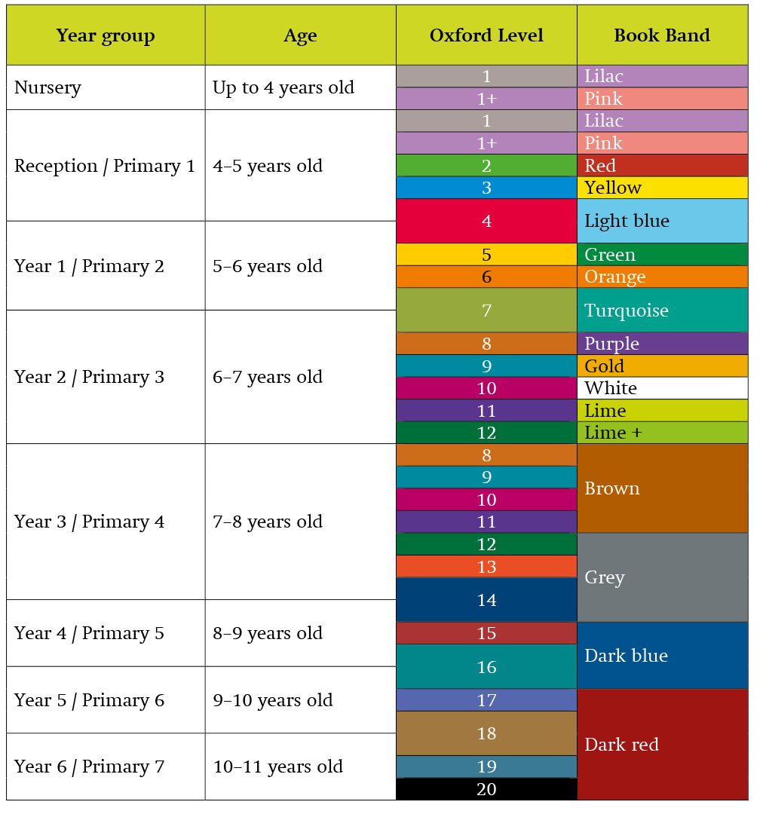
Ready Respectful Safe
Which colours will my child read?
All children in Year 5 should take home a colour-banded book. Children at this age are free to change their books independently. Dark Red and Dark Blue books are pitched at the correct age-related expectations. We have plenty of excellent titles in our year group library and teachers review children’s book bands based on their reading in class.

Slide 6
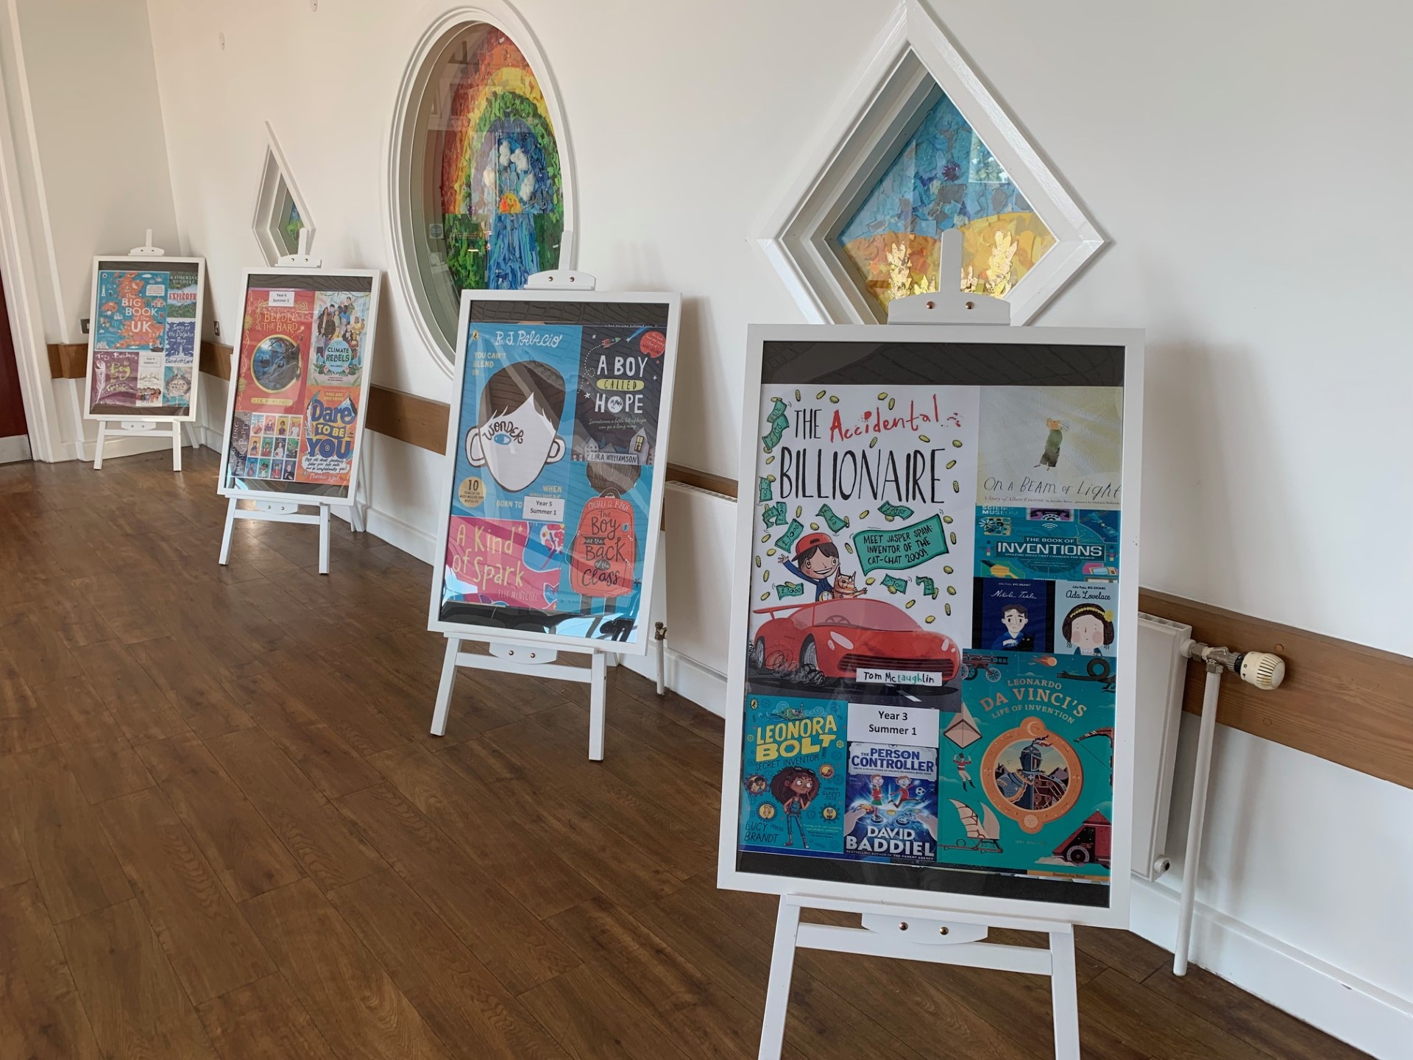
Ready Respectful Safe
Year 5’s Extended Book Spine
Alongside our lead text, we have chosen further books that complement the unit - we call this our Reading Spine. This reading list is bespoke to us and each book has been chosen purposefully by our wonderful teachers. We encourage children to read books from this list (look out for the reading stars that the children wear on their jumpers) and we love to explore these books as a class book at the end of the day.
Reading Spine books should be chosen in addition to our Oxford colour banded books.
We recommend that our Y5 children read one book from the book spine each half term but one Oxford colour-banded book each week.
Where children read their own ‘pleasure’ book, this is monitored carefully by the Year 5 staff to ensure that their choice of book is appropriate. Where children bring to school a book that is not challenging, we discuss healthy reading habits and support the child to choose a more appropriate book. Teachers tie together their knowledge of the child and their knowledge of children’s books to recommend the best books.
In practice, we find that our children are also experts at recommending books! Through their developing book talk and love of books, we find that it’s the children who are able to recommend new (and old) books to the class. We are proud of their skills at seeking out the best books and how their excitement for their book inspires their peers to give it a read!

Slide 7
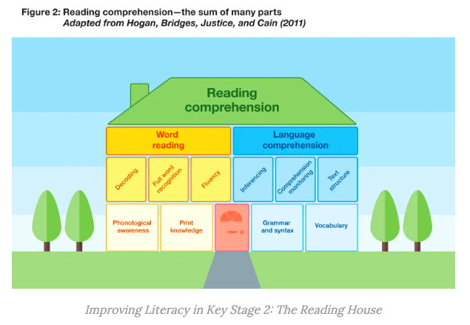
Ready Respectful Safe
Year 5’s Evidence Based Research
The Reading Comprehension House (Hogan et al., 2011)is a visual concept that supports Y5 teachers in ensuring that the guided reading sessions are effective in supporting the reading process. The Reading Comprehension House concept suggests that the different elements develop in stages. The foundations of reading are considered to be phonological awareness (hearing and distinguishing sounds in speech), grammar and syntax (which develops as a child’s language grows) and vocabulary. With these elements in place, the next “floor” can be developed. This includes learning letter- sound correspondences, developing an understanding of inferencing, monitoring understanding of the text and learning about how texts are organised. The Reading House also illustrates the distinction between language comprehension (SVOR) and the product of both word reading and language comprehension in reading comprehension.
This visual concept reminds Y5 teachers that children may be at different stages of reading development.

Slide 8
Ready Respectful Safe
Year 5’s Evidence Based Research (continued)
The goal of teaching reading is to enable children to comprehend written texts. To do this, pupils need to build both word reading and language comprehension skills. These two key components of reading are supported by a broad academic consensus and underpinned by research evidence. The ‘reading comprehension house’ below illustrates that word reading and language comprehension are underpinned by a number of other building blocks of reading. These component parts build on one another and connect together as children learn to read.
The left-hand side of the house illustrates that to become proficient at word reading, children need to build an awareness of the sound structures of language (phonological awareness) and knowledge of how language is represented in writing (print knowledge). This will support pupils to learn how to decode, translating written words into the sounds of spoken language. Skilled readers begin to recognise some full words automatically after repeated encounters with them and learn to read with fluency.
The right-hand side of the house illustrates that to build strong language comprehension skills, pupils need to develop an understanding of grammar and syntax and build up a wide-ranging vocabulary. They will also need to learn how to make inferences (using information in a text to understand things that are implied rather than explicitly stated) and monitor their own comprehension as they read. Additionally, pupils need to learn about different text structures and genres.

