Slide 1







Year 5
Summer
1
Ready Respectful Safe
Wonder
Why this particular book and not something else?
In R. J. Palacio’s award-winning book Wonder, readers will learn a lot about respect and kindness by walking in the shoes of the story’s main character – Auggie.
This story is a MUST-READ for all children and is absolutely aligned to the values that we promote at Muscliff Primary School.
Kindness is our driving value this half term and Year 5 consider what it actually means to ‘choose kind.’
Our words are powerful: they can make someone feel wonderful or awful
We are all responsible for the words we say and type, especially when they are about other people because words have the potential to hurt; just as much as a punch or a kick. Auggie was devastated when he overheard some of the boys at his school calling him mean names on Halloween.
Don’t be afraid of difference
In Wonder, Auggie is seen as different because he was born with a condition that left him with a facial abnormality. Sadly, both in real life and in the world of books, a lot of people are scared by differences, because they often don’t understand them. Our differences are what make us all unique and special.
Don’t judge a book by its cover
Because you’ll never get the full story! Lots of the characters that we meet in Wonder immediately judge Auggie because of how his face looks; as a result, they’re often mean to him or they just avoid him because they’ve already made up their minds about him.
Using Wonder as a springboard, Y5 look at how significant people in history stood up to challenge
Key Question:
Why do you think Wonder deserves to be one of our ‘Beautiful Texts’?
What do we learn (as the reader) about kindness as each character learns about kindness? How does their learning support our learning?

Slide 2
Year 5
Summer term
1
Ready Respectful Safe
English Skills that will be developed through this unit:
Perspective is a key skill to unpick this half term. The book is presented from different view points, sometimes retelling the same event but from someone else’s perspective. Being an efficient writer means that you are able to write purposefully from a range of perspectives. When we write from the viewpoint of someone else, it is necessary to adapt our style so that the writing ‘feels’ like it has been written by that person. But how do we do this? In this unit, Year 5 consider how Palacio writes to give each character their own voice.
identify formal and informal style in writing.
use parenthesis and vocabulary to add informality.
infer the meaning of language from a text.
identify and use the passive voice.
Writing Composition in school:
Y5 children will be challenged to write from different perspectives.
Children will all write a letter to the school but from various perspectives. Some children will write to the teacher from Auggie explaining how he feels about starting a new school. Some children will write a formal letter from mum to school to explain her son’s (Auggie) needs and apply for a place for Auggie. Other children will write a formal children from the headteacher to Auggie’s mum to reassure her that Auggie will succeed at his new school.
Help at Home:
The book starts with an inspirational quote: “You can’t blend in when you were born to stand out” and “When given the choice… choose kind.” Find an inspirational quote and explain what it means. This could be made even better if you can find a quote that links to one of our school values.
Create some word art using synonyms for ‘kind’ – how many words can you find that mean ‘kind’? To make this even better, you could explore other key words, such as ‘tolerance.’
School’s have something called a mission statement. It’s a bit like a promise or a commitment that the school makes to all of the children. Write a classroom statement that helps the reader to understand what we need to do in our classroom to ensure everyone is happy. Here’s a start: “In this classroom, we choose to be kind…”
Write a note from your mum or dad that explains to your teacher why you didn’t do your homework this week!
Write a note from Mrs Pipe to your mum or dad to explain that their child (you) will never need to do homework ever again as you are so clever!
Which character in Wonder is your favourite and why?

Slide 3

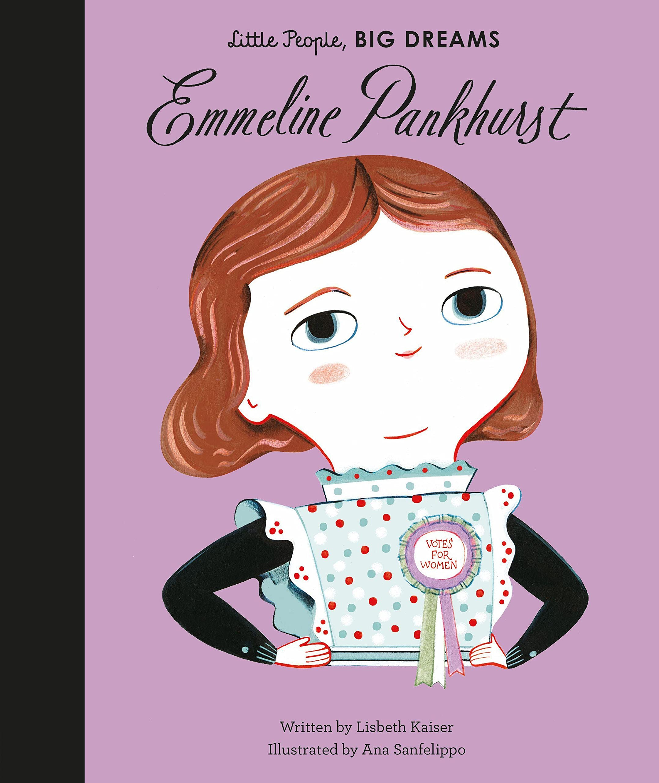
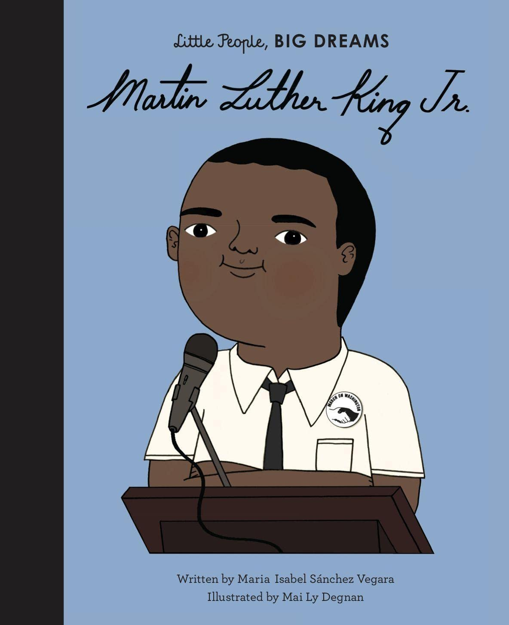



Year 5
Summer term
1
Ready Respectful Safe
Other texts we use in school:
Our Extended Book Spine
I'm Dan Hope and deep inside my head I keep a list of things I want to come true. For example, I want my sister, Ninja Grace, to go to university at the North Pole and only come back once a year. I want to help Sherlock Holmes solve his most daring mystery yet. And if it could be a zombie mystery, all the more exciting. I want my dog to stop eating the planets and throwing them up on the carpet. And finally, the biggest dream of all, I want my dad to love me.
A KIND OF SPARK tells the story of 11-year-old Addie as she campaigns for a memorial in memory of the witch trials that took place in her Scottish hometown. Addie knows there's more to the story of these 'witches', just like there is more to hers. Can Addie challenge how the people in her town see her, and her autism, and make her voice heard? A story about friendship, courage and self-belief.
There used to be an empty chair at the back of my class, but now a new boy called Ahmet is sitting in it. He's nine years old (just like me), but he's very strange. He never talks and never smiles and doesn't like sweets - not even lemon sherbets, which are my favourite! But then I learned the truth: Ahmet really isn't very strange at all. He's a refugee who's run away from a War. A real one. With bombs and fires and bullies that hurt people. And the more I find out about him, the more I want to help.
That's where my best friends Josie, Michael and Tom come in. Because you see, together we've come up with a plan. . .

