Slide 1

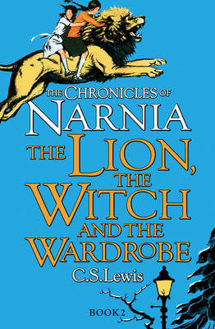





Year 5
Autumn term
2
Ready Respectful Safe
The Lion, The Witch and The Wardrobe
Why this particular book and not something else?
C.S.Lewis is an author that we feel every child should experience.
C.S Lewis is skilled at enticing the reader in to his world through the use of highly engaging language and descriptions. But C.S Lewis not only brings the reader into this world, he is also a master at keeping the reader keen to stay in that world in order to find out more; he is the master of generating curiosity through awe and wonder. Given that curiosity is one of our values, we use this book as an opportunity to unpick exactly how we too can make our writing so alluring to our own readers.
School values this book reinforces:
This book actually highlights many values, including resilience and responsibility. However, the value that we pick out within this book is curiosity. We consider not only the curiosity of the main characters but also the techniques the author uses to make the reader curious.
Writing Composition in school:
Towards the end of this unit children will re-write the scene where Lucy steps into the wardrobe for the first time. Using the skills mentioned below, they will describe the awe and wonder of Narnia and show Lucy’s amazement at seeing this world for the first time. Children’s work will be assessed the skills taught within this unit as well as previously taught skills.
Skills that will be developed through this unit:
In our previous unit before the half term break, children created engaging descriptions using Charlie and the Chocolate Factory. In this unit, we explore the skills that the author uses to not only engage and entertain but to also draw the reader into the world of Narnia and how C.S Lewis successfully makes the reader curious to read on. High quality descriptions are achieved through:
Figurative language, simile/metaphor, personification.
We will consider manipulating sentences by reordering and understand the changes this has on our reader’s experience.
Relative clauses will be explored in this unit to provide extra detail.
Finally, adverbials of time, manner and place will be investigated.
There are so many skills to practise to achieve excellent quality descriptions!

Slide 2
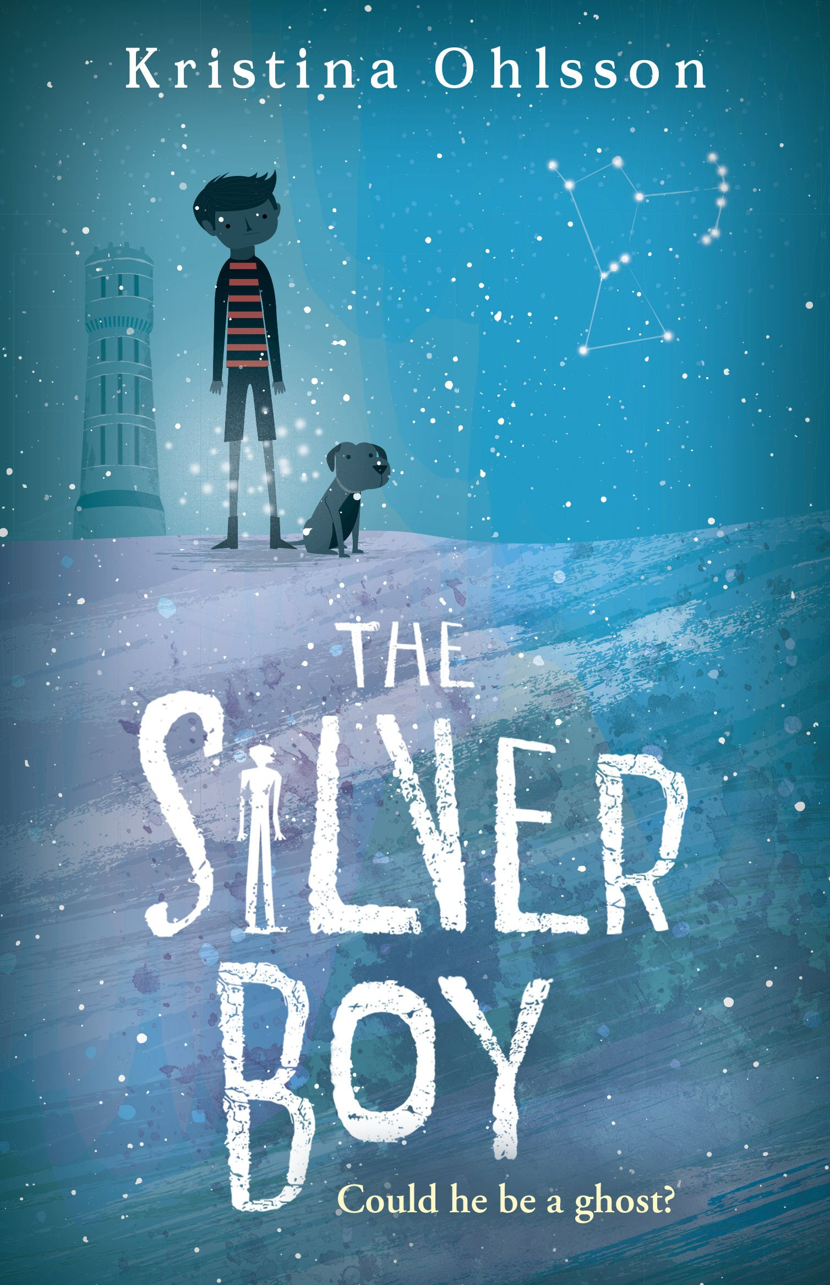
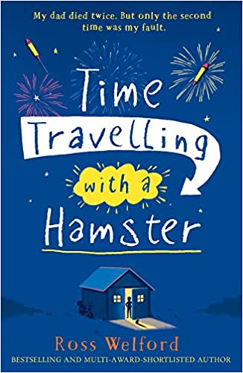
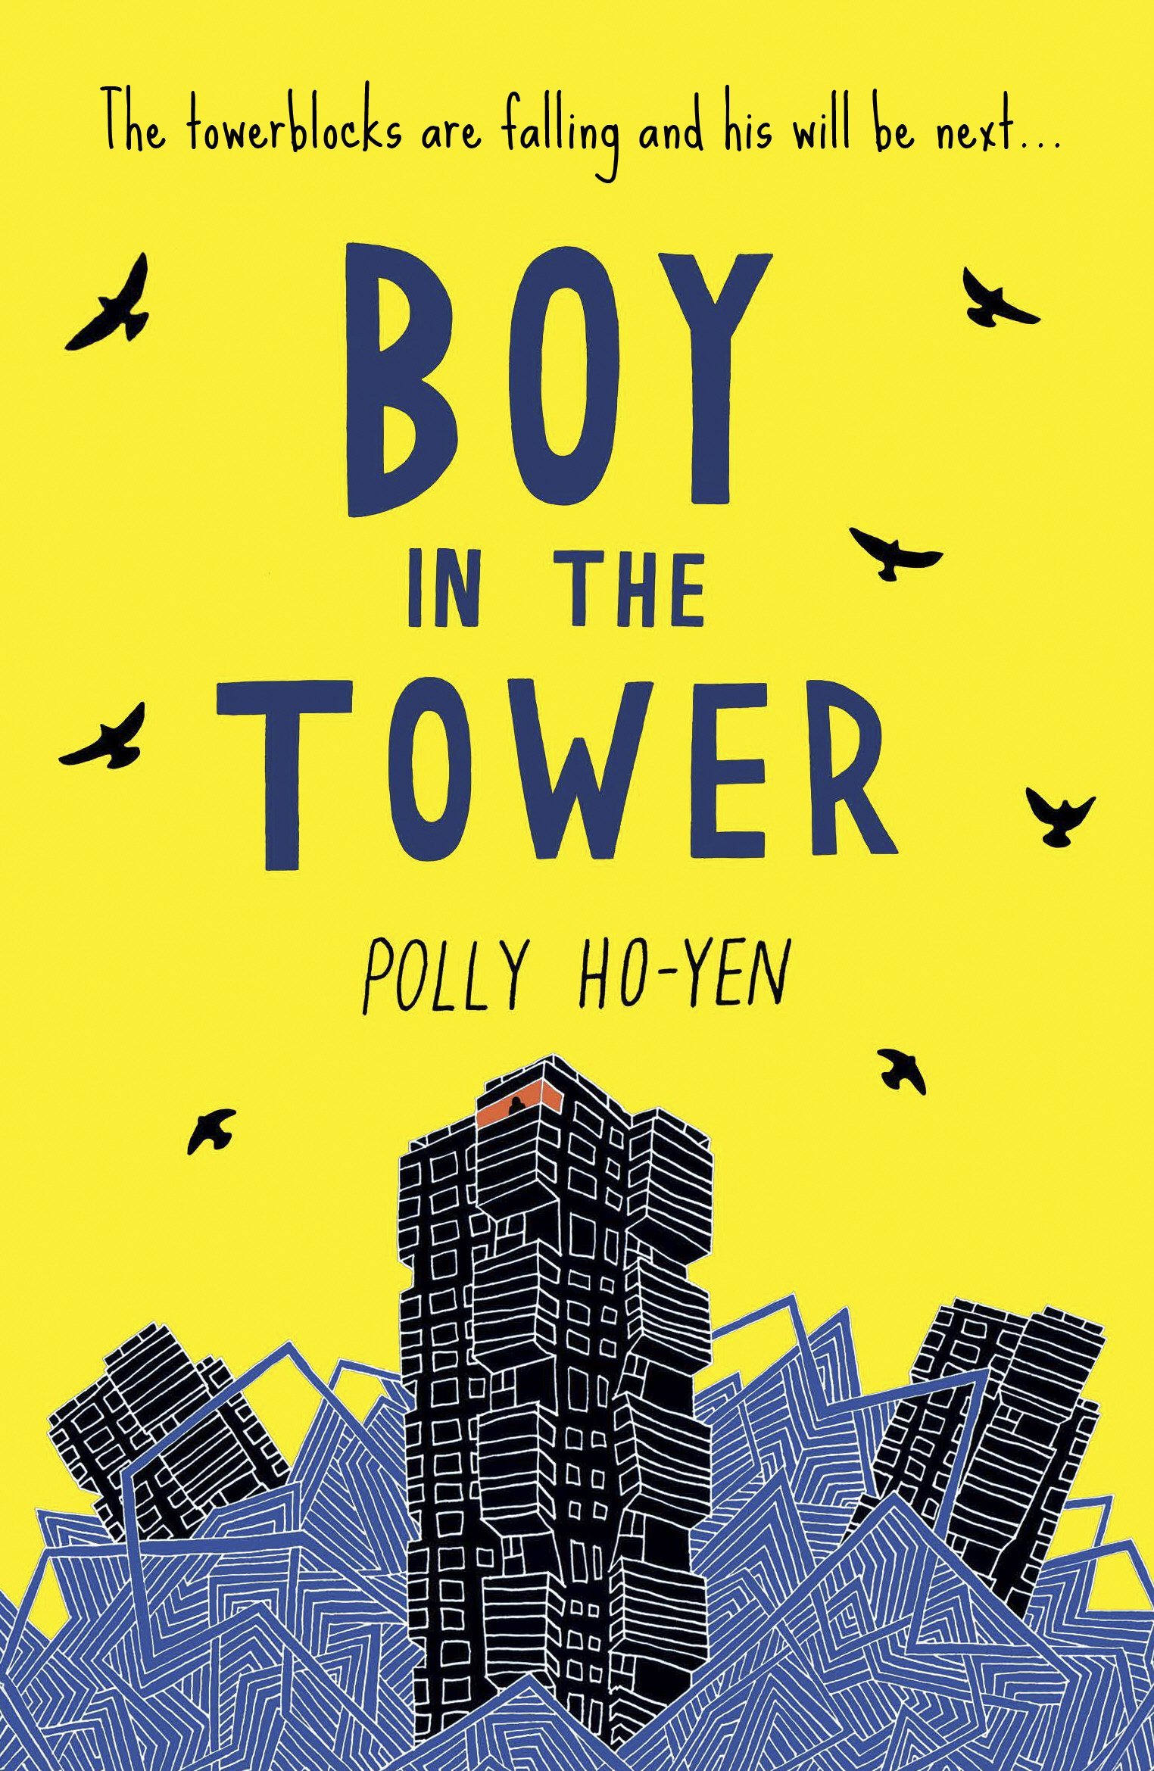
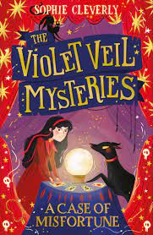
Year 5
Autumn term
2
Ready Respectful Safe
Writing Homework
Here is a brief summary of all of the written homework tasks that will be set this half term. Each task will be explained in more detail each week in the red homework folder. The homework closely mirrors the skills that the children will learn in English.
Week 1: a character description that suggests mystery and makes the reader inquisitive. Using a thesaurus would support this.
Week 2: find relative clauses and understand how they give extra information to a noun.
Week 3: explore how the order of a sentence changes how the reader emphasises each sentence part in a different way.
Week 4: explore similes and metaphors in a description of an autumn night.
Week 5: personification as a skill to enhance descriptions. Nouns take on human characteristics. For example, ‘the leaves danced across the playground.’
Week 6: idioms and figurative language, such as ‘it’s raining cats and dogs.’
Week 7: a setting description using the skills of adverbs of time, manner and place.
Our Extended Book Spine
To complement The Lion, the Witch and the Wardrobe, we can thoroughly recommend these texts for this half term:
Please turn over to find out more about these recommended books.
Reading any of these books will contribute towards a new reading star!

Slide 3
Year 5
Autumn term
2
Ready Respectful Safe
Our Extended Book Spine
To complement Treasure Island, our school can thoroughly recommend these texts for this half term:
Book Title | What is it about? | What my teachers think about this book…
The Silver Boy (Kristina Ohlsson) | They thought ghosts didn't exist . . . But when Aladdin’s parents discover food is being stolen from their restaurant, he and his friends decide to investigate. Soon, Aladdin notices a strange boy – dressed in short trousers, despite the freezing cold. But as hard as he tries to catch him, the boy always disappears – leaving no tracks in the fresh snow. Before long, Aladdin and his friends are pulled into a web of secrets and history, | I think I have found my book for the evenings as winter approaches! This book comes with fantastic reviews and would suit children who enjoy mysteries.
The Violet Veil Mysteries (Sophie Cleverly) | Violet Veil wants nothing more than to prove her worth and become her father’s apprentice at Veil & Sons Undertakers. And one rain-soaked night she gets her chance when she meets a boy, Oliver, who is wandering around the graveyard. Only, the last time Violet saw Oliver, he was indoors and very much dead, waiting to be buried. Violet has just found her first case, and it doesn’t get bigger than this: can she, with the help of her dog, Bones, help Oliver solve his own ‘murder’? | Parents might want to read this book themselves first as the story mentions death (she is the undertaker’s daughter). This book is fast paced and we think enticing. It has a strong female protagonist and may suit those children who enjoyed reading last year, The Firework Maker’s Daughter as there are similar themes.
Boy in the Tower (Polly Ho-Yen) | Ade loves living at the top of a tower block. From his window, he feels like he can see the whole world stretching out beneath him. His mum doesn't really like looking outside - but it's going outside that she hates. She prefers to sleep all day inside their tower, where it's safe. Except it isn't any more. Strange plants have started to take over and tower blocks are falling down around them. Now Ade and his mum are trapped and there's no way out... | This is a high quality text, full of tension written by a primary school teacher. The setting descriptions are very good. This would be a book for parents to enjoy alongside their child and would certainly support children’s writing skills.
Time Travelling with a Hamster (Ross Wellford) | “My dad died twice. Once when he was thirty nine and again four years later when he was twelve.” On Al Chaudhury’s twelfth birthday his beloved Grandpa Byron gives him a letter from Al’s late father. In it Al receives a mission: travel back to 1984 in a secret time machine and save his father’s life. Al soon discovers that time travel requires daring and imagination, all without losing his pet hamster. | Adventure! Time travel! Hamsters! We know what Mr Barton will be reading this half term at home!

