Slide 1

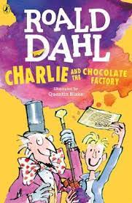





Year 5
Autumn term
1
Ready Respectful Safe
Charlie and the Chocolate Factory
Why this particular book and not something else?
We have carefully chosen this book as our lead text because in analysing a text that children are likely to already be familiar with, it gives Y5 the opportunity to unpick and discuss themes and ideas on a deeper level of understanding. Year 5 can also delve more confidentially into understanding how the text was written (the author craft) and why it is so successful. Essentially, Dahl presents us with a book rich in characterisation and our Y5 children will dig deep into how Dahl crafts his characters. We build empathy with Charlie and a dislike for his peers. But how does Dahl do this? Well, after this unit, our Year 5 children can explain how successful characterisation is achieved and use these skills to create their own strong characters.
School values this book reinforces:
Kindness is the value that defines Charlie’s character. Children recognise that humility brings its own reward and this links well to our own school views on rewards: at Muscliff, we focus our praise on effort and motivation and explain to our older children that when we find something is rewarding, we do not need a tangible reward.
Writing Composition in school:
Throughout this English unit, a key focus will be to understand how Dahl makes his character descriptions so successful. To assess the children’s writing skills (all listed in the box below), children will be writing a developed piece of work that describes Charlie’s reaction to the glass elevator at the end of the story. Your child will try to capture the awe and wonder of this scene and describe in great detail Charlie’s reaction. Teachers will also be looking for direct speech and interaction between characters that develops the scene.
Skills that will be developed through this unit:
Children will understand that the starting point to a well-developed sentence must be an accurate basic sentence. We consider the choice of verb as an important building block – a more ‘grown-up’ thesaurus is useful to support language development. Using ‘co-ordination’ introduces another main clause and expands an idea. But can we still punctuate our sentences accurately when our sentences start to grow and become longer and longer?
Full speech punctuation then plays a huge part in developing our characters. We call this ‘direct speech’ and the punctuation we use are ‘inverted commas.’ We don’t call them 66 and 99 these days! The key learning, however, is about what the characters say. The children will be taught to ‘avoid a tennis match’ between characters and to only use speech when it is purposeful and has an impact on the narrative. The skill that we assess in this unit is, ‘using speech punctuation to move a story forward and to develop characterisation.’
Creating a powerful reported clause (said the character) to add value to the direct speech is another skill you’ll see your child developing during this wonderful unit of work.

Slide 2
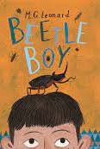
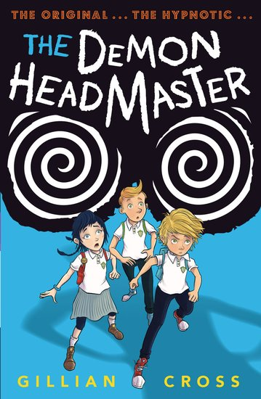
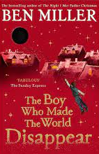
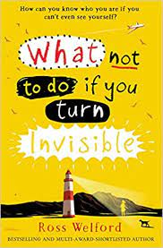
Year 5
Autumn term
1
Ready Respectful Safe
Writing Homework
Here is an overview of each written task for this half term. Over this half term, your child should aim to complete some writing at home each week. The time they invest in their written homework will vary from child to child – parental discretion is advised. Alternatively, you may wish to focus on just one or two of these activities and develop them over several weeks with your child.
As this unit focuses on characterisation, invent your own villain. Consider other villains from stories that you know. Create a character profile – you’ll need to describe the character’s looks but think carefully also about the mannerisms that could deepen the level of characterisation. For example, an evil teacher might look over his glasses with a sneer. Finally, what might they say and how would they say it? Once you’re happy with the character profile, begin building the information into a paragraph. Start by writing just simple sentences, which you should aim to expand using the Y5 skills that are on the reverse of this page.
Whilst you’ll be writing plenty of descriptions in school, you could write a non-fiction page based on some independent research about the Mayans.
Was Wonka right to ‘smuggle’ the Oompa Loompas into this country? Why was it the right choice and why might his actions be considered as wrong? Create an argument that outlines points for both sides.
Imagine you are an Oompa Loompa. Write a postcard home to convince your friends to join you in Wonka’s factory.
Newspapers feature in the story. Write the newspaper report that reveals that Wonka will be opening his factory to the finder of a golden ticket.
Our Extended Book Spine
To complement Charlie and the Chocolate Factory, our school can thoroughly recommend these texts for this half term:
Please turn over to find out more about these recommended books.
Reading any of these books will contribute towards a new reading star!

Slide 3
Year 5
Autumn term
1
Ready Respectful Safe
Our Extended Book Spine
To complement Treasure Island, our school can thoroughly recommend these texts for this half term:
Book Title | What is it about? | What your teachers think about this book…
Beetle Boy | Darkus can't believe his eyes when a huge insect drops out of the trouser leg of his horrible new neighbour. It's a giant beetle – and it seems to want to communicate. But how can a boy be friends with a beetle? And what does a beetle have to do with the disappearance of his dad and the arrival of Lucretia Cutter, with her taste for creepy jewellery? | This is written in a similar style to Dahl so if you like Dahl and Walliams, give this book a try. It is award-winning, very fun and has vivid characters. Don’t forget – this unit is all about building vivid characterization into our own work so we can recommend this book to support your writing development.
The Demon Headmaster (Gillian Cross) | When Dinah is fostered by the Hunters she thinks her biggest problem will be fitting in with her foster-brothers, Lloyd and Harvey. However, once she starts at her new school it's clear that there's more to worry about. All the children, apart from a handful including Lloyd and Harvey, are too well-behaved - robotic almost - and oddly keen to please the creepy headmaster. The three children set out to discover the nature of his influence over everyone . . . but then Dinah finds herself saying and doing things she has no power over. Soon they uncover the headmaster's wicked plan. Controlling the school is just a practice run. He has set his sights on dominating the entire nation! The children must foil him before he succeeds . . . but with Dinah under his spell they've got a challenge on their hands. | Everyone in the year team likes this book. It is a little bit scary but consider how the author has made this scary. This book provides some great descriptions of the villain so is also a good choice of book for developing writing skills to improve characterization.
The boy who made the world disappear (Ben Millar) | Harrison tries his best to be good. He doesn’t steal, he always shares with his sister and he never cheats at board games, but Harrison also has a BIG flaw … He can't control his temper! So when he’s given a black hole instead of a balloon at a party, Harrison jumps at the chance to get rid of everything that makes him cross. But when it’s not just things he hates that are disappearing into the black hole but things he loves, too, Harrison starts to realise that sometimes you should be careful what you wish for... | Magical adventure, time travel, funny, illustrations. Give this book a try if you fancy reading something a little different. We liked the contrasting nature of Harrison’s character.
What not to do if you turn invisible (Ross Wellford) | Turning invisible at will: it's one way of curing your acne. But far more drastic than 13 year-old Ethel Leatherhead intended when she tried a combination of untested medicines and a sunbed. It's fun at first, being invisible. And aided by her friend Boydy, she manages to keep her extraordinary ability secret. Or does she? When one day the invisibility fails to wear off, Ethel is thrown into a nightmare of lies and deception as she struggles to keep herself safe, to find the remedy that will make her seen again - and solve the mystery of her own birth. | Deals with issues of bullying, self-confidence and friendship. Good characters and plot, funny

