Slide 1

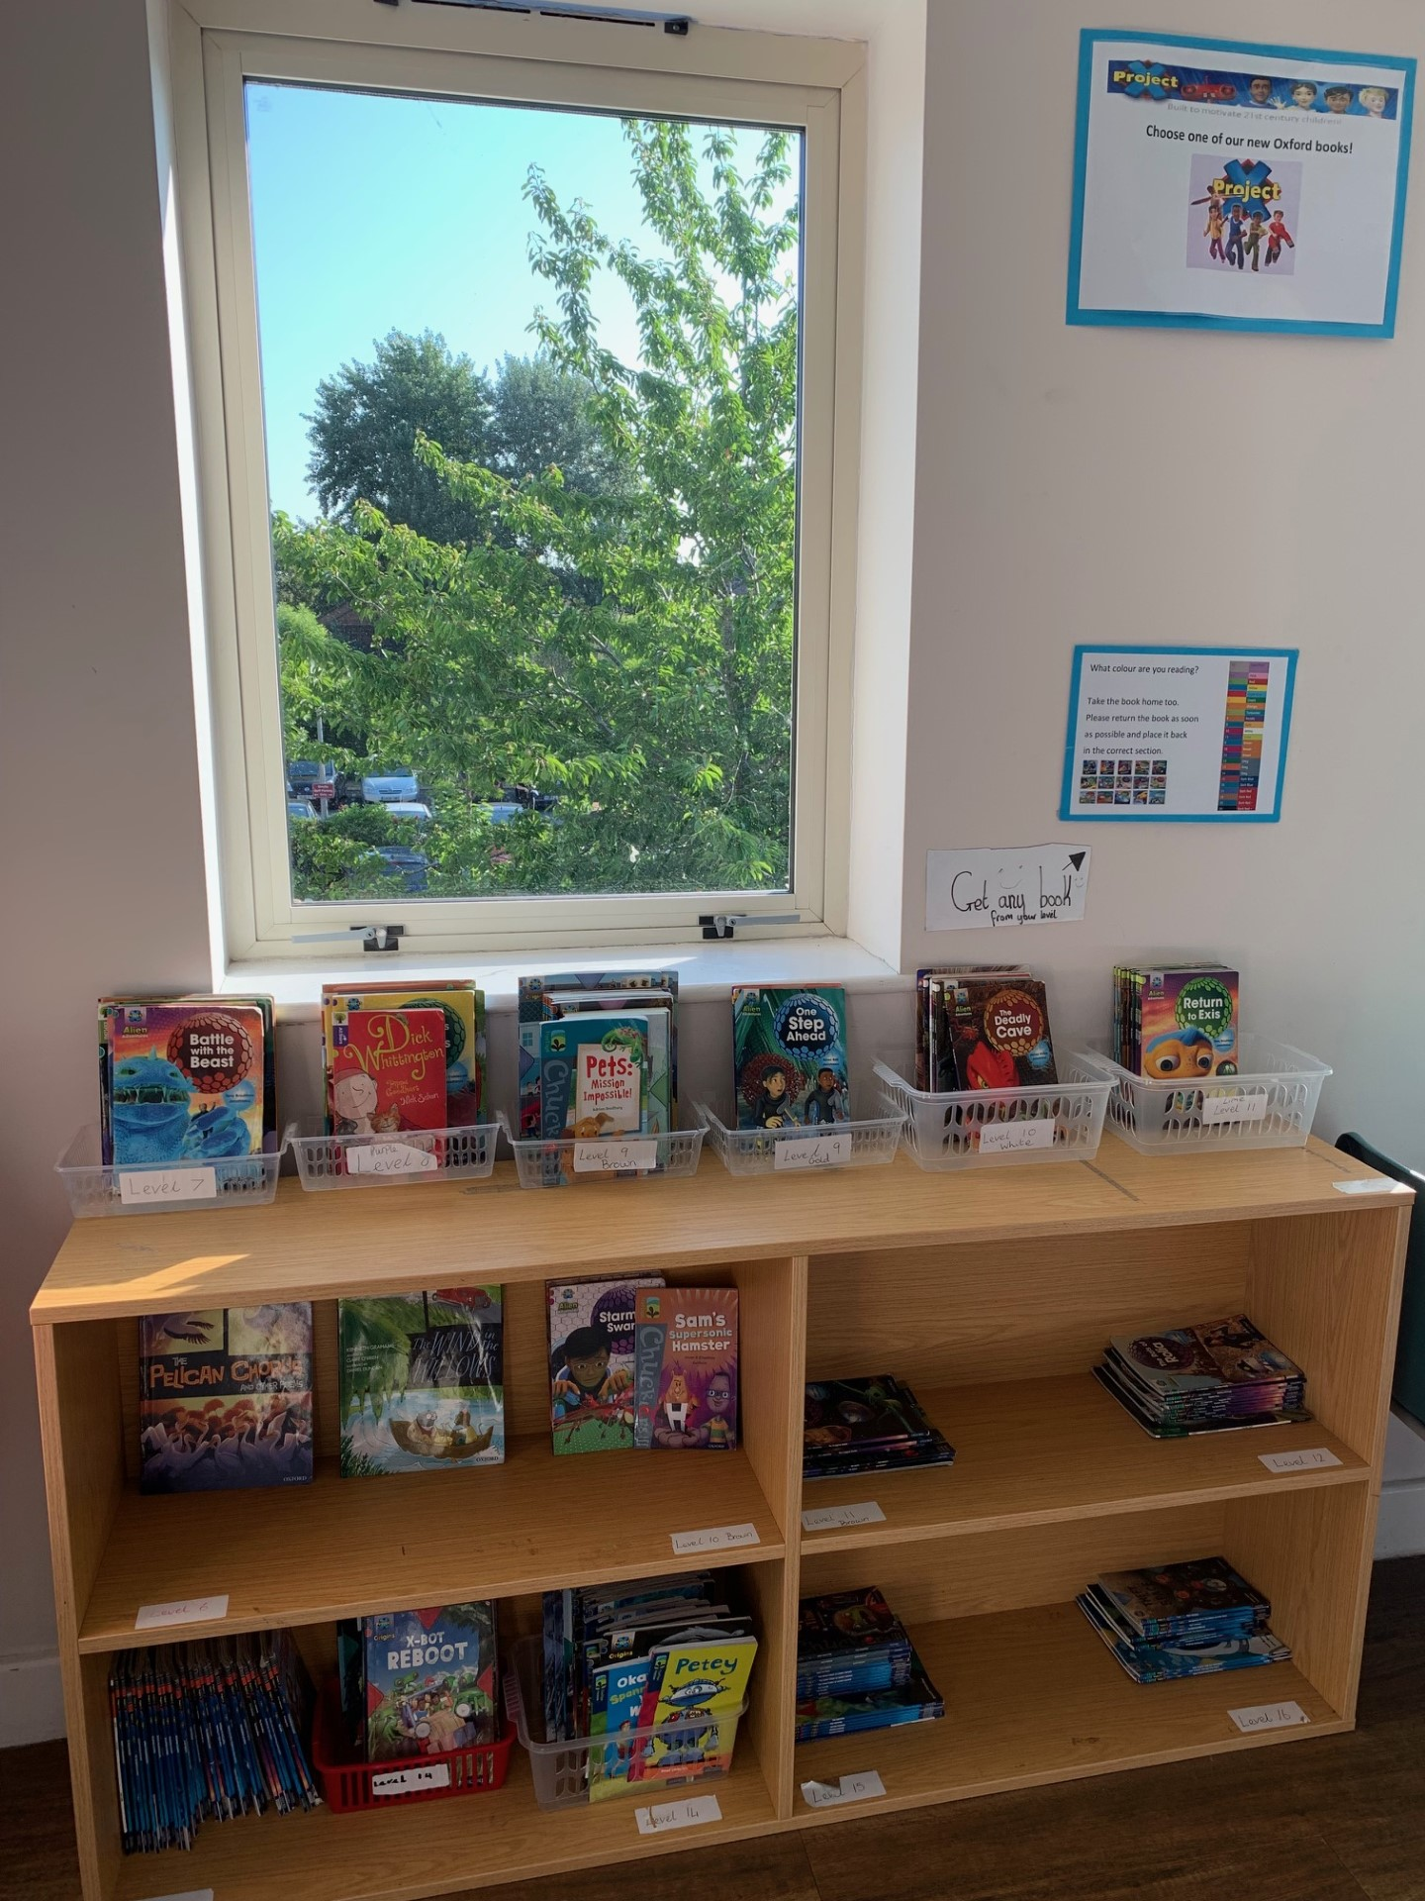
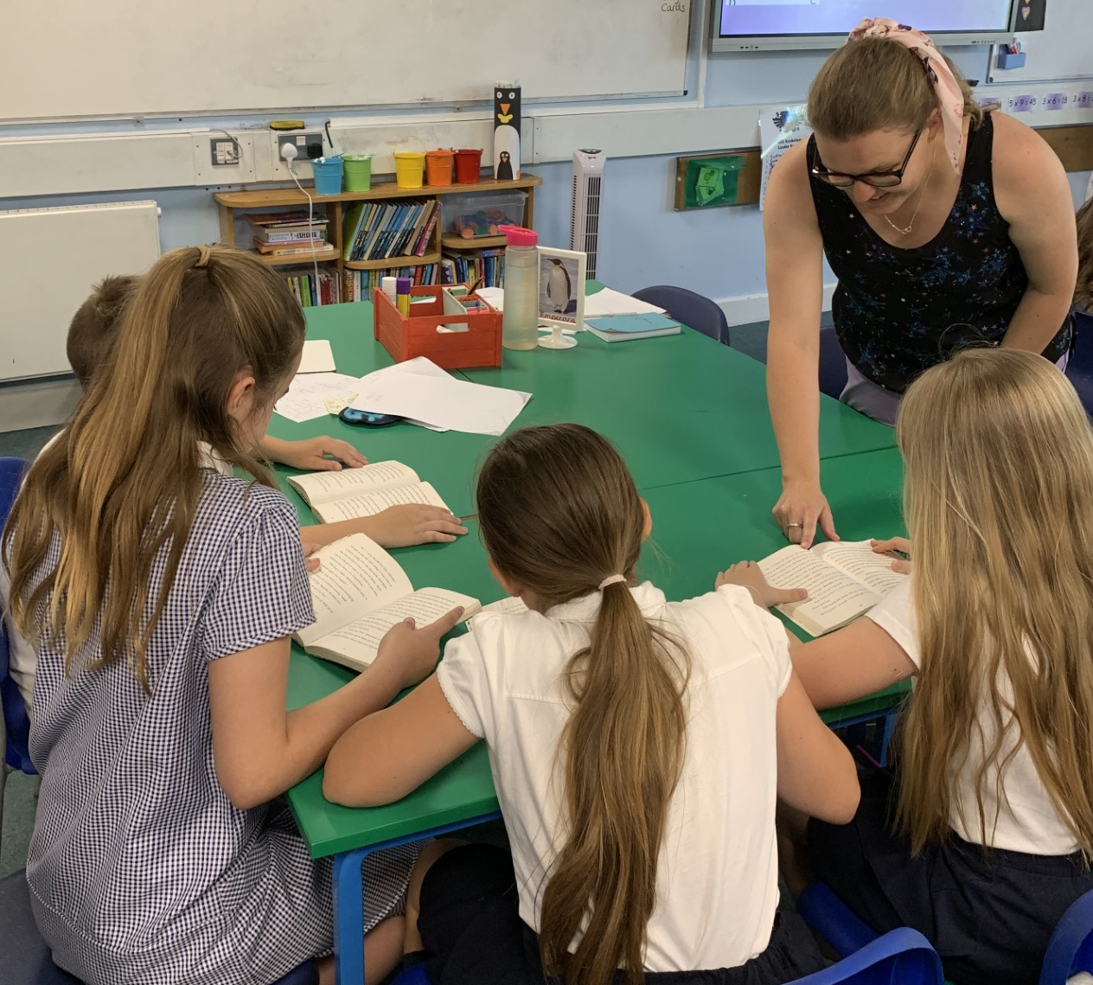
Ready Respectful Safe
Welcome to Reading in Year 4!
Our aim in Year 4 at Muscliff is to:
instil a curiosity for exploring a variety of reading material
develop children’s book talk and response to reading
recommend books and authors in our culture of reading
develop competent and confident readers who have a thirst for reading
develop healthy habits for independent reading and book choice
develop pupils’ ability to read aloud with prosody for the purpose of performance
to support the development of pupils’ language and vocabulary.
In Year 4, we understand that:
reading lies at the heart of the curriculum, and it's of the upmost importance to a child's personal, social, and academic success, as well as their general wellbeing
a reading culture is an environment where reading is championed, valued, respected, and encouraged
background knowledge and vocabulary are essential components of reading comprehension.

Slide 2
Ready Respectful Safe
What does a typical reading session look like in Y4?
Supplemented by Oxford Reading Tree books, our primary source of high-quality guided reading texts is actually our lead English text. In studying our class text thoroughly, children become fully immersed in the style of literature and have the opportunity (and time) to explore the book fully with the supportive discussions led by the teacher. The impact is cohesion; children are able to develop their reading skills whilst also developing high quality book talk. Here’s where the quality book talk really shines through and it is evident the moment you step into a reading session! We spend plenty of time exploring how the author uses key features and the impact it has on us as the reader. We get to grips with characterisation and the devices the author uses to create this. We unpick the language and vocabulary carefully recognising that this is key to children’s development as readers. At Muscliff, we believe that reading should be developed within context.
To develop all strands of reading comprehension (and to successfully meet our Year 4 standards) each session will focus on a specific strand.
Here’s what you would see in a typical lesson:
Drama
Drama activities enable Year 4 children to put themselves into the position of a character. This develops children’s inference skills as they need to interpret what they have read and link this to how a character is feeling.
Language
This session tends to be more adult-led than many of our sessions as it is important that the meaning and context of vocabulary is transferred. Sometimes we record words using a language pyramid as this can be a useful concept.
Debate
Arguments are one of our favourites! This requires a more wholistic understanding of the text. Since structuring lessons using debate, our children have become much more efficient in tackling the infamous 3 mark questions as they are more able to make a point, justify the point with evidence from what they have read but also look for further points to either ‘back up’ their original idea or points in the text that would oppose the original point.
The Author Craft
Here we analyse how and why an author writes a particular word or phrase. We noted from question level analysis that previously our children lacked the ability to answer questions that involved author’s choices. For example, “Why do you think the author choose the word erupted.” In the past, children would have written, “for effect.” Now children are more able to pinpoint what the effect is.
Written Response
And of course, children do need to become familiar with showing their reading comprehension in more formal ways. Teachers create their own questions and activities that support all comprehension skills.

Slide 3
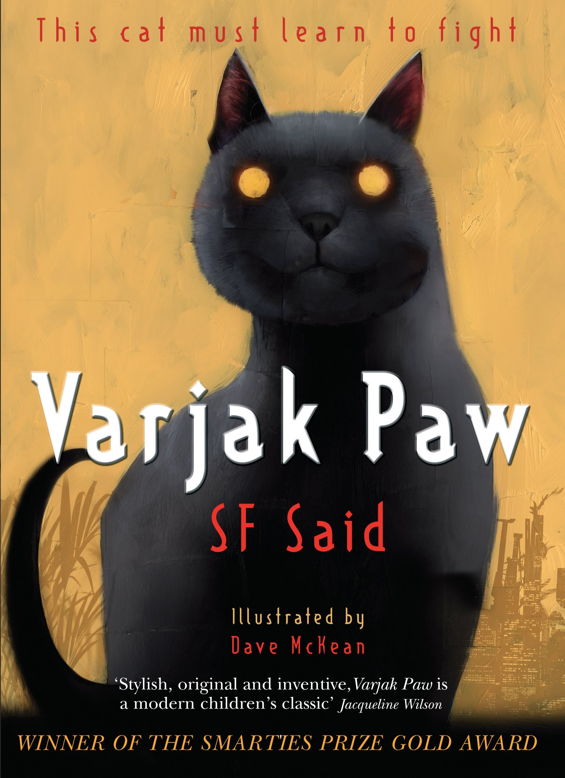
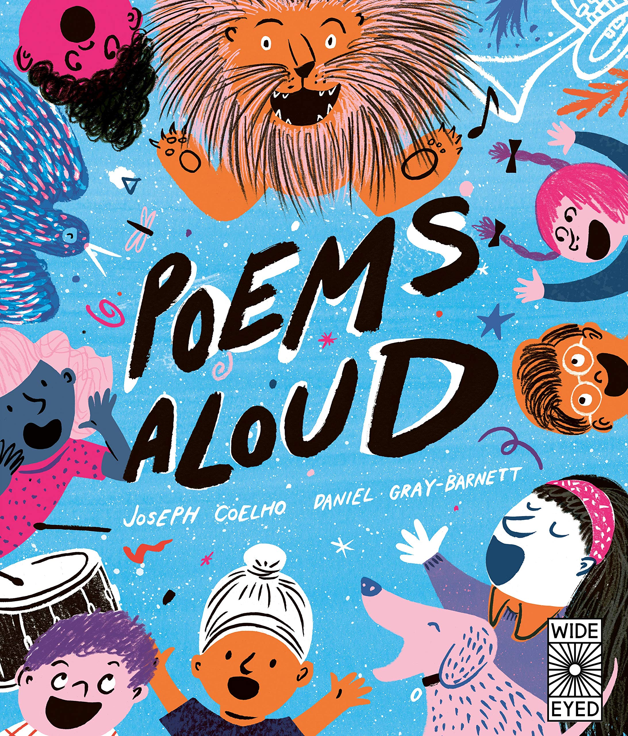


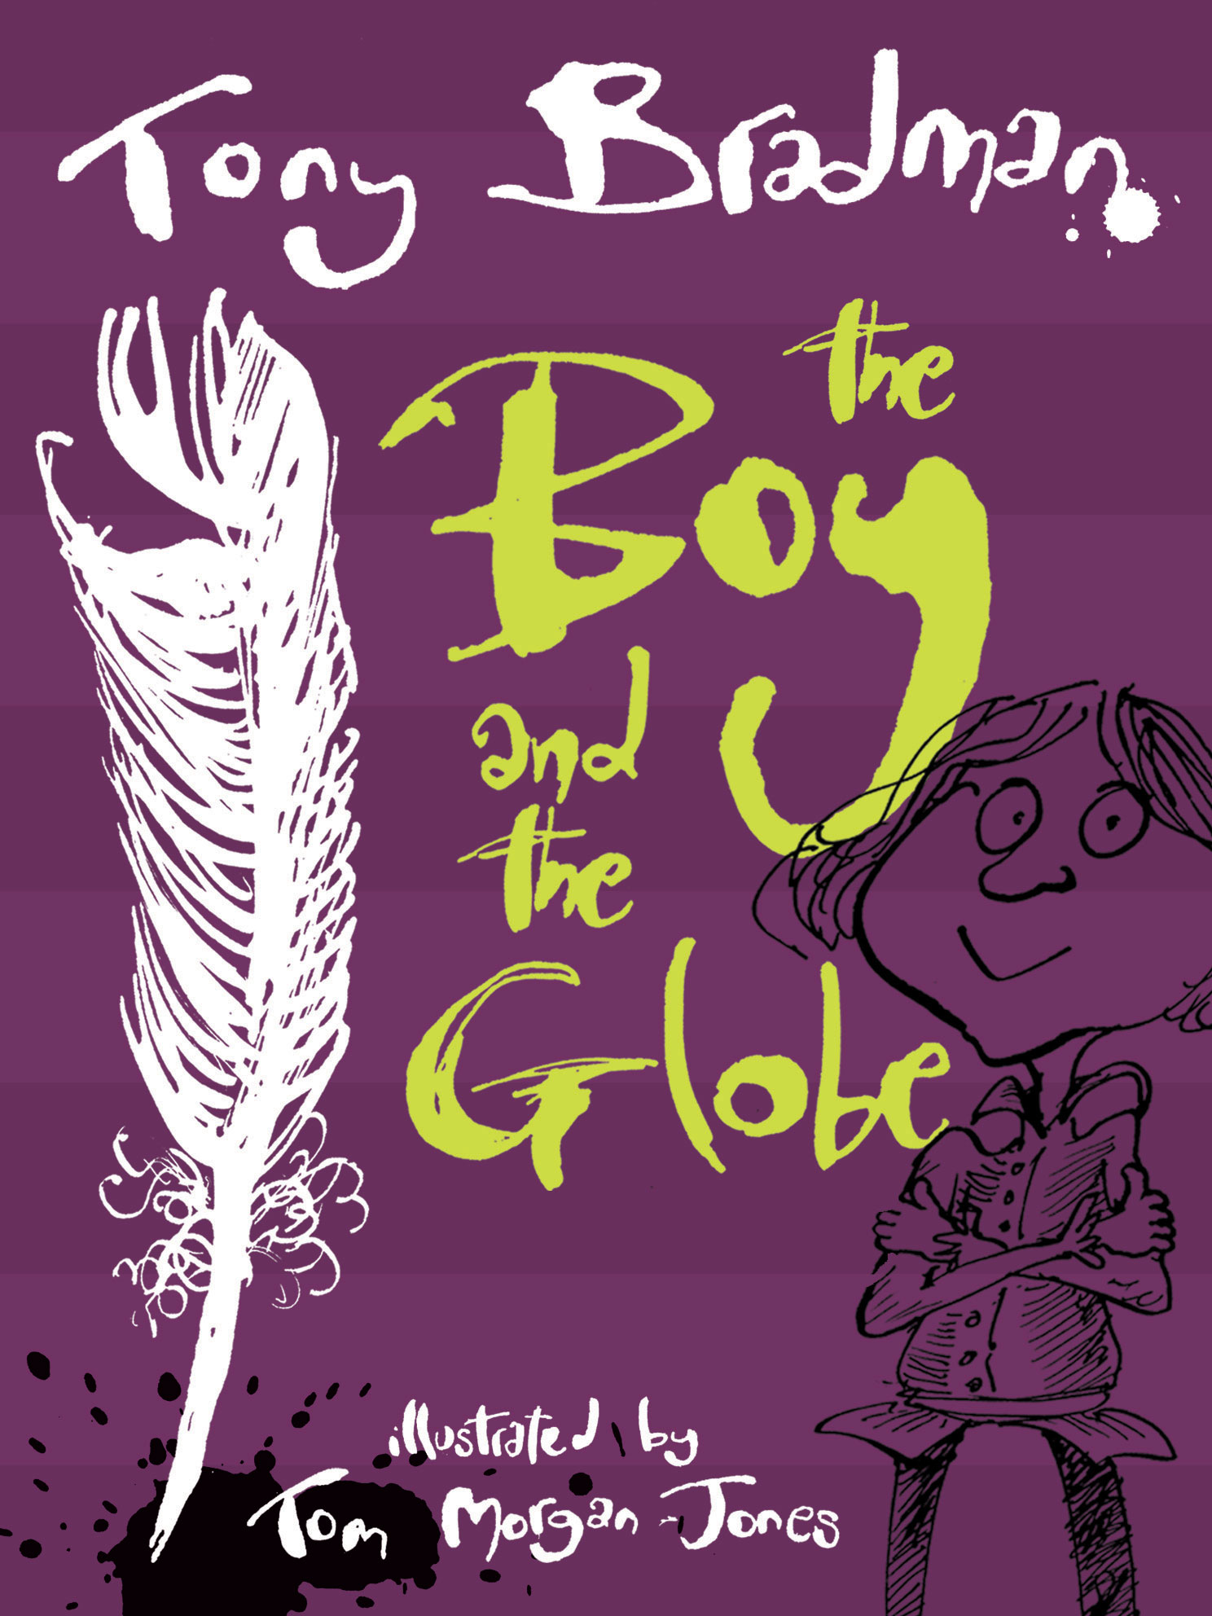

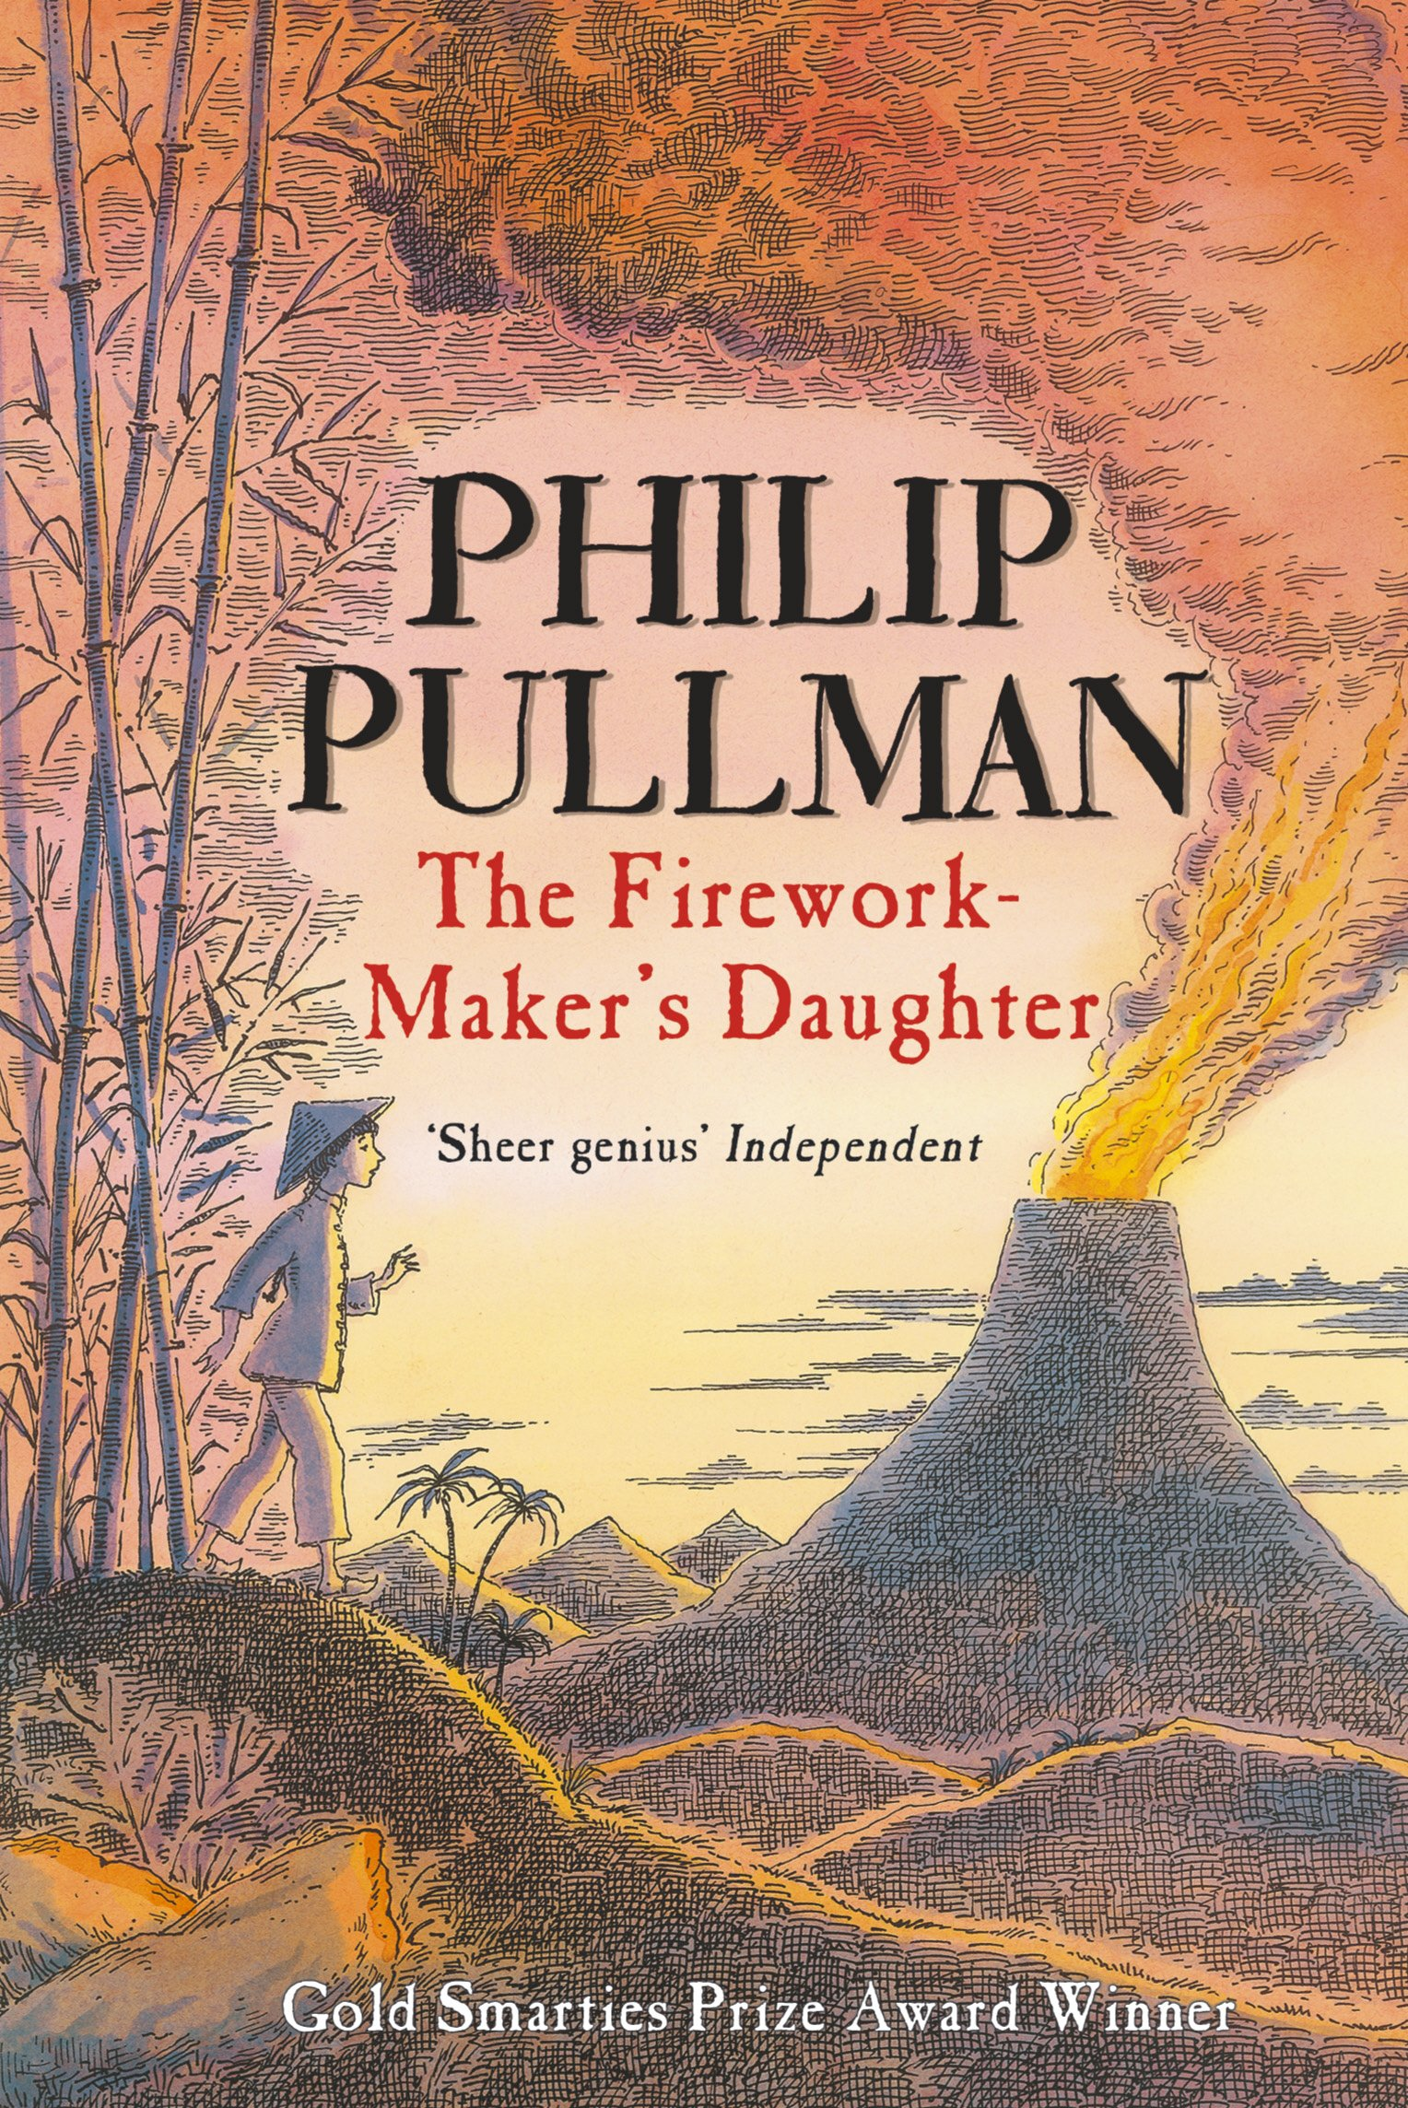
Ready Respectful Safe
Texts
Here is a reminder of our lead texts in Year 4, which we use for guided reading
Year 4 End of Year Expectations
Read, on sight, all the words from the Year 3/4 spelling list.
Recognise when words are an exception to the rule.
Independently suggest what might happen in a text from implied meaning.
Locate information using skimming, scanning and text marking.
Pull together clues from action, dialogue and description to infer meaning.
Identify and name different forms of poetry.

Slide 4
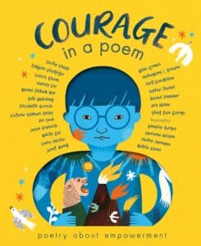
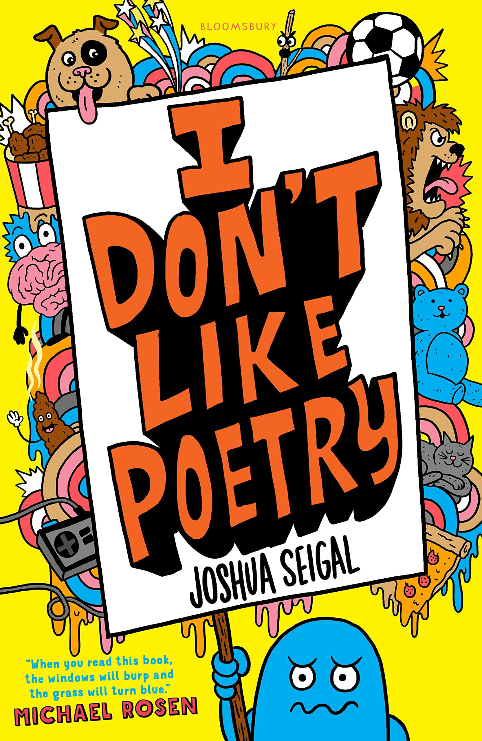
Ready Respectful Safe
Year 4 Poetry
Poetry is a genre we particularly enjoy in Year 4 for several reasons. Firstly, it is important for children to explore prosody with the intention of reading aloud specifically for performance. Reading aloud is always something that young children are encouraged to do… but with poetry we read aloud for the purpose of engaging your audience. We teach the children interesting techniques such as crescendo, diminuendo, piano and lente that make the performance more effective!
Secondly, reading poems that follow a structure and rely on repetition increases the confidence of those children who find reading a challenge.
Also, poetry is a fantastic opportunity to explore figurative language where we need to use our inference skills. In this form of literature, poets are liberated and can use metaphors. Things in poems might not always be as they first appear.
Finally, poems are fun! And the poems we choose in Year 4 certainly inspire children to pick up a poetry book to read independently!
Year 4’s Book Spine
Alongside our lead text, we have chosen further books that complement the unit - we call this our Reading Spine. This reading list is bespoke to us and each book has been chosen purposefully by our wonderful teachers. We encourage children to read books from this list (look out for the reading stars that the children wear on their jumpers) and we love to explore these books as a class book at the end of the day.
We really enjoy sharing one last book just before home time!

Slide 5
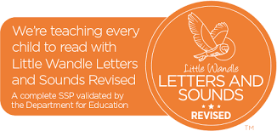
Ready Respectful Safe
Phonics and Intervention in Year 4
Older students struggling with reading may have gaps in their phonics knowledge and it is important to assess and establish what those gaps are. For example, although all of our Year 4 children have had comprehensive teaching of phonics in YR – Y2 following the Little Wandle programme, they may struggle to apply phonic knowledge when decoding new multi-syllable words. Showing them how to find the vowels and then the syllables may enable them to activate their existing phonic knowledge. On the other hand, the difficulties of an older struggling reader may involve the Language Comprehension continuum of the Simple View of Reading (SVoR). Phonics intervention may not be helpful for those students and instead they will need assistance with developing their understanding of vocabulary, how texts work and how to infer.
Year 4 use ongoing-assessment effectively to identify where pupils are struggling in word reading, reading fluency or language comprehension and when pupils require additional targeted support.
Where phonics is identified as the main barrier to progress (and using Year 2 phonics re-set test data), Year 4 use the Little Wandle rapid catch-up programme. This would be delivered as a small group intervention although is more likely to be 1:1 depending on the specific needs of the learners.
Dyslexia Intervention in Year 4
At Muscliff, we use Project X Code (Oxford) to support children with dyslexia. Project X CODE is a proven reading intervention programme and combines phonics and comprehension development. In each book, text 1 is 100% decodable to build confidence and develop vocabulary; Text 2 is 80% decodable to challenge children and deepen comprehension. We chose this intervention programme as is it dove-tailed well into our whole school reading scheme and was selected after teachers conducted research as part of a CPD programme of enquiry. Over the time, we have closely monitored the progress of the children using ‘code’ and their engagement in the books has remained high throughout. Steps of progress have been continually made, which keeps the children enthused and eager to read more. We regularly monitor the progress being made by the children and gain regular feedback from TAs supporting those children. We can see small steps being made daily (this really engaged and enthused the children) which contributes to progress across the year.

Slide 6
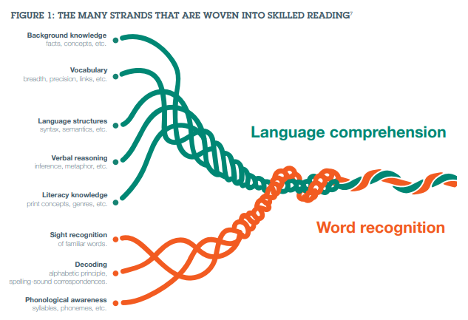
Ready Respectful Safe
Our Evidence-Based Research
Scarborough’s reading rope is a useful visual as this not only extends the range of language skills required in reading, but also shows how mastery and integration are important.
This concept is what has shaped the structure of our guided reading sessions.
The rope diagram aims to model the reading process by showing the relationship between the decoding and understanding domains and how they strengthen over time as a result of reading.
This is important because different children have different strengths and weaknesses.
When we teach reading in Year 4, we explore each of these strands that contribute to mastery in reading.
Scarborough’s reading rope

Slide 7
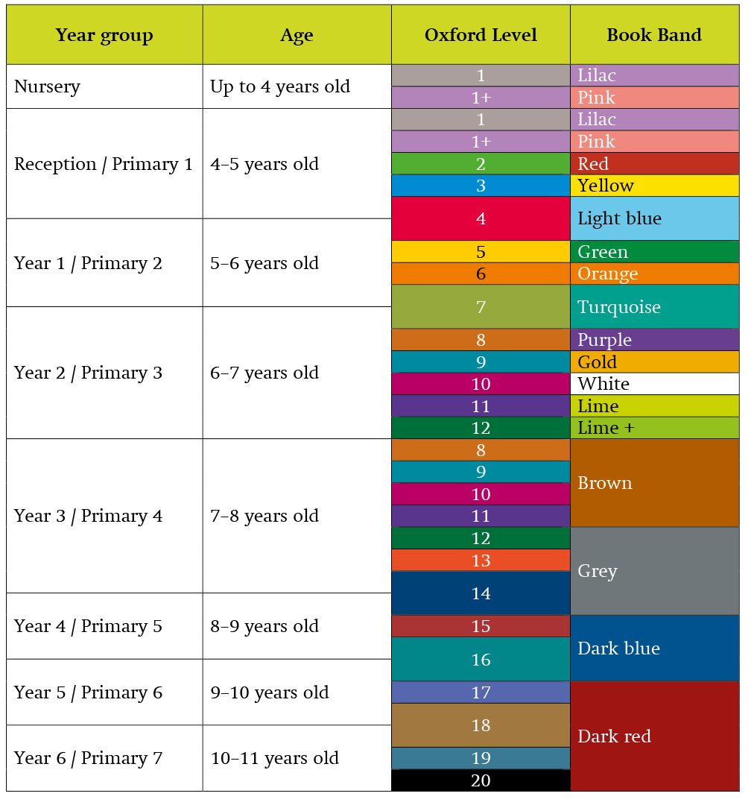
Ready Respectful Safe
Which colours will my child read?
All children in Year 4 should take home a colour-banded book. Children at this age are free to change their books independently (although they may need some encouragement to do so from the class teacher or their parents). Grey and Dark Blue books are pitched at the correct age-related expectations. We have plenty of excellent titles in our year group library.

Slide 8
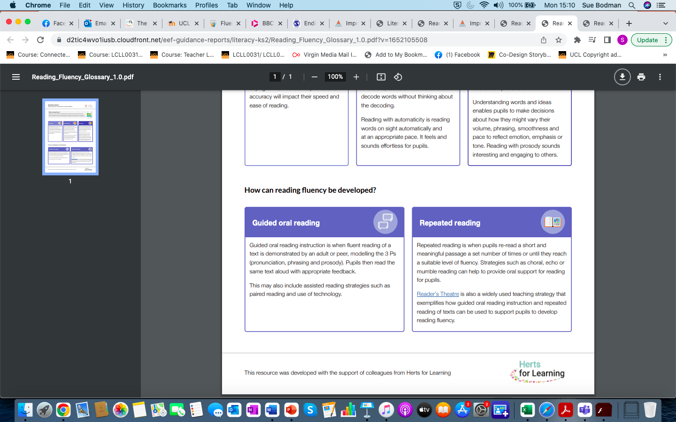
Ready Respectful Safe

Slide 9
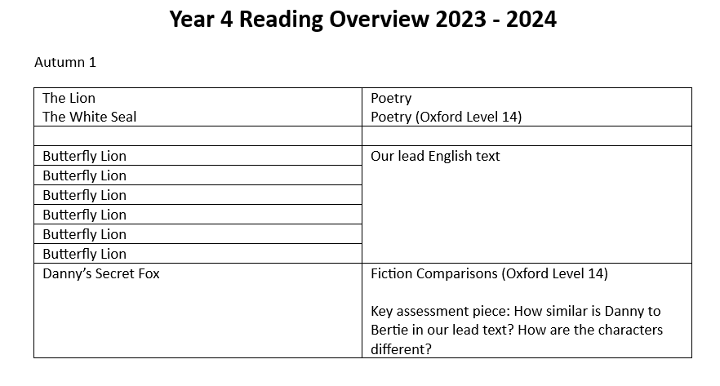
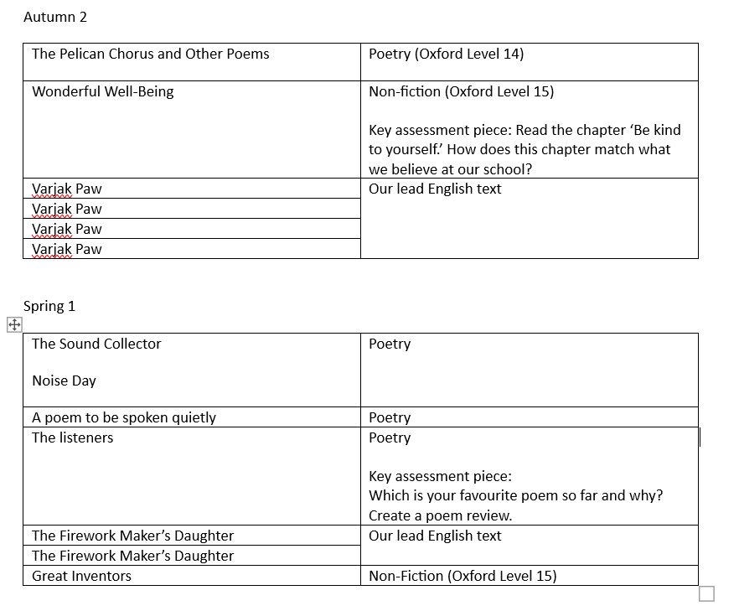
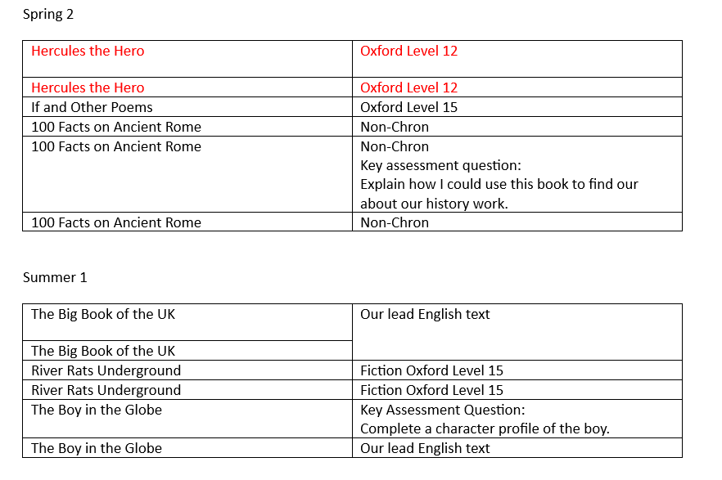
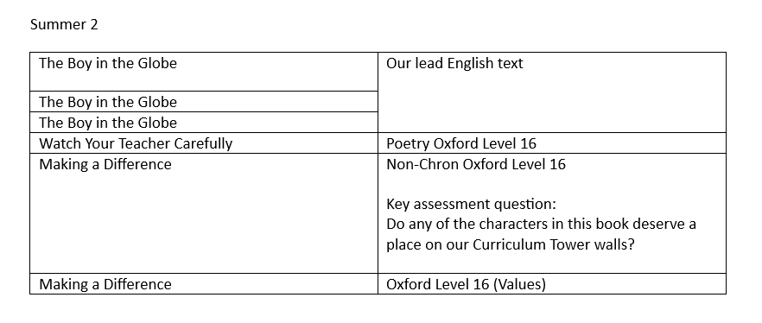
Ready Respectful Safe

