Slide 1

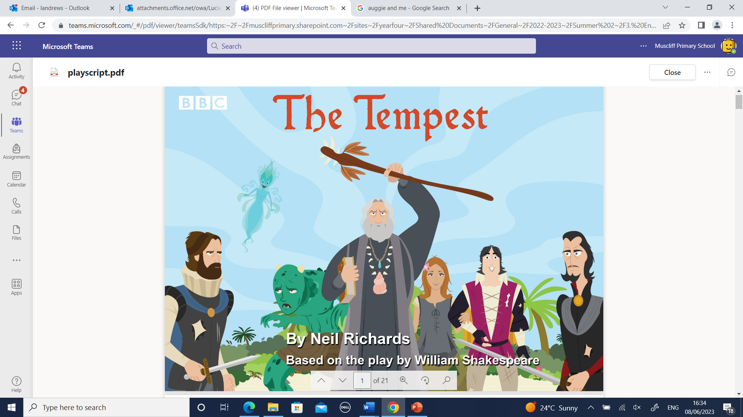






Year 4
Summer
2
Ready Respectful Safe
The Tempest
Value: Aspiration
Key Question:
“Don’t let anything get in your way.” Is this sometimes true, always true or never true? In our story, should Shakespeare sabotage the Rose so that the Globe is the best theatre? After all, his rivals are getting in his way! Would that be aspirational?
Can you set a personal goal for the holiday?
Why this particular book and not something else?
What better way to complete Year 4 learning for the year than with another half term with the bard himself, William Shakespeare. Year 4 complete The Boy in the Globe and use this as a springboard to launch into our playscript, The Tempest. We are happy to give Y4 a taste of Shakespeare in a fun way so that they are familiar with some of his work – although a very long way off, it is highly likely that they will need to read more of his plays when they move on to secondary school. Studying a playscript, understanding the content and then being able to interpret this are key skills in performance. We can’t wait to see how the children get on in performing this wonderful play.

Slide 2
Year 4
Summer term
2
Ready Respectful Safe
English Skills that will be developed through this unit:
Our Year 4 children are now efficient at writing speech and accurately punctuating this so it’s a good opportunity to take this a step further. Now we know ‘the rules,’ it’s time to have fun! We look at using speech punctuation to represent accents and voices in our characters. This will add another layer to our characterisation. For example, “Alwight. You ‘ave to come and visit me theatre in London!”
Children also consider phrases that originated from Shakespeare and use this figurative language themselves. Actually, our language is much richer for Shakespeare. Here’s just a few examples:
To wear your heart on your sleeve
A wild goose chase
The world is your oyster
Of course, performance will be a key feature of our learning also as we perform The Tempest.
Writing Composition in school:
Children will write playscripts using characterisation.
A balanced argument will give the children a chance to reflect on aspirations: should they sabotage the Rose theatre to make the Globe theatre more successful?
The Tempest performance.
Help at Home:
Imagine you have visited Shakespeare’s play-house! What was your experience like? What play did you go and see? Remember to use your senses and your imaginations to describe what it was like.
If you could meet Shakespeare, what questions would you ask him?
Describe a storm at sea! What would the waves and wind be like? Go for as much description as possible!
Continue researching phrases that came from Shakespeare (like the ones in the list above). Pick two or three and explain what they mean.
If you were an actor or actress, which Shakespeare character would you like to play and why?
Can you set a personal goal for the holiday?

Slide 3

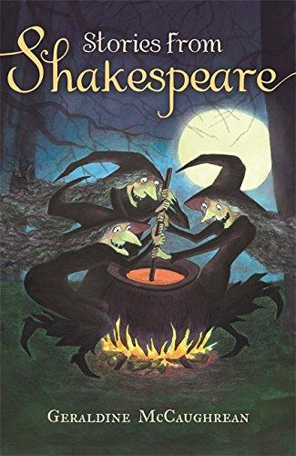



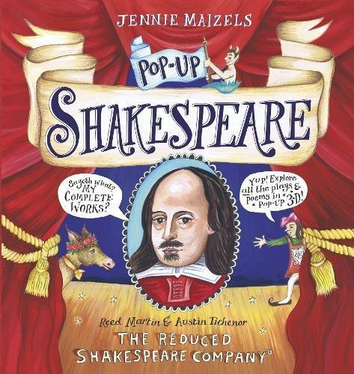

Year 4
Summer term
2
Ready Respectful Safe
Our Extended Book Spine

