Slide 1

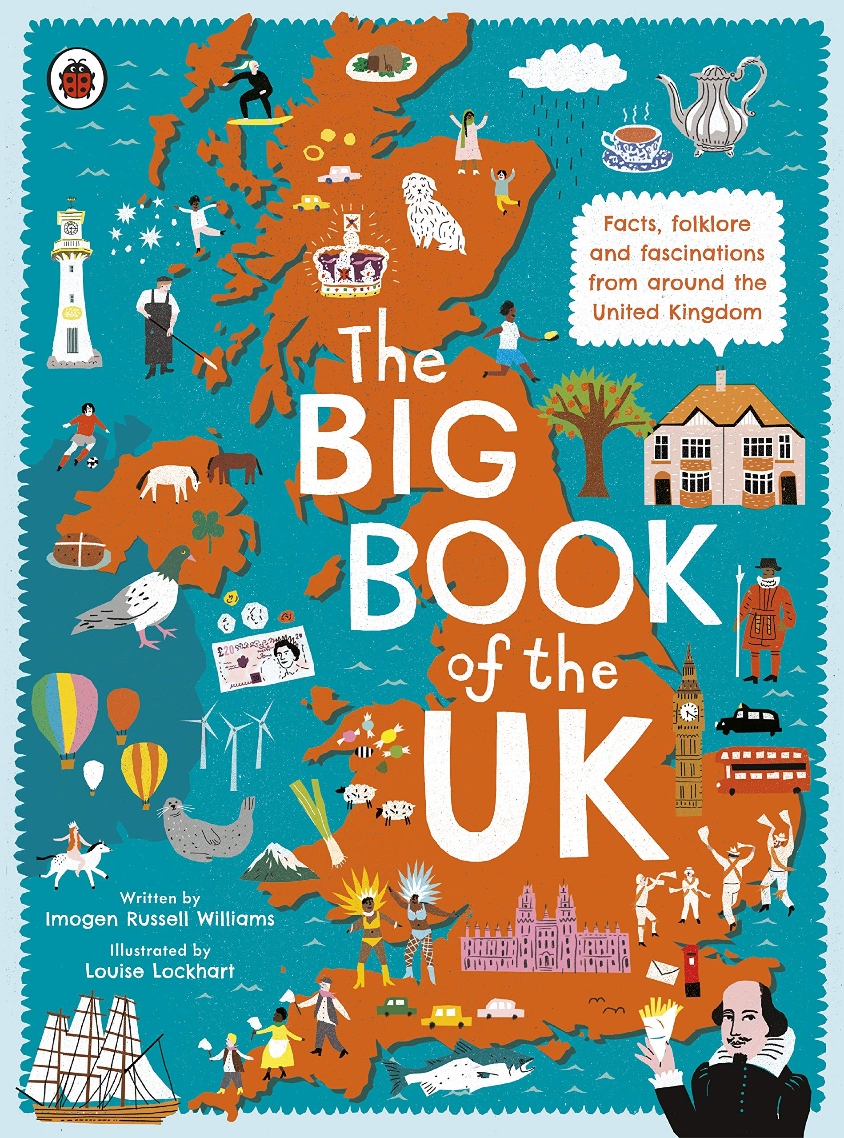
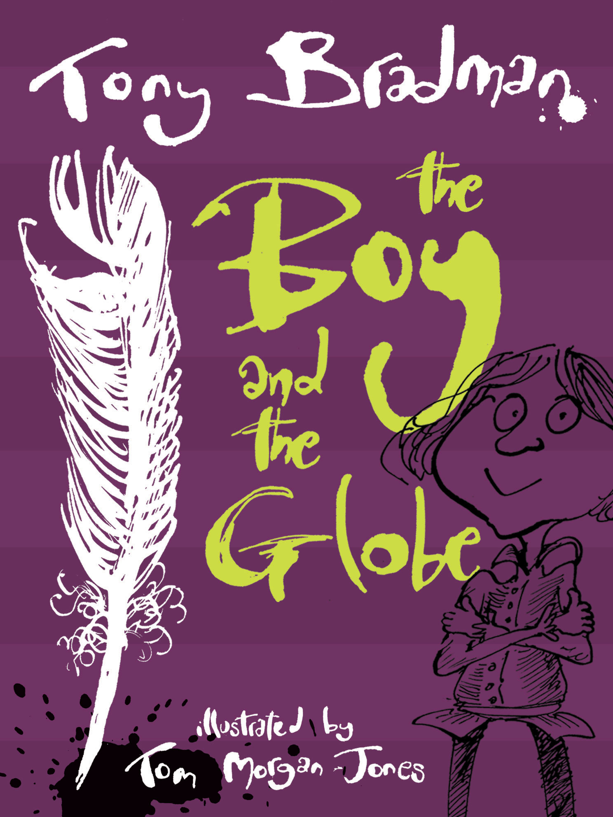
Year 4
Summer
1
Ready Respectful Safe
The Big Book of the UK
The Boy and the Globe
School values this book reinforces: Responsibility
Britain is built on freedom and equality where everyone is aware of their rights and responsibilities. How do the facts in The Big Book of the UK help us to understand that the people of Britain can be different in many ways?
Why these particular book and not something else?
We spend three weeks on The Big Book of the UK and then make a start on The Boy in the Globe, which stretches into next half term. Both of these books are just delightful!
Our theme for both of these books is: entice the reader. Both books are very different but both show Y4 how to engage with the reader so that the reader wants to find out more for themselves.
The Big Book of the UK is a stunning non-fiction text – it is visually appealing and packed with facts about the UK. We have chosen this book because it has been organised in a particular way to highlight the cultural and historical features of the UK. When reading this book, children will feel both fascinated and proud. The fascination comes from the many interesting facts about the history of our nation; there is so much to learn. This book is a celebration of the diversity of our nation – when reading this book, children will feel a sense of pride of belonging to the UK.
The Boy in the Globe is a fictional story that supports children to understand about life in Britain (and specifically London) in the times of Shakespeare. We love how theatre-life is described in this book in wonderful detail. The author Tony Bradman creates an enthusiastic character who is passionate about theatre; Y4 will see theatre through the boy’s eyes and will understand why this character loves the theatre so much.

Slide 2





Year 4
Summer term
1
Ready Respectful Safe
English Skills that will be developed through this unit:
Both of these books are about enticing the reader into the book to satisfy their curiosity.
In the Big Book of the UK, the factual information is presented in a way to make the reader want to find out more and even visit the feature being described. Y4 create leaflets using persuasive features; they make their writing appealing so that their reader wants to visit.
The Boy in the Globe focuses on a description of the theatre. The author creates a character who is absolutely enthralled by what he sees on the stage. Can we capture the magic of the theatre well enough to inspire our readers too?
Writing enticing noun phrases
Expanding a sentence to add appeal to the reader
Reading with intonation to entice the reader
Linking ideas through paragraphing
Specific vocabulary – sounding like an expert
Description adjectives and characters
Writing Composition in school:
Hubble, bubble, toil and trouble! Year 4 will describe the three witches’ performance on stage. They make the description so vivid that the reader would want to visit the theatre for themselves.
Year 4 create a leaflet inviting their reader to visit an attraction in the UK. But can Y4 write in a style that entices their reader enough to make them want to visit?
Help at Home:
Pick up some leaflets about local attractions. Arrange them in order from most appealing to least appealing. What features do they all have in common? What MUST a leaflet have? What MIGHT a leaflet have?
Using persuasive sentences, describe the features of your favourite park. What makes this park the best to visit. You can write your ideas as bullet points. Try to use an expanded noun phrase for each feature.
3) Imagine a visitor is coming to Bournemouth. Write a paragraph about what they could do at the beach.
4) Research William Shakespeare. What fascinating facts can you find about him?
5) Continue your research about William Shakespeare – why do you think people liked his plays? Which plays did he write?
6) Would you rather go to the theatre or the beach? Explain your choice.

Slide 3
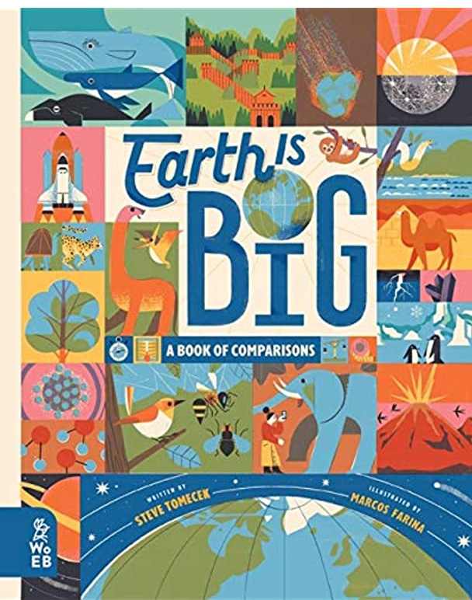
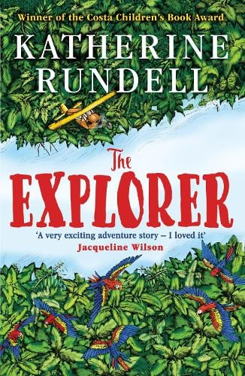



Year 4
Summer term
1
Ready Respectful Safe
Our Extended Book Spine
Get to know our planet in a whole new way by comparing it to a huge variety of other incredible things – from tiny particles to giant star clusters. Did you know soap bubbles are some of the roundest objects in the universe? Or that we humans are totally outnumbered by chickens? Or that the driest desert on Earth isn’t scorching but freezing? Tour some of the most extreme places on the planet and beyond it, take a look at life forms from bacteria to elephants to redwood trees and explore what makes our planet the perfect home for us.
From his seat in the tiny aeroplane, Fred watches as the mysteries of the Amazon jungle pass by below him. He has always dreamed of becoming an explorer, of making history and of reading his name amongst the lists of great discoveries. If only he could land and look about him. As the plane crashes into the canopy, Fred is suddenly left without a choice. He and the three other children may be alive, but the jungle is a vast, untamed place. With no hope of rescue, the chance of getting home feels impossibly small. Except, it seems, someone has been there before them.
Finn has always been different, and in the tiny fishing village of Stromhead he sticks out like a sore thumb. Always told to keep away from the water, he's felt that something was missing until one day he dives in and finds that, swimming with the dolphins, he feels completely at home. But his new friends are in danger of being injured by the rubbish that floats out into the water - and now a supermarket is going to release thousands of balloons that could drift out to sea and cause even more damage.
Join Stella Starflake Pearl and her three fellow explorers as they trek across the snowy Icelands and come face-to-face with frost fairies, snow queens, outlaw hideouts, unicorns, pygmy dinosaurs and carnivorous cabbages . . . When Stella and three other junior explorers get separated from their expedition can they cross the frozen wilderness and live to tell the tale?
Featuring the true stories of 40 inspirational women creators - from writers to inventors, artists to scientists - this book is as inspirational as it is educational. Readers will meet trailblazing women such as revolutionary architect, Zaha Hadid, actor/inventor Hedy Lamarr, environmental activist Wangari Maathai, modernist painter and animator Mary Blair and physicist Chien-Shiung Wu. Some names will be familiar, some will not - but all these women had a lasting impact on their fields.

