Slide 1

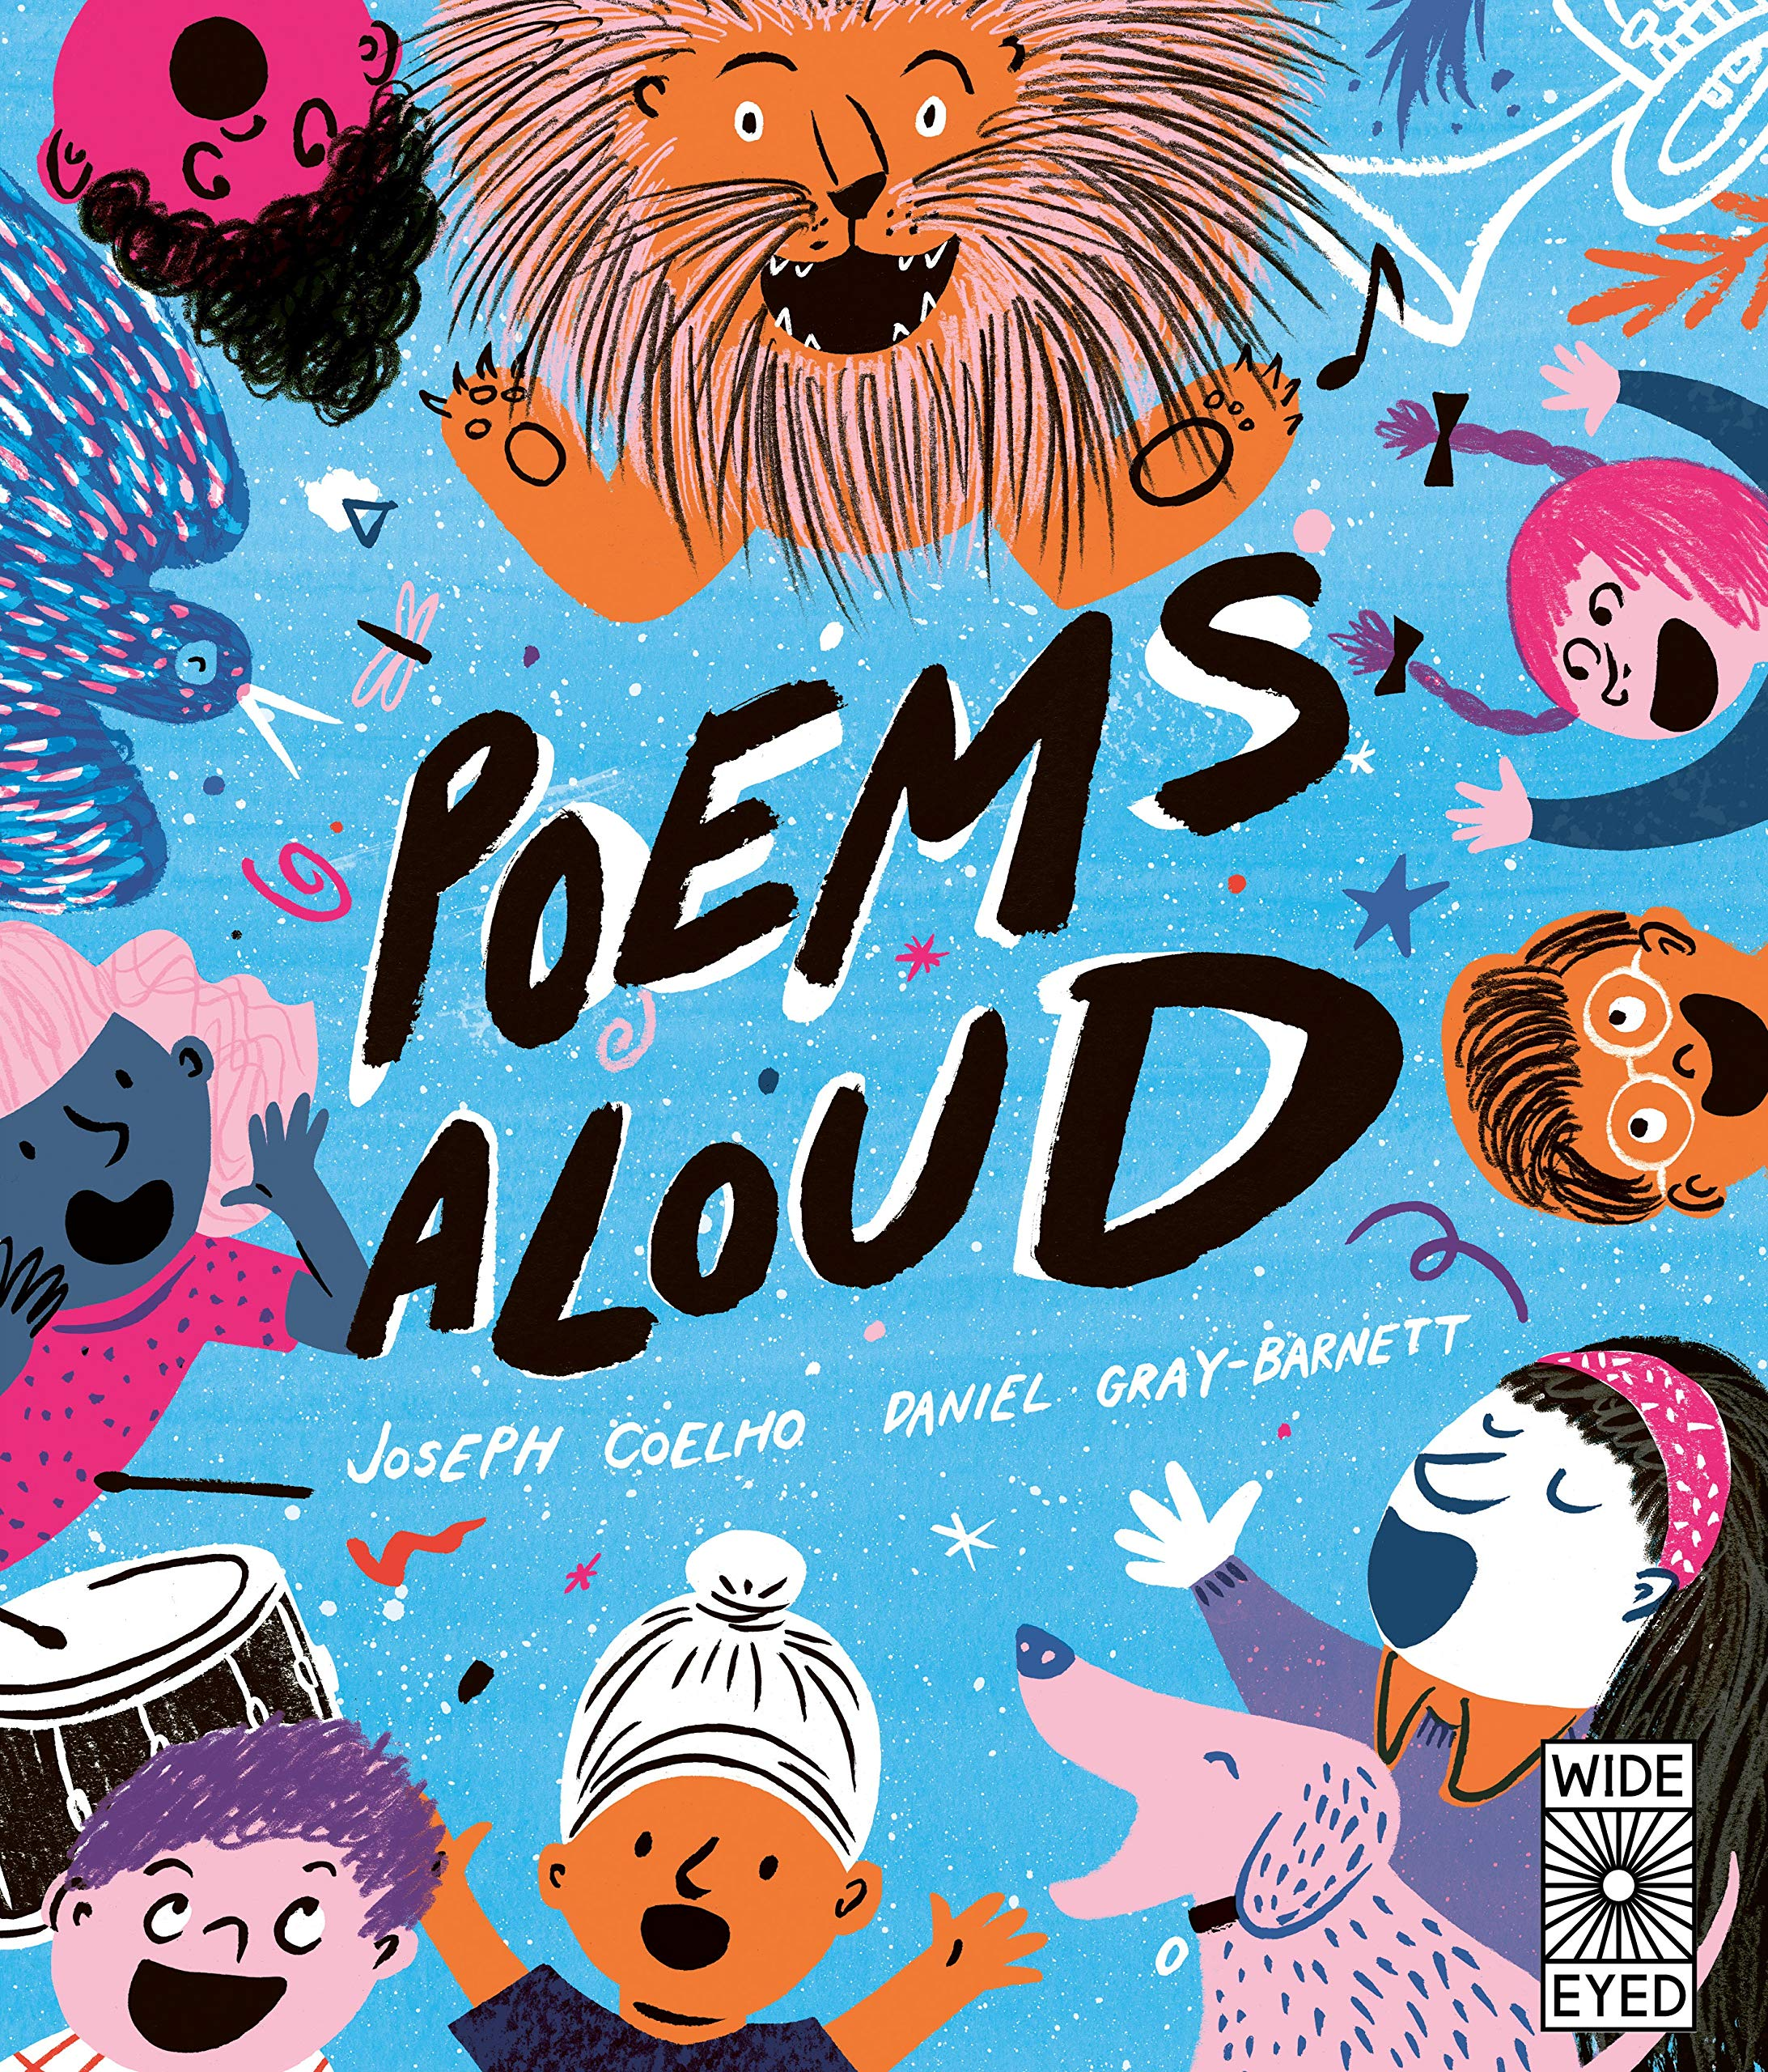
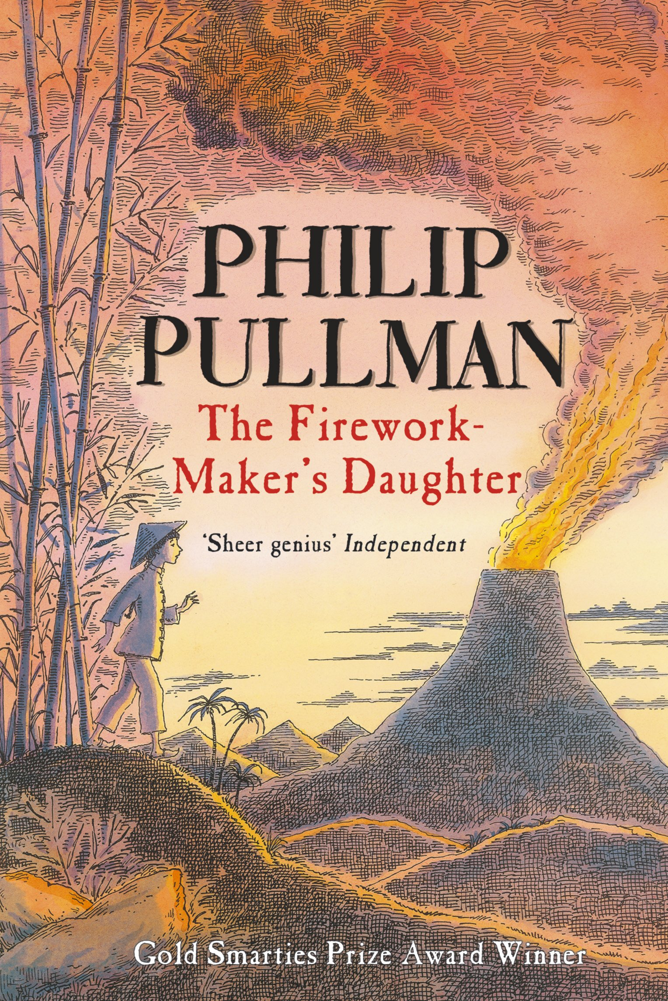





Year 4
Spring term
1
Ready Respectful Safe
Poems Aloud and
The Firework Maker’s Daughter
Why these particular books and not something else?
This unit is a sense sensation! Throughout this half term, Y4 will be discovering more about the senses, particularly sound and then light, and these books, chosen by us, help to set the tone. (Did you notice what we did there? Tone!) In the first part, we consider sound and use this very new book, Poems Aloud as it supports performance poetry. We really unpick how we use our voices in different ways to support the meaning and messages in poetry. Children learn about tone, pace and pitch as well as crescendo. Of course, all of this language is further reinforced in music lessons. When we move on to learning about light, the Firework Maker’s Daughter presents us with some truly remarkable visual descriptions. Essentially, this book is a fairy tale from a different culture.
English Skills that will be developed through this unit:
In Poems Aloud, we learn how to recite poems using various techniques, such as: rhythm, volume, pace, building to a crescendo or reducing to a diminuendo. We match techniques to the style and tone of the poem. Finally, we follow a set pattern to write a new poem that follows the same structure.
In the second part of this unit, we consider the structure of fairy tales. We look at common characteristics of heroes and villains and unpick the moral element of any fairy tale, regardless of its cultural origin. Children build on their story telling skills so that they can replicate a story to demonstrate a moral.

Slide 2
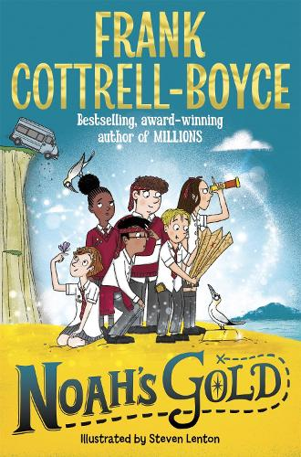
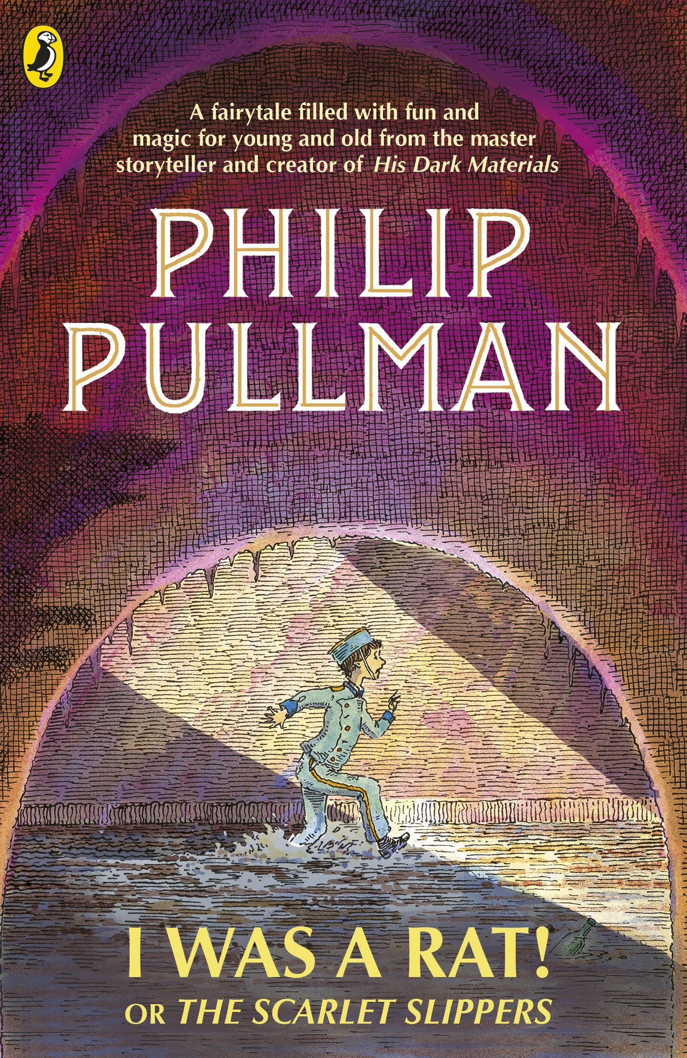
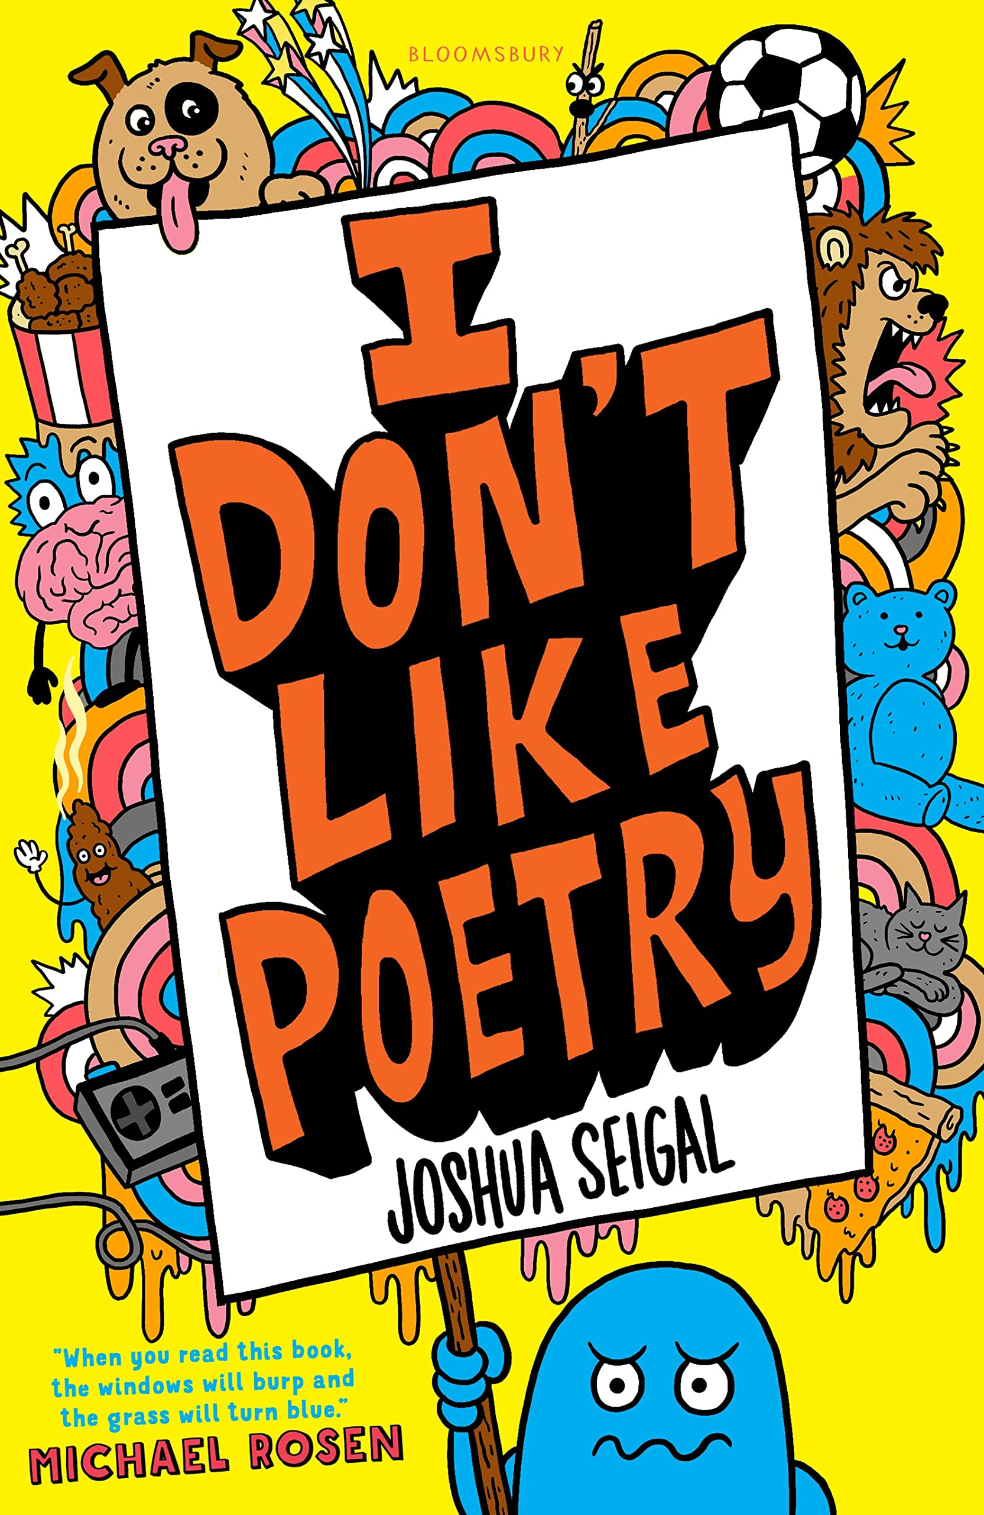
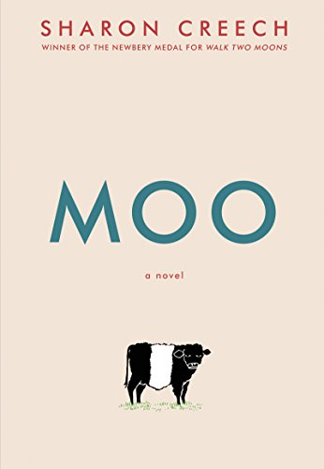
Year 4
Spring term
1
Ready Respectful Safe
Writing Homework
Here are the writing tasks that will appear each week this half term on the homework sheet in the red folder. The tasks here mirror the children’s learning in class. As always, the task is secondary to the conversation you have with your child about their learning. It’s that chat that will support your child most with their progress and understanding!
1) Tongue Twisters are a fun form of poetry. Use the internet to find a tongue twister – copy it out and practise saying it.
2) Music lyrics are a form of poetry. Find a song that is performed quietly or a different song that was written to be performed loudly – how does the message in the song affect how the song is performed?
3) Think of fairy tale villains… what do the villains say? Use full speech punctuation to write their words. Example characters could be the giant in Jack and the Beanstalk, “Fee, Fi, Fo, Fum, I smell the blood of an Englishman.” Or the wolf in The Three Little Pigs. “I’ll huff and I’ll puff and I’ll blow your house down.” You should then rehearse saying their lines out loud!
4) Choose a fairy tale you know very well and find a version of it on YouTube being read aloud. Read the tale aloud yourself too – possibly to an audience of teddies in your room. Practise using your voice to support the story telling.
5) Watch this video on YouTube about Yeh Shen (a Chinese version of Cinderella). https://www.youtube.com/watch?v=xpacm4ET-Cs
What is the same about the story to the version of Cinderella that you know?
6) Watch the next video of Yeh Shen. https://www.youtube.com/watch?v=raqCNujgE38
What is different in Yeh Shen when you compare it to Cinderalla.
Our Extended Book Spine
To complement our lead texts, our school can thoroughly recommend these texts for this half term:
Please turn over to find out more about these recommended books.

Slide 3
Year 4
Spring term
1
Ready Respectful Safe
Our Extended Book Spine
To complement Treasure Island, our school can thoroughly recommend these texts for this half term:
Book Title | What is it about? | Why it’s chosen?
I don’t like poetry by Joshua Seigal | Packed full of silly, funny, or downright hilarious poems (with a few serious ones mixed in) this brilliant collection from exciting young poet, Joshua Seigal. | Poetry
Noah’s Gold by Frank Cottrell-Boyce | Being the smallest doesn't stop you having the biggest ideas. Eleven-year old Noah sneaks along on his big sister's geography field trip. Everything goes wrong! Six kids are marooned on an uninhabited island. Their teacher has vanished. They're hungry. Their phones don't work and Noah has broken the internet. There's no way of contacting home . . . Disaster! Until Noah discovers a treasure map and the gang goes in search of gold. | Adventure, thought-provoking, humor
Moo by Sharon Creech | When Reena, her little brother, Luke, and their parents first move to Maine, Reena does not know what to expect. She is ready for beaches, blueberries, and all the lobster she can eat. Instead, her parents “volunteer” Reena and Luke to work for an eccentric neighbour named Mrs. Falala, who has a pig named Paulie, a cat named China, a snake named Edna—and that stubborn cow, Zora. This heart-warming story, told in a blend of poetry and prose, reveals the bonds that emerge when we let others into our lives. | Empathy, friendship, poetry
I was a rat! Or the Scarlett Slippers by Phillip Pullman | I was a Rat! Roger insists, and insists . . . In fact, when Bob the cobbler and his washerwoman wife, Joan, find the young boy abandoned on their doorstep, these are the only words he says. And he does have ratty behaviour, it's true. Staying with Bob and Joan, however, Roger learns quickly to behave more like a human child. They try to find his parents, but the orphanage, police and hospital all have nothing on their records about a lost boy in the city. What is the truth? As more and more people find out about Roger the mysterious rat-boy he faces more and more danger. But sometimes help comes from the most unexpected of places . . . | Thrilling Adventure, mystery, a tale of chance and misfortune

