Slide 1

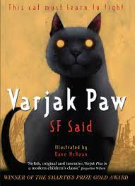





Year 4
Autumn term
2
Ready Respectful Safe
Varjak Paw
W
Why this particular book and not something else?
This book is a beautiful text as it is a tail of resilience framed within a well-written narrative – it’s just what the children in Y4 need as an example of writing to create a specific mood. Varjak Paw is a tale of bravery, fighting for justice and overcoming challenges whilst growing wiser too. There’s plenty for the Y4 children to discuss in terms of values and morals. On top of this, SF Said, the author, provides the children with wonderful descriptions that really capture the mood beautifully: "He has eyes the colour of danger!“ What a line! Year 4 children think carefully about how they can create such vivid characterisation themselves.
School values this book reinforces:
Resilience is the key value in this book. We follow Varjak Paw in his development from a house cat with little understanding of the world beyond his garden to a character who is ready to not only explore the wider world but someone who has empathy and the ability to act when he sees injustice.
Writing Composition in school:
It’s all about tension and characterisation! Y4 create an end piece, consisting of several paragraphs that describe their own cat character feeling scared by their surroundings and environment.
Skills that will be developed through this unit:
For composition, we consider how SF Said builds tension that leaves the reader desperate to read on! We analyse how we know how characters are feeling and how we can build strong characterisation ourselves.
Speech (including accurately punctuated direct speech) for characters helps us show a character’s mood. To complement this, a thoughtful reported clause (not just using the verb ‘said’ helps us really show our reader what a character thinks. We also add describing body language as an additional technique to add to the list of ingredients in the speech.
Paragraphing within a narrative is a skill to develop. Until now, children have been taught paragraphing mainly through non-fiction and subheadings. Use of paragraphing in a story is a skill to master.
Editing and improving work will remain as a focus throughout the year.
Adverbials (and fronted adverbials) is something that is also taught this half term but continually revisited.

Slide 2
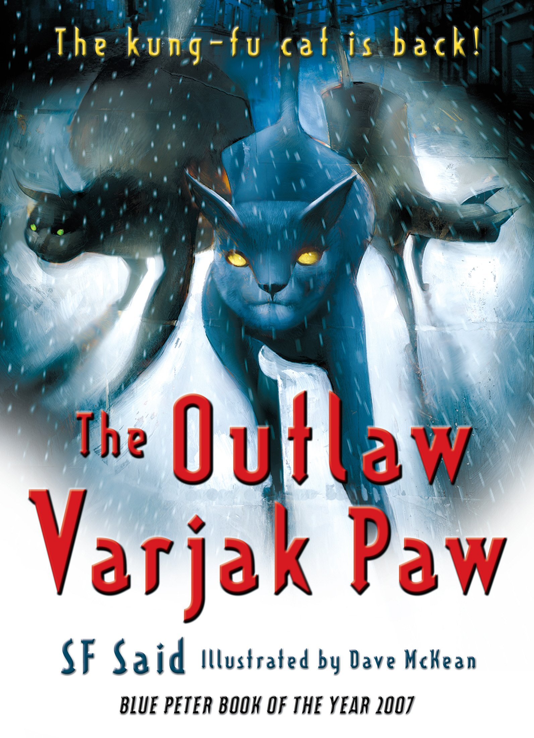
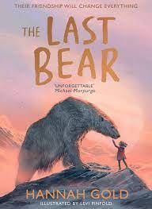
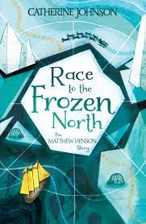
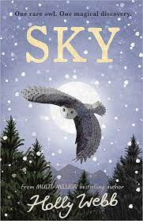
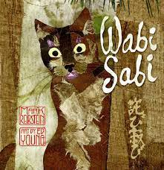
Year 4
Autumn term
2
Ready Respectful Safe
Writing Homework this half term…
“He has eyes the colour of danger!“
We like this description! What do you think of when you see different colours? To begin, make a list of colours and put a feeling, emotion or noun next to each colour. For example, yellow = happiness, grey = loneliness. To make this even better, begin to construct full sentences: When I see yellow, I am filled with happiness.
2) Words for SAID! How many different words can you think of that mean ‘said’? Once you’ve come up with a few, you might even be able to organise these words into different groups according to feelings. For example, angry words for said. You might wish to organise them in a different way, perhaps according to how loud the said word is. Present your work any way you wish!
3) Over the week, when you read the book you take home from school, spend some time looking at how the characters interact with each other. Take note of what the character says but also if there are any clues about how the character speaks or what they do (their body language) while they speak. Draw a picture of a character, trying to show their feelings and reactions. Write their spoken words in direct speech.
4)For this homework, you’ll need to be able to rewind a film or a television programme. Hunt for any programme that interests you but you’ll need to find a part where two characters are talking to each other, even better if they are arguing with each other.
Watch the scene once to understand. Rewind! Watch it again and write down what the first character says. Watch again but listen to their voices – how did they speak? Watch it again but look at how they act when the speak – what do their bodies do? Repeat for the other character. Write the conversation remembering to add a new line for each speaker.
5) The author of Varjak Paw is called SF Said. If you could ask him any questions about his book, what would they be? Remember to use question marks at the end of each question. To make your work even more interesting, you could sort your questions into groups. For example, questions about the characters, questions about how he plans his books, questions about where his ideas come from.
6) Using your descriptive skills, body language and direct speech, create a paragraph that describes two children tiptoeing down the stairs on Christmas Eve. Imagine they have heard some noise from the chimney! What would they say to each other? How would the reader know they are curious?
Our Extended Book Spine
To complement Varjak Paw, our school can thoroughly recommend these texts for this half term:

Slide 3
Year 4
Autumn term
2
Ready Respectful Safe
Our Extended Book Spine
To complement Butterfly Lion, our school can thoroughly recommend these texts for this half term:
Book Title | What is it about? | What your teachers think about this book
The Last Bear by Hannah Gold | There are no polar bears left on Bear Island. At least, that’s what April’s father tells her when his scientific research takes them to this remote Arctic outpost for six months. But one endless summer night, April meets one. He is starving, lonely and a long way from home. Determined to save him, April begins the most important journey of her life… | As this is a celebration of friendship and love it brings out our school values perfectly. It’s a beautiful tale and we are sure that you’d enjoy snuggling down to read this one with your child as the evenings get darker!
The Outlaw Varjak Paw by SF Said | The second adventure in the life of the extraordinary Mesopotamian Blue, Varjak Paw: kung fu for cats! Having saved the city cats from a fate worse than death, Varjak Paw finds himself the elected and popular leader of a new gang - a gang that supports freedom and kindness for all. But will the pressure take its toll on this brave yet sometimes naive cat? Soon the city erupts in an all-out gang war as the evil Sally Bones attempts to control the lives of all cats. Horrified and outnumbered, Varjak and the others must fight for their freedom or die trying; can Jalal's Way really be the best way? | Many of our children love Varjak Paw so much that they read the next book too! I’ve read this book at home myself and I think it’s amazing. As children already know the characters, they will enjoy hearing about their next adventures. It’s a great book to read together with your child.
Race to the Frozen North: The Matthew Henson Story by Catherine Johnson | Matthew Henson was simply an ordinary man. That was, until Commander Robert E. Peary entered his life, and offered him a chance at true adventure. Henson would become navigator, craftsman, translator, and right-hand man on a treacherous journey to the North Pole. Defying the odds and the many prejudices that faced him to become a true pioneer. This is his incredible and often untold story. | Mystery, adventure, friendship, this book has it all. Apparently, it’s a true story… Miss Sturgeon really wants to read this book to her class as the
Sky by Holly Webb | Staying with her grandparents in the Scottish Highlands, Lara is fascinated by the rare white snowy owl her grandad has spotted flying nearby. And when she follows the beautiful bird into the woods, it leads her on a magical adventure… Transported a century back in time, Lara befriends Amelia, who confides in Lara about her cruel cousin, who she’s sure is trying to hurt the baby owls nesting in the woods. When Lara discovers the hatchlings belong to her owl, Sky, she’s determined to help. But how can she protect them when she needs to return to her own time? | Mrs England loves owls but that’s not why she wanted this book on the list… It is packed with action, adventure, magic and enchantment, which makes it the kind of book she would choose to read towards Christmas.
Wabi Sabi | Wabi Sabi, a little cat in Kyoto, Japan, had never thought much about her name until friends visiting from another land asked her owner what it meant. At last, the master says, "That's hard to explain." And that is all she says. This unsatisfying answer sets Wabi Sabi on a journey to uncover the meaning of her name, and on the way discovers what wabi sabi is: a Japanese philosophy of seeing beauty in simplicity, the ordinary, and imperfection. Using spare text and haiku, Mark Reibstein weaves an extraordinary story about finding real beauty in unexpected places. | This is a delightful picture book. It’s different to the other books on this list and you may find you like it. See if you can borrow this one from the library at Castle Point.

