Slide 1

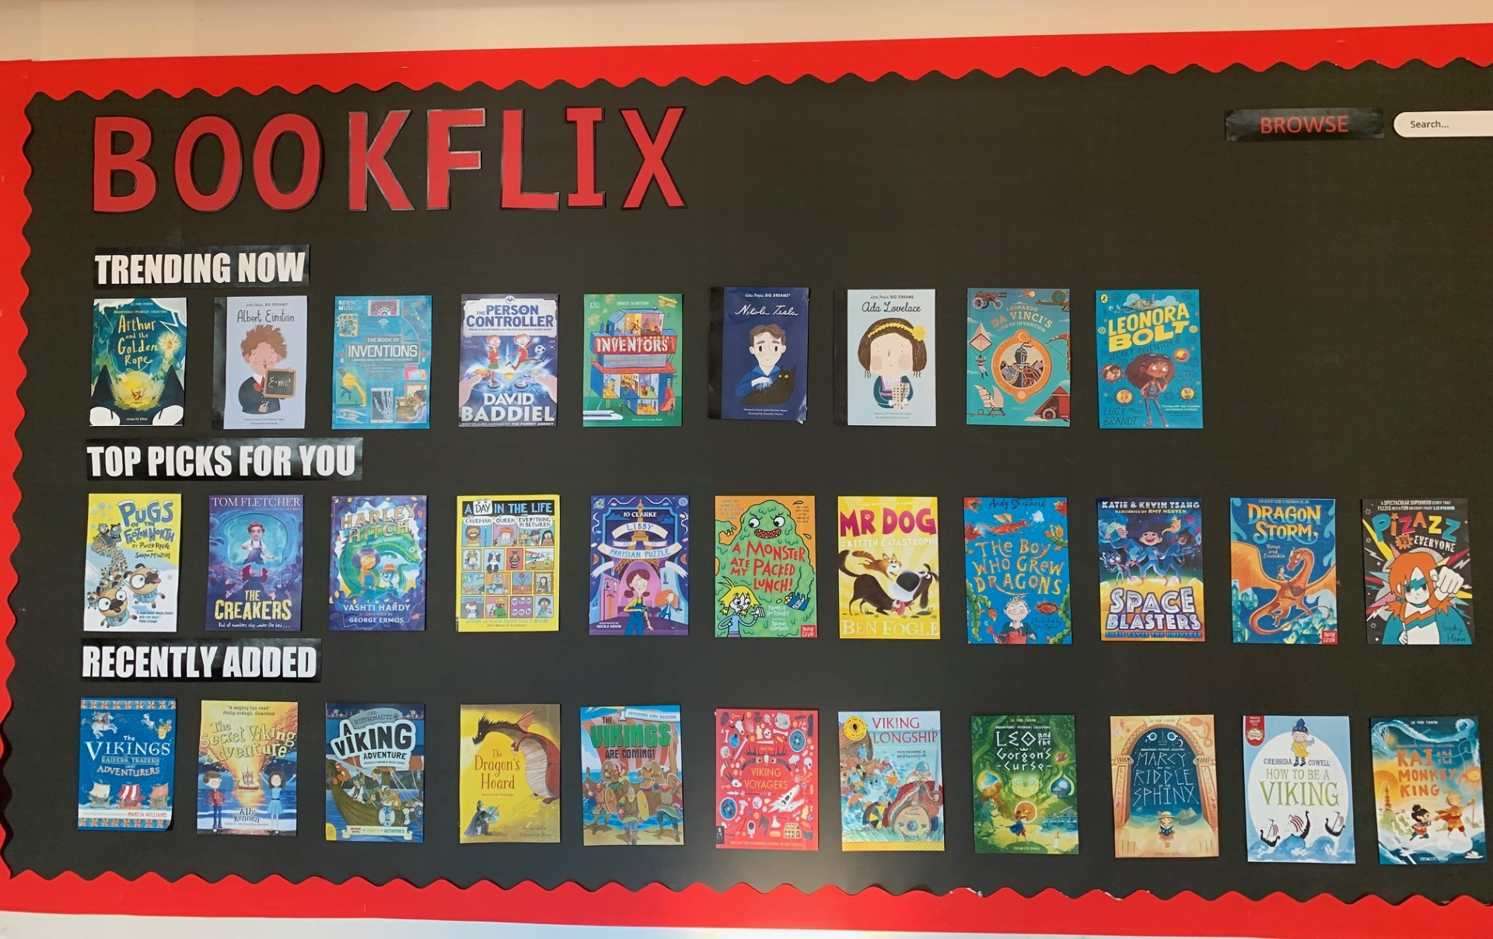
Ready Respectful Safe
Welcome to Reading in Year 3!
Our aim in Year 3 at Muscliff is to:
develop competent and confident readers who have a thirst for reading
ensure pupils who have learnt how to decode develop fluency through regular and monitored reading, (and texts are read aloud to pupils who are unable to decode)
develop pupils’ ability to read aloud with prosody to support the development of pupils’ language and vocabulary
develop healthy habits for independent reading
In Year 3, we understand that:
fluent reading supports comprehension because pupils’ cognitive resources are freed from focusing on word recognition and can be redirected towards comprehending the text
through regular, monitored reading, pupils’ orthographic development improves, leading to fluency
background knowledge and vocabulary are essential components of reading comprehension.

Slide 2
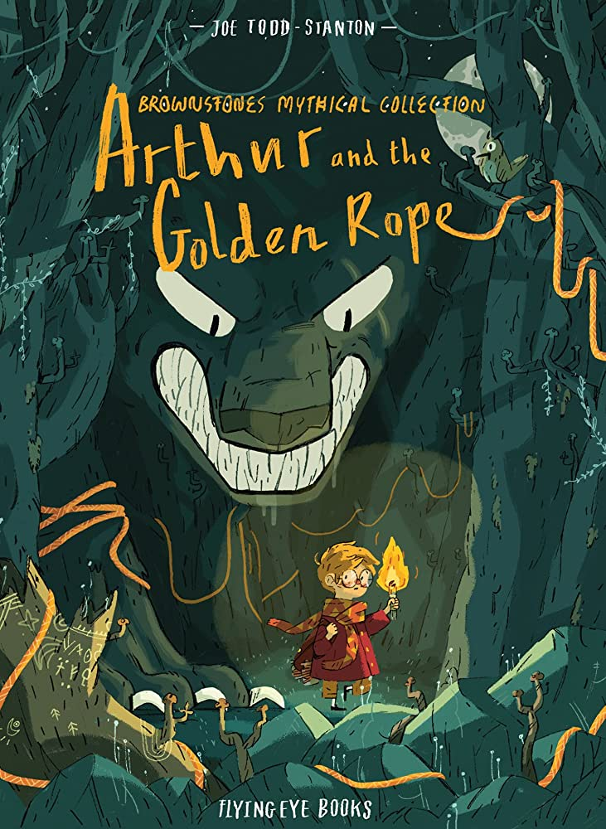
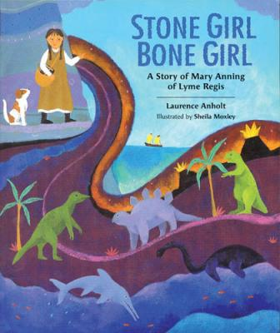
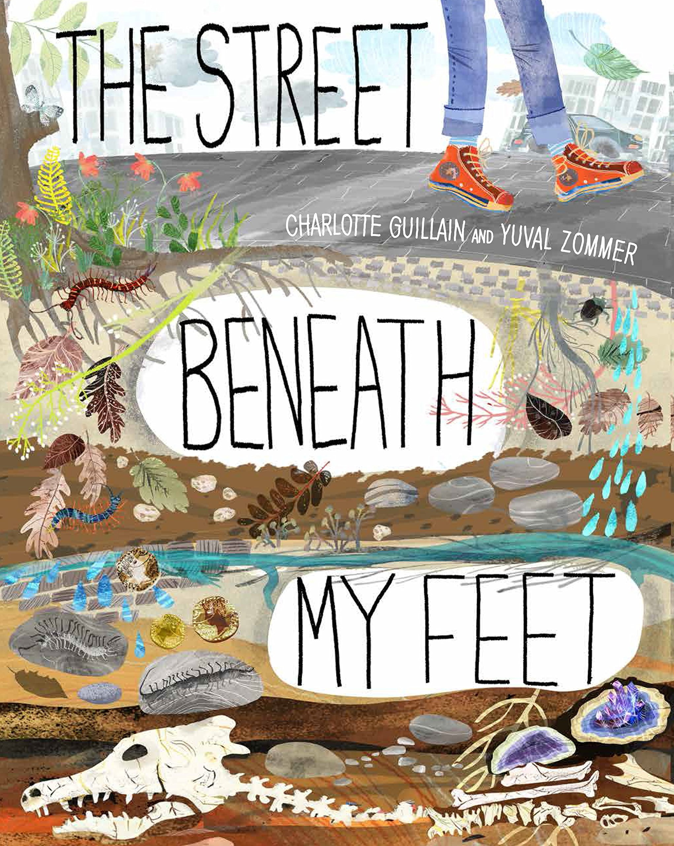
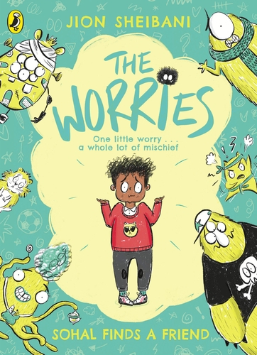

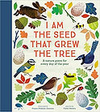
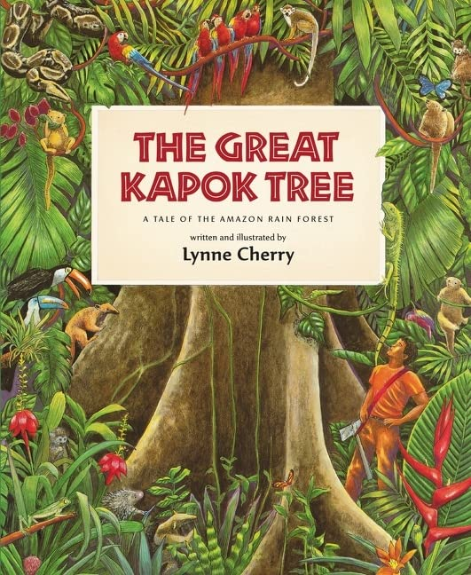
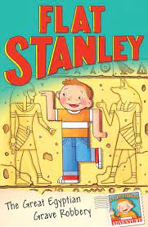
Ready Respectful Safe
What does a typical reading session look like in Y3?
For the first half term, reading is organised as a reading carousel with two or three groups reading with adults each session. Children would read twice each week and the book would be a colour-banded book from Oxford. Typically in the Autumn Term, we use Project X books as we find this range of Oxford books to be most engaging. By half term, the teacher would have a good understanding of each child’s reading ability and strands that might need reinforcing in order to make continued progress. By Christmas, the teaching structure will then move to whole class teaching using Oxford Reading Tree material. This would be facilitated by the copy of the book being made available on the whiteboard (using Oxford’s e-library) with children following with a copy of the text.
As the year progresses, the teaching material will be supplemented with high quality texts from our reading spine.
By also using our lead English text as an integral source for guided reading, children become fully immersed in the style of writing. Here’s where the book talk really shines through! We spend plenty of time exploring how the author uses key features and the impact it has on us as the reader. We get to grips with charaterisation and the devices the author uses to create this. We unpick the language and vocabulary carefully recognising that this is key to children’s development as readers.
Texts
Here is a reminder of our lead texts in Year 3.

Slide 3
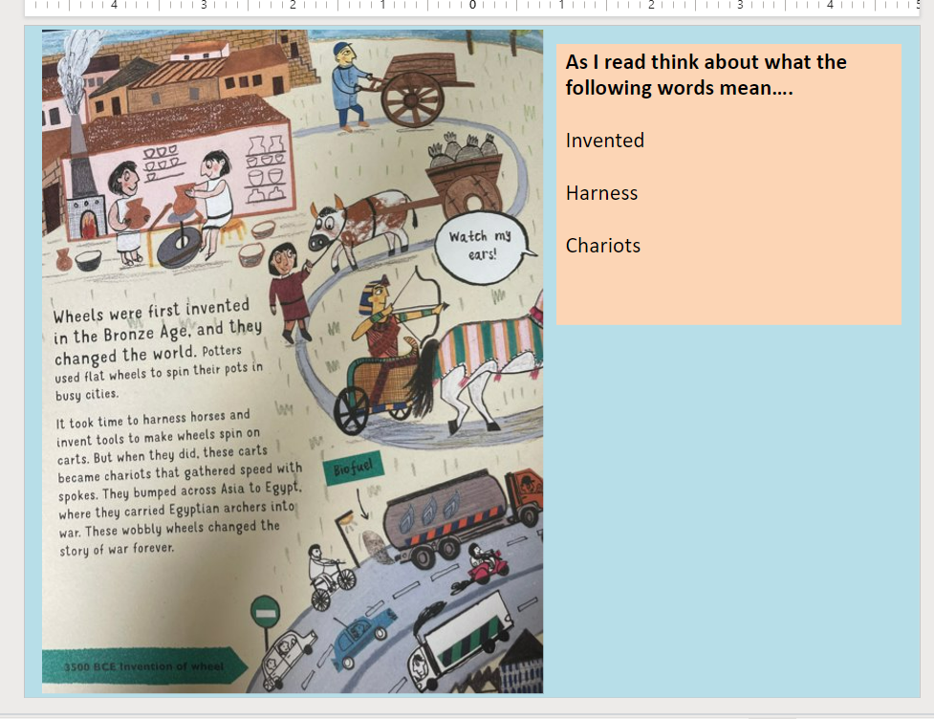
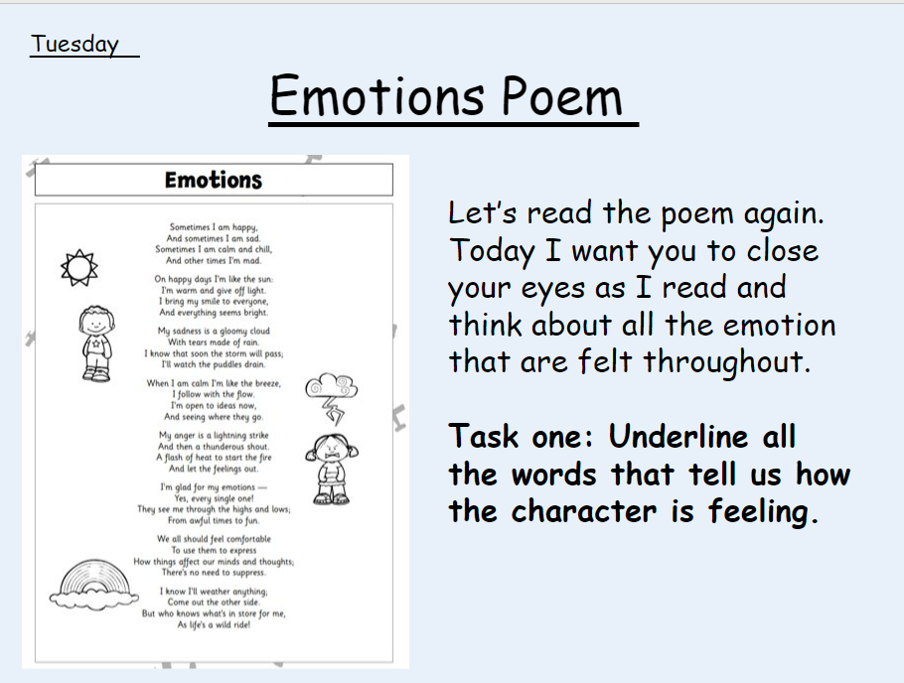
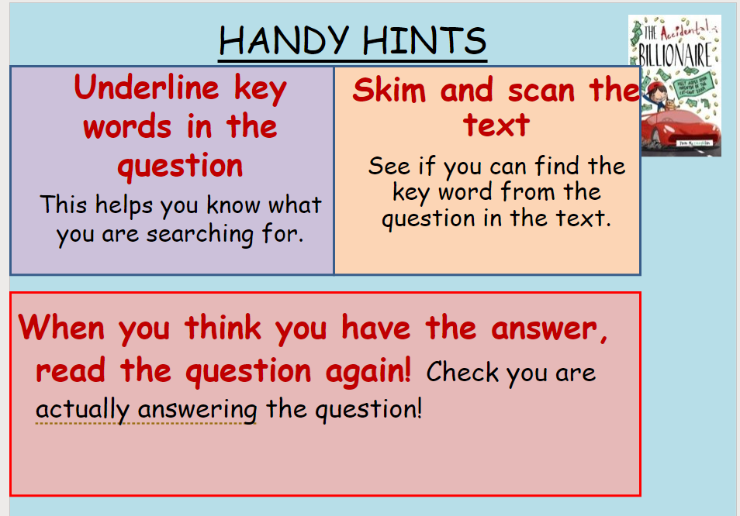
Ready Respectful Safe
A love for reading…
Our reading sessions explore language strands, including: background knowledge, vocabulary, language structure, reasoning, and author skills. We also continue a focus on fluency through: phonic knowledge, decoding and sight recognition.
But as we develop these reading skills and the children grow in confidence and competence, it is crucial that we demonstrate a passion for books and reading.
It only takes a moment once you step into a classroom and hear our Year 3 teachers reading to the children, that we share a genuine love of the books we read. The book talk we have cultivated is something we are very proud of!

Slide 4
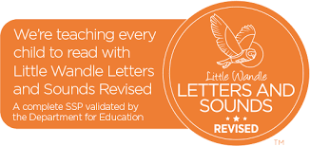
Ready Respectful Safe
Phonics and Intervention in Year 3
Older students struggling with reading may have gaps in their phonics knowledge and it is important to assess and establish what those gaps are. For example, although all of our Year 3 children have had comprehensive teaching of phonics in YR – Y2 following the Little Wandle programme, they may struggle to apply phonic knowledge when decoding new multi-syllable words. Showing them how to find the vowels and then the syllables may enable them to activate their existing phonic knowledge. On the other hand, the difficulties of an older struggling reader may involve the Language Comprehension continuum of the Simple View of Reading (SVoR). Phonics intervention may not be helpful for those students and instead they will need assistance with developing their understanding of vocabulary, how texts work and how to infer.
Year 3 use ongoing-assessment effectively to identify where pupils are struggling in word reading, reading fluency or language comprehension and when pupils require additional targeted support.
Where phonics is identified as the main barrier to progress (and using Year 2 phonics re-set test data), Year 3 use the Little Wandle rapid catch-up programme. This would be delivered as a small group intervention although is more likely to be 1:1 depending on the specific needs of the learners.
Dyslexia Intervention in Year 3
At Muscliff, we use Project X Code (Oxford) to support children with dyslexia. Project X CODE is a proven reading intervention programme and combines phonics and comprehension development. In each book, text 1 is 100% decodable to build confidence and develop vocabulary; Text 2 is 80% decodable to challenge children and deepen comprehension. We chose this intervention programme as is it dove-tailed well into our whole school reading scheme and was selected after teachers conducted research as part of a CPD programme of enquiry. Over the time, we have closely monitored the progress of the children using ‘code’ and their engagement in the books has remained high throughout. Steps of progress have been continually made, which keeps the children enthused and eager to read more. We regularly monitor the progress being made by the children and gain regular feedback from TAs supporting those children. We can see small steps being made daily (this really engaged and enthused the children) which contributes to progress across the year.

Slide 5
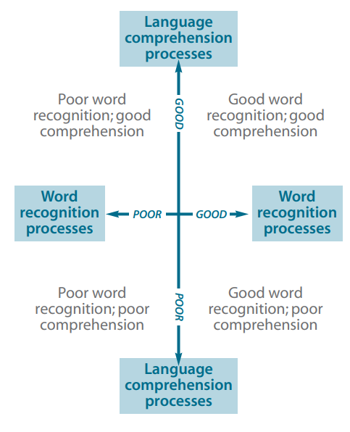
Ready Respectful Safe
How do we assess the children?
The Simple View of Reading (SVoR) helps us to understand the barriers to a child’s reading fluency (and therefore how we can best support them to make progress). By using assessments carefully we can identify areas of the reading process that are contributing less effectively to the integration of skills. However, the model helps us understand that reading can be expressed by a multiplicative theorem – so development in both linguistic and word reading areas are both necessary as they interact.
We informally assess children every time they read with the teacher! For children who are not progressing as we would expect, reading conferences (1:1 reading with the teacher) are used to analyse the child’s approach to reading.
Tests
At the end of each term, we use more formal assessments to monitor progress against the end of year expectations. We use NfER tests across the school as we find their tests most accurate.

Slide 6
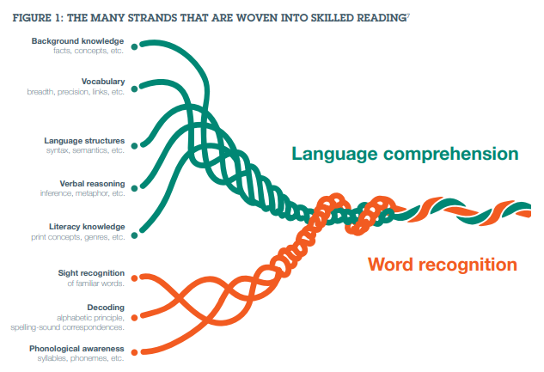
Ready Respectful Safe
Analysing Barriers in Year3
Year 3 are mindful of further models (other than SVoR) that help us unpack the complexity of what it means to develop reading skills and offer further support to those who children in Year 3 who are finding it difficult to progress in reading.
Scarborough’s reading rope is a useful visual as this not only extends the range of language skills required in reading, but also shows how mastery and integration are important.
The rope diagram aims to model the reading process by showing the relationship between the decoding and understanding domains and how they strengthen over time as a result of reading. It takes the information from the SVoR and expresses it differently so that we can more clearly see how mastery develops through integration.
This is important because different children have different strengths and weaknesses.
When we teach reading in Year 3, we explore each of these strands that contribute to mastery in reading.
Scarborough’s reading rope

Slide 7
Ready Respectful Safe
Year 3’s Book Spine
Alongside our lead text, we have chosen further books that complement the unit - we call this our Reading Spine. This reading list is bespoke to us and each book has been chosen purposefully by our wonderful teachers. We encourage children to read books from this list (look out for the reading stars that the children wear on their jumpers) and we love to explore these books as a class book at the end of the day.
We really enjoy sharing one last book just before home time!

Slide 8
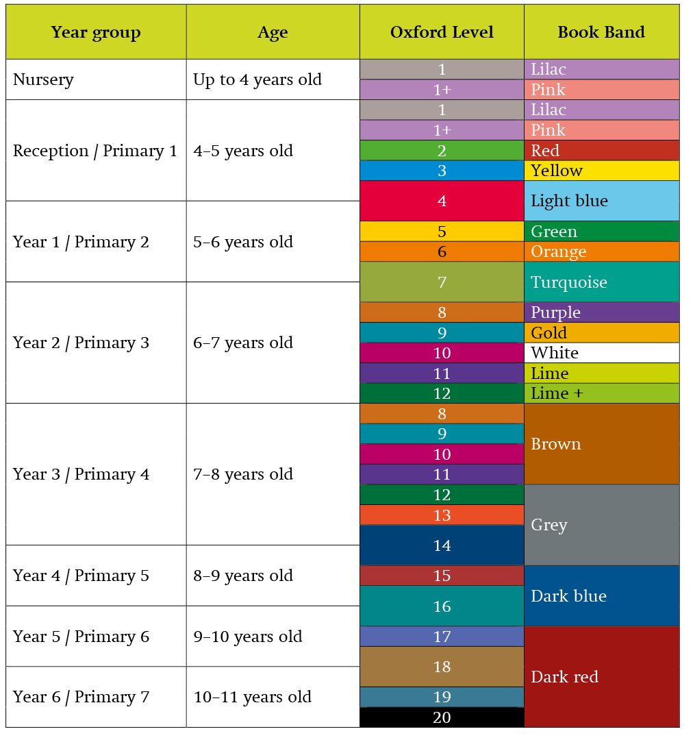
Ready Respectful Safe
Which colours will my child read?
All children in Year 3 should take home a colour-banded book. Children at this age are free to change their books independently (although they may need some encouragement to do so from the class teacher or their parents). Brown and then Grey books are pitched at the correct age-related expectations. Note that the content of Brown revises Year 2 skills and is a convenient starting point for Year 3 children.

Slide 9
Ready Respectful Safe
Year 3 End of Year Expectations
Read loudly and confidently, understanding how to use a range of punctuation.
Use knowledge of root words, suffixes and prefixes to read and understand new words.
Make inferences on the basis of what is said and done
Predict what might happen on the basis of what has been read so far
Justify inferences using evidence in the text.
Make links between the book they are reading and other books they have read.

