Slide 1

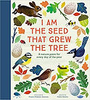
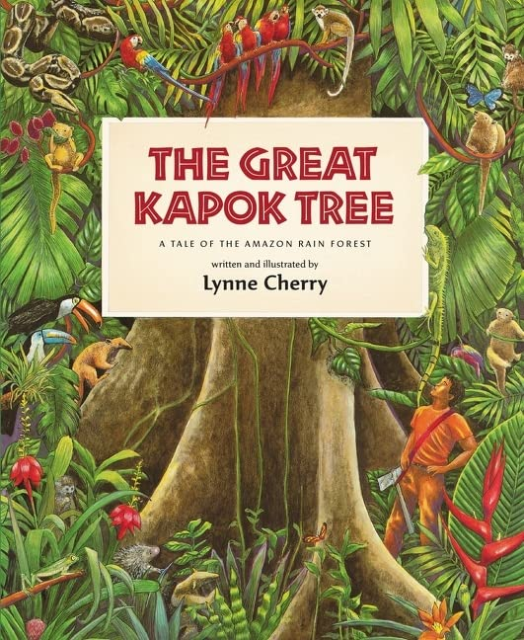





Year 3
Spring term
1
Ready Respectful Safe
Wild World
Why these books and not something else?
New for this year, we have chosen these beautiful books to inspire our children and enrich their language and vocabulary. ‘I am the Seed’ is a poetry anthology and each poem reflects the seasonal changes associated with that day's position in the year. The book is structured into monthly sections and the poems are accompanied by beautiful illustrations. When the teachers first picked up this book, we were enthralled by the language and imagery and thought it perfect to equip our Y3 with rich descriptions of wild weather. We have chosen The Great Kapok Tree as it too is a rich source of imagery to create vivid setting descriptions. We are confident that these are the best books to support Y3 to create high quality writing.
Writing Composition in school:
Children will imitate a given poem about wild weather. Using that poem as a modelled structure, they will adapt the poem by introducing and adding their own ideas and imagery.
We will write a description of a rain forest, rich in active language choices; children will be asked to use the language they have picked up from the poetry sessions to make their settings burst with imagery for their reader.
Finally, Y3 will create a non-fiction information page about what can be found in the rain forest.
English Skills that will be developed through this unit:
Spotting patterns and structures in poetry – what stays the same in each verse of the poem?
Replicating structures in poems- which ideas can we change in a poem?
Imagery, similes and metaphors – how can we bring the description to life?
Verb choice – how does the verb choice support the image? For example, if I said ‘the wind howled’, why is this better than ‘the wind blew’?
Noun phrases alongside prepositional phrases – the heavy, miserable clouds in the dark, grey sky.
Performing poems aloud – how can we use our voices, bodies and actions to bring the poem to life?

Slide 2
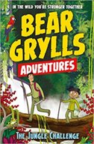
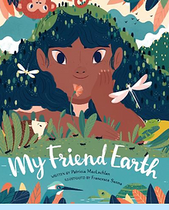
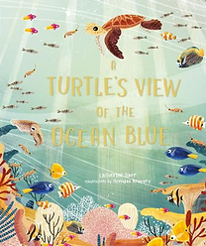
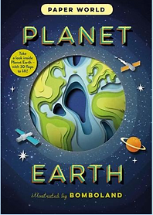
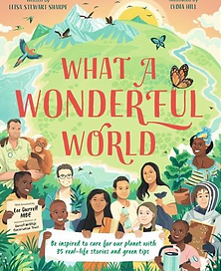
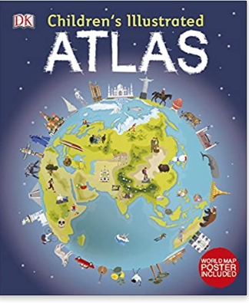
Year 3
Spring term
1
Ready Respectful Safe
Writing Homework
Make a list of different types of weather. Draw a picture or diagram for each weather. Under each picture, write down what you do when this weather is happening. For example, ‘a rainy day is the best day for staying at home and watching films.’ To make this more of a challenge, consider weather that happens in other countries that we might not see in England.
Using the internet or books you already know, find a poem about the weather. Here’s a good website too: https://www.kidspoetryclub.com/poems-about-weather
Read the poems with your adult at home and find one that you like. Copy a verse and write down why this poem appeals to you.
Watch a weather report on TV. Although at this time of year it’s likely to be raining, listen to how the weather presenter talks about the rain and the dull weather. Copy down some of the ideas you hear.
Create your own weather report for the day! To make this even better, you could either create a simple diagram or map to show the weather or, if you were feeling confident, you could practise your report and present it aloud to your family or teddy bear audience at home.
Research a type of weather using books at home or the library or the internet. Thunderstorms are always fascinating and is an ideal weather type for generating facts. Present your findings as a fact poster.
What is the weather like in another part of the world right now? Are seasons all the same the whole world over? If you were in Australia right now, what would the weather be like? Choose a foreign location and write some facts about the weather the people of that country experience.
Our Extended Book Spine
To complement this unit our school can thoroughly recommend these texts for this half term:
Please turn over to find out more about these recommended books.

Slide 3
Year 3
Spring term
1
Ready Respectful Safe
Our Extended Book Spine
To complement Treasure Island, our school can thoroughly recommend these texts for this half term:
Book Title | What is it about?
Bear Grylls | This book was previously the lead text for this unit but it has taken a back seat now. But this book remains as a favourite with the children! It’s a fun adventure book set in the rainforest. The main character is appealing as he develops patience and resilience as his adventure develops with Bear Grylls. As this was a class text, we have plenty of copies in school so feel free to ask to borrow this book if you feel your child would enjoy giving this book a go.
A Turtle's View of the Ocean Blue Catherine Barr & Brendan Kearney | A Turtle’s View of the Ocean Blue takes the reader on a tour of our world’s oceans and seas, guided by a turtle. In fact, the turtle is quickly overshadowed (in a good way) by the facts and figures he presents. The wealth of information – about the physical geography of the five oceans and the creatures that live there – is fascinating. Some of it, such as details of the water cycle, will be familiar to adults and is directly relevant to the National Curriculum programmes of study in Science and Geography. But I was impressed to see how much more than that the book covered and found myself captivated on every page by the complexity and variety of the different underwater regions. The depth and breadth of the information is matched by the glowing illustrations which look, appropriately, to have been painted in watercolours. Shades of blue predominate, as might be expected from the book title, but the details of plants, animals and geographical features show the technicolour range of life within the seas and oceans. The front cover actually shimmers with some of the details picked out in gold. As well as being packed with interesting content, this book is a beautiful object which will surely attract children to pick it up and browse through it.
Atlas | Continents and countries are brought to life through stunning photography and eye-catching illustrations. Uncover incredible geographical features, wildlife, culture, history, and landmarks in unprecedented detail. This incredible and inspiring visual atlas takes you on a fact-filled, continent-by-continent tour of the world! Throughout the pages of this adventure book, you'll discover more than 50 fascinating maps that are packed with fun facts and fresh images. Your child will learn all about the climate, populations, places, and industries of our world. Picture stories complement the maps, from the giant river that flows through the Amazon forest, to the frozen icebergs of the glacial Arctic. Discover the richness and diversity of human and animal life around the globe. Each map shows the countries, their capitals, famous landmarks, as well as their longest rivers and highest mountains. This educational book is more than a map book! This atlas book also shows young explorers how to read a map and use a key, compass, and scale. It's the ideal resource for classroom use, home learning, and armchair exploration.
Paper World: Planet Earth Ruth Symons & Bomboland | Planet Earth uses ingenious paper cuts to reveal the amazing details of our planet, from bubbling volcanoes to rushing rivers to its boiling hot interior. With detailed art by paper-cut studio Bomboland, a fact-packed text, and flaps and die-cuts on every spread, this unique novelty book will appeal to all.
My Friend Earth Patricia MacLachlan & Francesca Sanna | Our friend Earth does so many wonderful things! She tends to animals large and small. She pours down summer rain and autumn leaves. She sprinkles whisper-white snow and protects the tiny seeds waiting for spring. Readers of all ages will pore over the pages of this spectacular book. Its enticing die-cut pages encourage exploration as its poetic text celebrates everything Earth does for us, all the while reminding us to be a good friend in return.
What a Wonderful World Leisa Stewart-Sharpe & Lydia Hill Non-fiction | From the author of the BBC's children's book Blue Planet II, this book takes you on a breath-taking tour of our planet - from towering mountaintops, through grasslands, jungles, rivers, deserts, polar wildernesses and into the blue ocean - to discover the incredible variety of life that calls it home. Along the way, read the stories of 35 inspiring Earth Shakers - children and adults, from tree-planters to scientists, from all around the world - who have taken action to protect it. Plus, there are lots of practical tips and handy resources inside that give you the tools to make a positive change today. Every budding young activist will be inspired to make a change for a better future.

