Slide 1

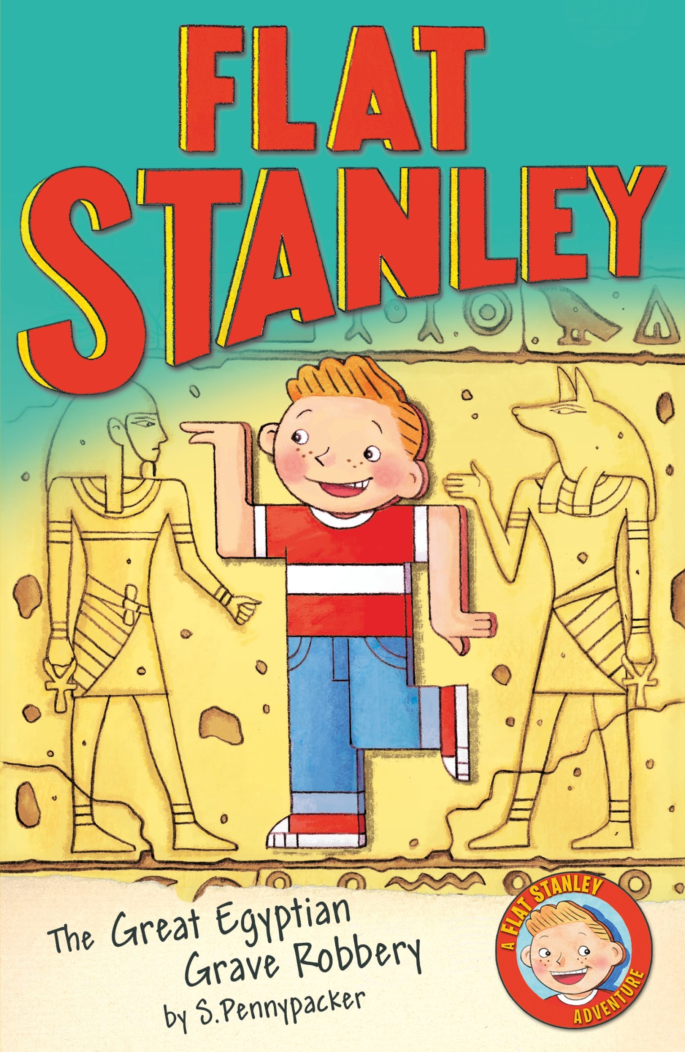





Year 3
Autumn term
1
Ready Respectful Safe
Flat Stanley
Why this particular book and not something else?
Understanding events that happened thousands of years ago can be very hard when you are only 7 years old yourself and trying to understand an Egyptian sarcophagus or a canopic jar is very challenging indeed. Luckily, Flat Stanley encounters this unfamiliar vocabulary in the book read by Year 3. This book is perfect for our Ancient Egyptians topic; we start off Year 3 by jetting off to Ancient Egypt and immersing ourselves in a different culture. We meet the famous Flat Stanley and follow him on his journey to Egypt where he helps to find some ancient treasure and scrolls whilst fighting off the tomb raiders! This fun and exciting text provides the children with many opportunities to learn about different tenses, sentence types, contractions and speech. The children are exposed to rich vocabulary and interesting adjectives which they then use in their own writing to describe the tomb full of treasures.
School values this book reinforces:
Being curious is a key value that we believe all children should develop and we encourage them to be critical thinkers, just like Flat Stanley. Through Stanley’s natural curiosity, this book shows our children that by being a critical thinker, we can begin to better understand the world around us.
Writing Composition in school:
In school, children will focus on achieving top-class setting descriptions. Using the skills listed below, children will explore how the author, Jeff Brown, carefully constructed his description so that the reader can ‘see’ the Egyptian tomb in their own mind. Children will describe the tomb for themselves as well as a setting description of a busy Egyptian market.
Skills that will be developed through this unit:
With a focus this half term on setting descriptions, children will be encouraged to use their full senses to create vivid images in their reader’s mind. What can be seen? What can be heard? What can be smelt?
Year 3 look at the 4 sentence types: statements, exclamations, questions and commands and consider how these can have an impact on the setting description. For example, What a sight to behold! What would Stanley discover in the next tomb? By exploring questions and commands and exclamations, we can directly invite the reader into our description.
Use of a dictionary and thesaurus will be another skill that is rehearsed in class and parents might want to consider supporting their child by looking at alphabetical order and using a dictionary together at home. Teachers will be looking for adventurous language choices and acquisition of vocabulary.
Children also consider tenses and review how different past and present tenses are formed.

Slide 2
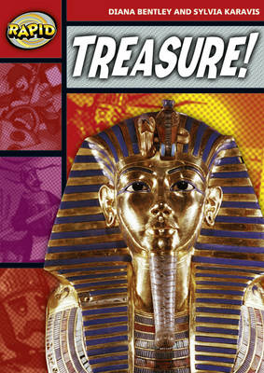
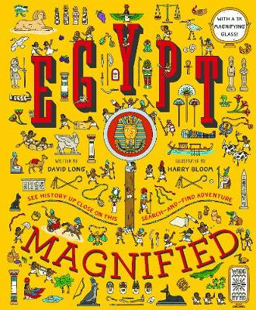
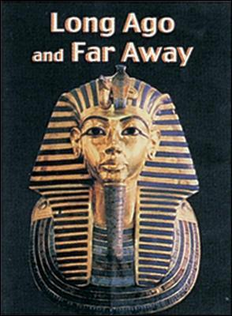
Year 3
Autumn term
1
Ready Respectful Safe
Writing Homework
Here is an overview of each written task for this half term. Over this half term, your child should aim to complete some writing at home each week. The time they invest in their written homework will vary from child to child – parental discretion is advised. Alternatively, you may wish to focus on just one or two of these activities and develop them over several weeks with your child.
Step outside your house and jot down what you can see/hear and smell. When you get back inside, build your observations into full descriptions. Check that all full stops and capital letters are correct. To make it more interesting for your reader, you could pick some words to improve by using a thesaurus.
Complete your own research about the Egyptians. Choose just one aspect that interests you and try to focus your research on that one area. So instead of a title, ‘Egyptians,’ your title might be ‘The Egyptian Pyramids.’ Create a fact sheet to present your findings. When you compose your work, consider using ICT to publish your work – the teachers love PowerPoint!
Have a listen to songs on the radio! Choose a song that you like to hear and write down some of the lines. Can you label the types of tenses that the song is written in?
Keep a diary this week. Aim to write a couple of sentences for each day. What was the best part of the day? What made you laugh and smile? To make this more of a challenge, you could try to use different tenses over the week. For example, Today I played football (past simple) and we were trying (past progressive) to score. I hope we play tomorrow (present simple).
As our focus is settings, show off your skills by choosing a new setting of your own choice that Stanley could visit. Think about the types of setting that could generate some wonderful language choices. For example, a woods at night time might give you more opportunities than some less exciting settings.
Our Extended Book Spine
Let us know if you come across any other books that are about your body or self-awareness or would be a good read to match this theme. If you can, bring the book to school and we can read the book as a class story at the end of the day. At Muscliff Primary School, we are keen to create a culture of recommending books and this would be an excellent way to share our book knowledge.
To complement Flat Stanley,
our school can thoroughly
recommend these texts for
this half term:

