Slide 1

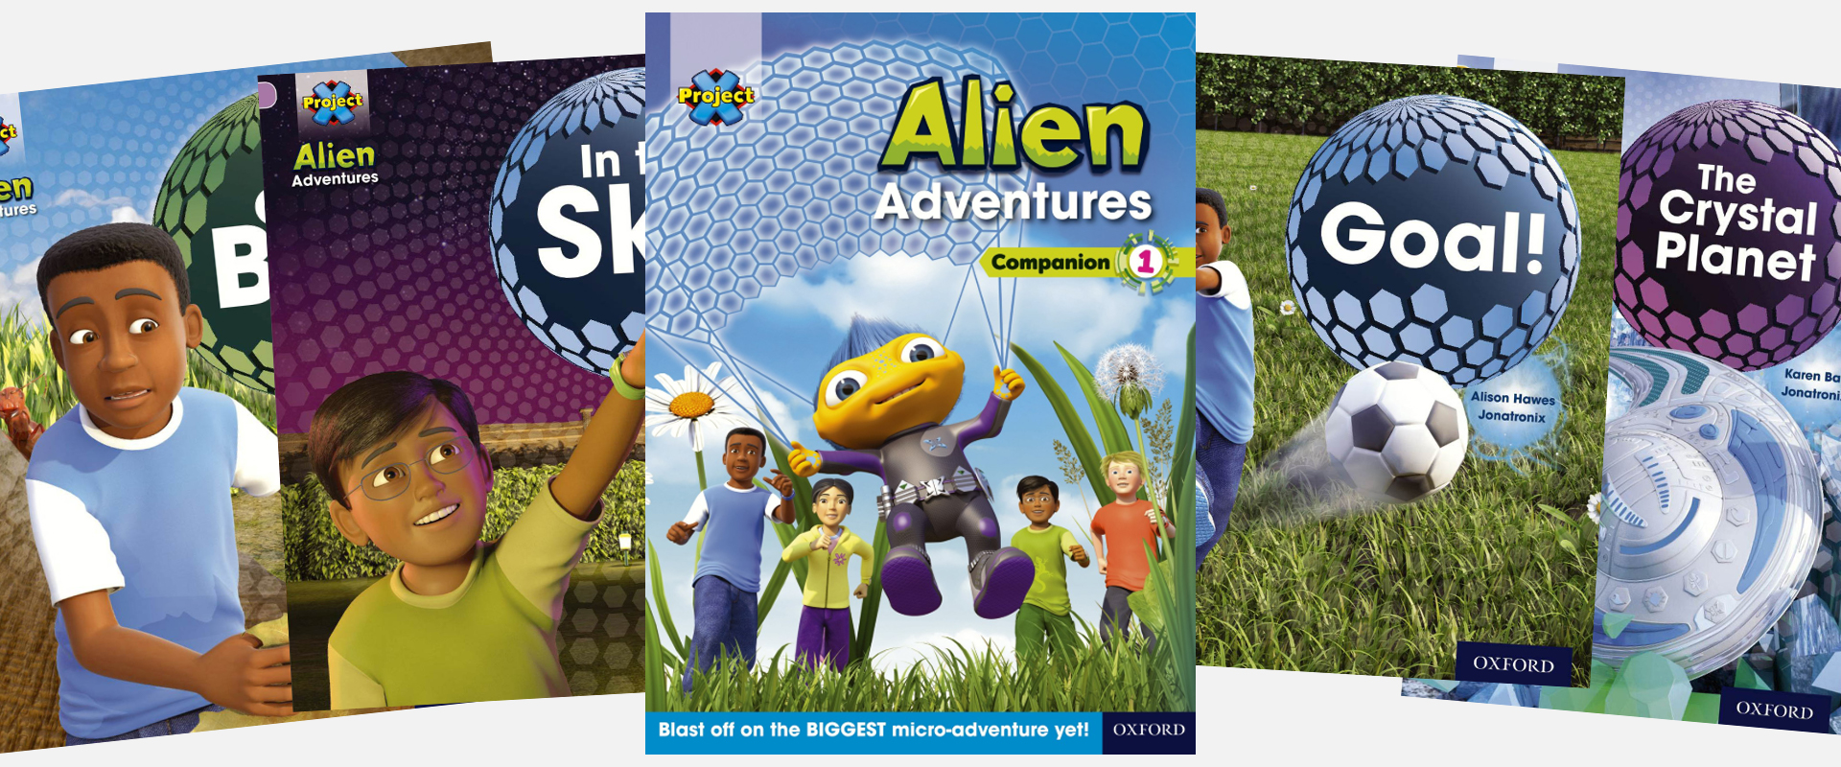
Ready Respectful Safe
Welcome to Reading in Year 2!
Reading comprises two broad elements: word reading and language comprehension. Both elements must be addressed to ensure pupils become skilled readers.
In the children’s learning up to this point, systematic synthetic phonics is the approach adopted for teaching pupils to decode and this continues to be the case into Year 2.
But once the children have successfully completed the Little Wandle programme, they begin Oxford Reading Tree colour-banded books. These books ensure a high-quality provision; there is a diverse range of texts to build children’s vocabulary, and we know that different children are engaged by different genres and topics, Oxford Reading Tree has developed an extensive range of series to help schools teach children to read and to enjoy reading.
Year 2 End of Year Expectations
Read accurately most words of two or more syllables.
Read most words containing common suffixes.
Read most common exception words.
Read most words accurately without overt sounding and blending, and sufficiently fluently to allow them to focus on their understanding.
Sound out most unfamiliar words accurately, without undue hesitation.
Check it makes sense, correcting any inaccurate reading
Answer questions and make some inferences.
Explain what has happened so far in what they have read.

Slide 2
Ready Respectful Safe
What does a typical reading session look like in Y2?
For the first half term, all children revisit Little Wandle Phase 5 so that these sounds are refreshed and revised; we ensure that all children are confident with their phonics. At this stage, reading is organised as a reading carousel with two or three groups reading with adults each session. Children read three times each week and the book would be a Little Wandle decodable book.
But once the children have been assessed using the Little Wandle assessments and have successfully completed the programme, they will move to whole class teachingsessions using Oxford Reading Tree material. In these sessions, we provide the children with an appropriately challenging book. If the child’s book is too hard, they will find it frustrating and might be put off reading. If their book is too easy, their reading won’t get any better. The children will read a number of books at one level, band or colour before your child’s teacher will decide that they are ready to move on.
Each session is complemented with questions and activities to develop the children’s comprehension. We use SATs style questions to become familiar with test format. At first, children complete comprehension orally (to minimize cognitive overload) but as the year progresses and the children become more competent and confident, written answers become the expectation.
Phonics catch up
Those children that need to repeat the Little Wandle programme, do so. This is organised into small groups of like-ability children. Children would receive explicit phonic session using the rapid catch up material from Little Wandle. The Guided Reading session remains as a carousel.
Year 2 EXS
Children begin Turquoise ORT books with oral comprehension questions. To begin this is organised as a carousel before becoming whole class teaching when the teacher is confident that this is appropriate. This progresses to Gold with some written comprehension questions.
Greater Depth
Children work at a quicker pace to create opportunities for deepening understanding. Children would be reading lime books by the end of the year and would typically be starting the year with fluency. Questioning is a key tool of deepening understanding and a heavy focus is applied to language and vocabulary.

Slide 3
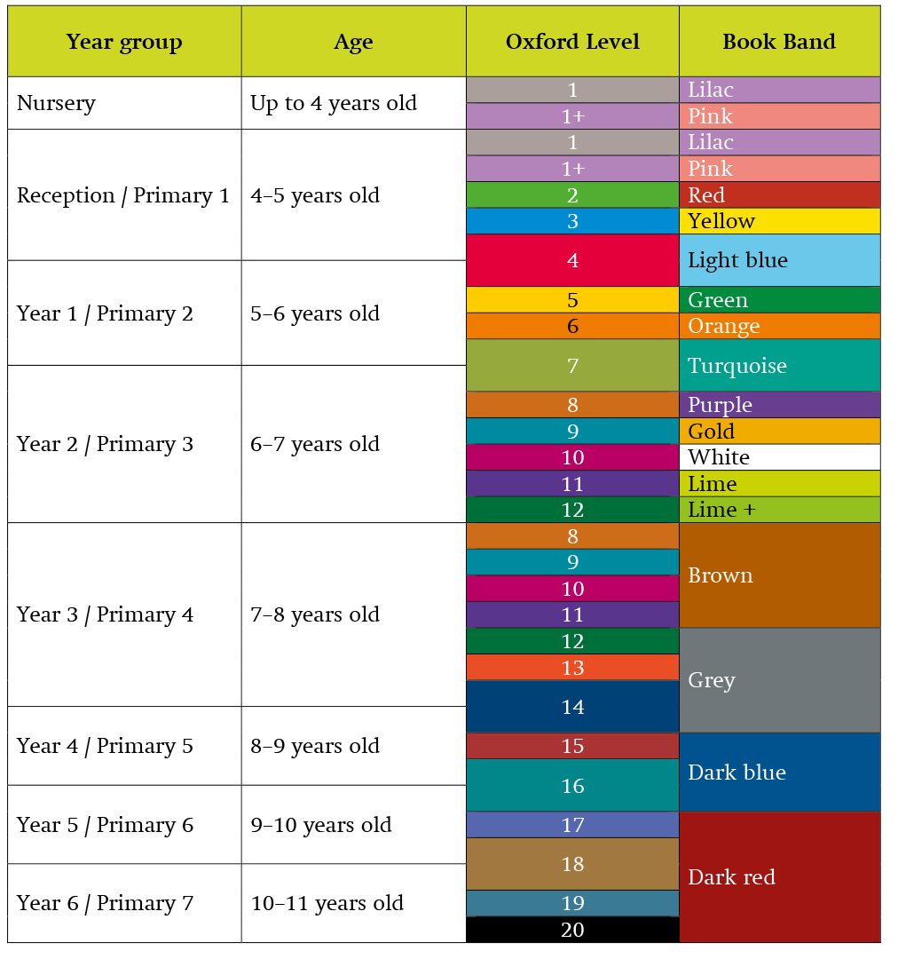
Ready Respectful Safe
Which colours will my child read?
Once children have completed the Little Wandle programme, they will be ready to read Turquoise books. There are 5 colour-bands to move through in the 5 remaining half terms. We expect most children to be accessing Purple books by Christmas and in order to be meeting the age-related national expectations, Year 2 children should be confidently tackling Gold or White by the end of the year. More confident children who are reading at greater depth are likely to be reading Lime books by the end of Year 2.

Slide 4
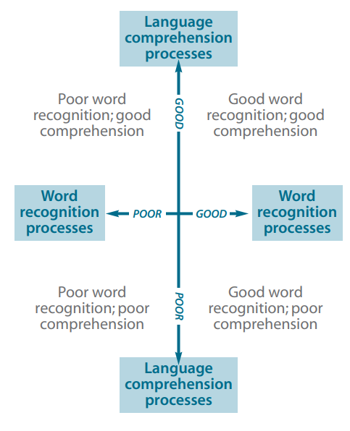
Ready Respectful Safe
How do we assess the children?
The Simple View of Reading (SVoR) helps us to understand the barriers to a child’s reading fluency (and therefore how we can best support them to make progress). By using assessments carefully we can identify areas of the reading process that are contributing less effectively to the integration of skills. However, the model helps us understand that reading can be expressed by a multiplicative theorem – so development in both linguistic and word reading areas are both necessary as they interact.

Slide 5
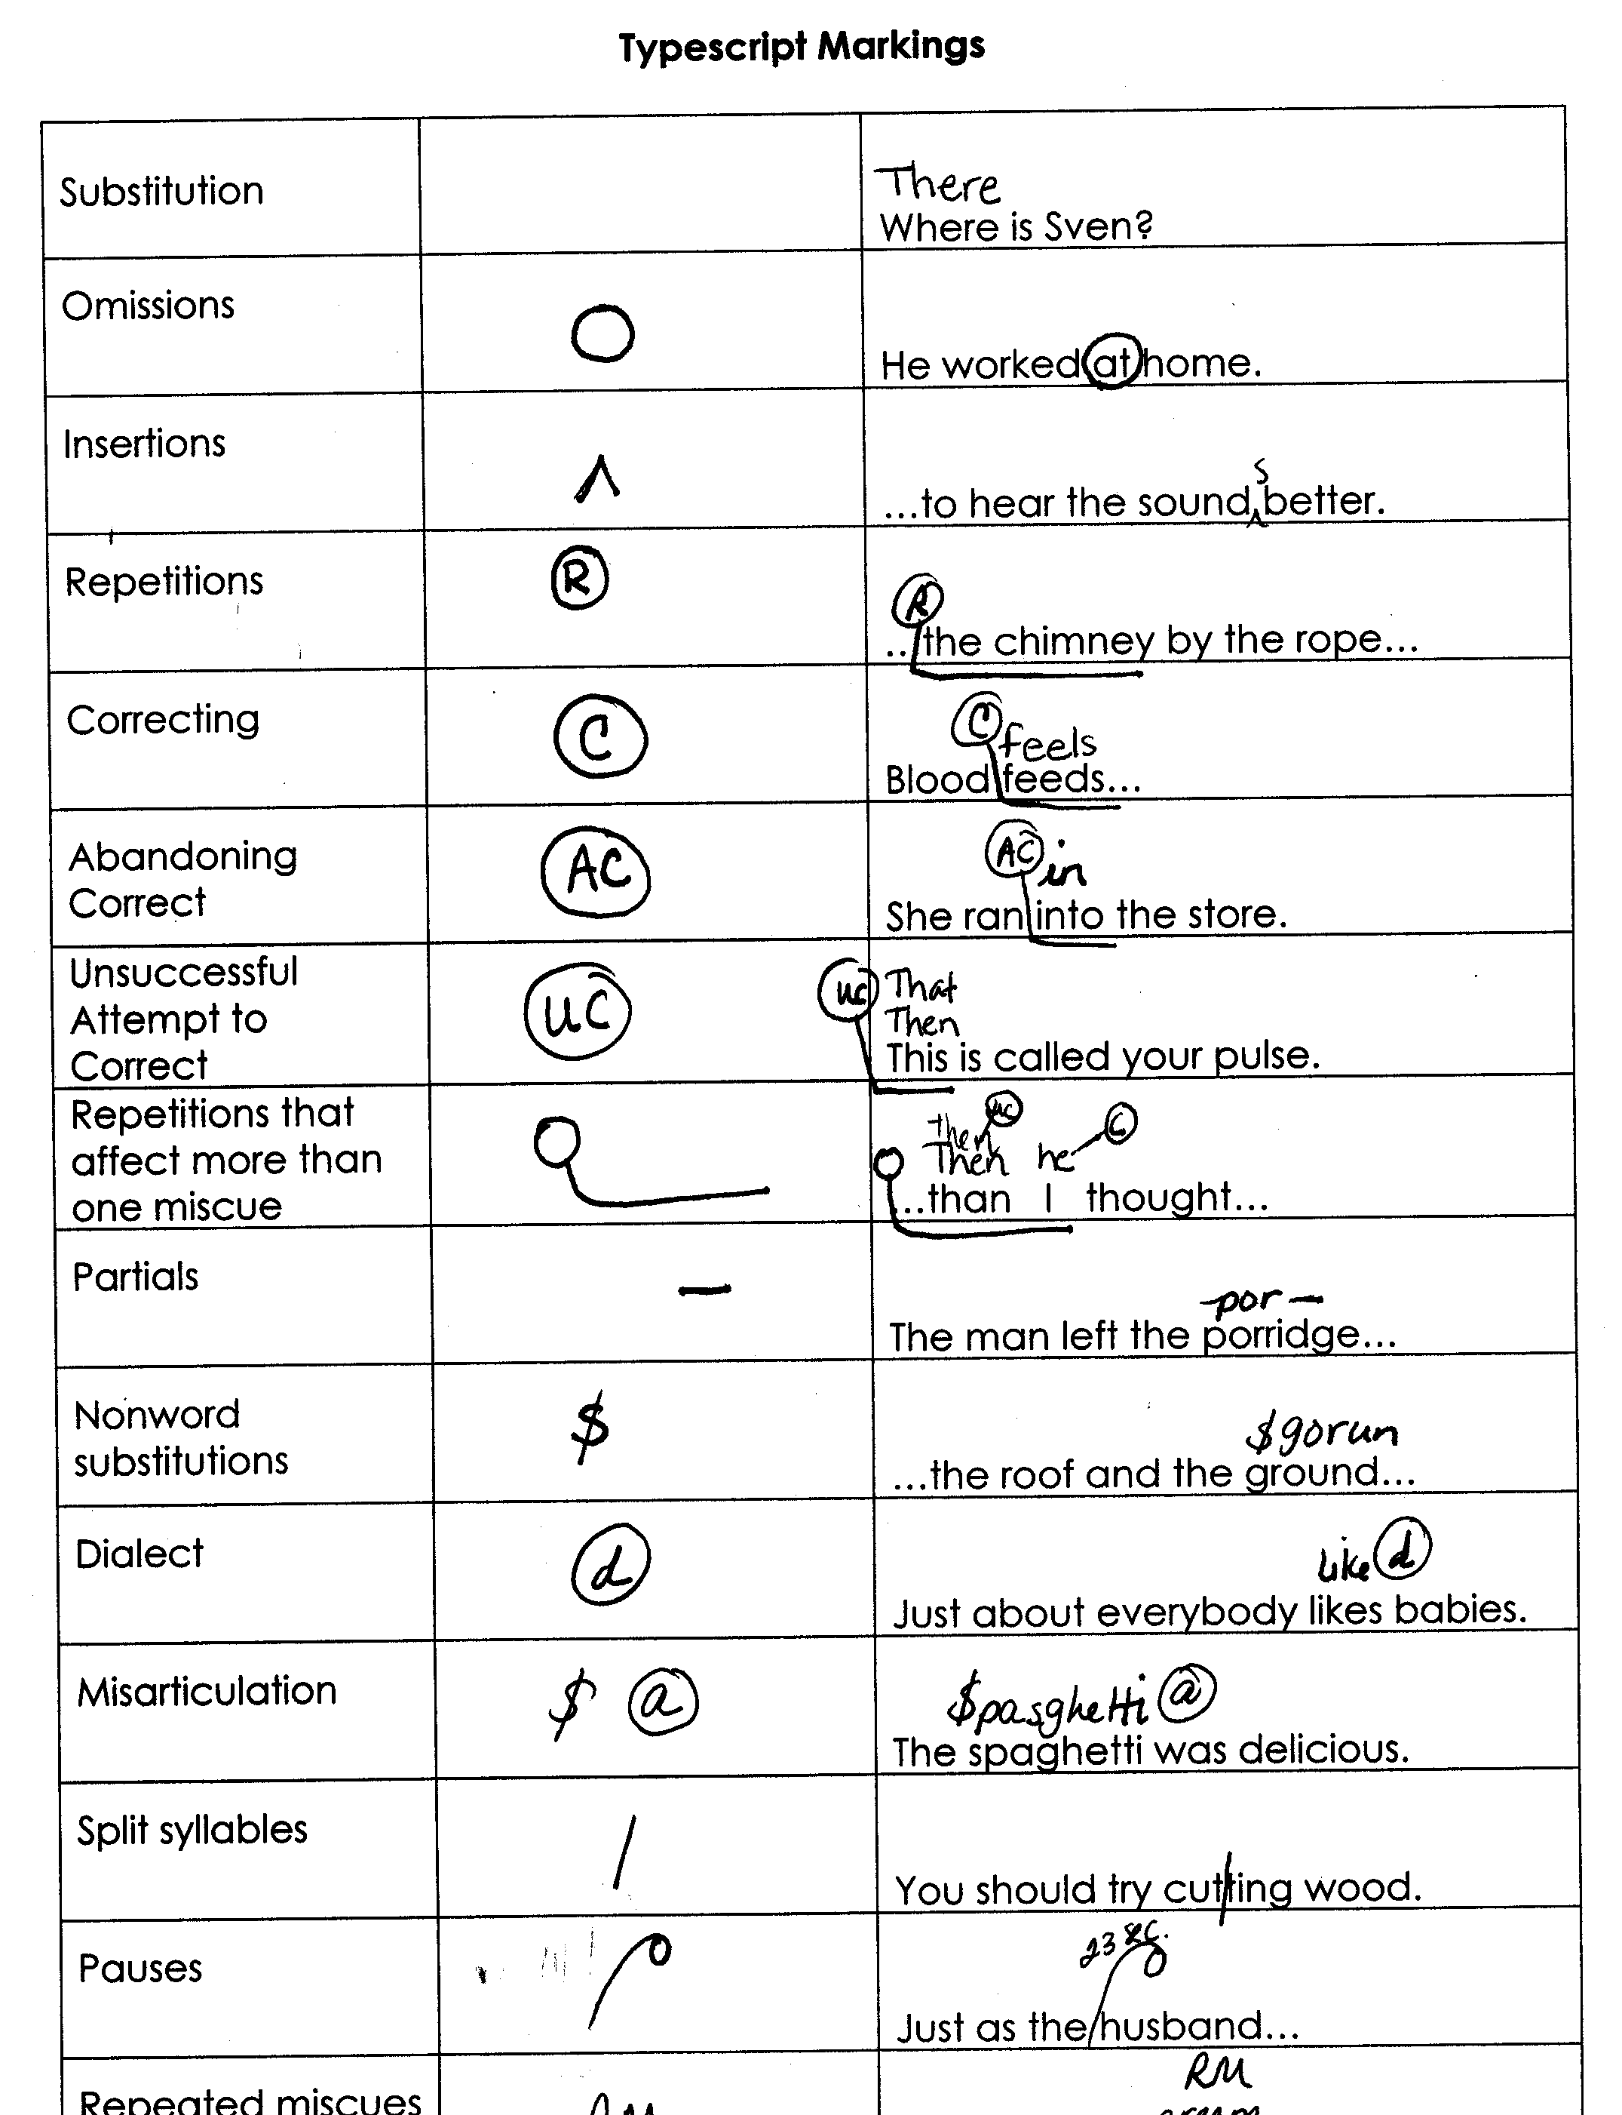
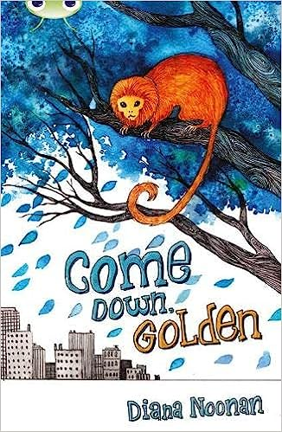
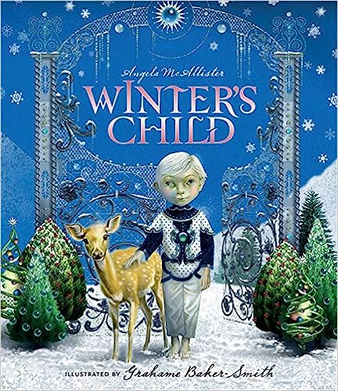
Ready Respectful Safe
Assessment and Grouping
What we do:
Miscue analysis tracking then group children according to their reading ability and needs.
Why we do this:
Responsive grouping is a key factor in successful organisation. Regular assessment ensures that children move between groups as appropriate to their level of attainment. It is also important to make sure that children are taught by the teachers(s) as well as the teaching assistants as pedagogical knowledge is a significant factor for impact.
Texts involve the reinforcement and practice of taught phonemes only to ensure that children are developing automaticity in decoding GPCs to pronounce words.
The impact:
The impact is that children receive the right type of support to move their learning forward.
These books appear in the Y2 exemplification material.

Slide 6
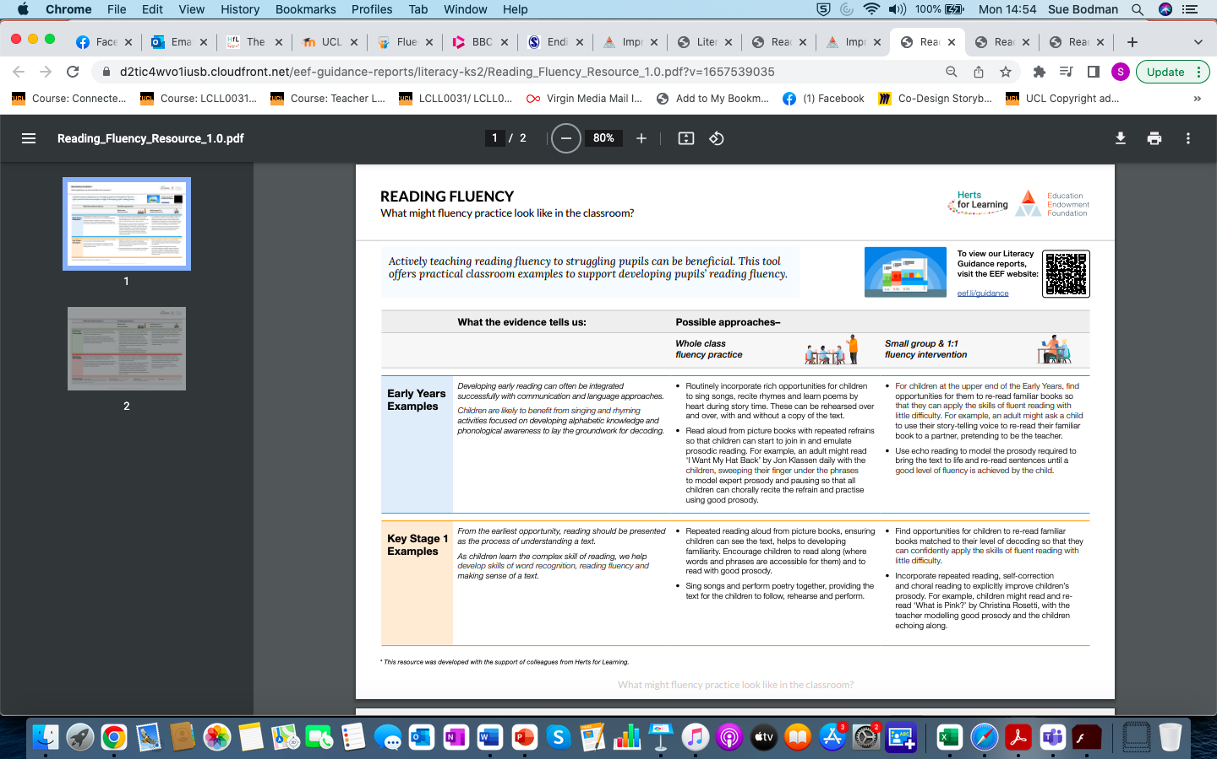
Ready Respectful Safe
What the evidence says:
Our approach:
What group work includes:

Slide 7

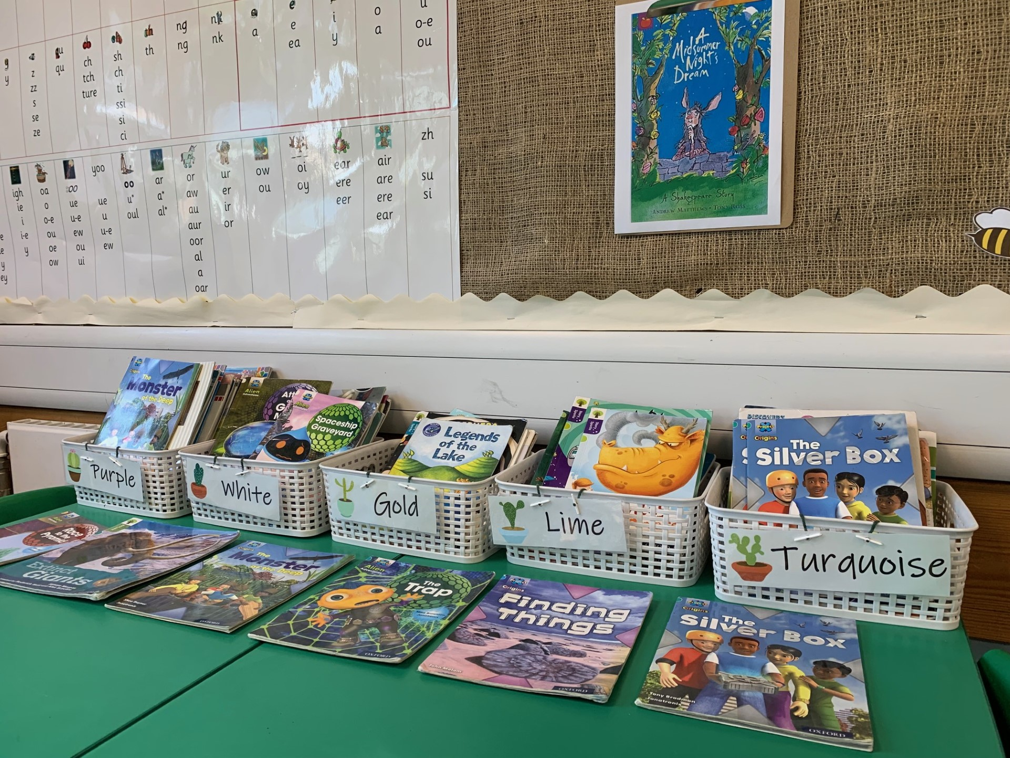
Ready Respectful Safe
Did you know?
Muscliff works alongside the people at OUP to develop new material! We were a pilot school for Oxford Reading Buddy (the online e-reading programme) and we frequently support OUP by reading their ‘proofs’ (which are a draft of the proposed book). Often, the developers will ask the children what they think about these new books so that changes can be made before the book is actually published.
What the children say:
“I like Project X books because they are really exciting.”
“I like it when my teacher reads the books to us in a voice.”
“My family bought me the book too (The owl who was afraid of the dark) so I can follow the story at home.”

