Slide 1

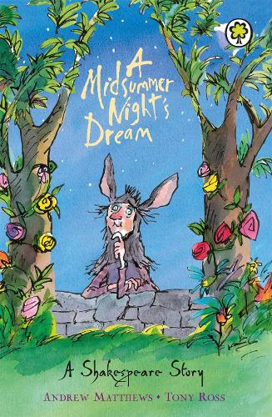





Year 2
Summer
2
Ready Respectful Safe
A Midsummer Night’s Dream
Why this books and not something else?
Shakespeare in Y2? Yes! We have chosen this book because it is a brilliant way to introduce the works of William Shakespeare to the children. Of course, this story has been retold (it isn’t a play) and adapted so that is accessible to Y2 children whilst still maintaining the same plot. We like this book because it illustrates how complicated friendships can be and it’s a good opportunity for us to reinforce how kindness is the root of all friendships.
Children in Y2 also learn about the lives of significant Britons during this term – it is fitting that we find out about William Shakespeare.
Key Question:
How can you solve a situation so that both you and your friend are happy when there’s something you don’t agree about?
School values these books reinforces:
Friendships can often be tricky! “The course of true love never did run smooth” is a quote from this William Shakespeare comedy, A Midsummer Night’s Dream and it seems Shakespeare’s observations are quite right. Relationships with your peers or friends can indeed sometimes be a challenge. During this half term, our lead value is kindness and we use this book to support the children to consider what it means to ‘work hard’ on our friendships. Relationships, as the children will discuss, need much kindness and consideration in order to flourish.

Slide 2
Year 2
Summer term
2
Ready Respectful Safe
English Skills that will be developed through this unit:
We will look at the suffixes _y, _er and _est to compare adjectives.
Suffixes _ful and _less will be used to describe the characters.
Expanded noun phrases always come in handy when building a description.
As always, children will use a range of conjunctions to ‘expand’ their sentences.
Editing work will be a key feature this half term. We will look at how to spot and correct errors and then look into how we can look for opportunities to make more significant changes to the content of our writing.
We will also build in opportunities to orally perform our work and present it to our friends in class.
Writing Composition in school:
Children will write a party invitation, a description of a character and a setting, and will retell part of the story in their own words. They will also write a recount of their trip to the New Forest.
Help at Home:
Describe one of your friends. What makes them so special? Think about what you do together and why you get along so well.
Imagine the best party ever! What would it be like? Write a few ideas down or draw and label a picture of the perfect party.
Please help me out with my problem. My best friend wants to play football at playtime but I don’t want to play! What should I do?
Describe a time when you have helped someone else.
Create a list of 5 things that you could do to show kindness towards someone in your family.

Slide 3
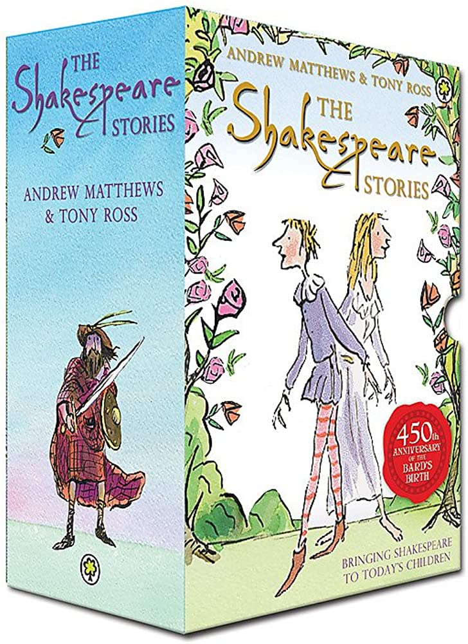
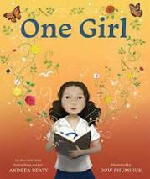



Year 2
Summer term
2
Ready Respectful Safe
Our Extended Book Spine
These retold Shakespeare stories by Andrews Matthews are brilliant for confident readers. We have the box set in our classrooms. Each book is great for introducing children to Shakespeare in a way that is appropriate for Year 2.
As a young girl sits forlornly on her front porch, a bright light shoots through the night sky, depositing a book at her feet. This precious gift unlocks a whole new world for the child. The book fizzes with magic, imagination and knowledge, leading her on an incredible journey to the classroom and beyond. As she reads more books, she is able to use her newfound knowledge to inspire others.
Anna Hibiscus lives in amazing Africa with her mother, her father, her baby twin brothers, and lots and lots of her family. Join her as she splashes in the sea, prepares for a party, sells oranges, and hopes to see sweet, sweet snow!
In this sequel to Amazing Grace, Grace travels to the Gambia to visit her father and has to adjust to new relationships with his new wife and family. Her love of books and stories always sustains and enriches her life.

