Slide 1

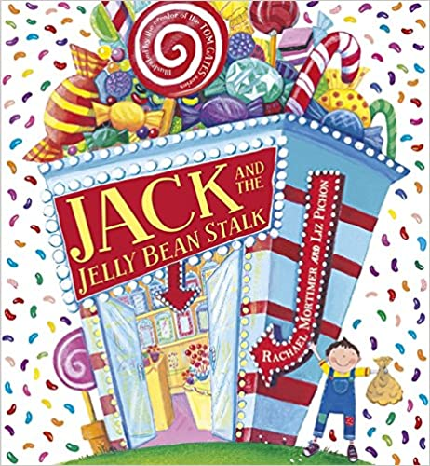
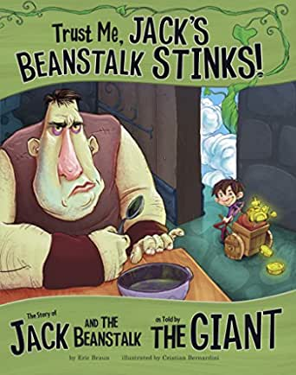





Year 2
Summer
1
Ready Respectful Safe
Fractured Fairy Tales
Why these books and not something else?
In order to be strong writers, children need to fully understand the concept of story structure and all the individual parts of a story that contribute to it. In this unit, we closely consider characters, setting, plot and point of view. And once we are comfortable with these key ingredients, we can begin to have fun fracturing them!
A fractured fairy tale is a retelling of a traditional fairy tale where some of the story elements are changed. The main goal of a fractured fairy tale is to teach an updated lesson or convey a more modern moral message. We have chosen these wonderful books to share with Year 2 as the children will already be familiar with the traditional version – that way they will be able to identify the twists and changes that the author makes. And once they understand this concept, Y2 can become authors themselves.
Fractured fairy tales are all about the ‘what ifs’ of the story, exploring brand new angles of the classic narrative to create something that’s totally original.
Because every writer will look at a story with a different ‘what if?’, the same basic plot can be transformed into countless new ways.
School values these books reinforces:
Aspiration is our lead value. The beanstalk represents opportunity. Sometimes seizing opportunities comes with a risk. What risks did Jack take and was it worth it in the end?
Key Question:
In a fractured fairy tale, you can change any part you want. Do you agree?

Slide 2
Year 2
Summer term
1
Ready Respectful Safe
English Skills that will be developed through this unit:
This unit is all about ‘fractured fairy tales.’ A fractured fairy tale is a story that follows the traditional tale that we all know, but some elements of the story are adapted. Here’s a few examples, The Three Little Wolves, Little Yellow Riding Hood, Goldilocks and the Three Lions.
For children to write a successful ‘fractured fairy tale,’ they need to first be able to:
Retell a known fairy tale and understand its structure and message
Sequence events and recognise integral parts of the story
Discuss which events are dependent on each other
Identify parts of a story that cannot be changed
Once children are confident in analysing the structure of existing fairy tales, they will develop skills of imitation and then innovation. They will need to identify parts of a story that can change and then be able to follow up so that their proposed changes ‘fit’ into the story as a whole.
Develop a story plan
Suggest ‘variables’ that could possibly change in a book
Understand how changes might impact the outcome
Link ideas across a whole piece
Writing Composition in school:
Children will be assessed on 3 pieces of writing:
A postcard from Jack, a character description of a giant, and of course a short story that is presented as a fractured fairy tale.
Help at Home:
1) Grab your favourite fairy tale. Read it through. Try to retell the story in your own words orally. You might even think of your own story actions with your hands to help you remember key words in the story.
2) Make a list of as many fairy tales as you can. Make a list of possible titles for alternative versions of these tales. For example, instead of Goldilocks and the 3 Bears, a book could be called Goldilocks and the 3 Sharks. You just need to think of possible book titles!
3) Write a postcard from Jack to his mum from the top of the beanstalk. What might he see?
4) Jack does not follow his mum’s instructions. This is not good. Make a list of some of the things that Jack did in the original story and then sort them into three groups: Risky ideas, good ideas, bad ideas.
5) If you had a magic bean, what would you wish for?
6) How does this story encourage children to follow their dreams? Create a poster about Aspiration and Jack and the Beanstalk.

Slide 3
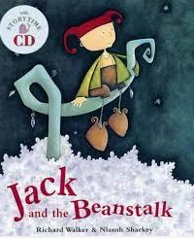
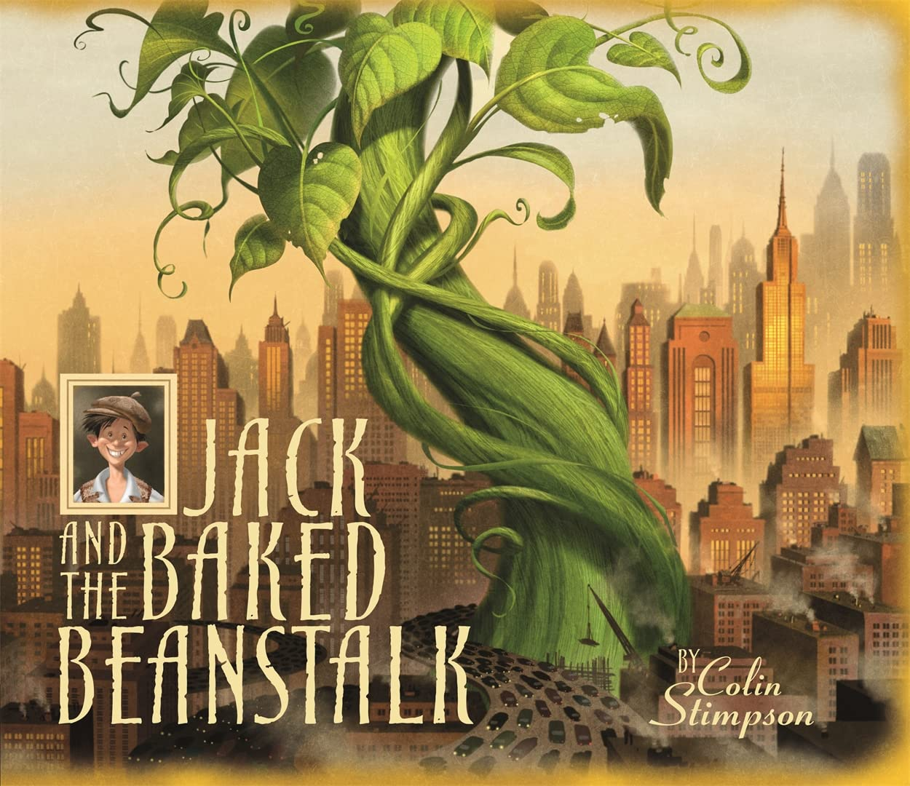
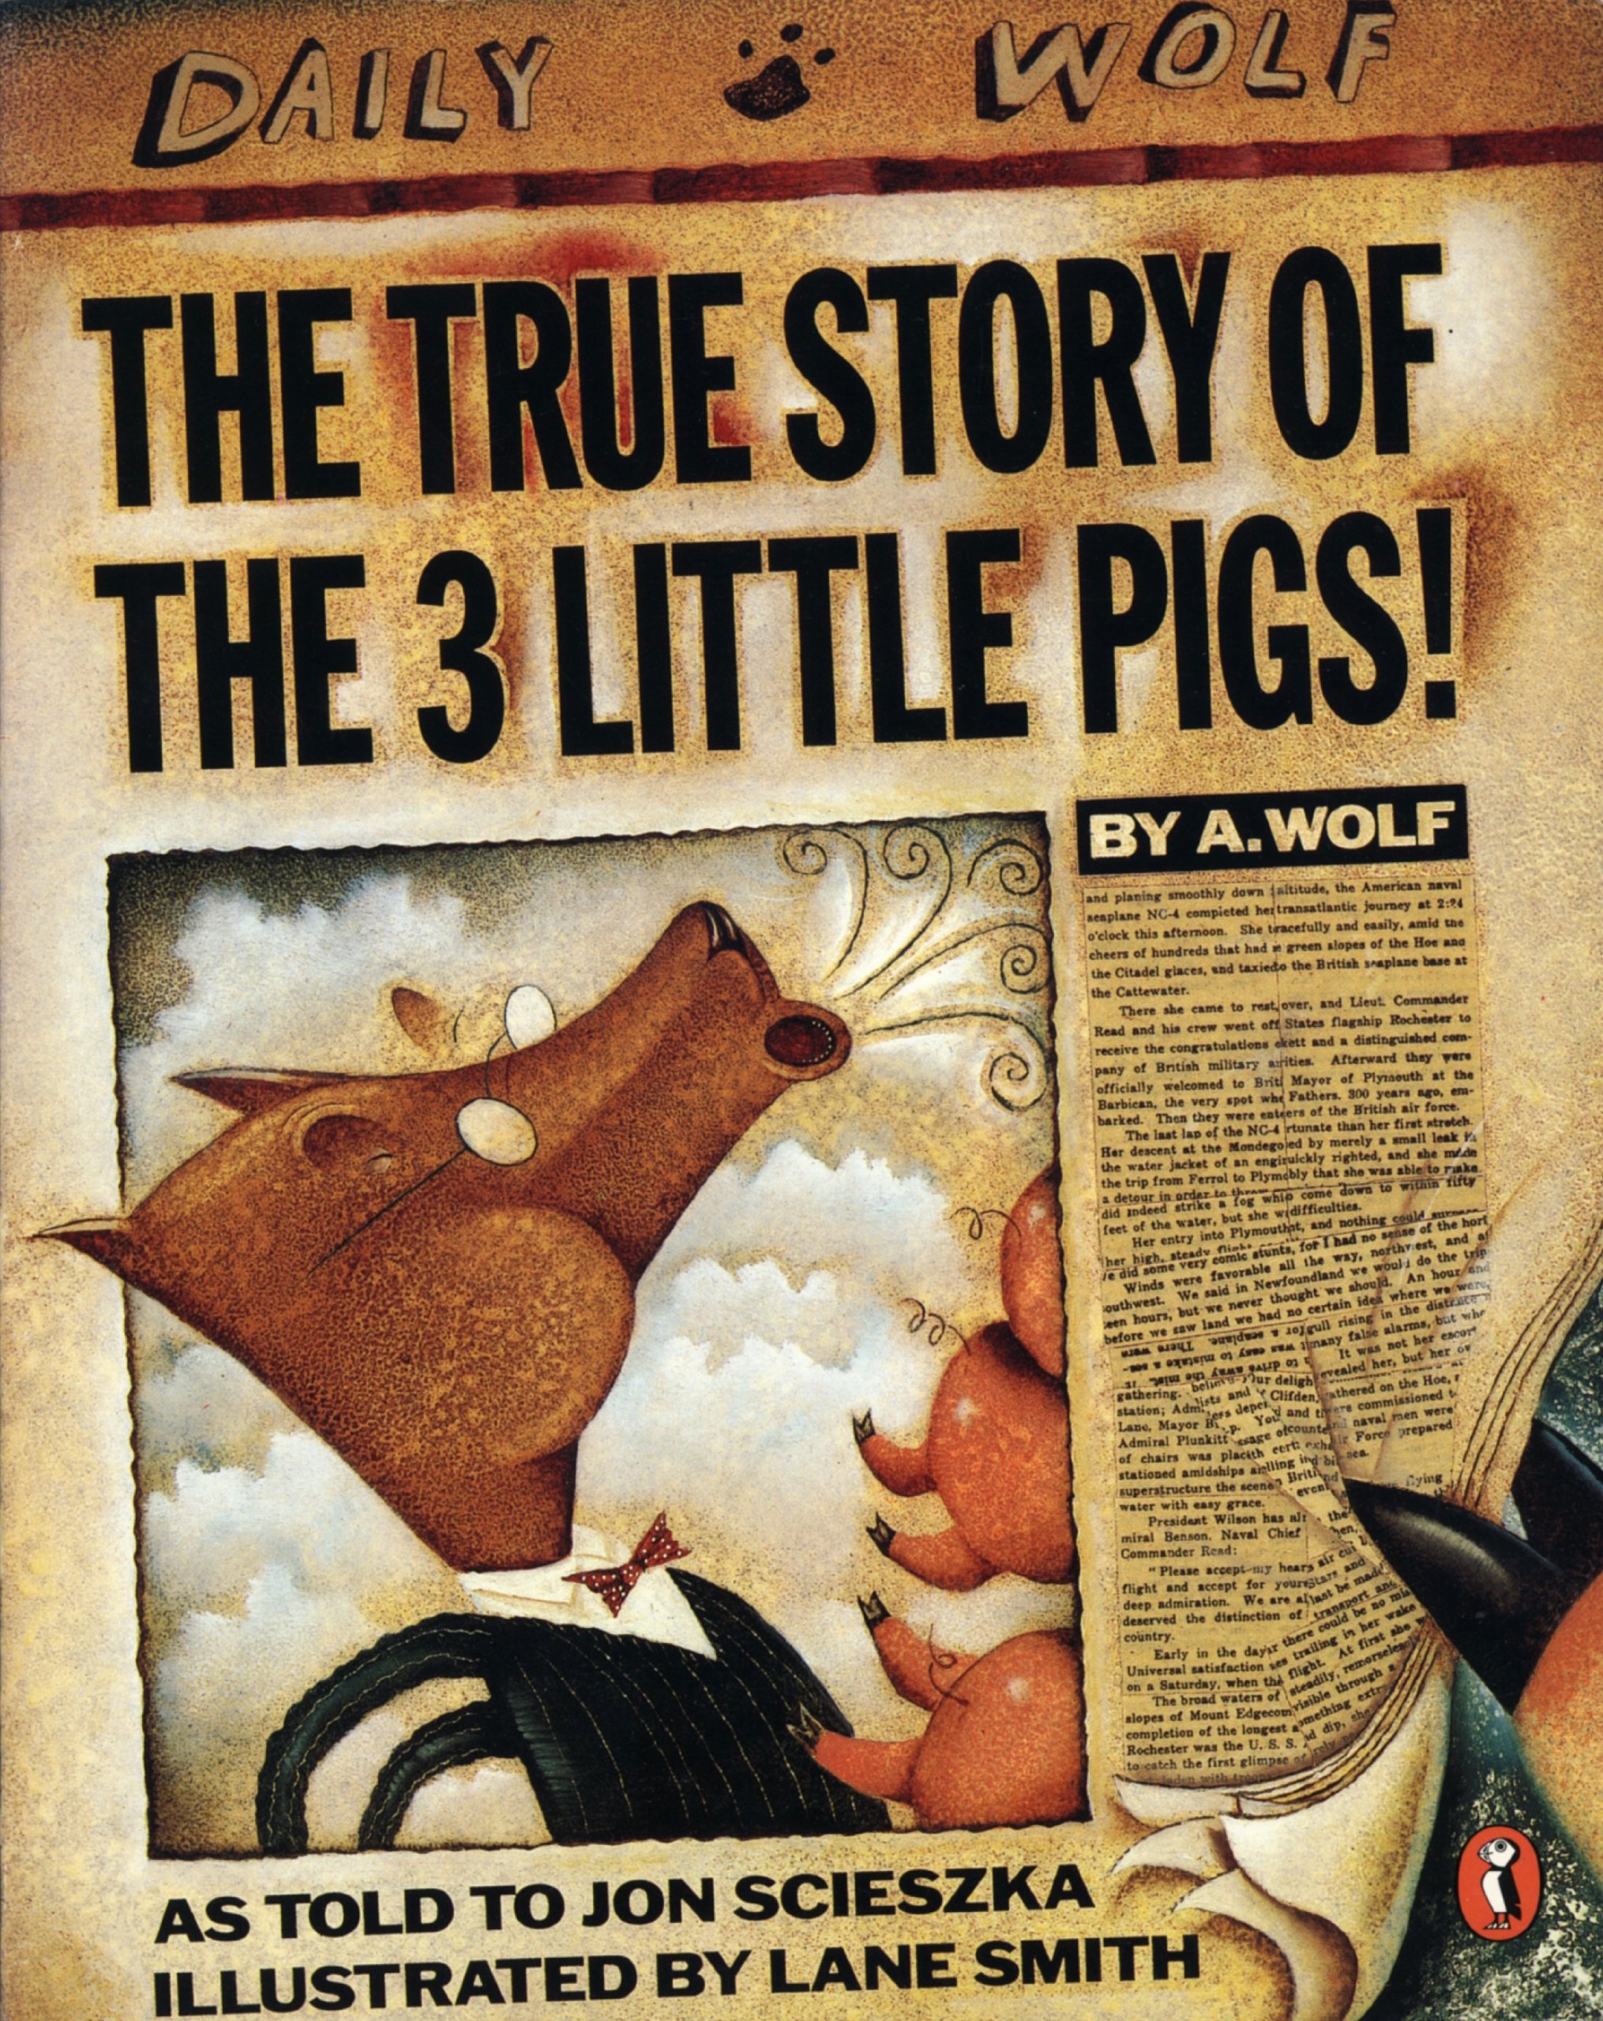
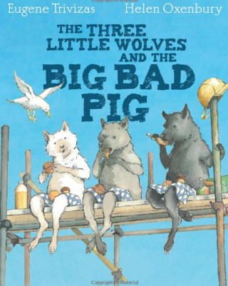
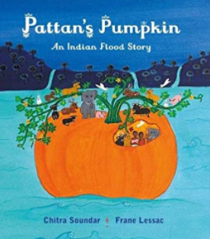
Year 2
Summer term
1
Ready Respectful Safe
Other texts we use in school:
Our Extended Book Spine
The three little wolves erect first a solid brick house. The big bad pig comes along and when huffing and puffing fails to work, he uses a sledgehammer to bring the house down. Next they build a home of concrete: The pig demolishes it with his pneumatic drill. The three little wolves choose an even stronger design next time round: They erect a house, made of steel, barbed wire, armor plates and video entry system, but the pig finds a way to demolish it too. It is only when the wolves construct a rather fragile house made of cherry blossoms, daffodils, pink roses, and marigolds that the pig has a change of heart.
Storyteller Chitra Soundar has adapted this flood story from one told in Kerala in southern India. Pattan and his wife Kanni grow food which they share with all living creatures. An ailing plant that he nurtures becomes a huge and splendid pumpkin which provides rescue and shelter when dark clouds gather and a flood threatens human, animal and plant life. Frané Lessac’s vibrant illustrations in a naïve art style complement this story relating to a seemingly simple lifestyle which has global as well as local implications.

