Slide 1

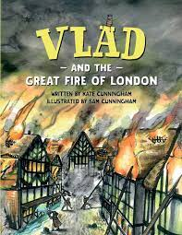





Year 2
Autumn term
2
Ready Respectful Safe
The Great Fire of London
Why this particular book and not something else?
This book is one of our favourites and brings a different perspective to our work on the Great Fire of London. Vlad is flea who lives on a rat during the fire and he sees and comments on the events. As it is written in first person (I) and as it is written as a recount, it is absolutely perfect for modelling the skills children need in order to be able to write their own diary of the Great Fire of London. In fact, it show-cases all of the skills that we really want the children to replicate in their own work during this unit. Through this key text, the children’s understanding of tenses is developed as they replicate the styles of the author and produce diaries and setting descriptions written in past tense.
On top of the quality of the writing, it’s a fantastic book for explaining the events of the Great Fire of London as well as all the names, dates and facts that children in Year 2 need to know about this significant event in British history.
School values this book reinforces:
Curiosity is our value for this unit – we love to hear the questions the children ask as well as celebrate their independent research.
Writing Composition in school:
Children will work towards creating a diary of the Great Fire of London as if they were there themselves.
Skills that will be developed through this unit:
It’s a busy half term (aren’t they all?) and Year 2 children will continue to reinforce basic sentence accuracy whilst learning and being introduced to new writing skills. We continue to bang the drum for consistent capital letters and full stops to punctuate sentences.
As we will be creating diaries and recounts this half term, the children will learn new skills that support this style of writing:
A main feature of the half term is using past and present tenses accurately through comparing past events to the present. This lends itself well to exploring _ed suffixes (such as play_ed, jump_ed) as well verbs that do not follow the _ed pattern, such as ‘think – thought, bring – brought’ (we don’t use thinked and brung isn’t even a word!). Some spellings also need some extra thought when we add the _ed, such as ‘skipped’ (although I’m not sure there was much skipping when London was burning!).
As much as possible, support your child by using their 5 senses to create noun phrases with carefully chosen vocabulary. As autumn turns to winter, there’s plenty of things to stimulate the senses and enrich your child’s vocabulary. Adjectives will come up again as we use our descriptive skills to write about the city ablaze.
To complement our history work, there will be plenty of new vocabulary that is specific to this unit too.

Slide 2
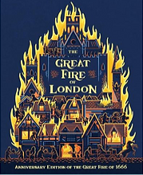
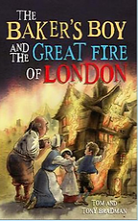
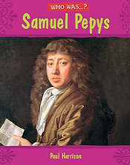
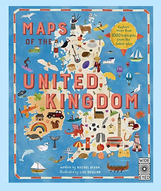
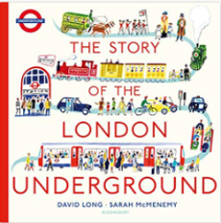
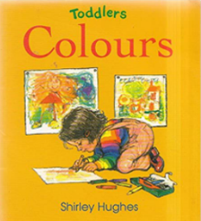
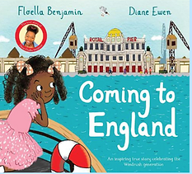
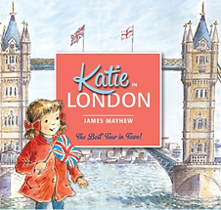
Year 2
Autumn term
2
Ready Respectful Safe
Writing Homework
Spot the Difference! You know how Spot the Difference works… what has changed in the pictures? However, as you play this with your child, think about the tenses you use. When you compare the pictures, you’ll actually be switching from past tense to present tense. “Mrs Payne was sitting but now she is standing.” A perfect activity for encouraging your child to use past and present tense.
Describe a bonfire or firework display using all of your senses. What can you see, smell, hear? (This is an ideal opportunity to also reinforce firework safety and not touching fireworks). Illustrations would enhance your work!
A firework poem that focuses on description would be a super opportunity to talk about and use adjectives and adverbs. Feel free to use the writing frame included or make up your own poem. Your child may need support in choosing the best descriptive words for the job.
A key focus this half term is diary writing. Have a try at keeping a diary for the week, weekend, or just recounting the day. Writing a recount or diary gives your child the opportunity to write extended sentences using conjunctions (because, when, as…) and their writing tends to flow as they recall more easily what they have done from their own experience.
As the autumn turns to winter, here’s another opportunity to create sentences that compare. This reinforces your child’s use of past and present tense. Think about changes in the seasons and use ‘then’ and ‘now’ as a way to introduce the task.
“Back in autumn the trees were golden but now they are bare.” “Then the sky was blue but now it is grey.”
Write a letter to Father Christmas to remind him about how you have been good this year. This will use past tense. You could also tell him about how you have been good this month too and this will use present tense.
Our Extended Book Spine
To complement Vlad and the Great Fire of London, our school can thoroughly recommend these texts for this half term:
Please turn over to find out more about these recommended books.
Reading any of these books will contribute towards a new reading star!

Slide 3
Year 2
Autumn term
2
Ready Respectful Safe
Our Extended Book Spine
To complement Treasure Island, our school can thoroughly recommend these texts for this half term:
Book Title | What is it about? | What your teachers think about the book…
The Great Fire of London: 350 Anniversary of the Great Fire of 1666 Emma Adams & James Weston Lewis | Published to mark the 350th anniversary of the fire, The Great Fire of London is a spectacular visual retelling of whole story of the fire, from the first piece of coal that starts smouldering in the oven of the Pudding Lane bakery to a whole city engulfed by raging red and orange flames. With stunning illustrations, captivating storytelling and a treasure trove of historical fact, this books is an absolute essential for classrooms covering this topic. | The Y2 team really rate this non-fiction text, which covers the historical facts. This book will support the children’s understanding of our historically based fiction text – VLAD. If your child likes facts and dates, then this book will give them the knowledge to make their work sound like a real historian.
The Baker’s Boy and the Great Fire of London | This exciting chapter book brings the tale of the great fire of London to life for young readers. When Will Farriner wakes to the sound of crackling flames and the smell of smoke, he knows something is terribly wrong! As his family escape the flames engulfing their bakery, Will realises he must stop the fire from spreading. But what can be done before all of London goes up in smoke? Full of adventure and danger, this chapter book is aimed at KS1 and lower KS2. | This is an introduction to chapter books. We intend to share this book with the whole class but it is an ideal book for parents to share with their child at home and we suggest parents and children take turns to read a little each night. The language is great at creating the visual pictures in the children’s minds.
Who was: Samuel Pepys? Paul Harrison | Samuel Pepys is famous for the diary he wrote 400 years ago. The diary tells us about lots of important events such as the Great Fire of London and the Great Plague. Find out why people thought his diary was written in code, why Pepys was known as the 'father of the modern navy' and why he was arrested and sent to the Tower of London. | This is a biography text detailing Samuel Pepy’s life, achievements and the problems he faced! We look at the life of Samuel Pepys in our history sessions this half term so it is a good choice of book to provide your child with extra information.
The Story of the London Underground David Long | When the first passengers climbed aboard the earliest ever underground train in 1863, it would have been impossible to imagine how the London Underground would change and grow over the next 150 years. From smelly steam trains running along a single track to the innovative electric tube system speeding through a vast network of tunnels beneath our feet today, the London Underground keeps this busy city on the move. | Another unusual book! We like this and we think it’ll be a popular choice on our bookshelf as it is very visually appealing. This links very well with our Geography work on features of London.
Colours by Shirley Hughes | Rhyming text introduces the colours of familiar objects and special places. | We have chosen this as it links to our colour mixing work on the Great Fire of London.
Katie in London James Mayhew | Come on a magical tour with Katie and discover London's most famous sights! When Katie and her brother Jack visit London with Grandma, something very unexpected happens . . . One of the Trafalgar Square lions comes to life and takes them on a wonderful tour of all the best sights! Including Buckingham Palace, the Tower of London, Big Ben and the London Eye. Featuring many of London's key landmarks, this storybook has become a bestselling introduction to London, and is perfect for children visiting the city for the first time. | This is a fiction text based on real features of London and would very much support our geography unit.
Coming to England Floella Benjamin & Diane Ewen | A picture book story about the triumph of hope, love, and determination, Coming to England is the inspiring true story of Baroness Floella Benjamin: from Trinidad, to London as part of the Windrush generation, to the House of Lords. When she was ten years old, Floella Benjamin, along with her older sister and two younger brothers, set sail from Trinidad to London, to be reunited with the rest of their family. Alone on a huge ship for two weeks, then tumbled into a cold and unfriendly London, coming to England wasn't at all what Floella had expected. | So many interesting points in it that can be picked up and discussed as a family. What can we do to make people welcome? This book reinforces our Muscliff values – everyone is special and unique – and gives an insight into cultures from other countries.
Maps of the United Kingdom Rachel Dixon Livi Gosling. | Take a tour of the United Kingdom - illustrated set of colourful and fact-filled county maps. Travel through England , Northern Ireland , Scotland and Wales and meet the incredible people born there, learn about the UK's proud history and discover ancient castles, modern feats of engineering and natural highlights. Maps of the UK is also a beautiful atlas of the UK's history and culture , showing how Britons from all over the world have shaped the country for thousands of years. | A fabulous introduction to the UK's geography, history and culture – Year 2 objective of naming the countries that make up the UK and capital cities.

