Slide 1


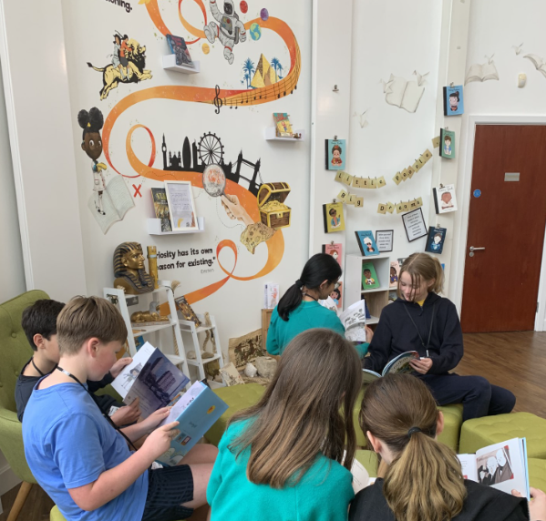
Ready Respectful Safe
Teaching and Learning Handbook

Slide 2

Ready Respectful Safe
School Culture
Most school leaders have an instinctive awareness that organisational culture is a key element of school success. They might say their school has a “good culture.”
You are invited to step into Muscliff…
Spend just a few moments talking to our children, watch the interactions and relational behaviour between pupils and adults, absorb the smiles, ask about our curriculum offer. We believe that our identity and our understanding of our vision pervades all we do. And it is through this unwavering commitment to our 5 core values, coupled with our continual, explicit sharing of our vision, that has helped us to cultivate a strong culture.
We call this “The Muscliff Way.”
We are particularly proud of our school’s identity and character, which we believe is incredibly strong and well-defined. As a result, everyone’s knowledge about Muscliff’s distinctive character — and what it takes to thrive in it — is widely spread and reinforced. Being part of Muscliff means that you too align to these values yourself and that you recognise their role in guiding your approach to your teaching practice, your professional behaviour and your interactions with the children.
This is what we do here at Muscliff.

Slide 3
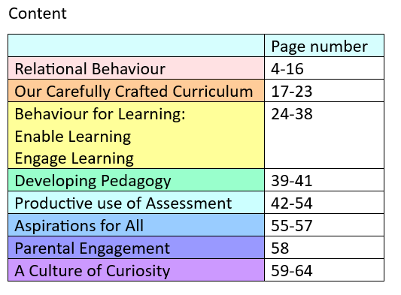

Ready Respectful Safe
Purpose
This document is designed as an informative tool: underpinned by our Muscliff ethos and derived from our own research into the most effective teaching, it will guide the reader through our Muscliff approach and unpick how success is achieved at every level; this is what we believe effective teaching looks like here.
It is also a celebration of the professionals at Muscliff who to strive to perpetually increase the impact they have on learning. Above all else, we urge our reader to use this document as a springboard for professional curiosity: ask questions and engage in professional dialogue with your peers to deepen your understanding of how children develop as learners.
There is no recipe, no professional development set of worksheets, no new teaching method, and no band-aid remedy. It is a way of thinking: ‘My role, as teacher, is to evaluate the effect I have on my students.’
(John Hattie – Visible Learning)

Slide 4
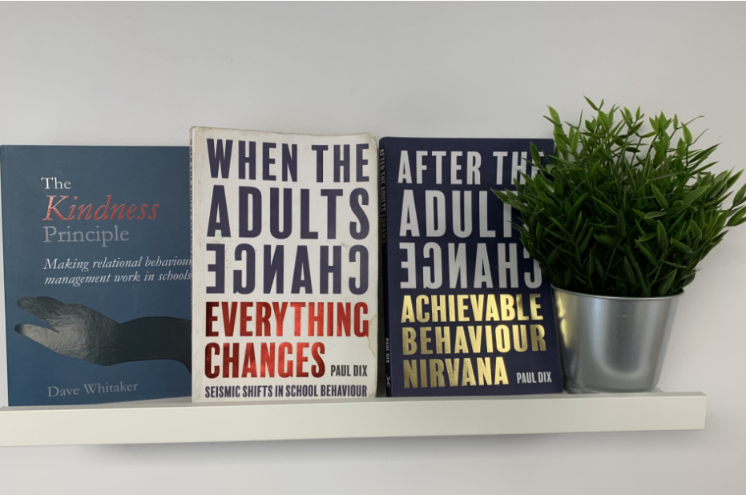

Ready Respectful Safe
Relational Behaviour
Muscliff is a welcoming, happy and safe environment where expectations and standards of behaviour are very high. Relationships are at the heart of every interaction. There is a growing body of research and understanding about the impact of Adverse Childhood Experiences (ACEs) on long term mental and physical health and the protective factors that mitigate the potential impact. It is our aim to maximise the protective factors of school by creating an environment of safety for all children. Such an environment has strong, positive and supportive relationships at its heart. This will encourage good behaviour and self-regulation from our children. At the core of our vision is our belief to developing self discipline is to feel safe and secure and free from fear.
We pride ourselves as being a school that loves to read. This includes our staff. One of our favourite authors is Paul Dix and his books are circulated amongst staff. We have also engaged in CPD with Pivotal and When the Adults Change led by Tara Ellie.
We have also invested in CPD and use a trauma informed approach. This was delivered by Clare Williams from Trauma Informed Schools.

Slide 5


Ready Respectful Safe
Belong
This is what we believe…
No significant learning occurs without significant relationships.
So this is what we do…
Develop openness to trust
Build a sense of security, belonging and connection
Teach and embed skills to manage and regulate difficult emotions
Develop awareness of ourselves and the emotional needs and perspective of others
Resolve conflict
Repair and restoring relationships following conflict
And this is how that looks…
When you step into Muscliff, you will notice immediately that we are defined by our nurturing and relational behaviour and approach. We talk explicitly to the children about what it means to be part of Muscliff and the Muscliff community and that we wear our uniform with pride.
“I am welcome and wanted.” “I belong here.”
Time is always invested to understand each child as an individual. We talk… a lot!
Trauma Informed Schools approach (CPD invested in this).
Nurturing culture with boundaries.
Relationships with rules & expectations

Slide 6

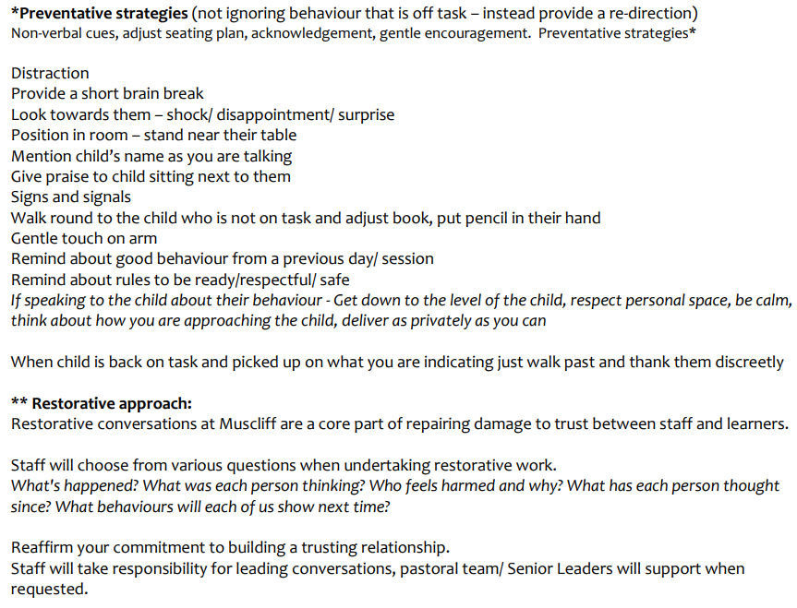
Ready Respectful Safe
Trauma Informed Approach
This is what we believe…
Whilst relational approaches are effective in meeting in the needs of all students, they hold additional value for children and young people who have been affected by adversity at some stage during their childhood, or who continue to experience difficulties of this nature. Relational approaches are at the heart of trauma informed practice, due to the emphasis placed on the importance of secure and trusting relationships in school and the sense of safety these provide.
So this is what we do…
All staff attended CPD led by Clare Williams from Trauma Informed Schools.
And this is how that looks here…

Slide 7
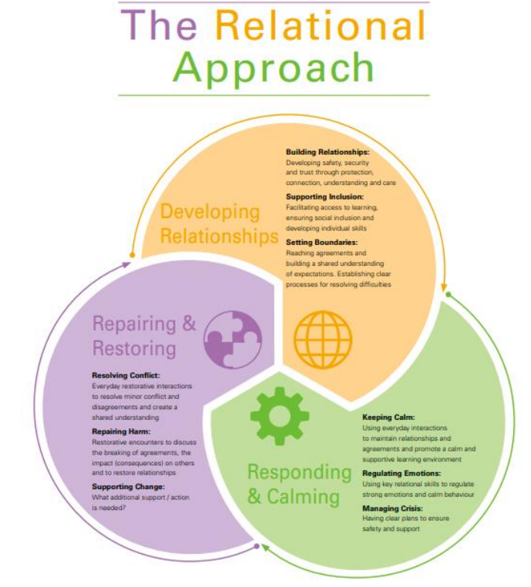
Ready Respectful Safe
Relational Behaviour

Slide 8
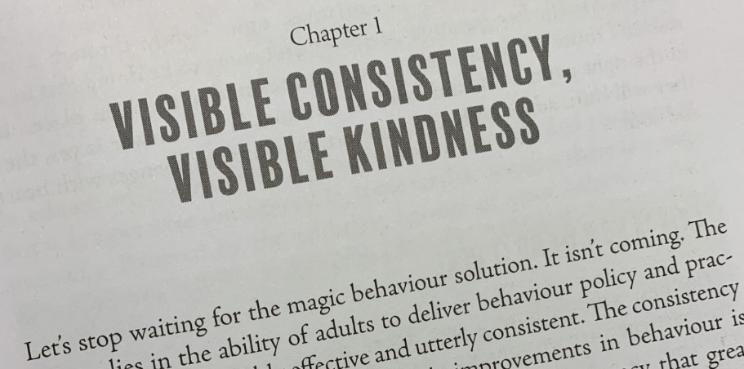
Ready Respectful Safe
Consistent Relational Behaviour
This is what we believe…
A consistent approach is the top trump card. A predictable and secure environment benefits all pupils.
So this is what we do…
We recognise that consistency lies in the behaviour of adults and not simply in the application of procedure. A truly sustainable consistent approach comes from the determination of every member of staff to hold firm. The key is to develop a consistency that ripples through every interaction on behaviour. Where learners feel treated as valued individuals they respect adults and accept their authority.
And this is how that looks…
We proudly and perpetually beat the drum that we are Muscliff!
Whole school assemblies are used as an opportunity to share the message with everyone about ‘what we do here’ (please see our section on assemblies).
We use a shared language, which staff model to the children and to each other.
There is an expectation that everyone should ‘pick up the tab’ because at Muscliff, we all (pupils and staff) truly believe in RESPONSIBILITY and promote this at every opportunity.
We have year leaders who work with and across their base to ensure that every member of the team uses our common vernacular.
We share and use scripts that may look like this:
Scripting = being ready with a clear message that says ‘you own your behaviour, you can change it, you are better than this, I am not giving poor behaviour attention’.
When I saw you… (do something positive yesterday/ earlier) – that is the behaviour I want to see. Thank you
Restorative – between you and the child – don’t hand it over to someone else. – we will look at some key restorative questions shortly.

Slide 9
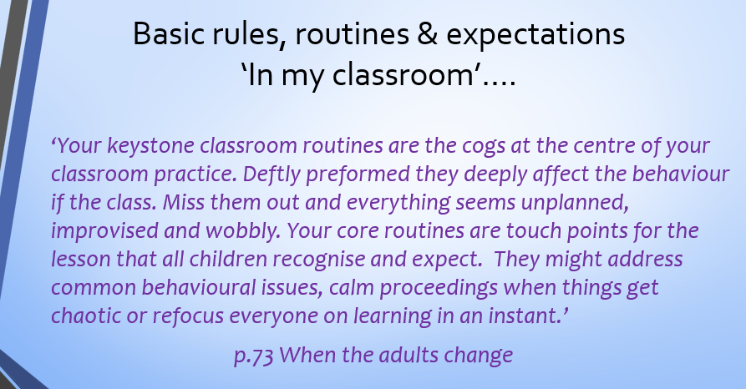
Ready Respectful Safe
Rules and Routines
This is what we believe…
Setting clear expectations can help communicate shared values that improve classroom and school culture.
So this is what we do…
Engagement with learning is always the primary aim. For the vast majority of learners a gentle reminder or nudge in the right direction is all that is needed. We recognise that although there are occasions when it is necessary, every minute a learner is out of the lesson is one where they are not learning. Staff praise the behaviour they want to see which has a positive impact on other children. In the case of unwanted disruption in classes, behaviours are tackled discreetly and following clear steps.
And this is how that looks…
We all follow the flow chart (next page), which is our collaborative agreement.

Slide 10
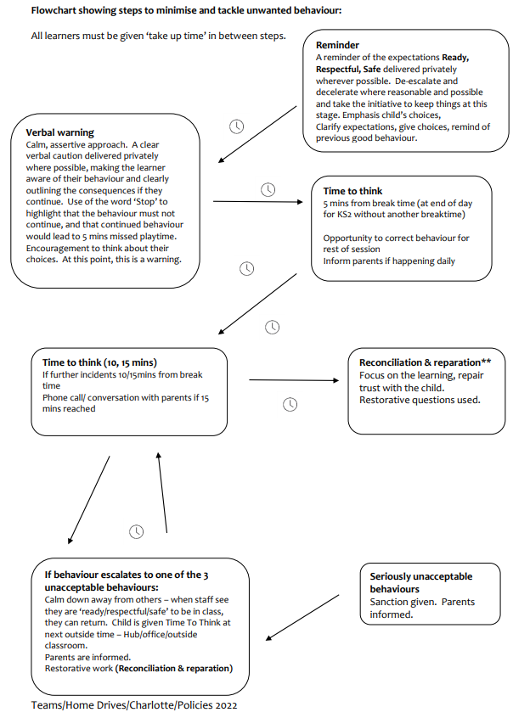
Ready Respectful Safe
Relational Behaviour

Slide 11

Ready Respectful Safe
Ready, Respectful, Safe
This is what we believe…
Setting clear expectations can help communicate shared values that improve classroom and school culture. Teachers are key role models, who can influence the attitudes, values and behaviours of their pupils.
So this is what we do…
After engaging in CPD based on ‘When the Adults Change’ (Paul Dix), we use 3 school rules: Ready, Respectful, Safe.
be predictable – schools use sanctions and rewards in many different ways to reinforce desirable behaviours. The success of any system will be determined by its implementation, and predictability is a key part of this. For instance, sanctions that are only enforced sometimes will be less effective than those that always, predictably, follow a certain behaviour. Being predictable helps to reinforce your school’s high expectations of pupils
be aware – awareness is important for preventing low-level disruption as well as for quickly managing bullying or other behaviours that threaten pupils’ emotional safety. To maintain awareness, you should position yourself physically so that you can visually monitor the whole class even when speaking to an individual or small group and frequently ‘be seen looking’ so that pupils know you are aware of what they are doing
be responsive – responding early to low-level disruption usually helps to shut it down quickly. ‘Least-intrusive’ approaches – i.e. those which limit disruption to learning, including non-verbal signals – can be appropriate at this stage, such as pausing abruptly, moving physically closer to disruptive students or looking at pupils to show that you know what they are doing and that it is not acceptable (the ‘teacher glare’)
review your expectations – you will have set your expectations with the best of intentions, but it may be appropriate to carefully review them if pupils are struggling to do as you wish. You should avoid lowering your expectations, but it may be helpful to alter routines to make these expectations more achievable

Slide 12
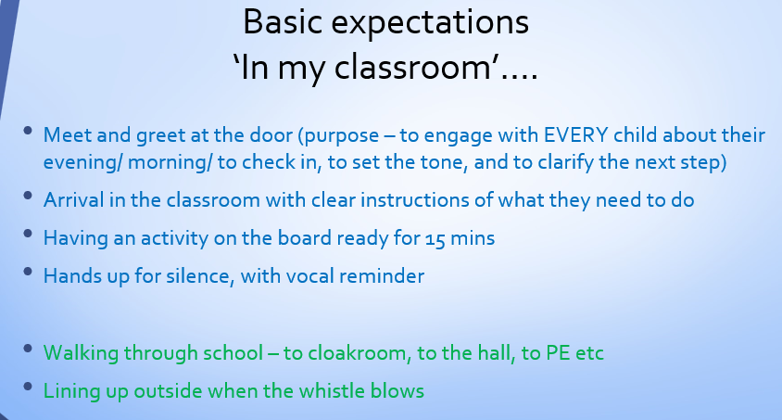

Ready Respectful Safe
Relational Behaviour
Responding consistently to pupil behaviour is important for two reasons:
reinforcing expectations – if you only sometimes reinforce your expectations in how you use sanctions and rewards, then pupils quickly learn that your expectations are optional. Over time, you will likely find that pupils adhere less and less to your high behavioural expectations
fairness – pupils have a strong sense of fairness, so, if they notice (or perceive) they are being treated differently than their peers, this can undermine your relationship with them. Therefore, it is important to ‘be fair’ and to ‘be seen to be fair’. This can include, for example, using least-intrusive interventions so that pupils don’t feel that they are being singled out in front of their peers and linking your use of rewards and sanctions to the school behaviour policy. By being explicit like this, you make it clear to pupils why they are being sanctioned and others know what they need to do to achieve the rewards that their peers receive.
And this is how that looks…

Slide 13
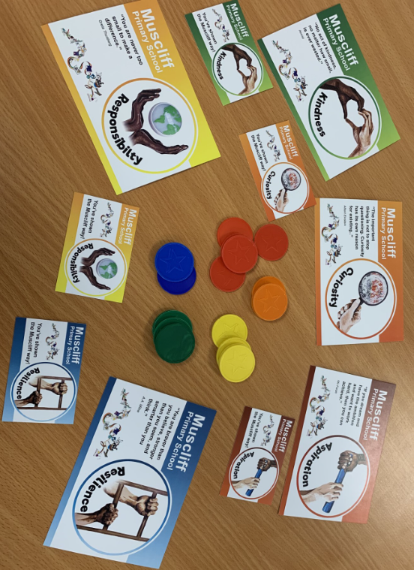
Ready Respectful Safe
Rewards and Praise
This is what we believe…
Acknowledging and praising pupil effort and emphasising progress being made is integral to our culture.
Pupils are motivated by intrinsic factors (related to their identity and values) and extrinsic factors (related to reward).
So this is what we do…
We all follow the same reward system across the school.
And this is how that looks here…
The logos on the rewards correspond to the images in our Curriculum Tower. We designed these images ourselves, which were translated into art work by a local artist.
Children receive VIP tokens for showing the Muscliff Values. These are physically given to the children at point of award and collated in their classroom. VIPs are then placed in the central Tower area at the end of the day. At the end of the week, we look at the amount of tokens in the tubes. Children are reminded that our reward is that we have a better school where everyone is invested in showing our values.
When children have made a special effort, they may also be rewarded on a personal level with:
A values sticker - when children receive a sticker we prompt them to consider which particular value they have demonstrated and how they might achieve one of the other values stickers.
A values card – this can be annotated by the class teacher.
A values postcard – this is posted home with a message from a member of SLT.

Slide 14
Ready Respectful Safe
Self Regulation
This is what we believe…
Self-regulation refers to a pupil’s ability to monitor, evaluate and modify their emotions and behaviours. This includes, for example, controlling emotions of anger, frustration or embarrassment – all common emotions experienced by pupils across their school career. The most effective learners are able to effectively regulate their own emotions, meaning they are better able to learn well, and to form positive relationships with others. If pupils struggle with this it can affect their own learning and future lives and may also negatively affect their peers.
So this is what we do…
The Education Endowment Foundation report that – on average – pupils from disadvantaged backgrounds, and lower-attaining pupils, are less effective at self-regulation than their peers. Therefore, explicitly teaching self-regulation may be particularly beneficial for these pupils.
Pupils’ self-regulation depends on their prior knowledge and their stage of development. However, developing pupils’ self-regulation is as important for early years practitioners as for teachers of older pupils – especially as it relates to the regulation of emotions, which supports successful learning.
Approaches to developing pupils’ emotional self-regulation include:
using story books and discussing how characters may feel and why
developing pupils’ vocabulary to describe their emotions
teaching self-calming techniques, like deep breathing
supporting pupils to recognise their own body clues linked to strong emotions, like a changing tone of voice, hot face and increased heart rate
And this is how that looks…
Opportunities are created through our curriculum offer to teach children about what managing emotions. We purposely choose books that present ‘big’ emotions so that we can unpick these through the eyes of the book character.

Slide 15
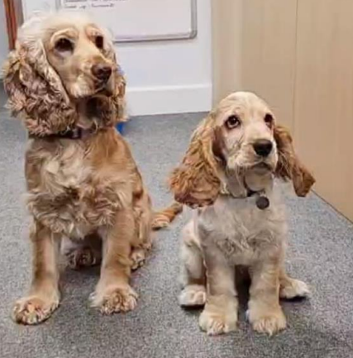
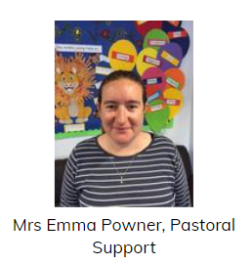
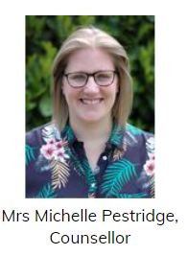
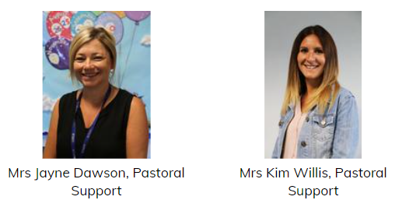
Ready Respectful Safe
Wider Pastoral Team
This is what we believe…
Sometimes children need emotional support that stretches beyond the classroom and requires deeper exploration.
So this is what we do…
We employ a wider team of professionals who work with our staff and children to provide more targeted, specific support.
And this is how that looks…
Our wider team consists of highly skilled professionals who are both experts in their field and highly supportive in their nature. As emotional literacy is a priority here, considerable investment is directed into having such an effective team. The impact is that children are well-supported and teachers are able to develop their own skills and knowledge through such expertise.
School Counsellor
Navigator
Play therapist
Trainee play therapist
Pastoral Support Team
School Social Worker
Honey and Dottie – our support dogs!

Slide 16





Ready Respectful Safe
Assemblies
Assemblies are an important part of our school culture. When it comes to shaping our school’s ethos and painting the picture of what our values look like in school, we believe assemblies hold a position like nothing else.
As you would probably expect, our assemblies feature a ‘Beautiful Text’ and our discussions around the book put our five Muscliff values in the spotlight; we tend to choose books that illustrate how our values support success. And on top of this, our children just love hearing stories! Assemblies always end with a short reflection about how we can apply what we have learned from the story.
Assemblies are held throughout the week and are led by a member of SLT. However, we are increasing the number of visitors who lead assemblies as we are keen to develop closer links with the local community.
Whole School Assembly Books
We use KS1 and KS2 assemblies to highlight the value. At the end of the assembly, children reflect on how the lesson in the story is relevant to them.
We have mapped out the whole year of assemblies as we know how important they are.
Each assembly ends with a time for reflection where we consider how the book relates to us here at Muscliff. All of our assembly books are available in our Curriculum Tower for classes to access and re-read.

Slide 17
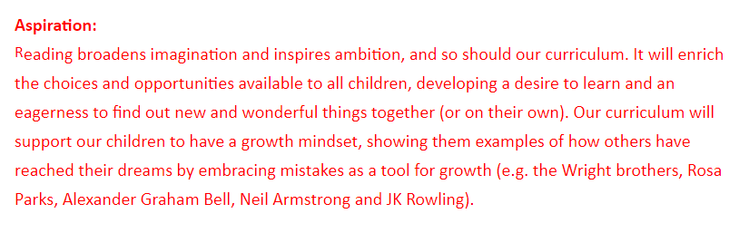
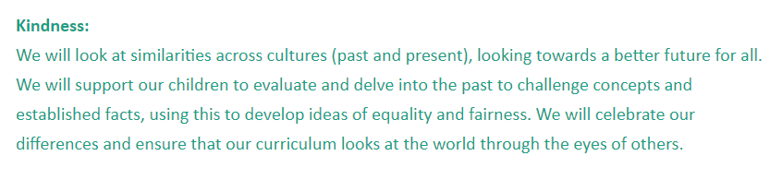
Ready Respectful Safe
A Values Curriculum
This is what we believe…
We believe that learning at Muscliff should be centered around our ‘beautiful’ texts and our core values.
So this is what we do…
At Muscliff Primary school, our curriculum is designed to enable our children to explore the world around them, as well as the world of the past and their own future, through first-hand learning experiences and inspiring curriculum content focused on linking key skills and knowledge from Reception to Year 6 and beyond.
And this is how that looks…

Slide 18
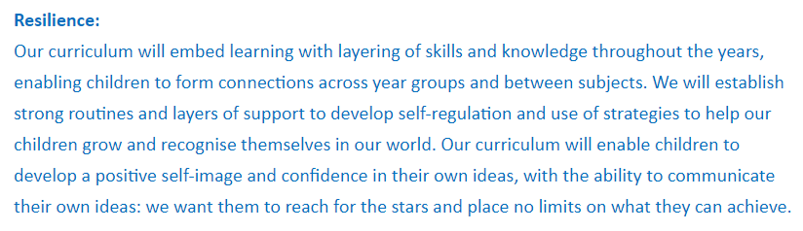
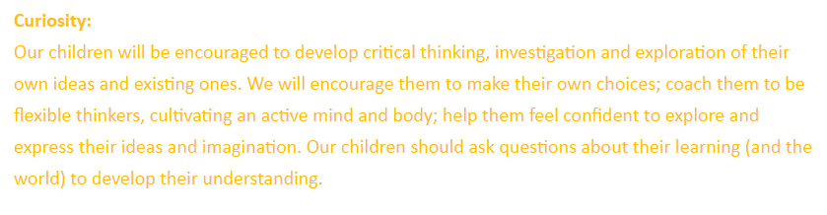
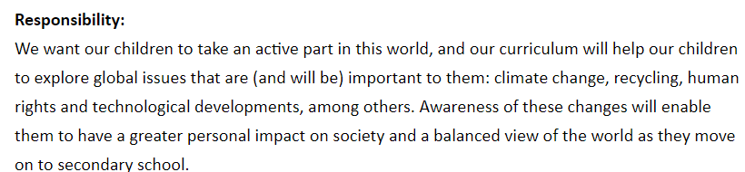

Ready Respectful Safe
A Values Curriculum
And this is how that looks…

Slide 19
Ready Respectful Safe
We are the authors
This is what we believe…
Muscliff children should receive the very best curriculum that is rooted in our values. We are proud of our bespoke curriculum offer.
So this is what we do…
We are the authors of our own curriculum. This means that we own it – we can shape and mould it, develop and add it, take it in any direction we choose… or even withdraw it altogether for something new. We work incredibly hard to ensure that this offer is as good as it can be for the children now. Our curriculum design takes a huge amount of effort and skill to create.
And this is how that looks…
Our curriculum starts with one value. We then carefully select an age-appropriate book that highlights that value effectively. The book we choose must have the ‘wow factor’ too and be an example of a text that we feel will inspire our children.
Next, we consider our key curriculum drivers and unpick objectives that would be taught best through this sequence. Ensuring curriculum coverage is important and the teacher’s knowledge of the year group is crucial. But ensuring progression of objectives across the whole curriculum (including Reception) requires a deeper knowledge of the curriculum. Teachers and Year Leaders are supported to make these significant changes to the curriculum. The impact is that our teachers develop their pedagogy and the children benefit from a wonderfully engaging curriculum.

Slide 20
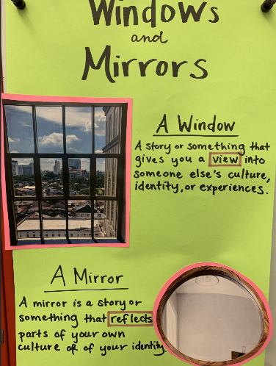
Ready Respectful Safe
Evolving Curriculum
This is what we believe…
Our curriculum should always evolve. We recognise that it must perpetually change and be reshaped and remolded so that it reflects our ever-changing world and local community. Our curriculum should be seen both as a mirror (to see the world our children are growing into) and a window (to the world beyond Muscliff).
So this is what we do…
We always seek ways to improve our curriculum offer to the children of Muscliff. Whether the change is fueled by our passion for books (for example, if we come across a new beautiful book that we feel our children simply must read) or if it is prompted by significant events and the changing landscape, we remain adaptable and reflective.
When we make changes to our curriculum, we consider what we know about the needs of our learners and look to evidence-based research; our curriculum is rooted in our culture of enquiry. By embracing change, we are creating a curriculum that is successive and durable.
And this is how that looks…
We expect our teams to be reflective about their curriculum and be prepared to make significant changes… or small tweaks. We need to know the needs of our cohorts in terms of their academic needs as well as their emotional-social needs. We must be experts in curriculum content and understand statutory objectives for every subject we teach.
We keep up to date with books that are appropriate for the age of children we teach.

Slide 21
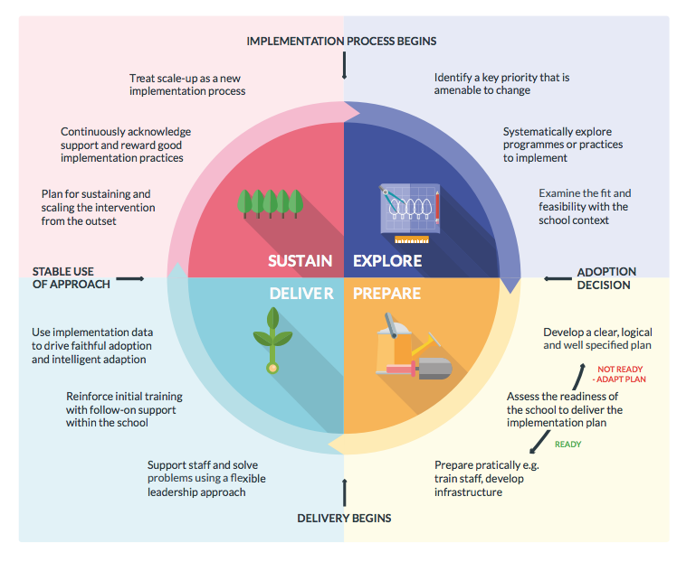
Ready Respectful Safe
Specific Schemes
This is what we believe…
There are some areas of the curriculum that should be taught through specific schemes. For example, schools are directed to adopt an accredited phonics scheme.
So this is what we do…
For the following curriculum subjects, we follow a scheme of work:
Phonics – Little Wandle
Mathematics – Maths – No Problem!
PE – Complete PE
French – Language Angels
ICT: Teach computing
RE: Discovery RE
And this is how that looks…
Each of the schemes have been adopted after careful research. We never adopt something on the basis of, “The school up the road is having success with this so let’s do the same.” In fact, where schemes are introduced, we do so using EEF’s guidance on implementing change. This is because we need to be confident that the scheme is well-matched to our needs and that we have considered fully the process involved in implementing this effectively. We believe that change is a process, not an event. Time is allowed to ‘explore’ a change fully, considering why this (and not something else)? We also ensure that the introduction of a new scheme is supported through best-quality CPD.

Slide 22
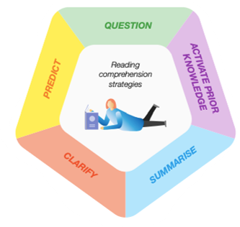
Ready Respectful Safe
Book Talk
This is what we believe…
The book talk is purposeful and seamlessly creates opportunities to explore comprehension strategies.
So this is what we do…
Book talk is our super-power! Language comprehension and composition are developed by talking, listening to and talking about stories, and by learning poetry and songs. We pride ourselves on the level of discussion of our texts and how language and vocabulary is explored. This year, Muscliff teachers are involved in CPD focussed on developing oracy in school through evidence-based research.
And this is how that looks…
Drama
Drama activities enable children to put themselves into the position of a character. This develops children’s inference skills as they need to interpret what they have read and link this to how a character is feeling.
Language
Language comprehension is the ability to understand the different elements of spoken or written language, like the meaning of words and how words are put together to form sentences.
Debate
Arguments are one of our favourites! This requires a more wholistic understanding of the text. Since structuring lessons using debate, our children have become much more efficient in tackling comprehension questions as they are more able to make a point, justify the point with evidence from what they have read but also look for further points to ‘back up’ their original idea.
The Author Craft
Here we analyse how and why an author writes a particular word or phrase. We noted from question level analysis that previously our children lacked the ability to answer questions that involved author’s choices.

Slide 23
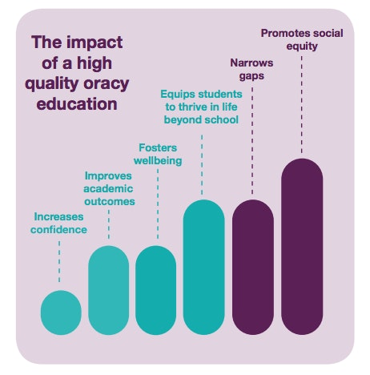
Ready Respectful Safe
Tell the Story
This is what we believe…
We know that communication skills, problem-solving skills and team working are viewed by employers as the most important soft skills. They value these skills above leadership, academic qualifications and understanding money skills. It is our duty to ensure our children are equipped for life beyond Muscliff and that starts with children’s ability to talk..
So this is what we do…
Our currency here is ‘talk.’
Successful learning means that children can ‘tell the story’ of their learning throughout the curriculum.
Our teachers are currently engaged in high-quality CPD linked to developing oracy and dialogic teaching.
Our ‘Book Talk’ is a key feature of what we do well here at Muscliff.
And this is how that looks…
Teachers recognise the value of talk and this is reflected in our curriculum offer.
We ensure pupils’ thinking is focused on key ideas within the subject and we does this through explicit sharing of key vocabulary. Vocabulary walls and knowledge organisers, alongside plenty of talk-based activities are how we promote language.

Slide 24
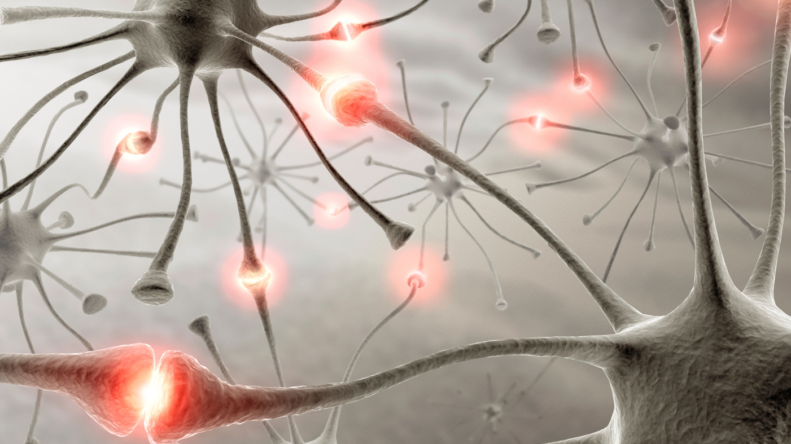
Ready Respectful Safe
Schema
This is what we believe…
Prior knowledge plays an important role in how pupils learn; committing key facts to long-term memory helps pupils to make sense of more complex ideas. Schema is a cognitive framework that helps us to organise and interpret information. As we take in new information, we connect it to other things we know, believe, or have experienced. Those connections form a structure in the brain.
A mental model or schema (plural schemata) is a pattern or network of thoughts, beliefs, and knowledge that organise categories of information and the relationships between them. Schema can be simple (e.g. cars are a kind of vehicle) or complex (e.g. to drive a car, you need to start the ignition, apply the clutch, put it in gear, check the mirrors, and so on).
So, this is what we do…
By encouraging pupils to think about how concepts relate to one another, we help them build increasingly complex and robust schemata. Metaphorically, schemata can be thought of as a system of hooks or shelves onto which pupils can hang, place or incorporate new knowledge, skills, beliefs and understandings. At Muscliff, we link what pupils already know to what is being taught (e.g. explaining how new content builds on what is already known).
We sequence lessons so that pupils secure foundational knowledge before encountering more complex content.
In all subject areas, pupils learn new ideas by linking those ideas to existing knowledge, organising this knowledge into increasingly complex mental models (or “schemata”); carefully sequencing teaching to facilitate this process is important.
We interweave concrete and abstract examples, slowly withdrawing concrete examples and drawing attention to the underlying structure of problems.
During our curriculum evenings for parents in 2023, we presented information about how we develop schema.

Slide 25
Ready Respectful Safe
Schema
This is what we do…
To help our pupils develop their schemata and build increasingly complex mental models we:
revisit the big ideas of the subject over time and teach key concepts through a range of examples
draw explicit links between new content and the core concepts and principles in the subject (e.g. by asking pupils to arrange ideas into categories - ‘Put together all the words that are about weather.’ ‘Arrange the images by the places you would expect to find them.’)
carefully sequence teaching to facilitate the process of organising knowledge into increasingly complex mental models (e.g. in maths, we organise a sequence of lessons where we introduce progressively less familiar quadrilaterals, always pointing out their common features)
when we want to get our pupils to think about how they learn (metacognition), we adopt a simple approach and repeat it often (e.g. use an acronym to help our pupils recall the steps)
Critical Thinking
Critical thinking describes the ability to obtain and analyse information about a given topic in an organised and rational manner, in order to understand the connections between concepts, facts and ideas, and to arrive at judgments or conclusions.
In order for critical thinking to take place, pupils must first have a secure knowledge of the concepts they are being asked to think about. It is difficult to think critically about a topic you know little about. However, there are also general aspects to critical thinking – aspects that are highly transferrable across subjects. These include constructing and deconstructing arguments, questioning, applying logic and reasoning, identifying and recognising logical fallacies, analysis, interpretation, inference, explanation, self-regulation, open-mindedness and problem-solving.
ensure they have a secure understanding of the subject area knowledge you want them to think critically about
invite them to think critically by sharing their reasoning and challenging the reasoning of others (e.g. by asking ‘What is your main reason for agreeing with Rhiala?’ ‘Why might Maddie have arrived at a different judgement?’)

Slide 26
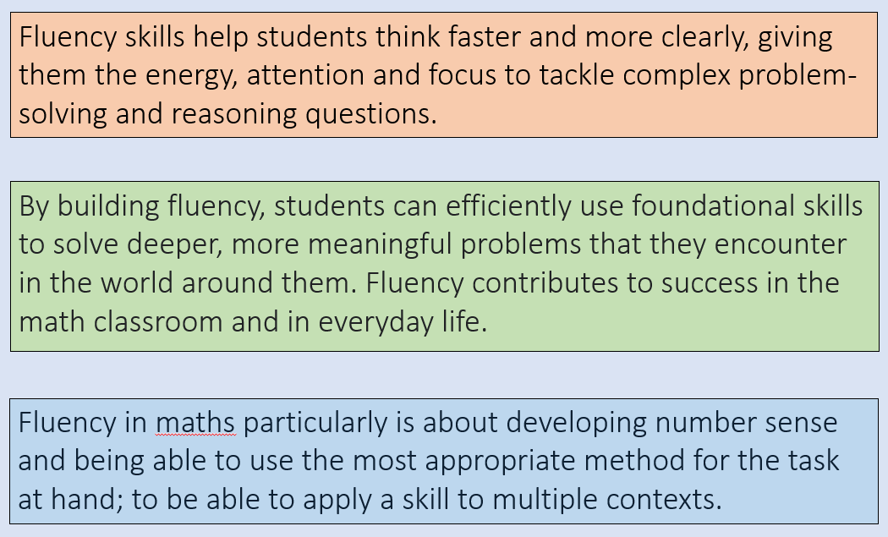
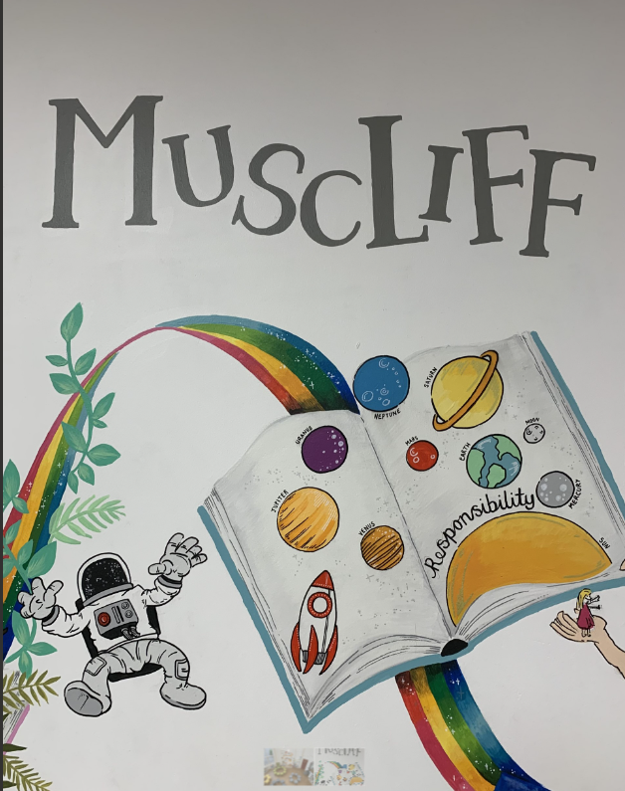
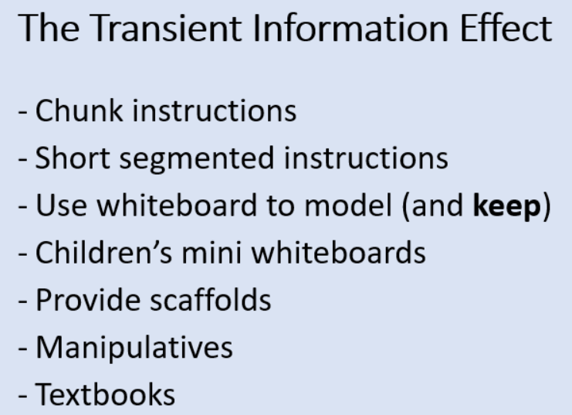
Ready Respectful Safe
Chunking Information
This is what we believe…
Giving manageable, specific and sequential instructions supports effective learning..
So, this is what we do…
We break complex material into smaller steps (e.g. using partially completed examples to focus pupils on the specific steps).
We reduce distractions that take attention away from what is being taught (e.g. keeping the complexity of a task to a minimum, so that attention is focused on the content).

Slide 27
Ready Respectful Safe
Spacing and Regular Practice
This is what we believe…
Spaced practice is a learning strategy whereby areas of the curriculum are broken up into short sessions, which are repeated over a longer period of time. This can be contrasted with ‘blocking’, whereby learning material is visited in large blocks which are not repeated. Spaced practice provides pupils with the time to form connections between the ideas and concepts, so that knowledge can be built upon and easily recalled later. By allowing a memory to be almost forgotten before it is next recalled, Ebbinghaus found the reactivation of the memory is more effortful, which strengthens neural pathways in the brain. When this process is repeated several times, the memory becomes stronger and much easier to remember. Requiring pupils to retrieve information from memory, and spacing practice so that pupils revisit ideas after a gap are likely to strengthen recall.
Regular purposeful practice of what has previously been taught can help consolidate material and help pupils remember what they have learned.
So, this is what we do…
To help with our pupils’ progress using spacing:
We consider how our curriculum is arranged and where the opportunities may be to introduce more spacing
We make sure we enable pupils to master foundational concepts first
We combine with retrieval practice activities such as low-stakes quizzing to improve recall
We balance exposition, repetition, practice and retrieval of critical knowledge and skills.
We plan regular review and practice of key ideas and concepts over time.
We design practice, generation and retrieval tasks that provide just enough support so that pupils experience a high success rate when attempting challenging work.
We increase challenge with practice and retrieval as knowledge becomes more secure (e.g. by removing scaffolding, lengthening spacing or introducing interacting elements).

Slide 28
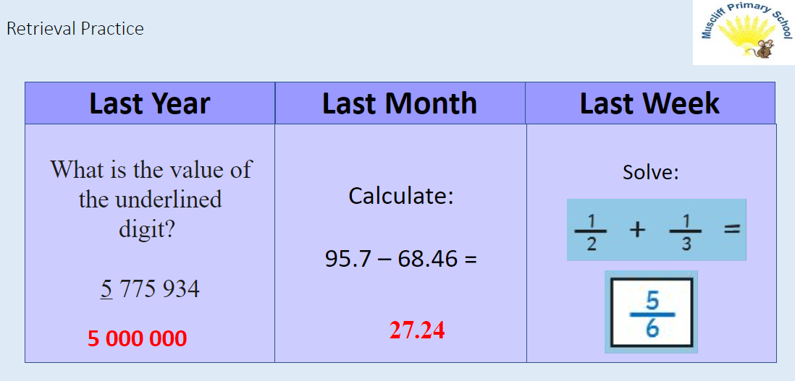
Ready Respectful Safe
Spacing and Regular Practice
So, this is what we do…
To help our pupils to improve recall, we:
require them to retrieve information from memory. (This can take the form of frequent, low-stakes quizzing; or we could ask them to demonstrate a previously taught skill so we can see what they have retained.)
try revisiting material from ‘last lesson, last week, last term’: lengthening the spacing increases the challenge and can strengthen recall, i.e. spacing the practice

Slide 29
Ready Respectful Safe
Consolidation
This is what we believe…
Consolidation refers to the process of strengthening or stabilising new memories, transferring new learning from short- to long-term memory storage. When a memory is created (or ‘encoded’), many aspects of that memory (including the context within which the learning occurred) are also stored. Teachers can draw upon this ‘coding’ to help their pupils consolidate new learning, as well as to recall learning stored in their long-term memory.
So, this is what we do…
To help our pupils to consolidate their learning, we:
give concrete worked examples and elaboration (e.g. explaining the new learning to someone else, or showing models of ‘what good looks like’)
give plenty of opportunity to retrieve knowledge that they might have begun to forget (e.g. by spacing your initial teaching and revision and doing recall activities such as low-stakes questioning)
establish ‘talk-partners’ within our classes, so that pupils establish the good habit of explaining things to one another
Cognitive Overload
To help our pupils avoid cognitive overloading of their working memory, we:
take account of our pupils’ prior knowledge when planning how much new information to introduce (e.g. in the previous week, do a quick diagnostic assessment using mini whiteboards or do some true/false questioning)
break complex material into smaller steps (e.g. use partially completed examples to focus pupils on each specific step)
reduce extraneous load that may divert attention away from key information (e.g. removing unnecessary animation or images from a PowerPoint slide or simplifying and sequencing instructions so that they are clearly and logically stated)
remind pupils of what they have already been taught and how the new information that they are being introduced to relates to this (e.g. by explicitly comparing content in the current lesson to that in past lessons)

Slide 30
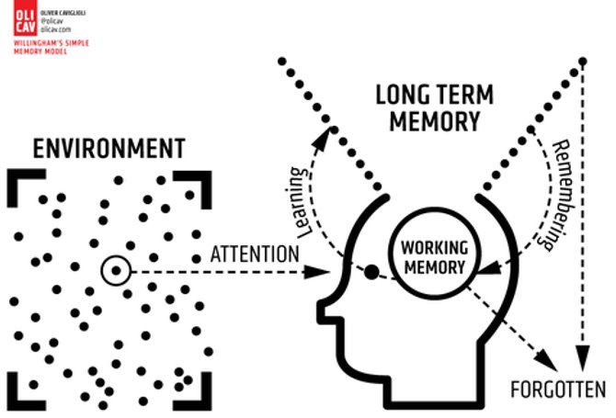
Ready Respectful Safe
Memory
This is what we believe…
An important factor in learning is memory, which can be thought of as comprising two elements: working memory and long-term memory. For something to be learned, the learner needs to focus on that specific thing, process it in the working memory and then commit it in a meaningful way to the long-term memory. At every stage, forgetting is an inevitable part of the process. We shouldn’t be surprised when it happens to children as it happens to us too! ​
Working memory is where information that is being actively processed is held, but its capacity is limited and can be overloaded.
Long-term memory can be considered as a store of knowledge that changes as pupils learn by integrating new ideas with existing knowledge.
So, this is what we do…
To help our pupils to learn more effectively, we:
build in opportunities for regular, purposeful practice of what has been learned (e.g. by getting into the habit of building practice time into all of our lessons. Practice can be done singly, in pairs or in larger groups)
help our pupils strengthen their long-term memories (e.g. for factual recall, by quizzing them to recall recent learning, and repeating this with longer intervals; for practical skills like catching or drawing, we can space their practice over a period of time)
anticipate misconceptions that are common within the areas we teach and develop ways of catching and correcting these (e.g. by using a series of focused multiple-choice questions to identify common misconceptions; the nature of incorrect answers can inform our teaching, so these questions are sometimes called diagnostic questions)

Slide 31
Ready Respectful Safe
Modelling
This is what we believe…
Worked examples that take pupils through each step of a new process are likely to support pupils to learn.
So, this is what we do…
Modelling is an instructional strategy in which the teacher demonstrates a new concept or approach to learning, and pupils learn by observing. It describes the process of learning or acquiring new information, skills, or behaviour through observation, rather than through direct experience or trial-and-error efforts. Modelling involves using a new method or concept as part of the instruction process, so that pupils can hear or see what you intend them to do. It helps them to understand more clearly how to solve a problem or construct a sentence, for example, by seeing it being done. It also enables them to practise more effectively, and therefore encode and consolidate the new learning in the long-term memory. Examples of modelling include written, visual or video guides, scaffolding, and worked examples.
Worked examples involve pupils studying the solved ‘problem’, rather than solving the problem themselves. They are highly effective because they reduce cognitive load, allowing pupils to focus on one step of a problem at a time without ‘getting lost’ in the problem. The aim is for the pupils to gain as close an understanding as possible of what their teacher sees as a high-quality model.
And this is how that looks…
Muscliff teachers use a wide variety of modelling techniques throughout the day and we often use ‘live’ modelling with the children. Whatever is being modelled, our teachers verbalise the thought process for the children – it’s powerful when children ‘hear’ how the teacher approaches a question/task, particularly when the teacher has to make decisions or overcome a difficulty. This creates empathy. Here’s a real example: the teacher modelleda sentence on the board. They verbalised the whole process: “In my first sentence I want to express how I feel about Victor Frankenstein. I am disgusted by your behaviour. Actually, I think I will go for appalled.” The teacher then began to write. “Oh. I can never remember if appalled is one letter p and then two letter ls or two ps and two ls…” Modelling allows a teacher to show that success requires thought.

Slide 32
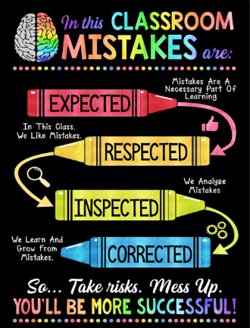
Ready Respectful Safe
Mistake-Friendly Classrooms
This is what we believe…
Mistakes are expected, inspected, respected and corrected.
So, this is what we do…
Before we begin to consider using mistakes as a springboard for learning, the learning environment and classroom culture needs to be ready for it. Create a positive environment where making mistakes and learning from them and the need for effort and perseverance are part of the daily routine.
And this is how that looks…
From the outset, we establish mistake-friendly classrooms through Ready, Respectful, Safe. When we feel safe in our classrooms, we are able to have a go and not feel embarrassed. Being incorrect does not come with risk. Respectful means we support our peers and do not make judgements. The key to our success is through praising mistakes and welcoming them when they arise - not stigmatising mistakes, or the children who make them. In our mistake-friendly classrooms, teachers use errors as opportunities to assess how students are understanding the learning and to support their critical thinking skills.
‘A Wise Error’ – one technique we use here is ‘which wrong answer is more right?’ It’s often the case that one answer is more right than another—that there’s some element of correctness even in incorrect answers. That creates an opportunity to tease out subtleties. We like to call these ‘wise errors.’
‘Own your mistakes’ (and this can be applied to our approach to social/emotional literacy as well as the academic side of things.
And once children feel able to make mistakes, that’s when the real learning happens.

Slide 33
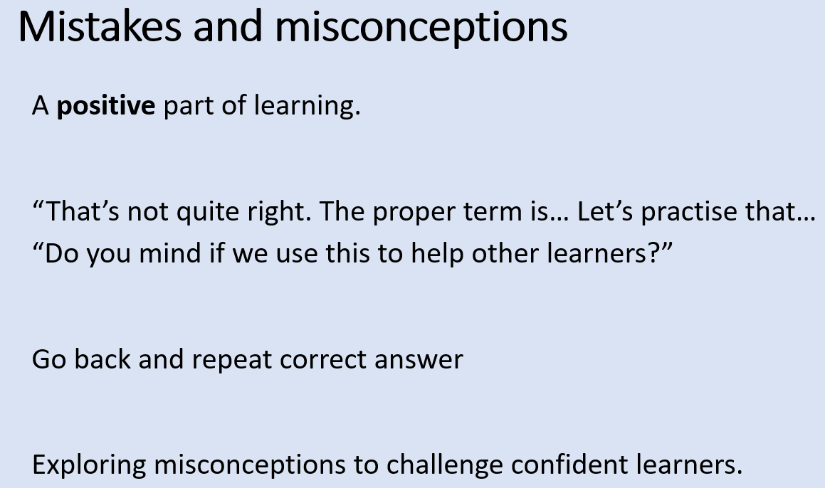
Ready Respectful Safe
Misconceptions
This is what we believe…
Misconceptions are an inevitable part of learning which arise when learners make connections between new information and prior experience. It is essential to identify, address and clarify misconceptions so that new learning can be based on sound knowledge and fact.
So, this is what we do…
We consider children's possible misconceptions at the planning stage – this equips teachers with pre-formed, clear explanations and a range of examples to draw upon.
We address these difficult points (rather than avoid them) which enable the children to acquire new knowledge and skills effectively.
One of the keys to doing this well is Plan for Error, a daily part of our morning briefings in which teachers anticipate student errors and their responses to them. We identify possible misconceptions – discuss these as a team – and then plan how to prevent these forming. And by expecting certain misconceptions we can, alternatively, build these into our lessons deliberately and scaffold a pre-anticipated misconception. Sometimes we might not want to deny the children of an important learning opportunity; sometimes exploring a misconception is even more powerful than not making the mistake in the first place..
We encourage pupils to share emerging understanding and points of confusion so that misconceptions can be addressed.

Slide 34
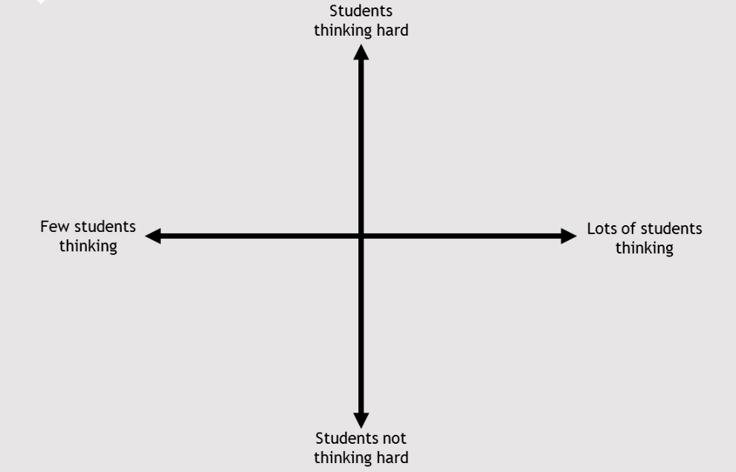
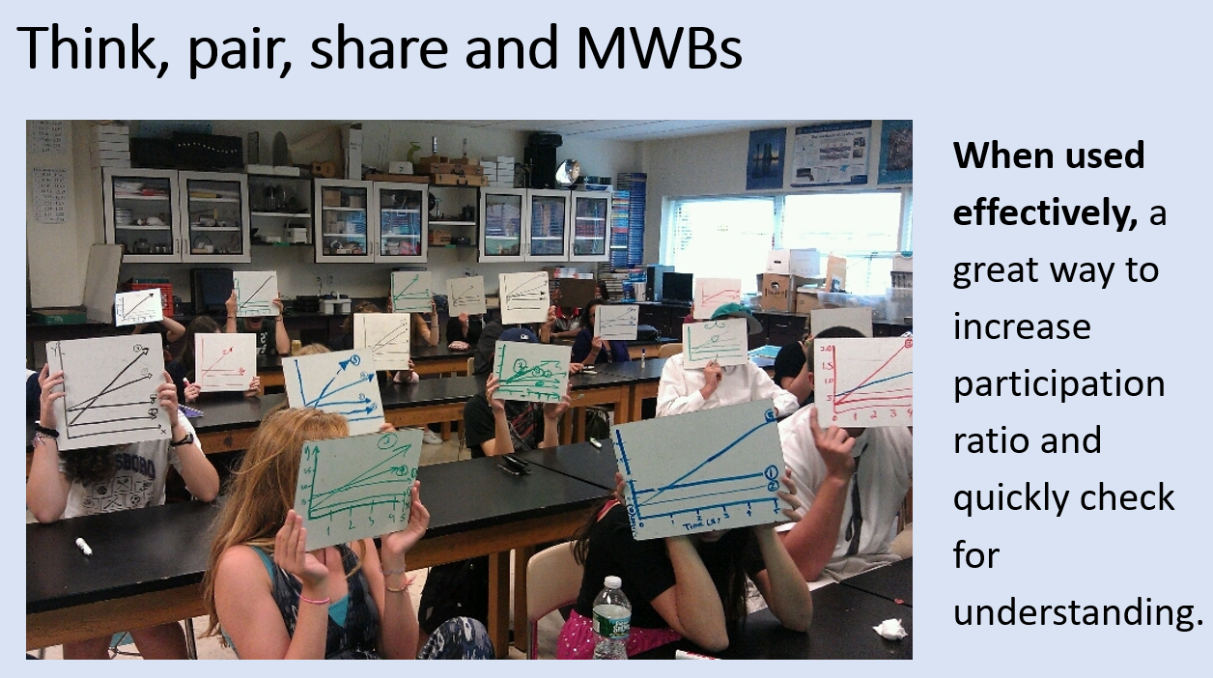
Ready Respectful Safe
The Ratio Lens
This is what we believe…
The most effective questioning should aim to increase pupil participation.
We need to ensure all pupils are engaged and thinking.
So, this is what we do…
We draw on Doug Lemov and Adam Boxer’s work on The Ratio Lens to help us to use questioning more effectively.
Participation ratio: how many of your students are participating and how often?
Think ratio: when they are participating, how hard are they thinking?
And this is how that looks…

Slide 35
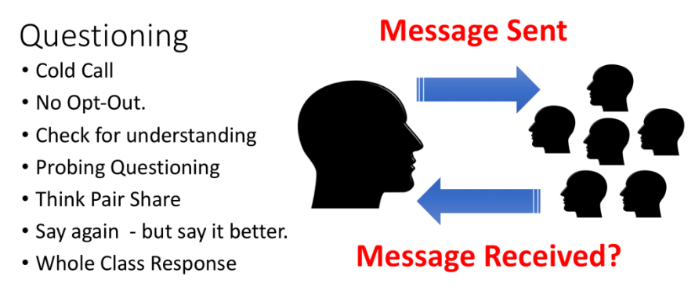
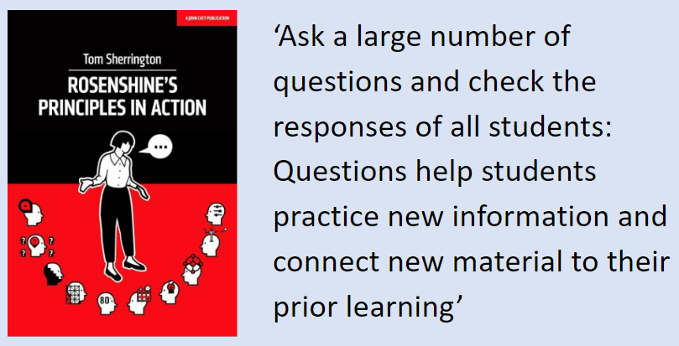
Ready Respectful Safe
Questioning
This is what we believe…
Questions help students practise new information and connect new material to their prior learning whilst allowing the teacher to check for understanding.
So, this is what we do…

Slide 36
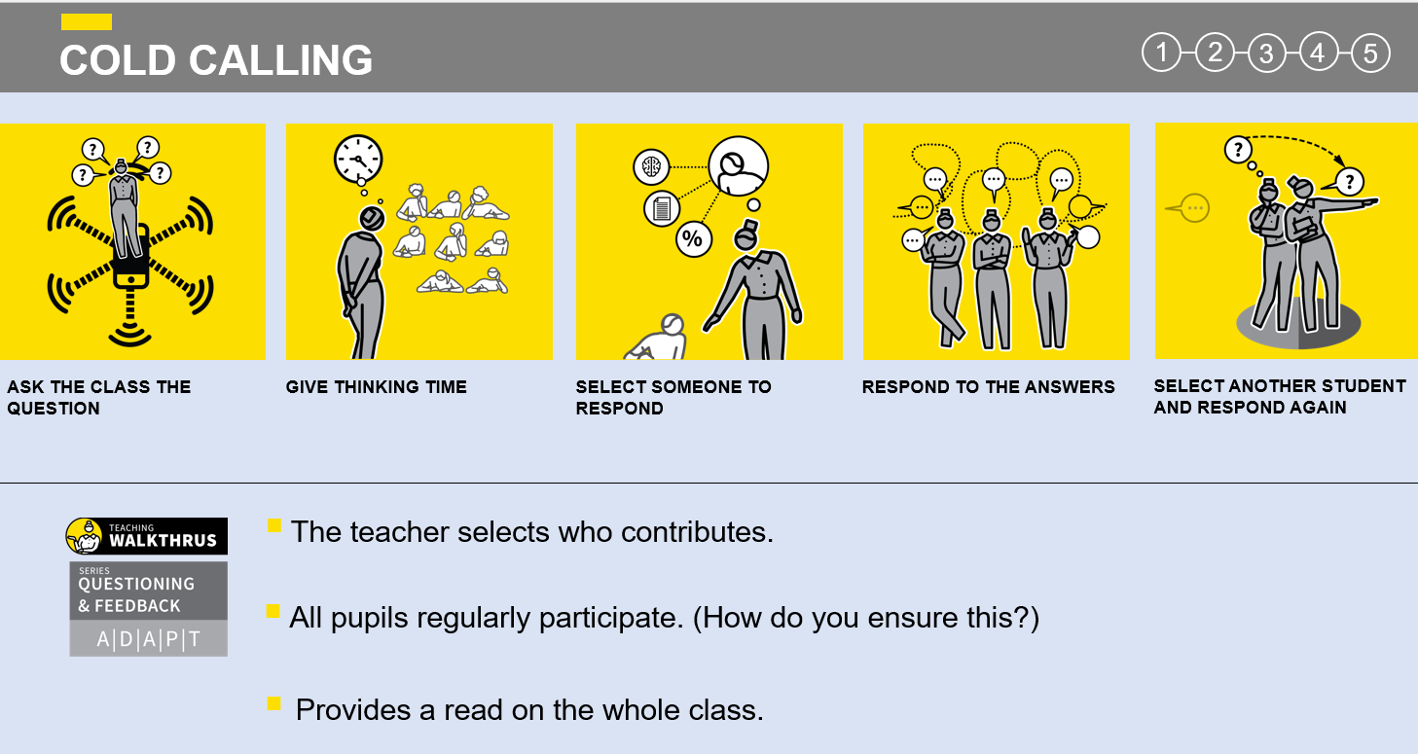
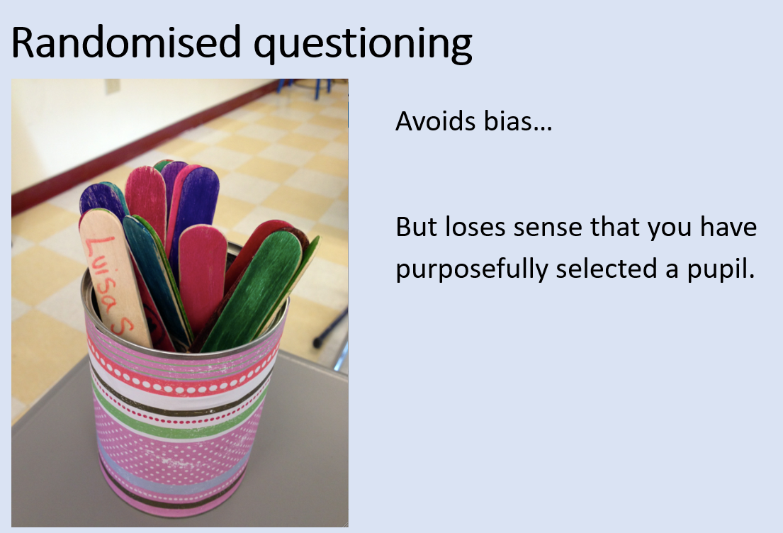
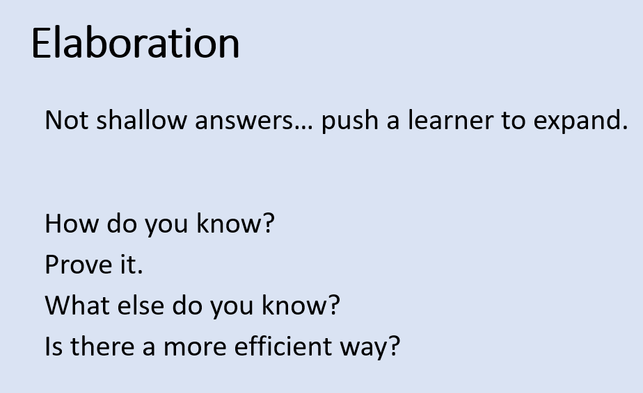
Ready Respectful Safe
Questioning
And this is how that looks…
Our middle leaders researched questioning and created a sequence of staff meetings to disseminate best practice.

Slide 37
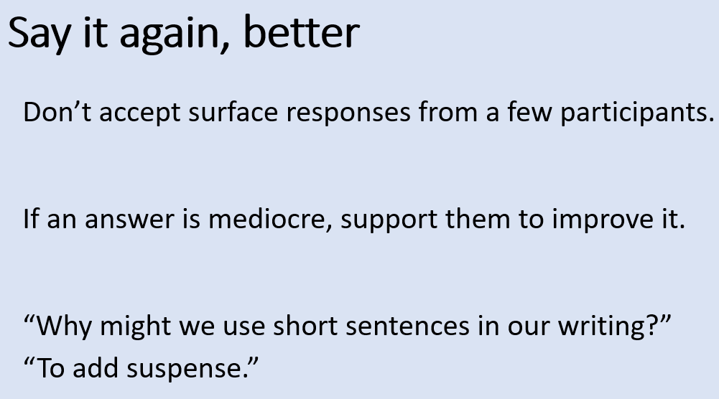
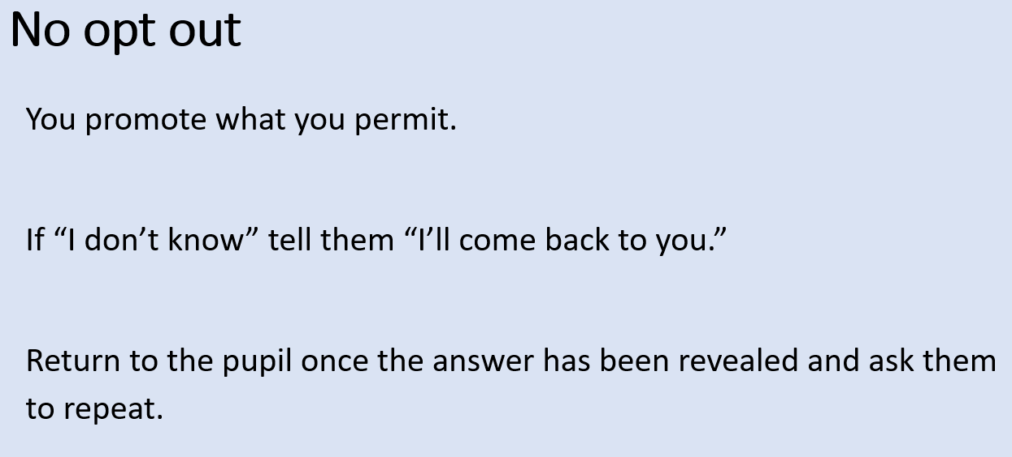
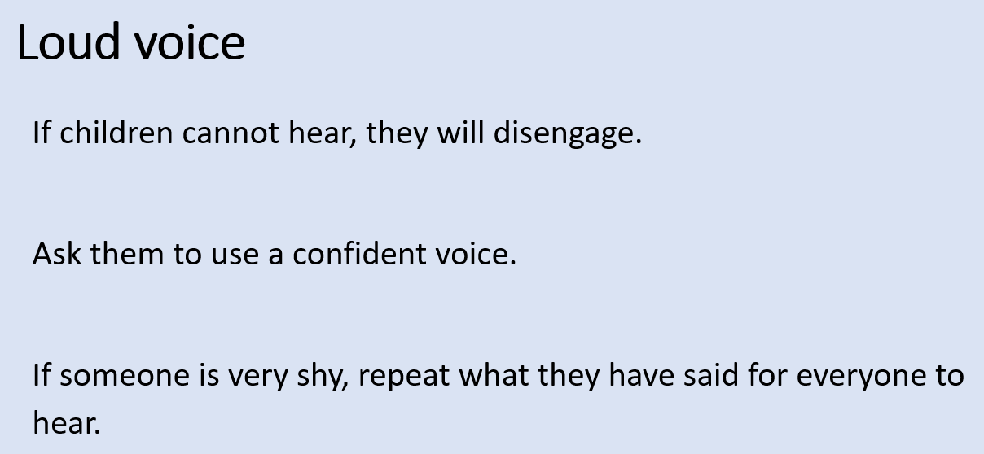
Ready Respectful Safe
Questioning
And this is how that looks…

Slide 38
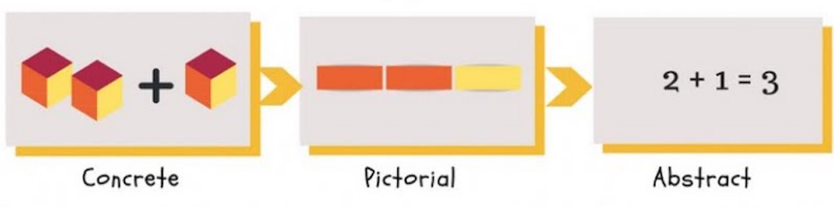
Ready Respectful Safe
Concrete Representation
This is what we believe…
When introducing abstract ideas, it is important to use concrete representations. These might take the form of analogies, metaphors, examples and non-examples. Teachers often over-estimate their pupils’ grasp of the abstract and then overlook the misconceptions that can arise. Numbers are abstract, as can be such concepts as the ‘Church’ (i.e. the institution), verbs, the past or ‘science’.
So, this is what we do…
use manipulatives (e.g. place value counters, Cuisenaire rods, shapes)
construct number lines and timelines
use play and drama to ‘act out’ words and concepts
provide a range of contexts to build robust schema (e.g. when providing a definition for an unknown word, provide examples in different contexts, including contexts that pupils can relate to, to strengthen their understanding of the meaning.)
when using graphic representation, make sure you are not introducing a new misconception (e.g. an image of a church building may not help pupils appreciate the idea of Church as an institution)
And this is how that looks…
In maths, we use a concrete, pictorial, abstract approach (CPA) in which new concepts are introduced using concrete representations which allow pupils to get to grips with new learning. When ready, children will start to use pictorial representations before moving on to use abstract methods. This process supports children to develop strong conceptual understanding which leads to mathematical fluency. With mathematical fluency pupils have a secure understanding of mathematical concepts which they can deploy flexibly and adapt as required for a given problem.

Slide 39
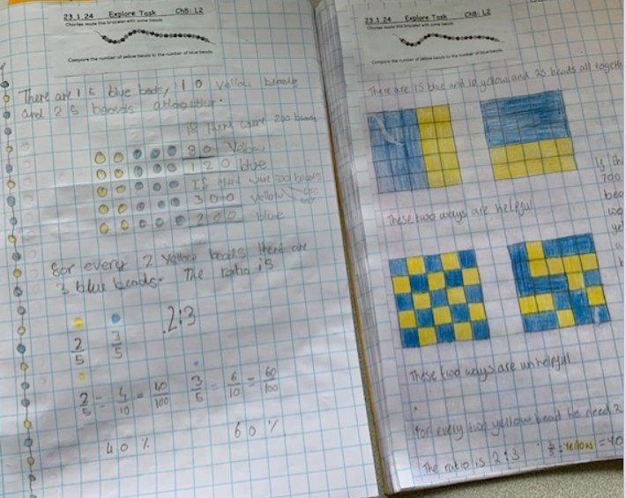
Ready Respectful Safe
Mastery
This is what we believe…
When we considered mastery within our bespoke curriculum, which understood that a key feature is planning the curriculum so that it is carefully sequenced, allowing pupils to learn foundational concepts first – concepts that are needed in order to understand more complex information. Examples of foundational concepts include learning the alphabet and phonetic sounds in literacy; learning to count, add and subtract in mathematics; and learning about cells and atoms in science. Over time, building up foundational understanding can help pupils develop confidence in their ability to recall relevant information while their knowledge gradually becomes more complex, and external support (or scaffolding) is gradually withdrawn.
So, this is what we do…
To help our pupils to master foundational concepts:
with our colleagues (such as our Curriculum Leader and individual subject leaders), we identify what these are and ensure they are prioritised in our curriculum
with colleagues, identify the likely common misconceptions that can hamper understanding of important concepts
give concrete examples and metaphors as these are often useful in helping pupils understand abstract concepts (e.g. stories and narratives, sayings, rules, mnemonics, equations and models. Sometimes it is helpful to think of real-world examples, of where Muscliff pupils might see or apply their new learning.)
And this is how that looks…
Mastery in maths
In maths, teaching for mastery allows all pupils to enjoy mathematical exploration and succeed in their learning. Key concepts are broken down into small steps with significant time invested to develop a securing understanding before moving on to new ideas. Pupils explore maths using a CPA approach
and apply their maths skills in real-life contexts. Pupils
make links between new learning and their prior
knowledge and face challenges with an inquisitive and
open mind. Key number facts are learnt to automaticity
to avoid cognitive overload and plenty of time is given
to explore concepts in depth and for pupils to explain
their understanding.

Slide 40
Ready Respectful Safe
Pedagogy and CPD
This is what we believe…
Secure subject knowledge helps teachers to motivate pupils and teach effectively. There is therefore a need for teachers to maintain and extend their subject and curriculum knowledge throughout their careers.
So this is what we do…
We improve your subject knowledge by:
engaging in high-quality subject-specific professional development (e.g. by doing development work such as planning and moderation with colleagues in school and in wider networks)
participating in wider networks of fellow professionals
building a repertoire of resources, illustrations and explanations by working with experienced colleagues. These colleagues may be in our school or members of networks (including online networks) which generate, share and critique such resources.
And this is how that looks…

Slide 41
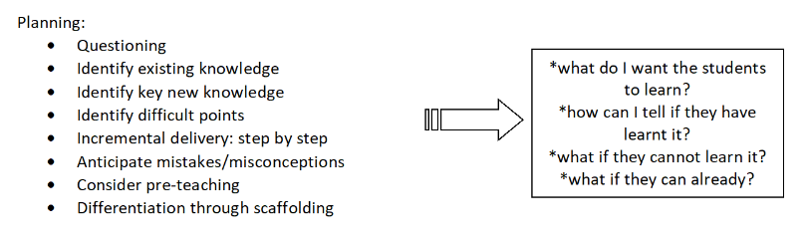
Ready Respectful Safe
Planning
This is what we believe…
We believe the best type of planning is derived through professional dialogue within a culture where teachers are prepared to share their best ideas and learn from one another. Planning is critical and underpins effective teaching, playing an important role in shaping students’ understanding and progression. It is the area of work where Muscliff teachers bring their passion and their desire to make a difference together.
So this is what we do…
When teachers meet, we focus on:
And this is how that looks…
Unit plans, long-term overviews medium-term plans, lesson slides… much thought goes into ensuring the children of Muscliff receive a tailored provision. The process of planning is efficient here: we require every lesson to be a high quality, effective learning opportunity. At the same time, we do not create unnecessary workload due to planning and paper-burden. Lesson planning is a thinking process, at the heart of teaching, and whilst individual lesson plans can contribute to this process, they can be a proxy for teaching: detailed daily or weekly plans are not something that are expected here at Muscliff. We want our teachers to spend that time on those things that have the most impact.
There are fundamentals that must be considered during our planning sessions.
Prior Learning: What do you need to know before you begin your lesson planning for a class?
Aim: What is the outcome?
Success Criteria: What does each layer of the learning look like?
Key Vocabulary
Specialist Subject Knowledge
Assessment Opportunities
Differentiation/Provision
Team meetings, shared reflections at the end of the day (with a Learning Log) and morning briefings are the opportunities for the most effective planning time. Our use PPA time efficiently: full-time teachers will be allocated a full day of PPA every fortnight.

Slide 42
Ready Respectful Safe
Verbal Feedback
This is what we believe…
Our Muscliff ethos, underpinned by the five values, Resilience, Responsibility, Kindness, Curiosity and Aspiration drive all of our policies. These values are therefore reflected in our approach to feedback. We are committed to nurturing a growth mindset through our approach to feedback, which celebrates mistakes and empowers children to reflect on misconceptions. Our approach, using Live Feedback, aims to facilitate the best possible use of learning time: we promote a dynamic response to the learning moment, adapting and tailoring sessions at the point of learning.
Resilience – our feedback approach at Muscliff allows learners to recognise that ‘being wrong’ is integral to learning. Rather than letting difficulties or failure overcome them and drain their resolve, resilient children use their mistakes as a learning opportunity to improve and come back even stronger – just like our very own Muscliff Mouse. We celebrate ‘wise mistakes’ and deepen understanding by ‘unpicking’ and exploring why particular mistakes have occurred.
Responsibility – our feedback approach recognises that feedback should empower children to take responsibility for improving their own work and their learning; it should not take away from this responsibility by adults doing the hard thinking work for the pupil. Feedback is specific, accurate and clear. We ‘find and fix’ and have a responsibility to react to valuable criticism.
Curiosity – we understand that curiosity drives pupil engagement. When we dare to follow our curiosity, we step out of our comfort zone. It’s here where the real learning happens. Curiosity is triggered when we become aware of a gap in our knowledge and our approach to feedback celebrates children who are able to refocus their learning to address misconceptions themselves with support. Children ask questions to further their understanding and look for their own answers. ‘Monty Says’ develops curiosity and prompts children to explore their learning from a different perspective.

Slide 43
Ready Respectful Safe
Verbal Feedback
Aspiration – feedback at Muscliff is developmental. It redirects or refocuses either the teacher’s or the learner’s actions to achieve a goal. Feedback alerts the teacher to misconceptions, so that the teacher can address these in subsequent lessons. Feedback must focus on deepening children’s understanding, driving them to aspire.
Kindness – feedback at Muscliff is also motivational at all levels; it encourages an enthusiasm to learn. Our approach supports a classroom environment where children feel safe to ‘have a go’ and their learning is valued. We celebrate our own mistakes and the mistakes of others without fear of reprimand or condemnation. It is a kindness, mindfulness and empathy that allow us to understand mistakes and use these to move forward.
Our Aims of feedback:
An ethos in which teachers can focus on the learning of pupils.
An approach that emphasises that every learning moment matters.
Exploit learning opportunities by unpicking misconceptions.
To anticipate misconceptions and plan for these.
To use teacher time more effectively to plot next steps.
An environment where teachers provide instant verbal feedback in lessons.
Foster targeted talk about knowledge and skills.
Encourage children to think about where they’re going, how well they are getting on and what’s next.
encourage, motivate, support and promote positive attitudes
celebrate achievement, presentation and effort
show pupils that we value their learning

Slide 44
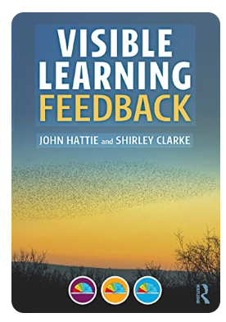
Ready Respectful Safe
Verbal Feedback
Where our approach originates:
At Muscliff Primary School, feedback is valued as an intrinsic and continuous part of the teaching and learning cycle, and we aim to maximise the effectiveness of its use in practice. We are mindful of the research surrounding effective feedback, including ‘Visible Learning’ and we also recognise the workload implications of written marking.
This policy is underpinned by theories of effective feedback, such as those developed by John Hattie. We recognise recommendations set out by the DfE. This policy is supported by the evidence of best practice from the Education Endowment Foundation.
And this is how that looks…
High quality feedback from all adults - at the point of children working - is one of the factors that we know has a huge impact. This could be verbally or in writing and is given to children immediately during the lesson. This is called ‘Live Marking’ and it makes a huge difference to how much progress children make every lesson. Many schools have adopted this approach already.
‘Live Marking’ means that rather than asking our adults to write long comments after the children have finished their work, we spend that time after a lesson reflecting on that recent learning and in designing and tailoring the next steps instead; this is more effective use of this time.
Providing verbal feedback was one of the changes that we made to support teachers’ workload. This decision was made following a research project as part of an NPQH.

Slide 45
Ready Respectful Safe
Reflection and Action
This is what we believe…
Teacher “reflection” as the way in which teachers construct the meanings and knowledge that guide their actions in the classroom.
So this is what we do…
Learning Logs are used to prompt teachers to reflect. Teachers keep a Learning Log as part of their day-to-day practice which is used before, during and after each lesson. In the first instance, the Learning Log is used to anticipate and plan for misconceptions, detailing where children may need support (based on strong teacher pedagogy and through looking at previous logs, anticipating where the teaching might need further unpicking to facilitate excellent learning). This prompts teachers to adapt their lesson resources or plan for more targeted questions. During the lesson, teachers may make notes in their logs – this is to reinforce the importance of continual reflection. At this point teachers reflect on what they might do differently to change the current course of learning. Every lesson counts and our approach reinforces this ethos. The Learning Log also tracks pupils’ achievements and recognises when children have shown deeper insight to their learning. At the core of the learning log is continued observation and next step dialogue. When children have found learning harder to access, the teachers reflect on how they might work differently to ensure good progress.
An 8.15am morning briefing gives the whole year team to discuss learning form the previous day and any adaptations to lessons for the coming day.
And this is how that looks…
Rather than spending hours marking, invest that time in ACTION. Muscliff teachers DO SOMETHING that leads to change.
Best practice is to act during the lesson. But we realise that this isn’t always possible. A change might be that teachers create a keep-up task for specific children. It could be that an additional resource is woven into tomorrow’s lesson to address a concept that wasn’t quite secure. The action will vary depending on the teacher’s reflection. It could be individualised, something for a group or class or an action for the whole year group.
Teachers talk about their reflections to support them in determining the best possible action.

Slide 46
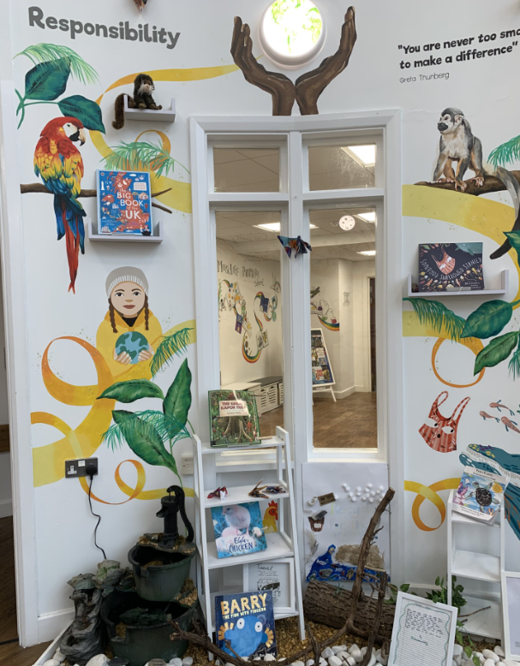
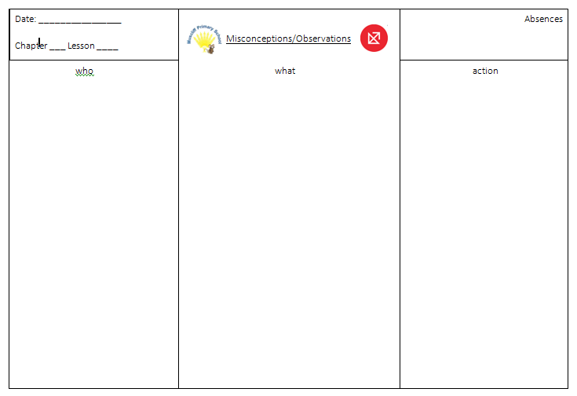
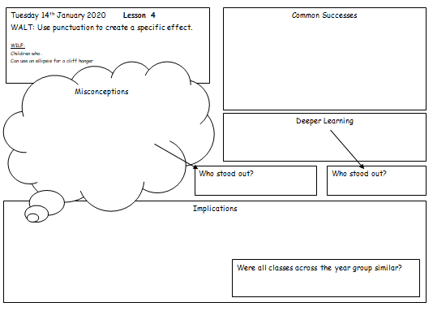
Ready Respectful Safe
Learning Logs and Verbal Feedback
Here is what a log sometimes looks like. Year groups will often adapt the layout so that it works for them. We regard the Learning Log to be a personal document that supports teachers’ reflection rather than something to just ‘tick a box.’ This means that document needs to work for the individual teacher to prompt their reflection and to support them when they engage in dialogue with their colleagues.
The log is part of scrutiny… but this is always done alongside the teacher who talks about the lesson and how learning was moved forward.
And this is how that looks…

Slide 47
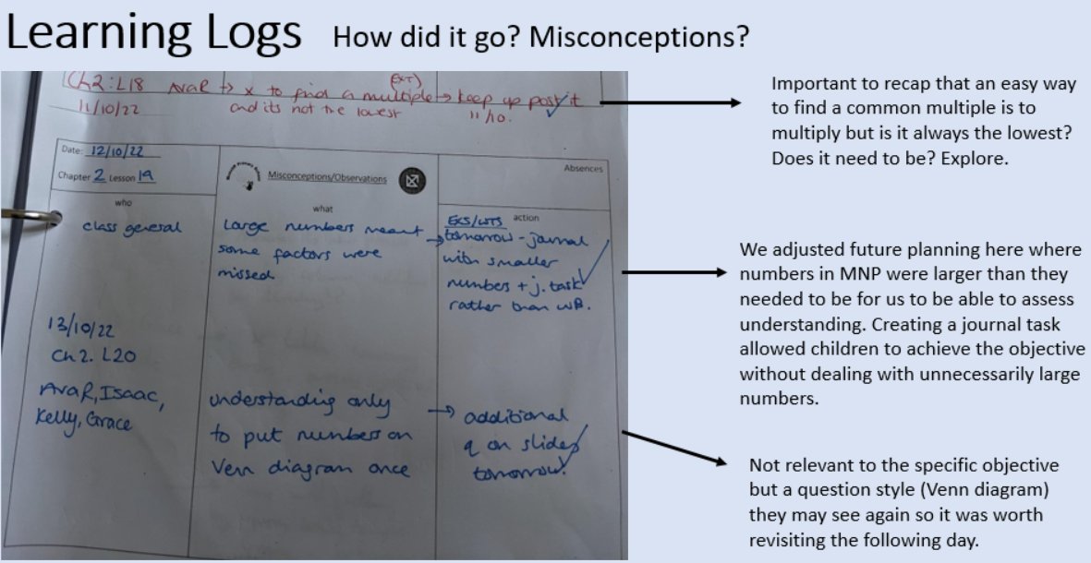
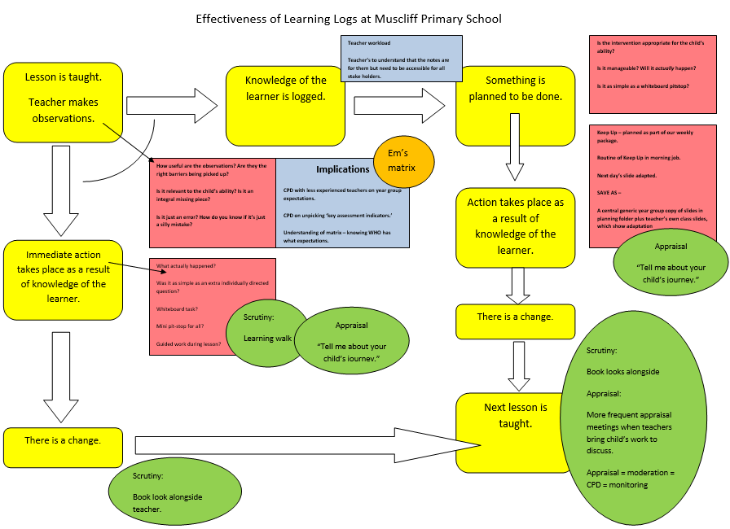
Ready Respectful Safe
Learning Logs and Verbal Feedback
And this is how that looks…

Slide 48

Ready Respectful Safe
Adaptive Teaching
This is what we believe…
Adaptive teaching involves being flexible and responsive about the methods used in lessons to ensure that they can meet the needs of all pupils and deviate from the lesson plan, where necessary. Adaptive teaching requires a reflective approach, since the teacher needs to be able to acknowledge the need to change the strategy being used. Although adaptive teaching is easier with experience, it can be achieved early in a teacher’s career through careful planning – by anticipating pupil misconceptions before they arise, for example. It is important that this is done in response to pupils’ needs, not as an artificial process which breaks the flow of the lesson.
Adaptive teaching includes providing targeted support to pupils who are struggling, but creating separate distinct tasks for different groups is less likely to be valuable: it risks lowering expectations for some, and it can add unnecessarily to workload.
So this is what we do…
intervene within lessons with individuals and small groups
divide your support between the whole class, specific groups and individuals (e.g. it is often possible to set up a whole-class independent task, freeing you to give extra support to a group or individual)
while maintaining high expectations for all, you can vary the quantity of work you demand from some or the amount of time you allow some to complete it
use and reuse templates, writing frames, key concepts mats and other worked examples as scaffolds you can easily introduce or withdraw as you adapt your teaching
And this is how that looks…
A mini pitstop
Use or resources and manipulatives
Further questioning
Working with an adult
Keep Up after the session
A specific morning ‘job’

Slide 49
Ready Respectful Safe
Formative Assessments
This is what we believe…
Formative assessment is a powerful way of improving pupils’ achievement and progress. It helps children to measure their own strengths and areas for development.
It allows teachers to understand pupil performance on a continuing basis, enabling them to identify when pupils are struggling, when they have consolidated learning and when they are ready to progress. In this way, it supports teachers to provide appropriate support (scaffolding or corrective activities) or extension (enrichment activities to deepen understanding) as necessary and informs progress. It enables teachers to evaluate their own teaching of particular topics or concepts and to plan future lessons accordingly.
So this is what we do…
Formative assessments are used to:
identify children’s strengths and gaps in their skills/knowledge
identify next steps for learning
inform future planning
enable appropriate strategies and scaffolding to be employed
facilitate the setting of appropriate targets for the class, group, and individual
track children’s rate of progress
support an evaluation of the effectiveness of teaching and learning
inform future teaching and learning strategies
identify individuals and groups for specific intervention or “keep up” support.
And this is how that looks…
Termly Progress Meetings (Reception – Year Six)
Teachers and their year lead will meet at least once a term to review outcomes of formative and summative assessment data gathered during the term, sometimes alongside a Deputy/Assistant Head teacher/ SENCo. The progress of each child will be examined, alongside that of the cohort as a whole and also different groups of children. This may be supported by SLT analysis of Insight data which may also identify similar or additional areas to focus on. These meetings will inform intervention and booster groups for the following term and a ‘Year Group Profile’ will be updated accordingly.

Slide 50
Ready Respectful Safe
Formative Assessments
And this is how that looks…
Formative assessment takes place continually in the classroom. Typical methods of formative assessment include:
Use of Learning Logs (see below) used for English and mathematics
Activating/re-visiting prior learning
High quality, targeted questioning developed through our CPD
Ongoing observations and record keeping
Range of opportunities for pupils to make their learning visible, for example, using practical apparatus and manipulatives
Discussions with children – as well as doing much talking here at Muscliff, we do an equal amount of listening.
Partner talk and strategic seating plans allow peer learning – teachers invest much thought in pairings that lead to effective learning
Mini Whiteboard work is used frequently in the classroom as a quick and easy way for the teacher to see who has ‘got it’
Presenting and addressing misconceptions are seen as a springboard for even more learning (see separate section)
Verbal and written feedback (read on)
Children’s self-assessment and ‘purple polishing pen.’
Short quizzes are used as a low stakes assessment method. This also provides opportunities for spacing teaching and assessment
Number sense/ Number Bond Awards (see Maths Fluency policy)
Little Wandle assessments – used continuously to identify gaps and to assign phonics based reading books to support current learning. Heat maps are used as a robust assessment tool
Spelling tests are used each week to track key words and recently taught patterns
End of topic/unit assessments support in achieving an overall teacher judgement for each curriculum subject.
Doodle Maths

Slide 51
Ready Respectful Safe
Summative Assessments
This is what we believe…
Summative assessment is important for informing parents/carers, governors and teachers of children’s attainment and progress. This will also inform whole school target setting and prediction of a cohort’s future attainment.
So this is what we do…
Summative assessments are used to:
identify attainment through one-off standardised tests at any given point in time
record performance in a specific area on a specific date
provide age standardised information
provide end of key stage test data against which the school will be judged
ensure statutory assessments at the end of EYFS, Year 1,KS1, Year 4 and KS2 are met
provide information about cohort areas of strength and weakness to build from in the future, through Question Level Analysis where possible.
And this is how that looks…
Year groups complete summative assessments at the end of each term. At Muscliff we use NfER tests as we appreciate how the content reflects the time of the year. We chose NfER after appraising the other summative tests that are widely used in primary schools.
We use Insight to store this data. We use Insight as year leaders and teachers can generate useful reports and matrices to support the focus of intervention. Each term year leaders will provide SLT with a report that unpacks the data so that it is even more meaningful; in this way, the summative data actually becomes formative data.
At the end of each term, teachers record their summative teacher judgments based on the work completed and progress made over that term of each child. These assessments are underpinned by all the formative assessment that has taken place across the term.
The assessment criterion is divided into four bands: Working below, Working Towards, Expected or Greater Depth.
At the end of the Autumn and Spring Terms, ‘Expected’ attainment is translated as ‘on track’ to meet age related expectations. It is translated as ‘secure’ in age related expectations at the end of the Summer term.
At the end of the Autumn and Spring Terms, ‘Greater Depth’ attainment is translated as ‘on track’ to meet age related expectations but also to be able to apply their knowledge in a range of situations. It is translated as having ‘greater depth’ knowledge of age related expectations at the end of the summer term.

Slide 52

Ready Respectful Safe
Summative Assessments
And this is how that looks…

Slide 53


Ready Respectful Safe
EYFS Assessments
This is what we do…
The Early Years Foundation Stage profile provides parents and carers, practitioners and teachers with a well-rounded picture of a child's knowledge, understanding and abilities. Throughout the year, teachers record children’s progress and achievements in their ‘Learning Journal’. They use ‘Development Matters’ as guidance to reflect and record the stages of development the children go through. Each child's level of development is assessed at the end of the year against the Early Learning Goals (ELGs). There are seventeen ELGs in total, within seven areas of learning:

Slide 54


Ready Respectful Safe
SEN Assessment
This is what we do…
In addition to Insight, Bsquared (connecting steps) is used to support with assessment of children who are working below age related expectations.
Small steps of progress are recorded and tracked. Connecting steps consists of assessment frameworks that break achievements down into smaller steps that lead up to mastering a skill.
The steps are used to build a picture of an individual child’s learning and progress. Gaps are identified and support targeted.
Online assessment tool
Show small steps of progress children working below age-related expectations make
Ongoing assessment
Children working below
Targets taken from reports, EHCP outcomes and BSquared
Reviewed minimum 3 times a year (October/March/July)
Written with child/parents and signed

Slide 55

Ready Respectful Safe
Scaffolding
This is what we believe…
Scaffolding refers to a variety of instructional techniques used to move pupils progressively toward stronger understanding and, ultimately, toward greater independence in their learning. It describes a system of prompts or supports that pupils can use at the beginning of a learning cycle, which are gradually withdrawn as they become more confident.
So this is what we do…
avoid overwhelming their working memory (e.g. by breaking new content down and reframing questions)
gradually reduce the amount of scaffolding that is given, as they become more confident*
give opportunities to repeat (rehearse), as this will build confidence and independence (You can allow them to practise with and without the scaffolds.)
And this is how that looks…

Slide 56



Ready Respectful Safe
Scaffolding
So this is what we do…
And this is how that looks…

Slide 57

Ready Respectful Safe
Golden Mouse and Monty
This is what we believe…
Providing opportunities for deeper thinking strengthens pupils’ understanding. By taking time to reflect on key ideas in depth, pupils acquire mastery and prepare themselves for success in subsequent learning.
So, this is what we do…
Golden Mouse (maths) and Monty (English) tasks are designed to provide opportunities for pupils to reflect deeply on key concepts. Much in the way that our teachers consider misconceptions and different contexts to build secure schemata for our pupils, these problems allow children to work through a similar work in a similar way. They may need to identify errors or misconceptions in provided examples or challenge themselves to provide detailed justifications for their understanding of an objective.
We encourage our children to develop the confidence to sit with a problem and take the time to reflet on their prior learning and how their existing knowledge can be adapted in new ways.

Slide 58
Ready Respectful Safe
Parental Engagement
This is what we believe…
When schools and parents listen to each other and work together, they have a really positive impact on attainment and student well-being.
So this is what we do…
Many schools claim to have an ‘open door’ policy. But what does this really mean? At our school, we work with our parents to develop relationships. The more the children see their parents and their teachers talking, the more we become part of the network of trusted adults.
And this is how that looks…
We value talk in all aspects of life and Muscliff and therefore we talk with parents a lot! On the gate before school, there is always a member of staff from that year group and at the end of the day, teachers are always welcoming.
Overviews and Rationales: we are a school that understands our vision well. And we are very able in communicating what effective learning looks like here. Our learning overviews each half term provide parents with information on not only what we teach, but why we teach it. Parents can find recommended reads as well as information regarding the key learning in Reading and Writing and other curriculum subjects. As a result of parental feedback requesting more information on the skills children will be learning this half term, this document was created to let families know the key features of the learning.
Curriculum Evenings: each year, we lead workshops for parents with a focus on how they can get the most out of homework as well understanding age-related national expectations. We model to parents how to use our wonderful reading books at home to support them in reading development. Our maths workshops focus on mathematical fluency.
Newsletters are created every month and we recognise how important this document is in communicating our vision as well as recognizing and celebrating the children’s achievements.
Parent Crafts: throughout the year, opportunities are created to invite parents into school to be involved in learning. We understand how much parents enjoy coming in.

Slide 59

Ready Respectful Safe
Professional Growth
This is what we believe…
“My role, as a teacher, is to evaluate the effect I have on my students.” (John Hattie)
Professional curiosity is part of our Muscliff culture. Teachers at Muscliff have a thirst for professional growth and bring together academic research, professional experience and judgment, as well as evidence and data from our own context to move our practice forward.
Professional skills:
Have high expectations and demonstrate the belief that all children will make progress and succeed.
Have a sound where children are not making progress.
understanding of how to ensure children make progress and to intervene effectively
So this is what we do…
To develop teachers’ professional skills we engage in 3 objectives each year:
Objective 1:
After considering the Teachers’ Standards, which strand stands out to you as an area of re-focus or an area where you are most skilled (and could support those around you)?
Objective 2:
What opportunities are there for you to develop within our whole school development plan? What CPD do you need in order to support the school in achieving our aims?
Objective 3:
This is a collaborative objective that draws on EEF’s Implementing Change document. Teachers develop their ability to use evidence-based research to impact a specific data area.
And this is how that looks…

Slide 60

Ready Respectful Safe
Professional Growth
And this is how that looks…

Slide 61

Ready Respectful Safe
Professional Growth
And this is how that looks…

Slide 62

Ready Respectful Safe
Professional Growth
And this is how that looks…

Slide 63

Ready Respectful Safe
ECT
This is what we believe…
Induction for Early Career Teachers (ECTs) is an important preparation for teachers, so that they can become ever more effective in the classroom and will wish to stay in the profession.
So this is what we do…
We use UCL as our provider of the Early Careers Framework. The ECF is a two-year government funded induction which offers a framework and resources to better support early career teachers and their mentors.
The programmes serve the early career teacher and their mentor, who is also a member of Muscliff staff. They fully address the 5 core areas of the Early Career Framework across 5 modules in the first year and 4 modules in the second year.
And this is how that looks…
Our ECTs are carefully placed within a team to offer a best model of support, working alongside our most experienced members of staff and benefiting from their guidance. An emphasis is very much placed on reflection with colleagues, and high-quality professional discussion. Our open door policy means that our ECTs are free to visit other classes and colleagues drop into ECT classrooms in a non-judgmental way.
Our ECTs are supported by a mentor (SLT) and we also benefit from having an ECT leader who facilitates the process on behalf of UCL. Our ECT reports have been used as model-exemplification by UCL.

Slide 64
Ready Respectful Safe
Further CPD
This is what we believe…
Our biggest asset is our staff. Investing in CPD is critical to succession.
So this is what we do…
We are invested in our positive professional learning culture for all staff at Muscliff and we are committed to cultivating a climate that encourages and supports professional growth and personal development. At Muscliff, we perpetually reflect and challenge our current practice and we consider how the decisions we make as professionals have an impact on pupil outcomes. Through this culture of enquiry, we support, direct and motivate staff so that they are better equipped to develop best practice that is rooted in trusted evidence. The impact is that our children are supported by the highest quality practitioners whose thirst for personal development and inquiring minds enables them to make careful decisions based on high quality research.

