Slide 1



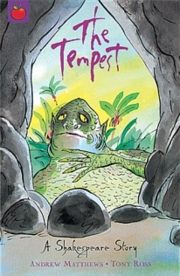








Year 4
Summer term
2
Ready Respectful Safe
History: The history of London
Music: Drumming
RE: Christianity- Do people need to go to church to show they are Christians?
Art:
Clay modelling
Computing: programming
PE:
A rotation of athletics, tennis and cricket
English
Descriptive writing
Characterisation
Correctly punctuated speech and reporting clauses
How you can help at home:
Identify speech in their reading book
Write a conversation between two characters from their reading book
Maths
Geometry
Position and movement
How you can help at home:
Look for 2D and 3D shapes around your home, then draw and label them
Key Text
How do you feel about Moll Cut-Purse and why?
Toby is a pick-pocket. Do you think he is happy with what he has become?
How do you think the story will end?
Other information:
PE days: Monday and Thursday
Tuesday 24th June: Sports day
Wednesday 16th / Thursday 17th July: performance
Homework:
Handwriting, spellings and written task
Maths – complete the 10 questions and your TTRS sound check!
Daily reading (at least 5 times a week)

