Slide 1

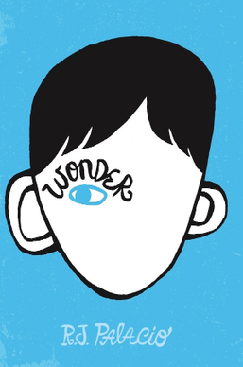
Year 5
Summer
2
Ready Respectful Safe
Wonder (continued)
Why this particular book and not something else?
Last half term, we considered this book with a focus on kindness. As we continue (and complete) this beautiful text, we look at the book to help us to reflect on aspirations, hopes and dreams.
Auggie wears an astronaut’s helmet. It has many meanings for Auggie, but the main purpose of it (at first) is to help him cope with being different. He uses it to hide away. But why an astronaut’s helmet in particular? As the story develops, the helmet becomes less like a crutch and more like a symbol of success. It is a significant symbol of having high aspirations and believing that he can achieve his dreams as he grows in confidence and self-belief.
What are your hopes and dreams? Although it’s very soon to know for certain what you want to be when you are older, you may have short-term goals. For example, to learn how to master a certain skill/trick in football. Or to achieve a specific belt in karate. In this unit, we develop our English skills and consider how our writing can reflect us at our best. We also use this book to frame our PHSE work this half term which is focused on what jobs we may like in the future.
Key Question:
Which job from these choices would Auggie most likely become as an adult and why?
An astronaut
A teacher
A surgeon
English Skills that will be developed through this unit:
It’s all about editing! When Year 5 edit their work, the process goes beyond simply spotting and correcting errors. It even goes beyond using a thesaurus to improve word choices. By the end of Year 5, we want children to develop the confidence and ability to make more significant changes to their written work through drafting and redrafting. These skills need to be modelled and taught. It takes courage and skill to be able to look back at a paragraph you have just written and be able to identify where there are opportunities to improve. We should aspire to be the best writers that we can be!

Slide 2
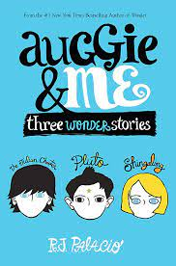
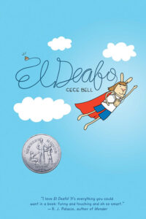
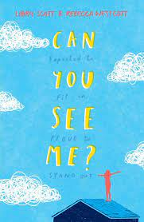
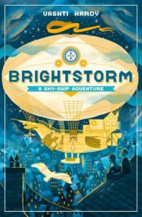
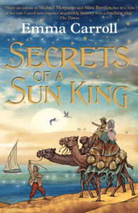
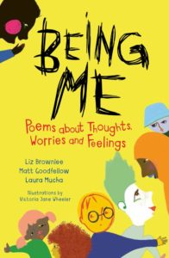
Year 5
Summer term
2
Ready Respectful Safe
Our Extended Book Spine
Writing Composition in school:
Y5 children will be challenged to use their descriptive skills in a more mindful way. Would a setting description be different if written from the perspectives of different people? How might the ideas of a person with a hearing impairment be different to that of someone who is blind?
Children will write a setting description of a forest with some senses removed.

