Slide 1

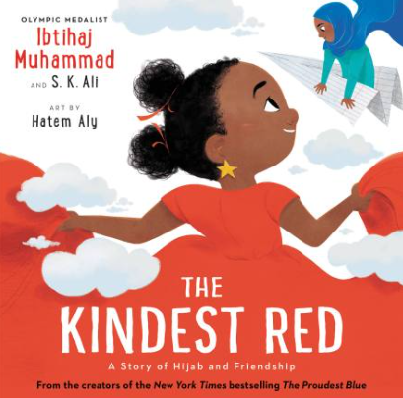
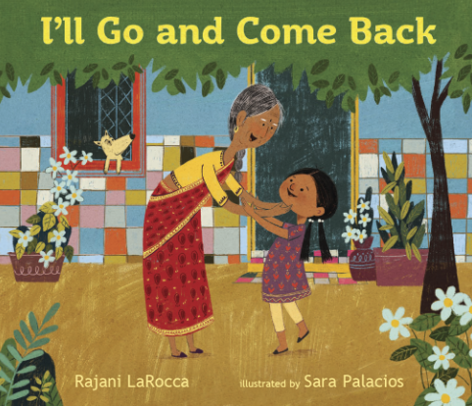
Year 2
Summer
2
Ready Respectful Safe
The Kindest Red
Why these books and not something else?
It is always a privilege to choose new books for the school. We are proud to introduce a brand-new unit that focuses on our whole school value of kindness whilst also exploring books that give our Muscliff children an understanding of Indian culture.
We noticed that The Proudest Blue was a very popular book in our class and was a particular title that was always being read and shared. So, we were keen to provide the children with another title by the same author.
Our curriculum at Muscliff is designed by us, for us and we have the freedom to choose how we deliver those statutory objectives that are set out in the National Curriculum document. At the same time, we are also committed to providing a curriculum with which all our pupils can identify. In recent years, we have welcomed many families who identify with Indian culture and so we wanted to make this unit of work one that stands out for its rich cultural references.
English Skills that will be developed through this unit:
The skill of persuasion is one key feature that will be explored this half term.
Expanded noun phrases always come in handy when building a description.
As always, children will use a range of conjunctions to ‘expand’ their sentences.
Editing work will be a key feature this half term. We will look at how to spot and correct errors and then look into how we can look for opportunities to make more significant changes to the content of our writing. We will also build in opportunities to orally perform our work and present it to our friends in class.

Slide 2
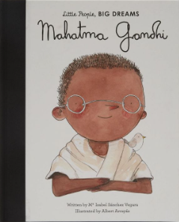
Year 2
Summer term
2
Ready Respectful Safe
School values these books reinforces:
Kindness is our theme for this half term. We consider how we can make our school, our local community and then the wider community a better place through considering our actions. In PSHE we link our texts to exploring where and how to seek support (including recognising the triggers for seeking support), including whom in school they should speak to if they're worried about their own or someone else’s mental wellbeing or ability to control their emotions.
Key Question:
What world would you like to live in?
What might a kind world look like?
Writing Composition in school:
Children will write a setting description of a kind world and in a separate piece, a busy market; a persuasive piece of writing for The Kindest Person Award; a thank you letter; a poem.
Help at Home:
Describe one of your friends. What makes them so special? Think about what you do together and why you get along so well.
Imagine a busy shopping area, like Castlepoint. What would it be like to walk around during the busiest times? Write a few ideas down or draw and label a picture of a busy time at the shops.
Please help me out with my problem. My best friend wants to play football at playtime but I don’t want to play! What should I do?
Describe a time when you have helped someone else.
Create a list of 5 things that you could do to show kindness towards someone in your family.

Slide 3
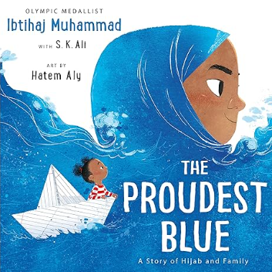
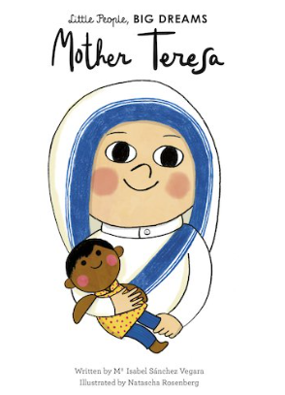
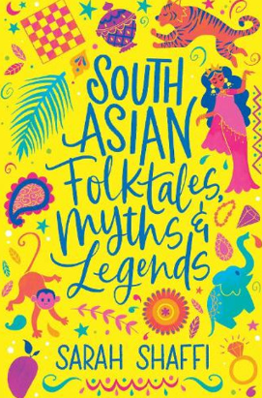
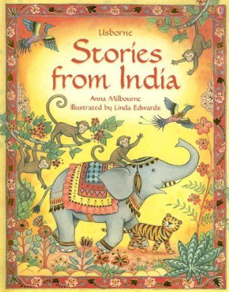
Year 2
Summer term
2
Ready Respectful Safe
Our Extended Book Spine
It’s Faizah’s first day of school, and her older sister Asiya’s first day of hijab – made of a beautiful blue fabric. But not everyone sees hijab as beautiful. In the face of hurtful, confusing words, will Faizah find new ways to be strong? This is an uplifting, universal story of new experiences, the unbreakable bond shared by siblings and of being proud of who you are, from Olympic medallist Ibtihaj Muhammad.
Part of the critically acclaimed Little People, BIG DREAMS series, discover the incredible life of Mother Teresa, along with her message of love and charity. Agnes (later to become Mother Teresa) was born in Skopje, North Macedonia. She was raised to love God and love others above all else, and from an early age, she knew she wanted to dedicate herself to religion, so she became a nun. She was fascinated by stories of missionaries helping people and wanted to do the same.
Enjoy a rich collection of folktales, myths and legends from all over South Asia, re-told for young readers. This book includes traditional favourites such as the story of Rama and Sita and classic folktales and mythology.

