Slide 1




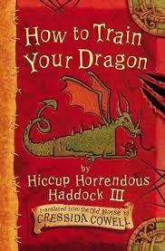







Summer 2
Ready Respectful Safe
History:
Vikings and Anglo-Saxons
Music and Art:
Viking songs and weaving
RE:
Sikhism
Geography:
Settlements
French:
Ice cream flavours
Pe: tennis/athletics/rounders
English
Expanded noun phrases
Prepositional phrases
Tenses
Spelling and grammar- apostrophes and contractions
How you can help at home:
Read a variety of books and genres
Discuss any new vocabulary that children discover
Discuss apostrophes and contractions that you spot in texts
Maths
Angles
Bar graphs
Perimeter and shape
How you can help at home:
Practise times tables in preparation for the Year 4 times tables test
Times table rockstars or Times table me
Key Text
How are characters developed in the story?
How can descriptive language help paint a picture for the reader?
What poetry do you know? Do you like it? Why? Why not?
Other information: School trip: 3AS 4th July, 3LC 5th July, 3LT 6th July Sports Afternoon: 1st July | Homework: Doodle English, Maths and Spelling Reading (5 times per week) Spellings

