Slide 1
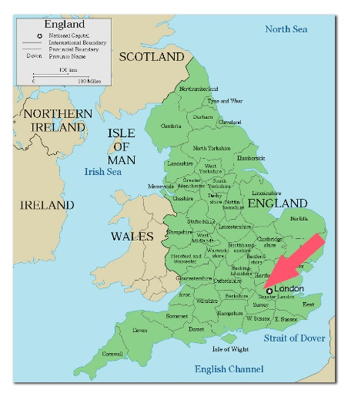
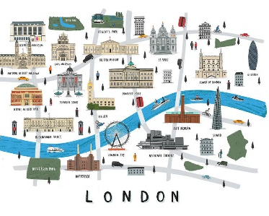
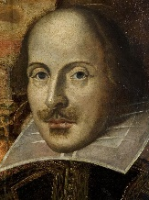
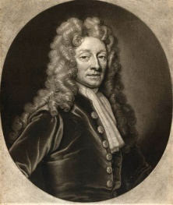
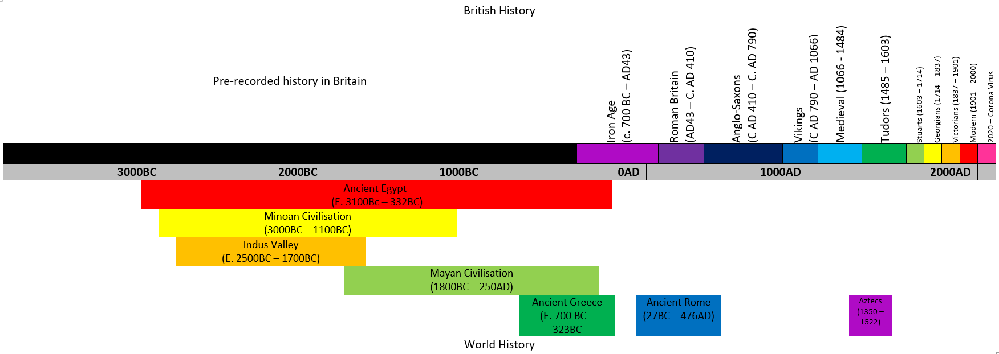
HISTORY: London through the ages
Date | 1485 - 1603 | 1564 | 1665 - 1666 | 1666 | 1666 | 1710 | 1760 | 2000 | 2022
Event | Tudor London. | William Shakespeare was born. | The Great Plague of London. | The Great Fire of London. | Christopher Wren was tasked with the rebuilding of London after the Great Fire, including St Paul’s cathedral. | Christopher Wren finished building St. Paul's cathedral. | The industrial revolution started in Britain. | The new millennium. | Modern London today.
Key facts
William Shakespeare was a poet and playwright. He wrote 154 sonnets and around 40 plays. The Globe theatre was built in 1599 and is still visited today by tourists. In 1665 and 1666, London experienced two enormous tragedies: the Great Plague of London and the Great Fire of London. The plague killed roughly 20 percent of the city’s population, while the fire burned about a quarter of London’s city. After the Great Fire of London, Christopher Wren was tasked with rebuilding many of London’s churches, including St. Paul’s cathedral. The Industrial Revolution began around 1760. It led to many of the biggest changes of the Victorian era. Many famous landmarks were built in London to commemorate the new millennium, including the London Eye, Millennium Bridge and the Millennium Dome.
Key Figures
William Shakespeare
English playwright, poet and actor. He is widely regarded as the greatest writer in the English language.
Christopher Wren
One of the most highly acclaimed English architects. He was responsible for rebuilding 52 churches in the City of London after the Great Fire in 1666.
Key Vocabulary
Term | Definition
Century (noun) | A period of 100 years.
Playwright (noun) | A person who writes plays.
Plague (noun) | A contagious bacterial disease characterized by fever and delirium, typically with the formation of buboes and sometimes infection of the lungs.
Industrial revolution (noun phrase) | the rapid development of industry that occurred in Britain in the late 18th and 19th centuries, brought about by the introduction of machinery.
Millennium (noun) | A period of 1000 years.
“History is a version of past events that people have decided to agree upon.” – Napoleon Bonaparte

