Slide 1
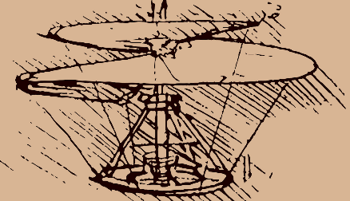
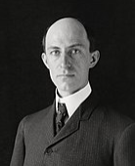
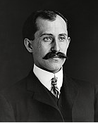
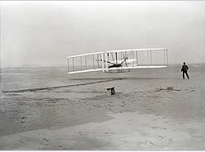
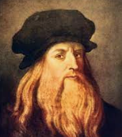
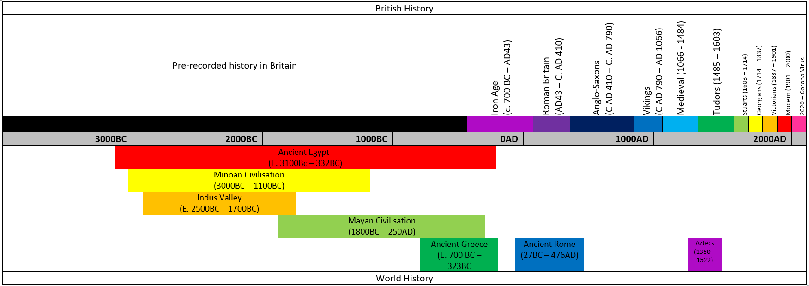
HISTORY: The power of flight
Date | 1480 | April 16th 1867 | August 19th 1871 | 1886 | 1892 | December 17th 1903 | Now
Event | Leonardo Da Vinci designed the first helicopter. | Wilber Wright was born | Orville Wright was born | The wright brother ran a print shop | The wright brother opened a bicycle shop | The first powered flight went 37.5m | We made and tested our own paper aeroplanes and paper helicopters
Key Figures
Wilber Wright | Orville Wright
Leonardo Da Vinci
Key facts
Orville and Wilber Wright invented the first powered aeroplane The first powered flight was on 17th December 1903 The aeroplane was called the Wright Flyer. It’s first flight went just 37.5m The design for the first helicopter was designed by Leonardo Da Vinci in 1480.
Key Vocabulary
Term | Definition
invented | Created the idea for/ made
flight | To be moving through the air
past | things that have happened before now
history | events that have happened in the past
present | what is happening now
future | a time ahead of now, where things may or may not happen
“History is a version of past events that people have decided to agree upon.” – Napoleon Bonaparte

