Slide 1
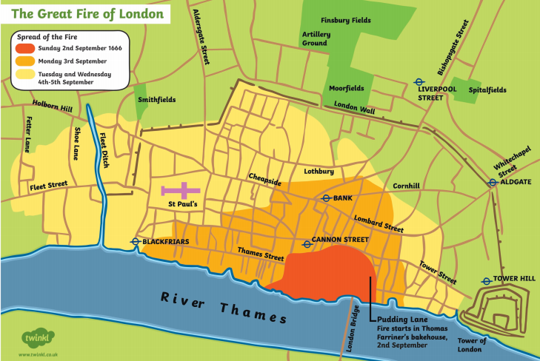
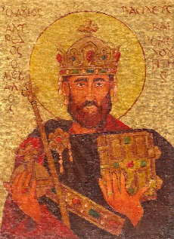
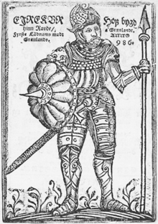
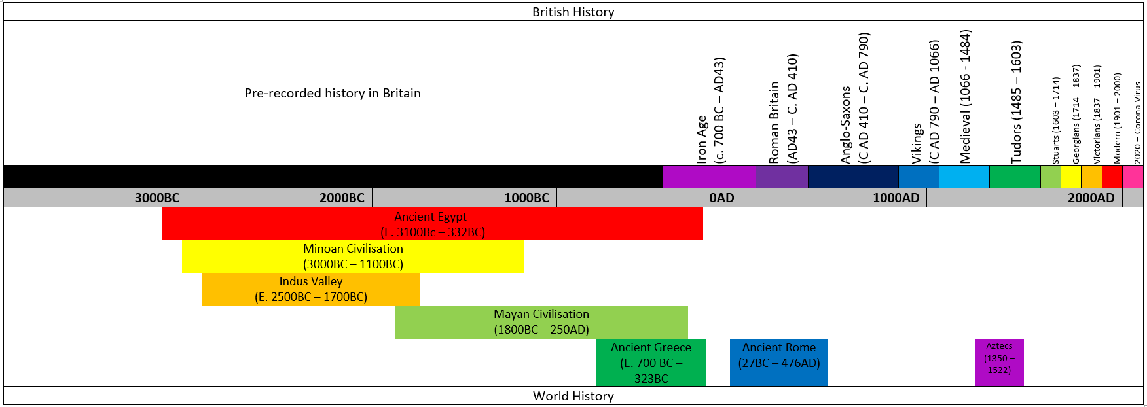
HISTORY: The Anglo-Saxons and Vikings
Date | 410AD | 450AD | 633 AD | 793AD | 867-878AD | 886AD | 1014AD | 1066AD | 1100AD
Event | The Romans leave Britain. | Angles and Saxons invaded Britain. | Lindsfarne Monastry is built. | The Vikings attack and capture the city of York (Jorvik) | Series of Viking victories. | The Vikings and King Alfred divide England. | King Canute of Denmark becomes King of England. | William (the conqueror) is crowned King of England, after the Battle of Hastings. | End of the Viking age.
Key facts
Both Anglo-Saxons and Vikings came to Britain to invade. Then they settled here, hoping for a better life. They would use swords, spears, axes, shields, bows and arrows when fighting. When the Anglo-Saxons first settled in Britain, there were 7 kingdoms, but by AD 868, there was just one Kingdom left (Wessex) as the others had been overrun by the Vikings. Many Anglo-Saxon Kings tried to resist the Vikings and fought hard to keep control of their land. The Anglo-Saxons and Vikings were Pagans and believed in many Gods.
Key Figures
Name | Alfred the Great
 | Made a peace agreement with the Vikings and divided England up. They did however, continue to fight
Name | Erik the Red
 | Known to be the most blood thirsty Viking. A violent character with flowing red hair.
Map: to change with each subject
Key Vocabulary
Term | Definition
exile | To be sent away.
invade | To enter and occupy land.
kingdom | An area ruled by a King.
Monastries | A building where people worship and devote their time to God.
Pagans | A religion where many Gods and Goddesses are worshipped
pillaged | To violently steal something
raid | A surprise attack
AD | Anno Domini - shows dates after the birth of Jesus
“History is a version of past events that people have decided to agree upon.” – Napoleon Bonaparte

