Slide 1
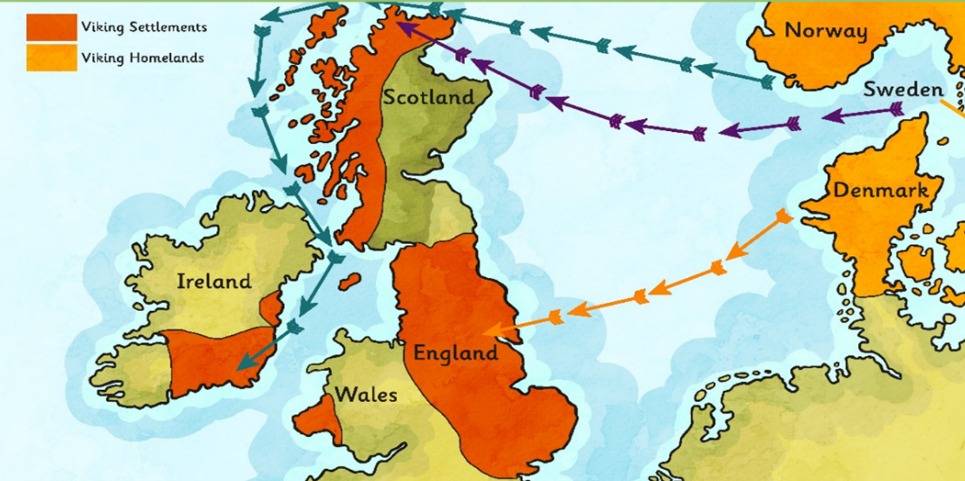
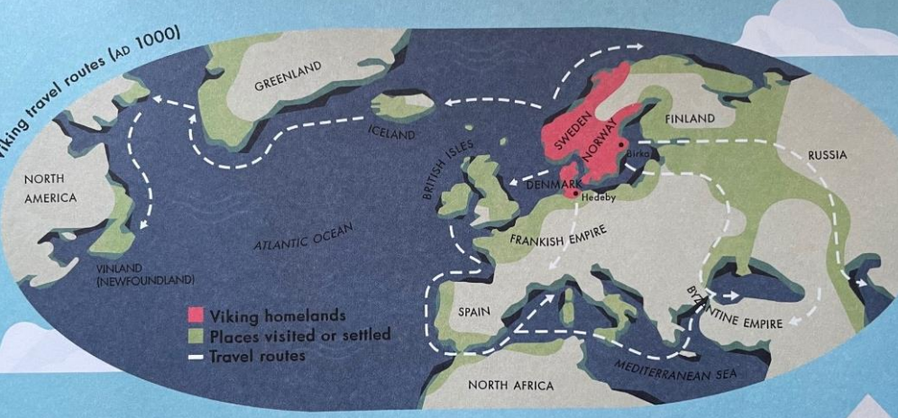
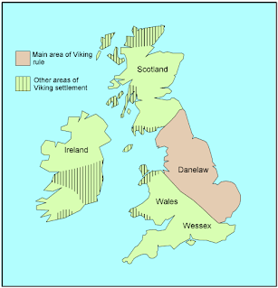
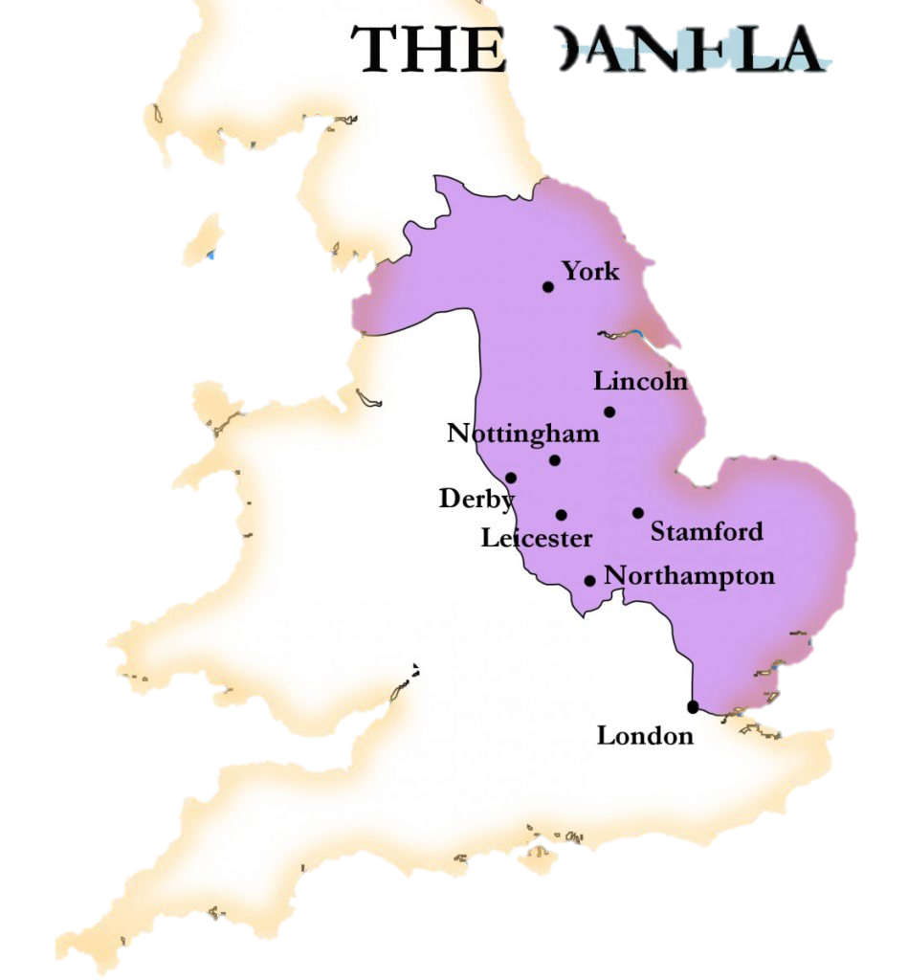
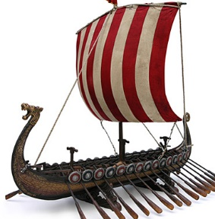
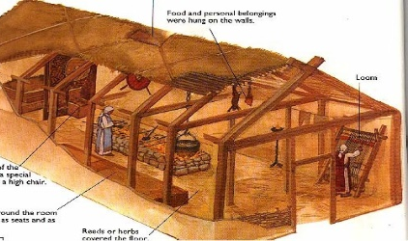
 | Geography: Vikings
Human Geography | Viking settlements: The Vikings left their homeland because their land was too hilly, covered in forests or had poor sandy soil. They thought they would have a better life in England. | Viking Settlements: The Vikings chose to settle in England because there was more flat land for farming, opportunities to trade, and lots of monasteries to steal from. | Viking settlements: The Vikings chose their settlements as they had good flat land for farming, were close to the coastline for fishing and longship access and were close to the markets for trading.
Important fieldwork
Cranborne Ancient Technology Centre. Comparing early settlements to modern settlements.
Key Vocabulary
Term | Definition
Scandinavia | The area made up of the countries Denmark, Sweden and Norway
Settlement | A place where people have come to live
Viking longship | a long, wooden ship used by Vikings for raids
Danelaw | The area in Britain ruled by the Vikings
Key pictures or diagrams
Viking settlements in Danelaw | Areas in Danelaw | Longship | Viking house layout
1040: First compass used to navigate (In China).
1271: Marco Polo sets off for China
1492: Columbus discovered America
1497: John and Sebastian Cabot discovered Canada
1540: Nicolaus Copernicus discovered the Solar System
1770: Captain James Cook discovered Australia
1911: Roald Amundsen led the first expedition to the South Pole
1969: Neil Armstrong was the first man to walk on the moon.
1507: First true map of the world by Martin Waldseemüller

