Slide 1

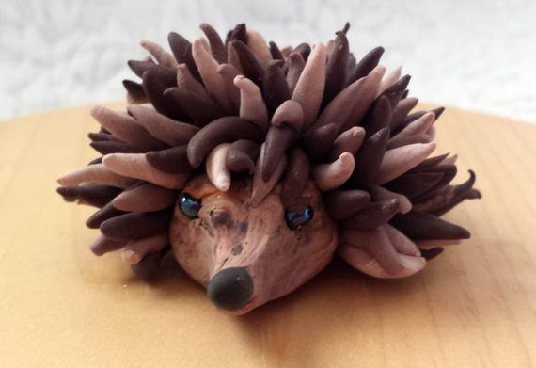
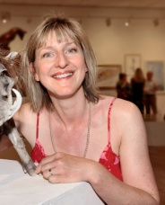

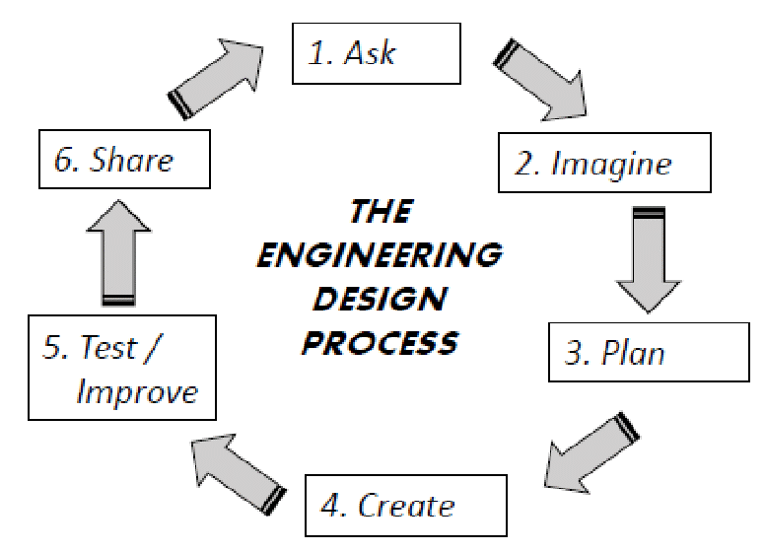
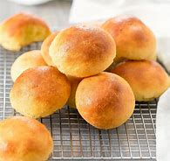
Design Technology
Design project: Clay Sculptures
Facts: Clay hardens over time. Water helps to soften the clay. Clay is sculpted into objects. |  | Skills Pinching Rubbing Smoothing Scrapping
ideas (noun)
evaluate (verb)
combine (verb) materials
select (verb) key tools
discuss and adapt (verbs)
design (verb)
measure (verb)
Key Figures
Nick Mackman (sculpture artist) | Pippa Hill (local sculpture artist)
Design project: Bread Making
Facts: Bread needs yeast to rise. Bread needs heat to bake it. |  | Skills Mixing Kneading Slicing
“I have not failed. I have just found 10,000 ways that won’t work.” – Thomas Edison
1650: First daily newspaper
1876: telephone invented
1902: first radio signals
1969: internet invented
1994: world wide web established
1957: first space shuttle launched
1927: first television broadcast
1817: First push bike invented and used
2007: first Iphone in use
1884: Firs motor car in use

