Slide 1



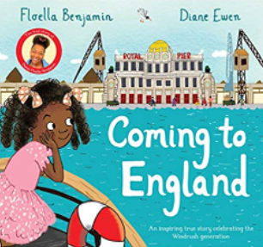







Year 1
Summer term 2
Ready Respectful Safe
PSHE-Being healthy
History- Investigating people from the past
RE- Jewish festivals Yom Kippur and Rosh Hashanah
Geography- Comparing England and Trinidad
PE- Athletics and ball skills
English
-Fact writing
- Postcards
-Non-fiction texts
- Story writing
-Reading and exploring other non-fiction texts
- Researching different countries
- Writing postcards/ letters to people
- Story writing
- Fact writing
Maths
Numbers to 100
-2D and 3D shape names and properties
Describing position and movement
Mass and length
Recognising numbers to 100 in the local area e.g. house numbers
2D and 3D shape hunts
Weighing and measuring e.g. cooking
Exploring position and movement e.g. whilst in the garden/ park
Books to read at home: - Non-fiction texts Reading books linked to our reading practice sessions Reading books for enjoyment | Books we read in class: Poles Apart Where the Wild Things Are Blown Away Coming to England No Place Like Home
Who were the Wright brothers?
How are Trinidad and England the same/ different?
How can we keep ourselves healthy?
Other information:
Homework:
Complete Numbots regularly to develop fluency.
Reading a Little Wandle book from school.
Read 5 times a week to earn your reading reward badge. Practise your handwriting spelling words from the reading records

