Slide 1
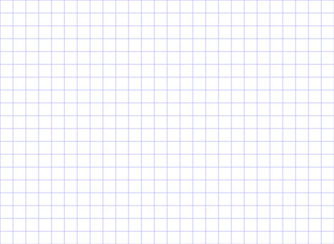
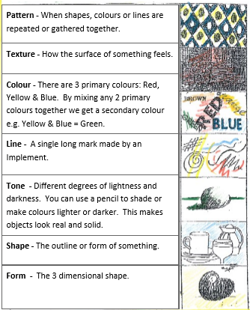
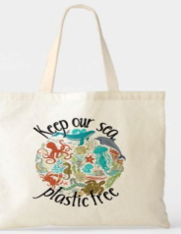
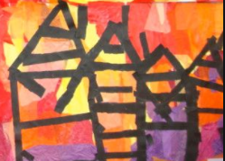
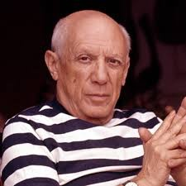

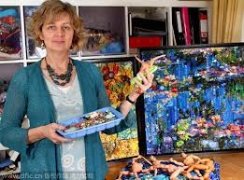
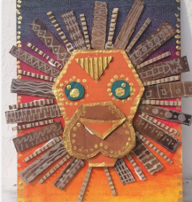
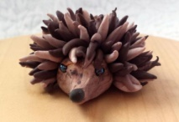
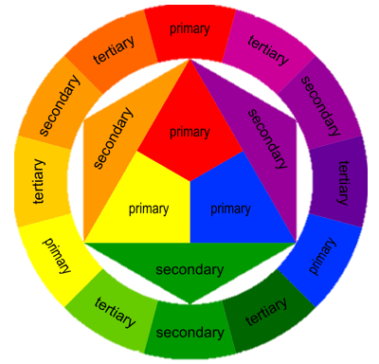
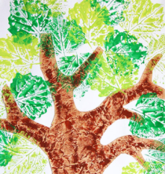
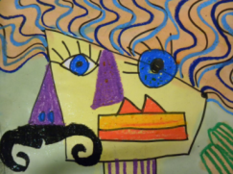
Art
Pictures
manipulate (verb)
weave (verb)
Collage (noun)
Representation (noun)
colour swatches (noun)
print (verb)
portrait (noun)
Landscape (noun)
still life (noun)
Important Artists
Pablo Picasso | Jane Perkins
Pictures
Pictures
Movement studied | Description / detail
Abstract Expressionism - Picasso | Real things are expressed without true representation using line, colour, size, shape and form to create a painting of thought and emotion. You can still see what it is but it looks different to the real thing.
21st Century Art – Jane Perkins | Collage using plastics found in the rubbish or in charity shops are combined to create a picture. Found objects are used by the artist to make something new.
1150 – 1425: Gothic
1400 – 1520: Renaissance
1600 – 1700: Baroque
1765 – 1850: Neo-Classicism
1765 – 1850: Romanticism
1870 –1890: Impressionism
1907 – 1915: Cubism
1700 – 1775: Rococo
1924 – 1939: Surrealism
1946 – 1956: Abstract Expressionism
1954 – 1970: Pop art
“Art is not what you see, but what you make others see.” – Edgas Degas

