Slide 1

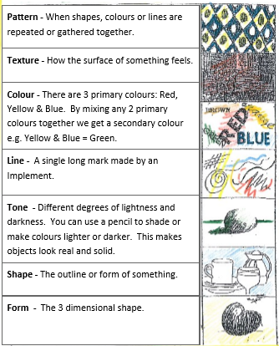
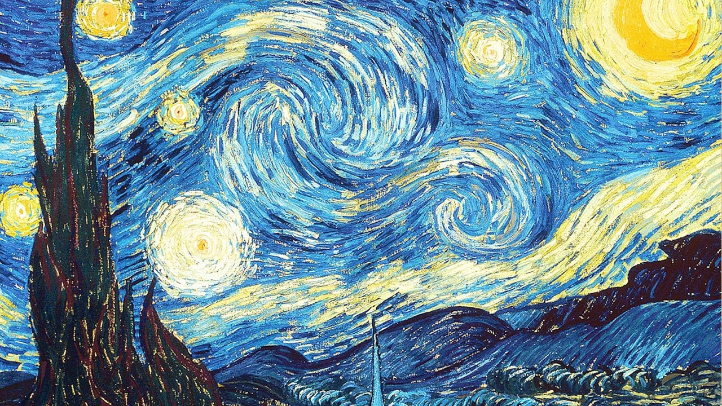
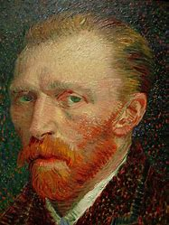
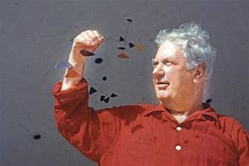
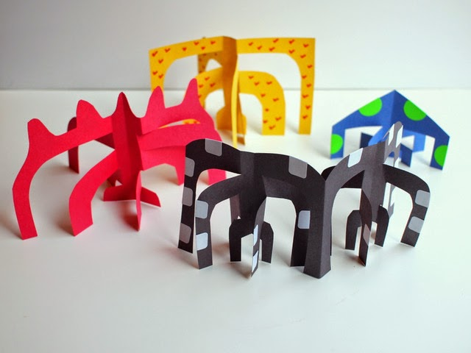
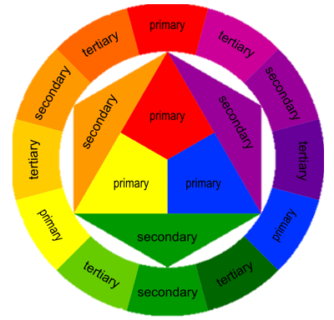
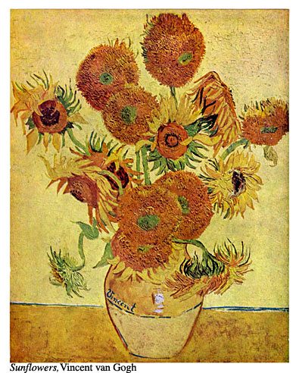
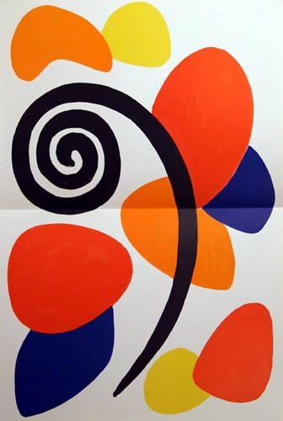
Art
scale & proportion (noun)
use colour as a reflection of mood. (hue, tone & colour) (verb)
colour wheels: oil pastels, painted & pencil crayon (noun)
draw & sketch on a variety of scales (verb)
landscape, still life & portraiture (noun)
density of pencil to replicate light & dark (noun)
weaving following a simple pattern of instructions (noun)
Important Artists
Vincent Van Gough | Alexander Calder
Focus of study | Description / detail
Vincent Van Gough | Vincent Van Gough was born on the 30th March 1853 in the Netherlands. He was 27 years old when he painted his first piece. He painted 900 paintings in ten years. He was so dedicated to his work that he often forgot to eat. He suffered from seizures and cut off part of his own ear! He only sold one painting in his lifetime. He died aged 37. Starry Night is one of his most famous paintings.
Alexander Calder | Was an American sculptor (1898-1976) who invented the mobile. Mobiles are a kind of sculpture where the pieces are moved by motors or the wind.
1150 – 1425: Gothic
1400 – 1520: Renaissance
1600 – 1700: Baroque
1765 – 1850: Neo-Classicism
1765 – 1850: Romanticism
1870 –1890: Impressionism
1907 – 1915: Cubism
1700 – 1775: Rococo
1924 – 1939: Surrealism
1946 – 1956: Abstract Expressionism
1954 – 1970: Pop art
“Art is not what you see, but what you make others see.” – Edgas Degas

