Slide 1
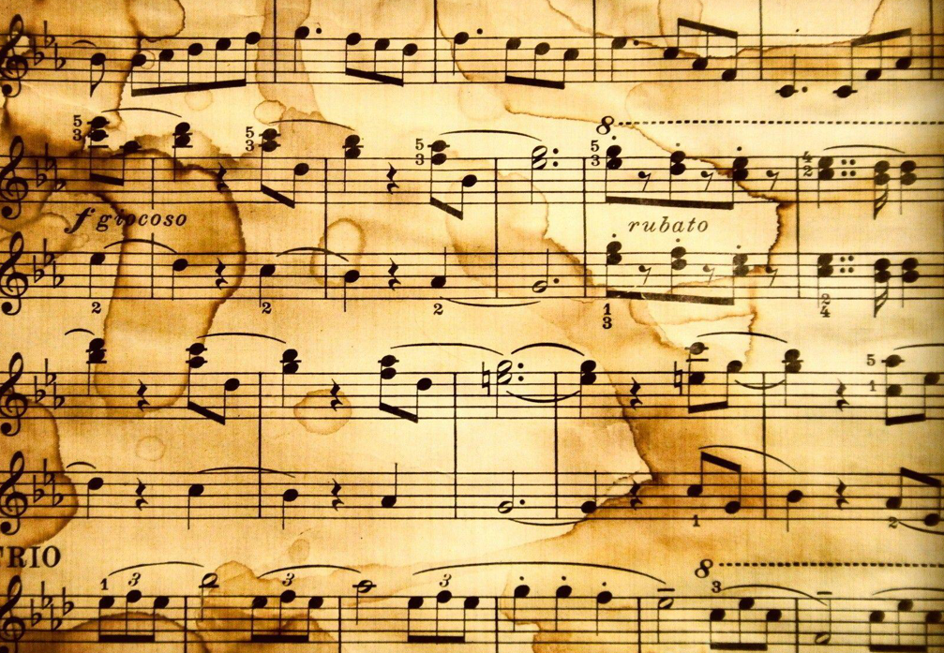
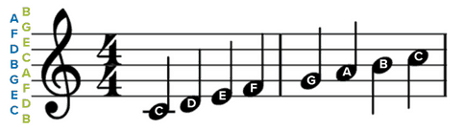
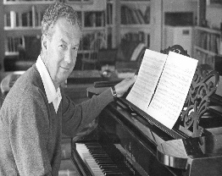
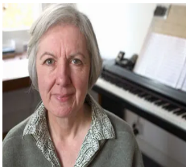
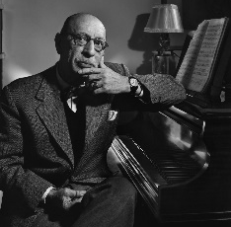

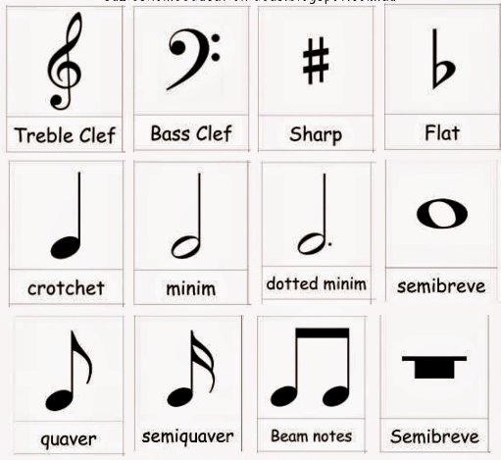
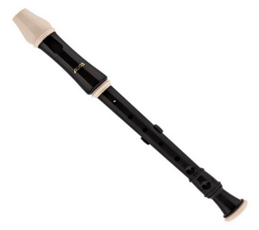
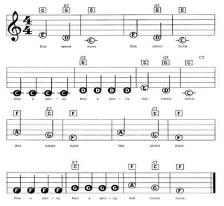
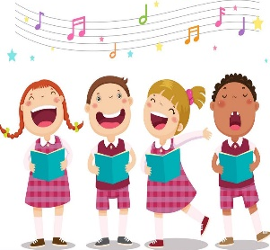
Music
Rhythm
The pattern of notes
Notation Reading notes on a score
Unison Sing together.
Lyrics Words in a song
Minim = 2 beats
Crotchet = 1 beat
Tempo How fast or slow the music is
Pulse
The main beat of the music
Expression Showing the meaning of the words
“Music can change the world.” – Beethoven
Key Composers
Benjamin Britten | Judith Weir | Igor Stravinsky
Music | Description
Dragon Ships
Viking Rocks
picture
picture
picture
Instruments Programmes
Recorder Charanga
Medieval
(approx. 400-1400)
Renaissance
(approx. 1400-1600)
Baroque
(approx. 1600-1700)
Classical
(approx. 1700-1810s)
Romantic
(approx. 1810s-1900)
20th Century
(approx. 1900-2000)

