Slide 1
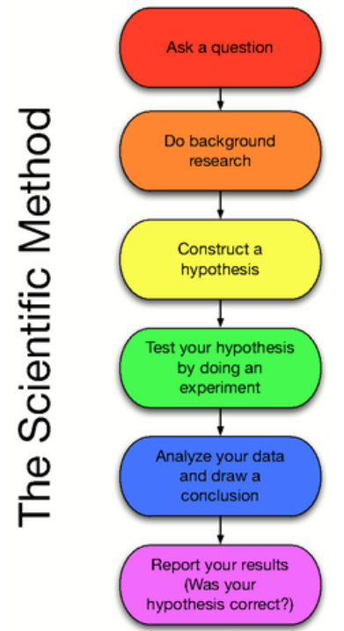
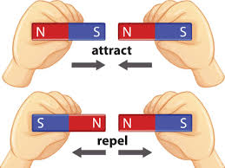
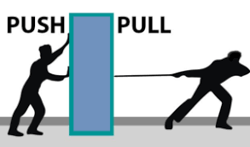
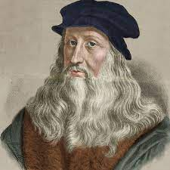
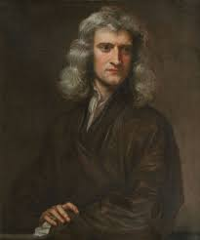
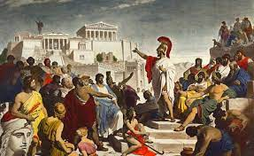
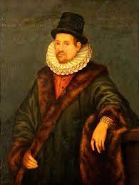
Science: Magnets and Forces
Key Concepts Smooth surfaces create less friction e.g. polished wood | Gravity is a force that pulls things to the ground | Magnets have 2 poles- North and South | Magnets are objects that produce a magnetic field | Not all materials are magnetic. Some every day materials that are magnetic are paper clips and fridges
Key Vocabulary
Term | Definition
Friction | The force between two moving surfaces
Poles | Two sides of a magnet where the magnetism is strongest
Force | A push/pull/twist or turn
Magnet | An object that produces a magnetic field
Attract | To pull towards
Repel | To push away
North | A pole on a magnet
South | A pole on a magnet
Metal | A solid material which is typicall hard, shiny and magnetic
Predict | Make an informed guess
Gravity | A pushing force exerted by the earth
Magnetism | The force of attraction and repelling caused by a magnet
gravity
Key Diagram / Image
Key Diagram / Image
Key Figures
Leonardo Da Vinci | Isaac Newton | Ancient Greeks | William Gilbert
“Science is simply the word we use to describe the method of organising our curiosity.” – Tim Minchin
1609: The moon is observed for the first time by Galileo using a telescope
1687: Newton discovers the law of gravity and motion
1751: Benjamin Franklin establishes that lightening is electrical (kite).
1859: Charlies Darwin publishes Theory of Evolution
1905: Albert Einstein’s theory of relativity E=MC2
1927: Lemaître produces the Big Bang theory
1969: The moon is walked on for the first time by Neil Armstrong
1997: Dolly the sheep is cloned by the Roslin Institute

