Slide 1

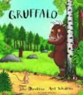

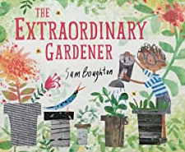





Year 1
Summer term 1
Ready Respectful Safe
Geography – the local area and map work
Science- planting a bean, parts of a flower
RE-Judaism and the celebration Shabbat
Art- sketching parts of a plant
ICT – programming and using digital cameras
English
- Writing for purpose (diaries, narratives and recounts)
- Orally constructing sentences and thinking like a writer.
-Subject and verb and expanding sentences with ‘and’
- Read regularly
- Non-fiction texts
- Retelling stories
- Identifying verbs, adjectives and conjunctions
- Making our own non-fiction books
Maths
Numbers to 100
Telling the time (o’clock and half past)
Days of the week and months of the year
Recognising coins and making amounts
Practise telling the time
Buying things using coins
Practise counting in 2s, 5s, 10s
Recognising and naming shapes at home
Books to read at home: - Non-fiction texts Reading books linked to our Reading practice sessions Reading books for enjoyment | Books we read in class: The Little Gardener The Extraordinary Gardener The Gruffalo
What does a bean need to grow?
What are the different parts of a plant called?
How can I show resilience like the characters in these books do?
Other information:
Homework:
Complete Numbots regularly to develop fluency.
Reading a Little Wandle book from school.
Read 5 times a week to earn your reading reward badge
Practise your handwriting spelling words from the reading records

