Slide 1

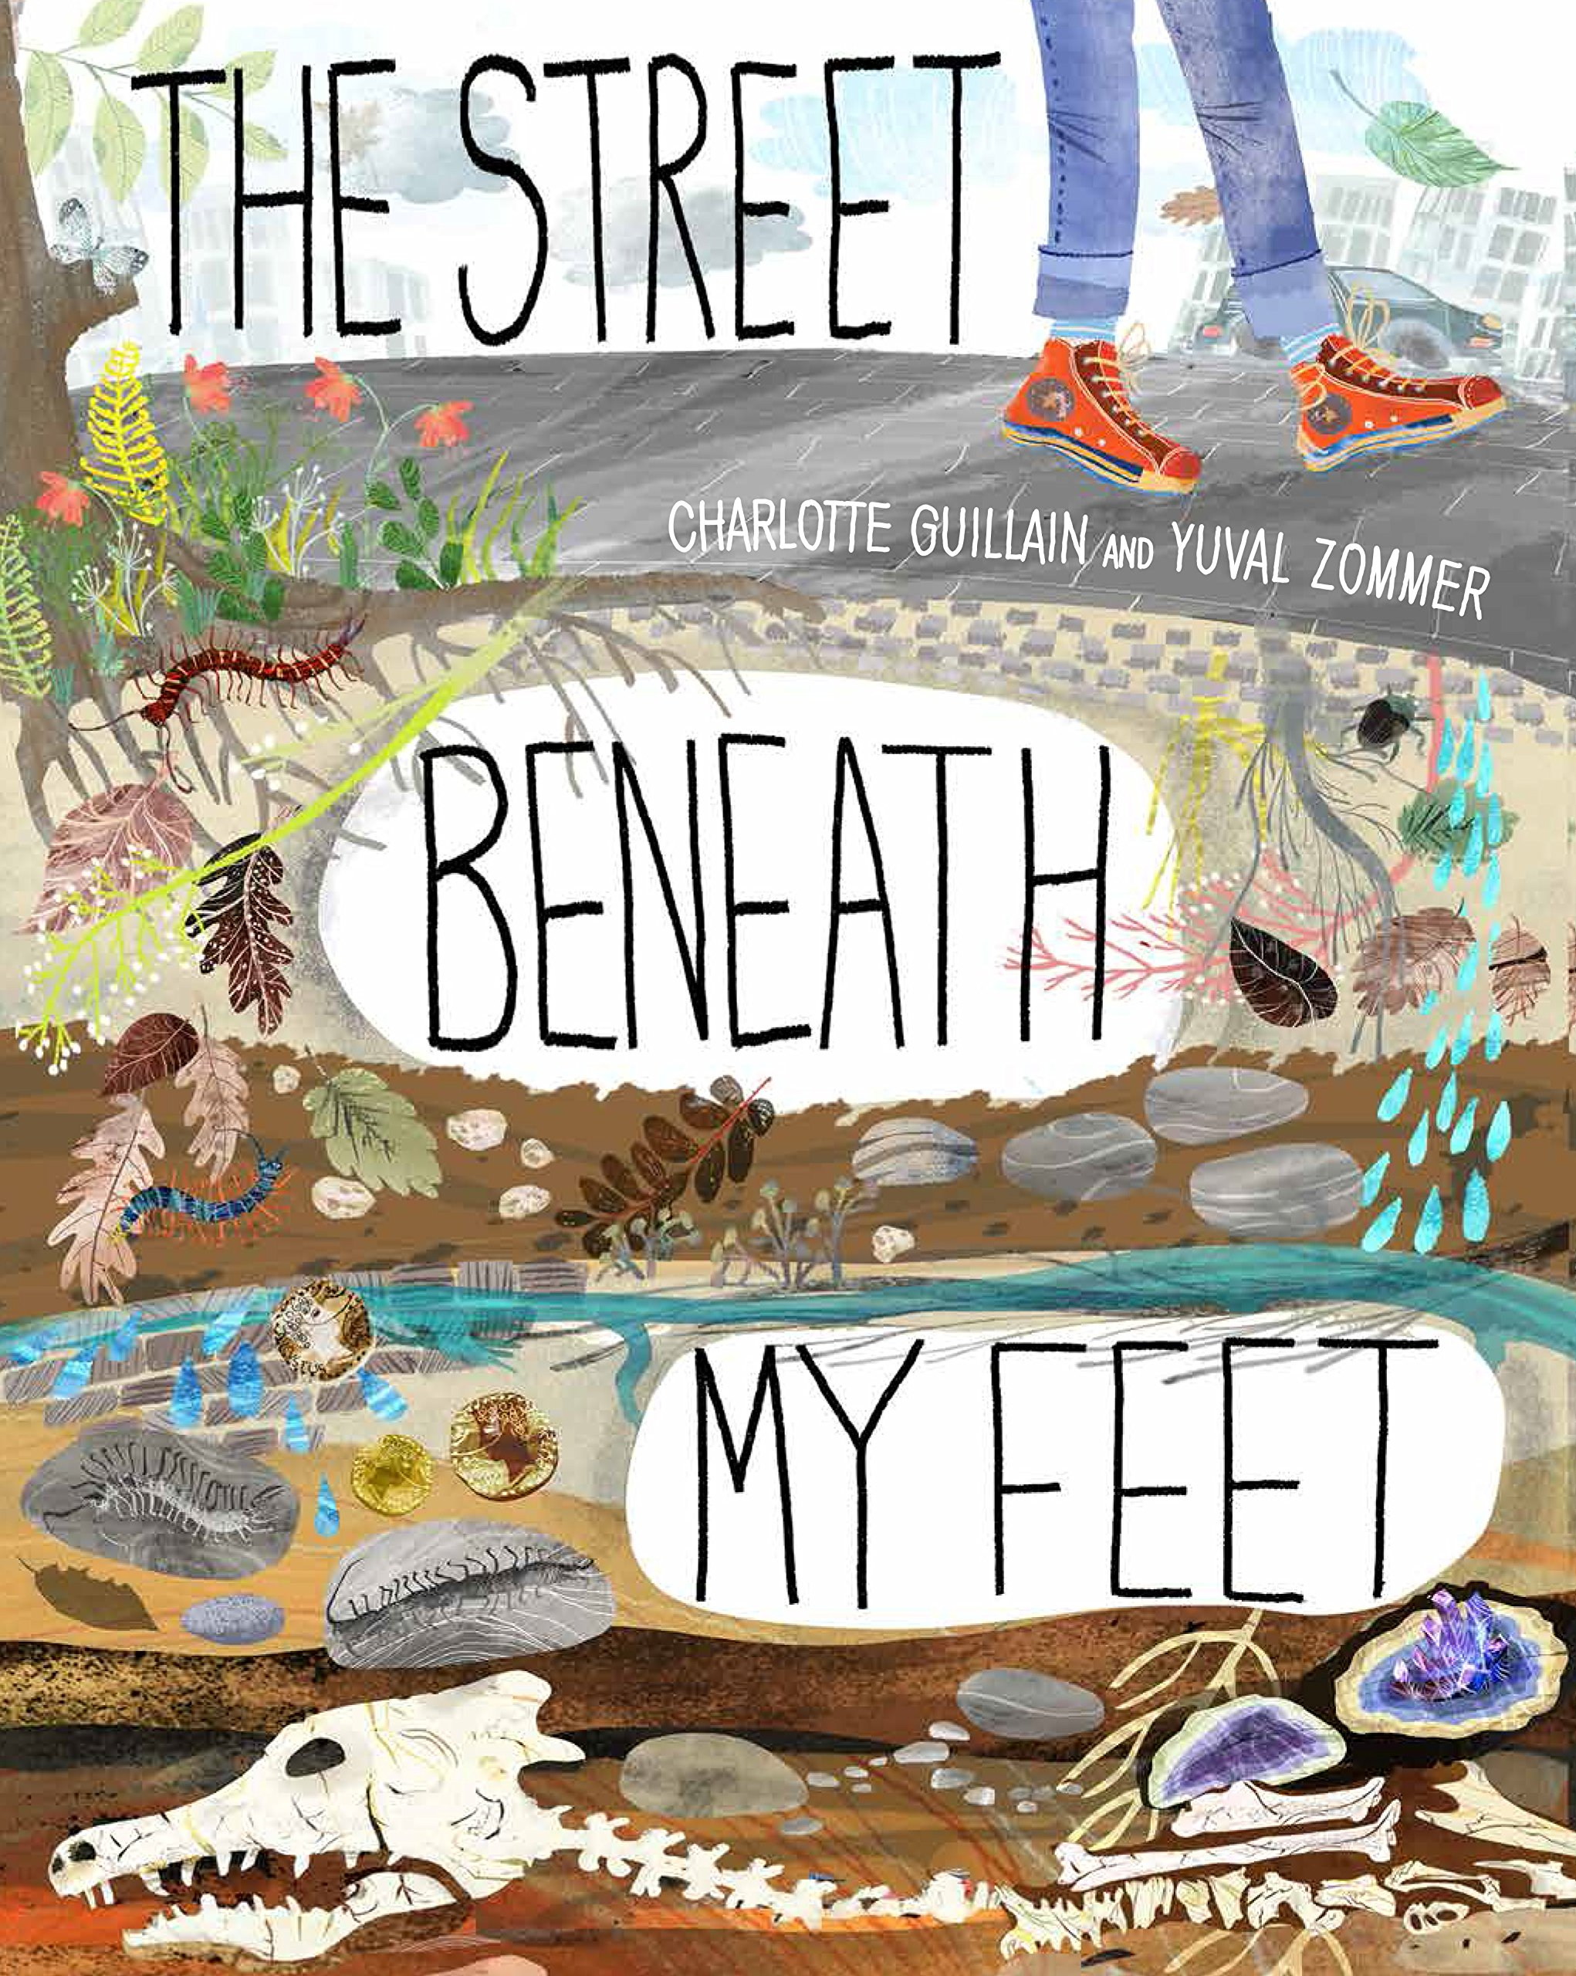
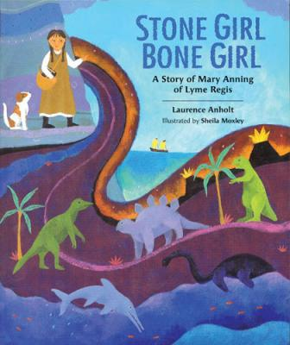





Year 3
Spring term
2
Ready Respectful Safe
The Street Beneath My Feet + Stone Girl Bone Girl
Why these particular books and not something else?
We love these books! Both are very different to each other but both books complement each other beautifully to bring the learning in Year 3 to life. The Street Beneath My Feet is a pull out book – when all the pages are stretched out, it is longer than the classroom tables! As the book physically unfolds, each page unfolds a layer beneath the earth and the children are curious to keep digging deeper. Stone Girl Bone Girl is a biography of Mary Anning. Mary Anning lived in Dorset and made incredible discoveries. She actually called her discoveries her ‘curiosities’ as at that time she didn’t know they were fossils. But despite her curiosity, Mary Anning came across barriers and discrimination that prevented her from being taken seriously.
School values this book reinforces:
Both curiosity and resilience are clearly signposted in these book. Children, like Mary Anning, should be curious to find out more but should have the resilience to continue to look for answers when doors shut.

Slide 2
Year 3
Spring term
2
Ready Respectful Safe
English Skills that will be developed through this unit:
As the unit unfolds (like the book), children take a close look at the choices that the authors have used to steer and guide the reader. The reader can navigate the content, understand the sequence of events in the correct order and enjoy the book due to how the books have been organised. But what are the features of these two books which help the reader?
Adverbials for chronology - this means time words and phrases that help guide the reader through the text and help us to understand the order and sequence of events more obviously. ‘At first,’ ‘Later in the same year,’ ‘Before all of this,’ are a couple of examples.
Prepositional phrases for clarity - we look at how prepositions help us to pinpoint where events occurred. ‘In the depths of the earth,’ ‘deep under a thick layer of mud.’
Subordination is also used to support the sequence of ideas: ‘When Mary was young,’ ‘As the world was beginning.’
Year 3 also look at:
Possessive apostrophe (including for regular plurals)
Commas for list
Sentence type (command, question, exclamation, statement)
Writing Composition in school:
Creation of a set of instructions that are crystal clear for the reader to follow.
An explanation page that is in chronological order.
Writing Tasks:
Go on a hunt (in your garden or down the beach) for a special stone. Pick one that is a bit unusual – perhaps its shape is different or maybe its colour stands out. Draw it. Give it a name, such as ‘snakestone’ (depending on what it looks like). Begin to build a made-up profile of your special stone. Use your imagination. For example, This is a louse-stone. It is a fossil of giant woodlice that roamed the earth millions of years ago. These lice grew to be as large as your fist…
Diagrams with arrows and pictures help us to understand a process in the correct order. Draw a diagram to show any procedure you want. For example, how to get dressed, how to do a football trick or how to plait your hair. Is your diagram clear enough to not need any words? Might your diagram be reliant on sentences to clarify information.
Create a profile of Mary Anning. Find out information about why she was special and consider why we read about her at Muscliff.
Write a descriptive paragraph describing the amazing moment when you discovered the fossil of an undiscovered dinosaur! Describe in detail how you carefully uncovered this fantastic scientific phenomenon and how you felt as you extracted the fossil from the layers of mud.
Research how a fossil is created. Make a poster to show the process. Include a diagram if its helps.
Stone Girl Bone Girl is better than The Street Beneath My Feet. Do you agree? Write an argument to put your view across. It would be amazing if your argument included a sentence about how these books teach our values of curiosity and resilience.

Slide 3
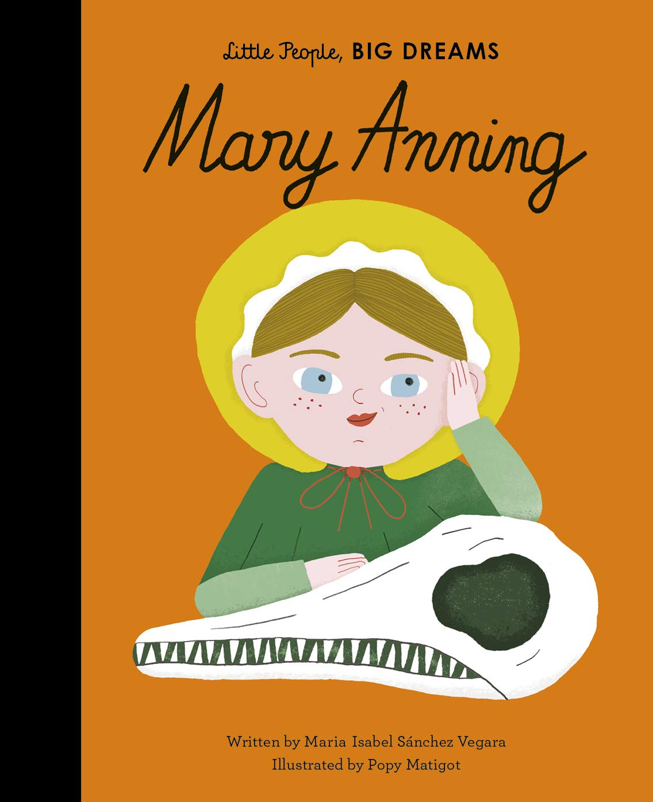
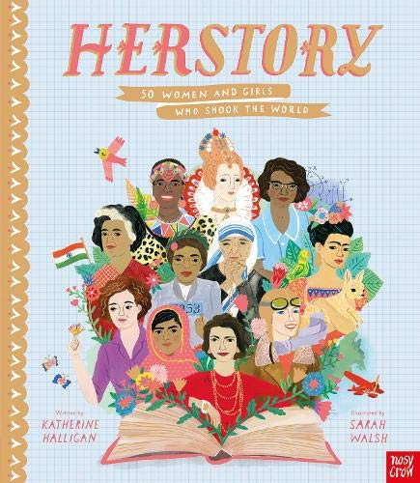
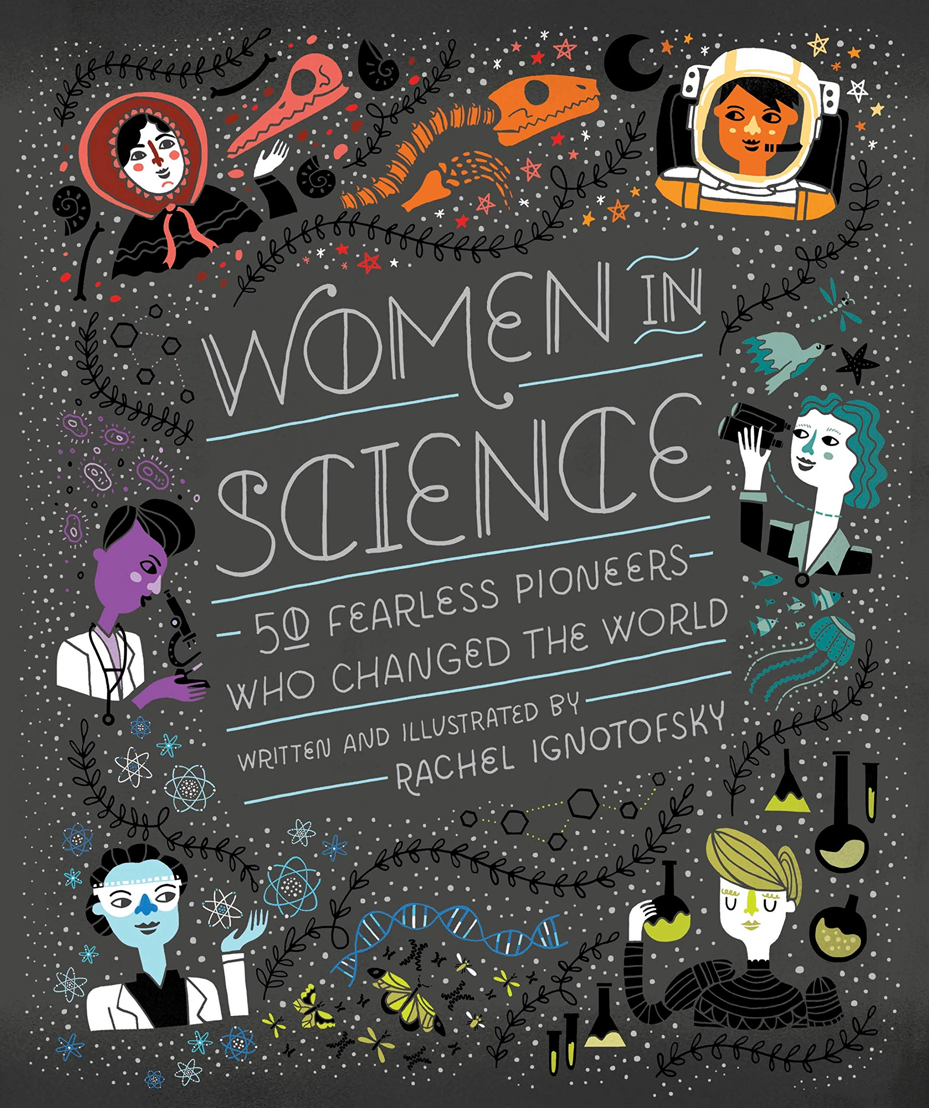
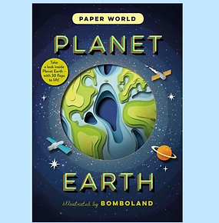
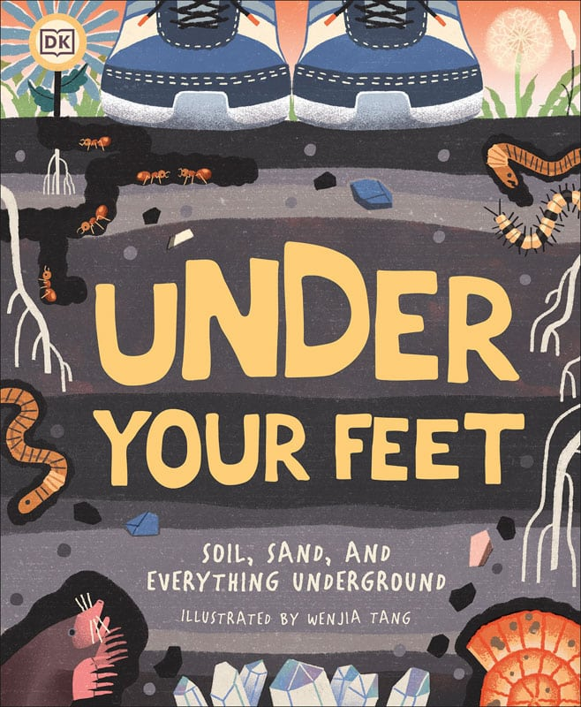
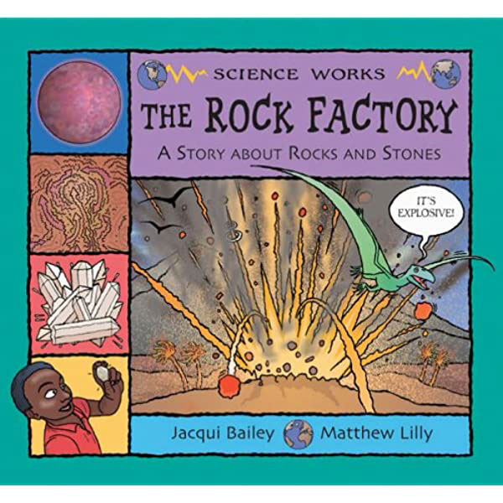
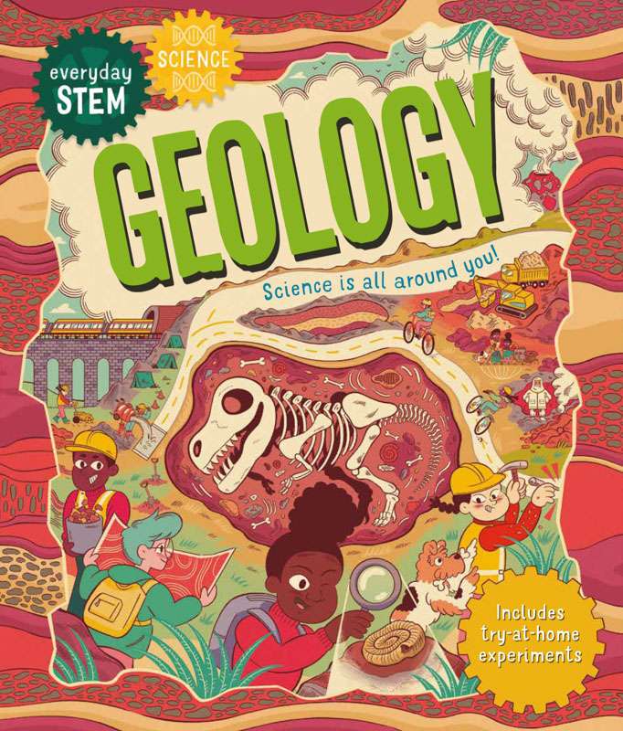
Year 3
Spring term
2
Ready Respectful Safe
Our Extended Book Spine
In our lead text, Stone Girl Bone Girl, Mary Anning uses her curiosity to find out more about the world around her. Being curious is a wonderful characteristic but sometimes we need other skills too to support that curiosity.
The three books above are wonderful for exploring inspirational women in history. Within these books we have people who have overcome discrimination and barriers to achieve a goal. They show resilience and curiosity in many ways. As these books are so special, they are kept in Mrs Fenby’s office but are available for you to borrow and read.
Planet Earth uses ingenious paper cuts to reveal the amazing details of our planet, from bubbling volcanoes to rushing rivers to its boiling hot interior. With detailed art by paper-cut studio Bomboland, a fact-packed text, and flaps and die-cuts on every spread, this unique novelty book will appeal to all.

