Slide 1



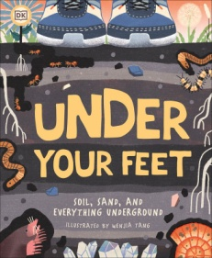

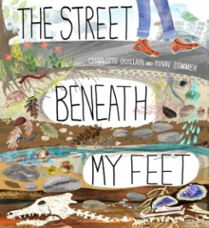
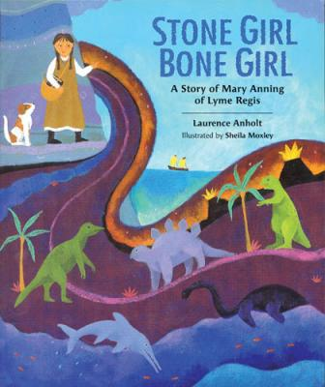
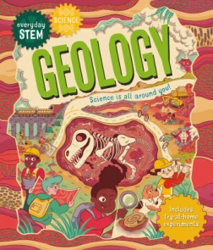

Spring 2
Ready Respectful Safe
Science:
Rocks and Fossils
Art:
Applying colour and creating prints
RE:
What is good about Good Friday?
PSHE
What keeps us safe?
Internet safety
History:
Stone Age
Bronze Age
Iron Age
French:
I am able..
Computing
Publishing media
PE:
Athletics
Hockey
Boccia
Dance
English
Identify sentence types
Adverbs for signposting
Coordination
Subordination
Possessive apostrophes
How you can help at home:
Write a diary entry after a day out using coordination and subordination.
Discuss any new vocabulary and keep a vocab book.
Maths
Counting money
Adding and subtracting money
Pictograms
Bar Graphs
How you can help at home:
Go to the shops and use money. Can you work out how much change you might get?
Keep practising your number bonds to 50 and 100.
Key Texts
  Why was Mary Anning’s prehistoric discovery important??
How do the grounds beneath the city and countryside differ?
Is there water on Mars?
Which scientists brought geology to life?
Other information: 25.2.25 Magical Starter: Dress up as an explorer or cave person. PE Days - Tuesday and Thursday W/C 10th March: Parents Evenings Ensure your child has an ‘old shirt/an apron’ for our Art printing sessions this half term. ☺ | Homework: Maths Fluency questions Writing task Reading (5 times per week) Spellings and Handwriting TT Rockstars

