Slide 1




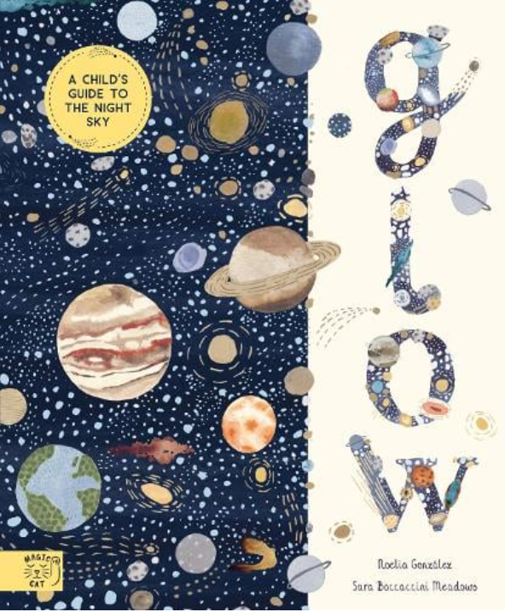







Year 5
Spring term 1
Ready Respectful Safe
SCIENCE: Earth & space
PSHE: online safety
Computing: vector graphics
SCIENCE: light
RE: Sikhism
PE: Hockey, Throwing and catching Tag Rugby, Dance
English
Relative clauses
Parenthesis (comma, dashes and brackets)
Semi-colons
How you can help at home:
✓ Find examples of parenthesis. How and why has it been used?
✓Create a space fact file or research report.
Maths
Comparing, adding, subtracting and multiplying fractions
Comparing, adding and subtracting decimals
How you can help at home:
https://whiterosemaths.com/resources/
https://www.ncetm.org.uk/resources/41211#previewanchor
https://www.visnos.com/demos/percentage-fraction-decimals-grid
Key Text
Which examples of Year 5 skills can you identify in the text?
How did myths help ancient societies understand the world?
How does the author create such a magical text?
Other information:
-WINCHESTER SCIENCE MUSEUM visit: Wednesday 8th January 2025
Homework:
-Doodle Maths
-Reading (minimum 4 times a week)
- English: handwriting and English task

