Slide 1







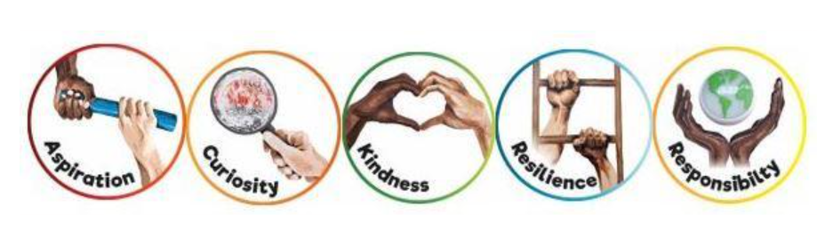
Spring 1
Ready Respectful Safe
Science:
Plants and living things
Music: Recorders
RE: Christianity
PSHE
Respect
Computing:
Sequencing Sounds
Geography:
Wild weather and our world
French: Musical instruments
PE:
Dance Hockey
Boccia
Athletics
English
Poetry
Vocabulary choices for imagery
Prepositional phrases
Similes
conjunctions
How you can help at home:
Read a variety of books and genres including a range of non-fiction texts
Discuss any new vocabulary that children discover
Maths
Length (cm, m, mm)
Mass (kg,
Volume (ml, l)
-Word problems linked to length, mass and volume
How you can help at home:
Practise times tables.
Have a go at baking using weighing scales and measuring jugs
Practical measuring – do you have a ruler or tape measure at home? What could you measure?
Key Text
How does the layout and the vocabulary choices of a poetry book differ to a fiction book?
What features are used to engage the reader?
How is a non-fiction book layout different from fiction book?
Other information: Our PE days are: Monday and Thursday Our Times Tables quizzes start daily! | Homework: Maths 10 Questions Reading (5 times per week) Spellings and writing task Handwriting

