Slide 1


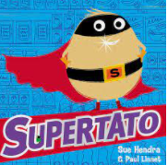
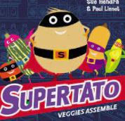

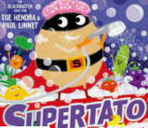
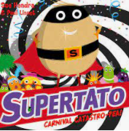





Year 1
Spring term 1
Ready Respectful Safe
Art- Giuseppe Arcimboldo
ICT – Exploring websites
RE- Christianity and friendship.
DT-Food and nutrition
PE- Dance & ball skills
English
-Retelling the story
-Talk for writing
-Adjectives
-Subject and verb
-Prefixes (un-) and suffixes (-ed and -ing)
-Read regularly
-Talk about the stories we have read
-Retelling stories
-Identifying adjectives
Maths
Numbers to 40, adding and subtracting and recognising 1 more and 1 less.
Multiplication , doubling numbers within 10, counting forward and backwards in 2s, 5s and 10s.
-Role play sharing an amount of objects between different numbers
-Water play/ measuring liquids
- Practise counting/ number recognition/ number writing
Books to read at home: -Sue Hendra stories -Any other fiction/ non-fiction texts that your child is interested in | Books we read in class: -Supertato -Supertato Veggies Assemble -Supertato Carnival Catastro-pea -Barry the Fish with Fingers -Norman the Slug with the silly shell -Nobot
Who is Giuseppe Arcimboldo and what was his art like?
What is healthy/ unhealthy? Where does our food come from?
How do we use a computer to explore websites?
Other information:
Homework:
Regular reading each week using the Little Wandle books.
Weekly handwriting and spelling practice.
Use of Numbots regularly to develop maths fluency.

