Slide 1
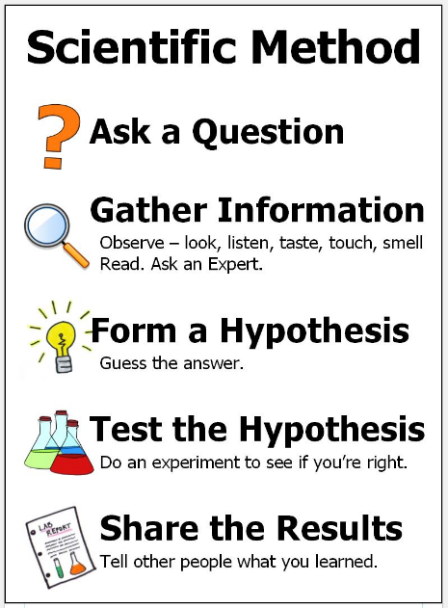
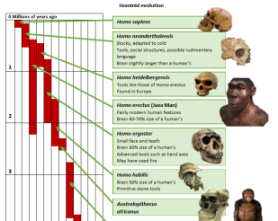
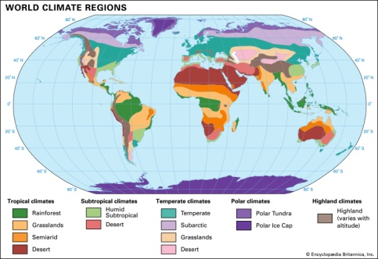
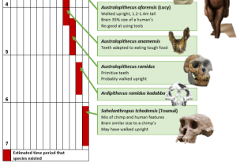
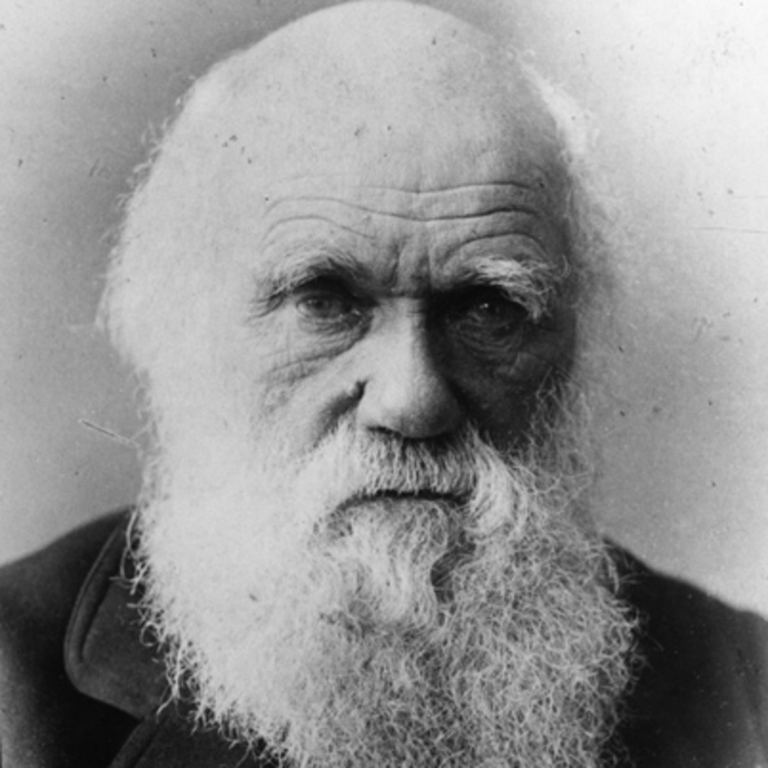
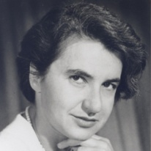
Science: Evolution
Why do animals need to adapt? An adaptation is a special skill which helps an animal to survive and do everything it needs to do. Adaptations could be physical changes to the animals body or behavioural changes . | What is an extreme environment? An extreme environment is a habitat that is considered very hard to survive in due to its considerably extreme conditions such as temperature, accessibility to different energy sources or under high pressure. | What is evolution? The theory that all the kinds of living things that exist today developed from earlier types. The differences between them resulted from changes that happened over many years. | Why are fossils important? Fossils give scientists clues as to what the Earth was like millions of years ago. We can use fossils and determine how organisms alive today evolved. | Investigations: Migration v hibernation: what is the difference? Who is Charles Darwin and how is he important within the theory of evolution?
Key Vocabulary
Evolution (noun) | The theory that all the kinds of living things that exist today developed from earlier types.
inheritance (noun) | The process by which genetic information is passed on from parent to child.
Traits (noun) | A genetically determined characteristic.
DNA (noun) | The fundamental and distinctive characteristics or qualities of someone or something.
Variation (noun) | The differences between individuals within a species. This can be caused by inherited or environmental factors.
natural selection (noun) | The process whereby organisms better adapted to their environment and therefore tend to survive and produce more offspring.
Offspring (noun) | A person's child or children or an animals young.
adaptation (noun) | The process of change by which an organism or species becomes better suited to its environment.
evolve (verb) | To develop gradually.
Key Diagram / Image
Key Diagram / Image
Key Figures
Charles Darwin | He was an English naturalist, geologist and biologist, best known for his contributions to the science of evolution. | Rosalind Franklin | In taking several high-resolution photos of DNA, Rosalind Franklin was instrumental in the discovery of DNA's structure.
“Science is simply the word we use to describe the method of organising our curiosity.” – Tim Minchin
1609: The moon is observed for the first time by Galileo using a telescope
1687: Newton discovers the law of gravity and motion
1751: Benjamin Franklin establishes that lightening is electrical (kite).
1859: Charlies Darwin publishes Theory of Evolution
1905: Albert Einstein’s theory of relativity E=MC2
1927: Lemaître produces the Big Bang theory
1969: The moon is walked on for the first time by Neil Armstrong
1997: Dolly the sheep is cloned by the Roslin Institute

