Slide 1
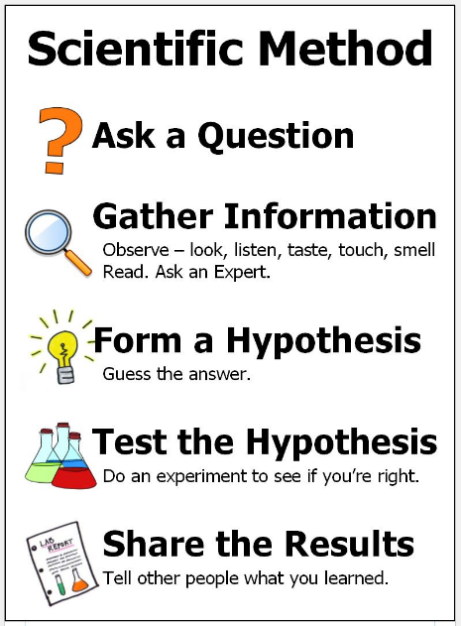
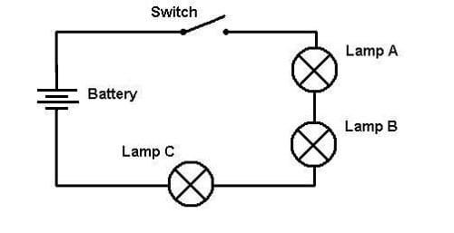
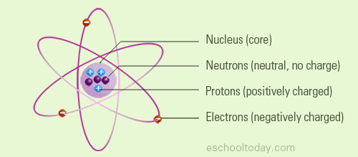
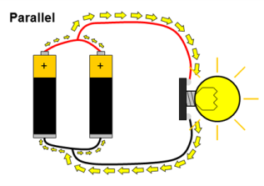
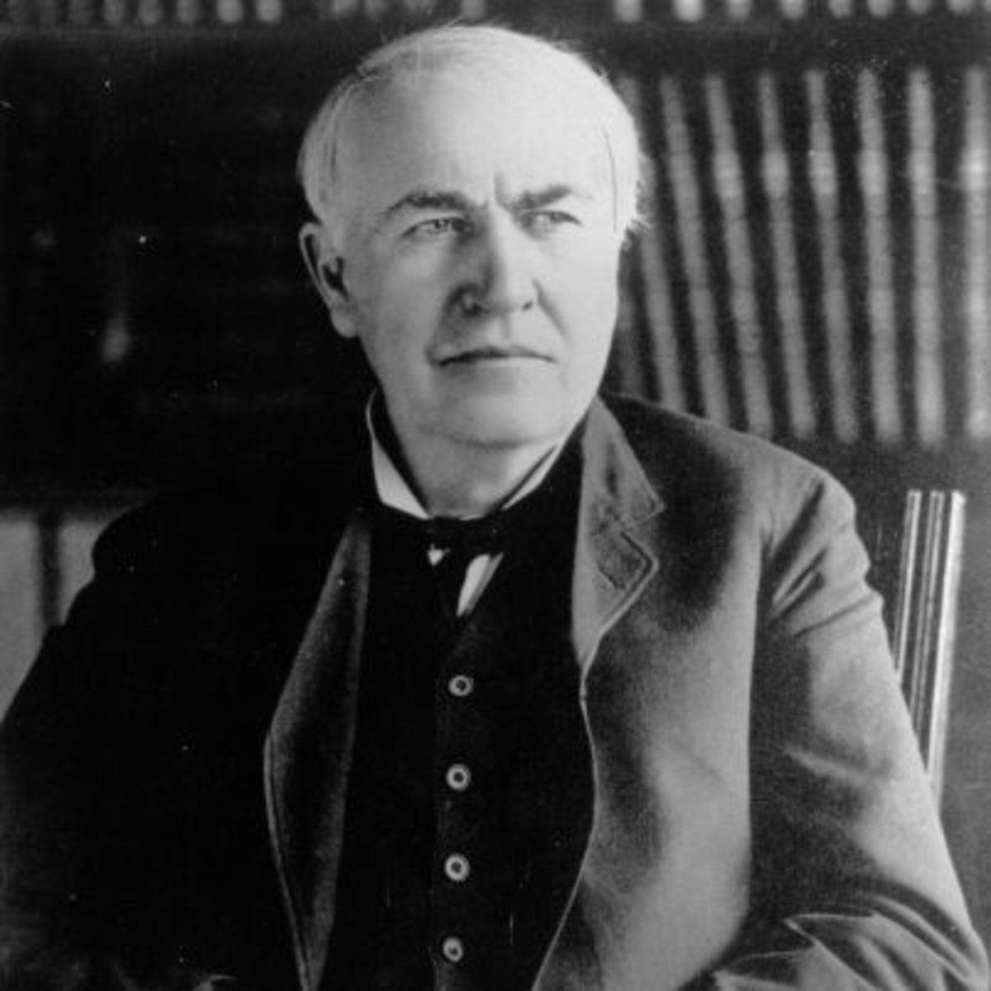
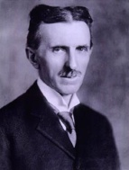
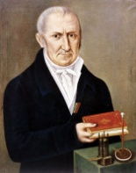
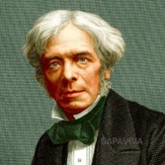
Science: Electricity
What is electricity? Electricity is the presence and flow of electric charge. Using electricity we can transfer energy in ways that allow us to do simple chores. Its best-known form is the flow of electrons through conductors such as copper wires. | Why was the discovery of electricity important? Electricity is one of the most important blessings that science has given to mankind. It has also become a part of modern life and Modern equipment like computers and robots have also been developed because of electricity. | What is an electric circuit? In order for electrons to flow they need a closed circuit. An electric circuit provides a complete, closed path for electricity. | Are all circuits the same? There are two types of electric circuits, the series and parallel circuit. A series circuit there is only one path for the electrons to flow. In a parallel circuit the different parts of the electric circuit are on several different branches. There are several different paths that electrons can flow. | Investigation: Do you think there could be too much power to a circuit? How could we find out? How could we make a buzzer/bulb more powerful?
Key Vocabulary
current (noun) | This is the amount of electricity flowing through the circuit (a flow of electrons moving in a loop in the circuit). It can be measured using an ammeter and measured in amps.
circuit (noun) | A roughly circular line, route, or movement that starts and finishes at the same place.
cell (noun) | A unit in a device for converting chemical or solar energy into electricity.
Motor (noun) | A machine that supplies motive power for a vehicle or for another device with moving parts.
voltage (noun) | An electric force that causes free electrons to move from one atom to another. A volt is the measure of electric pressure. Voltage is usually supplied by a battery or a generator.
source (noun) | The start of something. Where the energy comes from.
conductor (noun) | A substance or body capable of transmitting light, electricity, heat.
insulator (noun) | A substance or device which does not readily conduct electricity.
Key Diagram / Image
Key Diagram / Image
Key Figures
Thomas Edison | Nikola Tesla | Alessandro Volta | Michael Faraday
“Science is simply the word we use to describe the method of organising our curiosity.” – Tim Minchin
1609: The moon is observed for the first time by Galileo using a telescope
1687: Newton discovers the law of gravity and motion
1751: Benjamin Franklin establishes that lightening is electrical (kite).
1859: Charlies Darwin publishes Theory of Evolution
1905: Albert Einstein’s theory of relativity E=MC2
1927: Lemaître produces the Big Bang theory
1969: The moon is walked on for the first time by Neil Armstrong
1997: Dolly the sheep is cloned by the Roslin Institute

