Slide 1

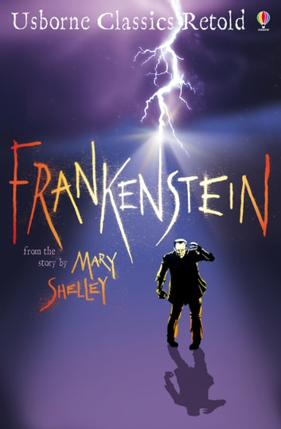





Year 6
Spring term
2
Ready Respectful Safe
Frankenstein
Why this particular book and not something else?
Having spent half the term hearing the narrative from the perspective of Victor Frankenstein, we now hear the events from the creation’s viewpoint. This provides us with an excellent opportunity to explore different perspectives. We empathise with the creation, acknowledging that he was deprived of love; we understand that society’s closed mindset, lack of empathy and their intolerance and prejudice he experienced were the reasons for him to become a ‘monster.’ But his actions cannot be justified. To this end, we chose this book as it highlights our responsibilities towards building a better society that is rooted in love and understanding towards differences, whatever those differences may be.
The maturity and the level of discussion in the Year 6 classrooms is outstanding; we are always impressed by how the Year 6 children are able to use the metaphor presented in this made-up story and how Y6 relate it to situations that are relevant to themselves and to the problems that children their age encounter. Our teachers are very skilled at delivering the content of the story in a sensitive and explorative way, steering the discussions on real-life, relevant dilemmas.
In the past, these top questions have arisen which have generated discussion:
What does it mean to forgive?
Is a bully born to bully?
Who were the key agents who might have changed the events and outcomes? What could they have done or done differently? Who do I have in my life who would help me?
This book provides Y6 with an opportunity to discuss children’s mental health and a platform for children to analyse and discuss healthy habits, obsessions and how dealing with stress is vital. In this sense, the ‘creation’ is a metaphor for worries that grow and can build to become overwhelming without the correct intervention or support. With news of secondary school allocation coming this half term, managing stress and worries is an integral part of this unit and is exactly why we choose this book over other books. The author makes Victor’s decline in mental health so clear that all readers can pinpoint where things went wrong, who could have helped him and what he might have done differently. When Victor reaches his crisis point, there are no surprises as we saw it coming. In tracking Victor’s mental health, Year 6 children become more aware of their own mental health. Our discussions about Victor’s mental health empower the children with the strategies to communicate their feelings in a more articulate way. Some key questions we use are: could Victor have done things differently? When should he have asked for support and how? How could Victor have been better supported by those around him in his times of mental crisis?
On top of this, Frankenstein continues to frame our scientific learning about Charles Darwin’s theory of evolution as well as our research on electricity and testing electrical circuits. Did you know? Mary Shelley writes about electricity and shows a fantastic understanding of science – not bad considering women of the time were not allowed to attend school nor find out about science!

Slide 2
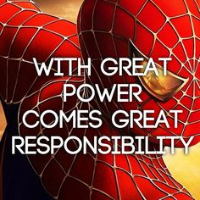
Year 6
Spring term
1
Ready Respectful Safe
English Skills that will be developed through this unit:
Apostrophes for possession including irregular plurals: In the following example, both are correct but have different meanings: the city’s buildings are big, the cities’ buildings are big.
Modal verbs: What could Victor have done differently? What would you do?
Formal tone: Be that as it may, the creation is unwholesome.
The subjunctive voice: If I were Victor, I would have…
Passive voice: The creation was corrupted by a prejudice society.
Reported speech: the creation said that he was neglected.
Writing Composition in school:
Children write a letter of complaint from Victor’s neighbours; they are concerned about the noise and disturbance during unsociable hours. This is a formal piece of writing so the style and language need to be fitting.
Children write a newspaper report; some children choose to write about the giant spotted in the woods, some children write about the lightning storm, some children choose to write about William’s tragic death. Whatever the children choose to write about, they must organise their work correctly and use the correct style and tone associated with reports.
Writing Tasks at Home:
You’ll find your writing tasks on your weekly homework sheet but one specific task that you might invest in is finding some inspirational quotes. Write down your favourite and explain why you’ve chosen it. This activity would very much help you when you come to write different perspectives where you will be asked to give advice to the ‘creation.’
Here’s my example that is particularly relevant for this unit of work.

Slide 3
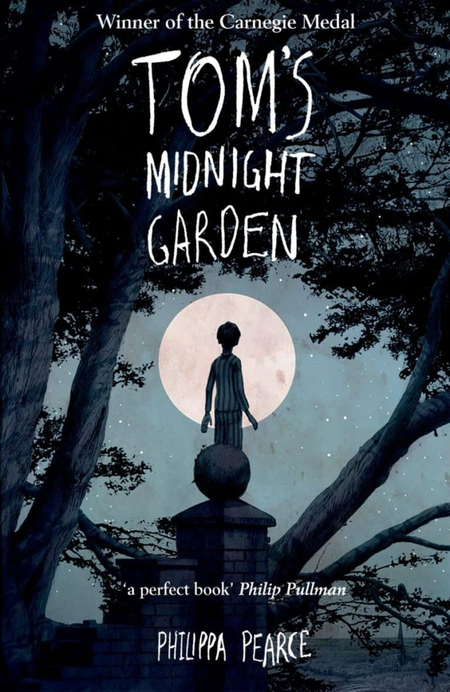
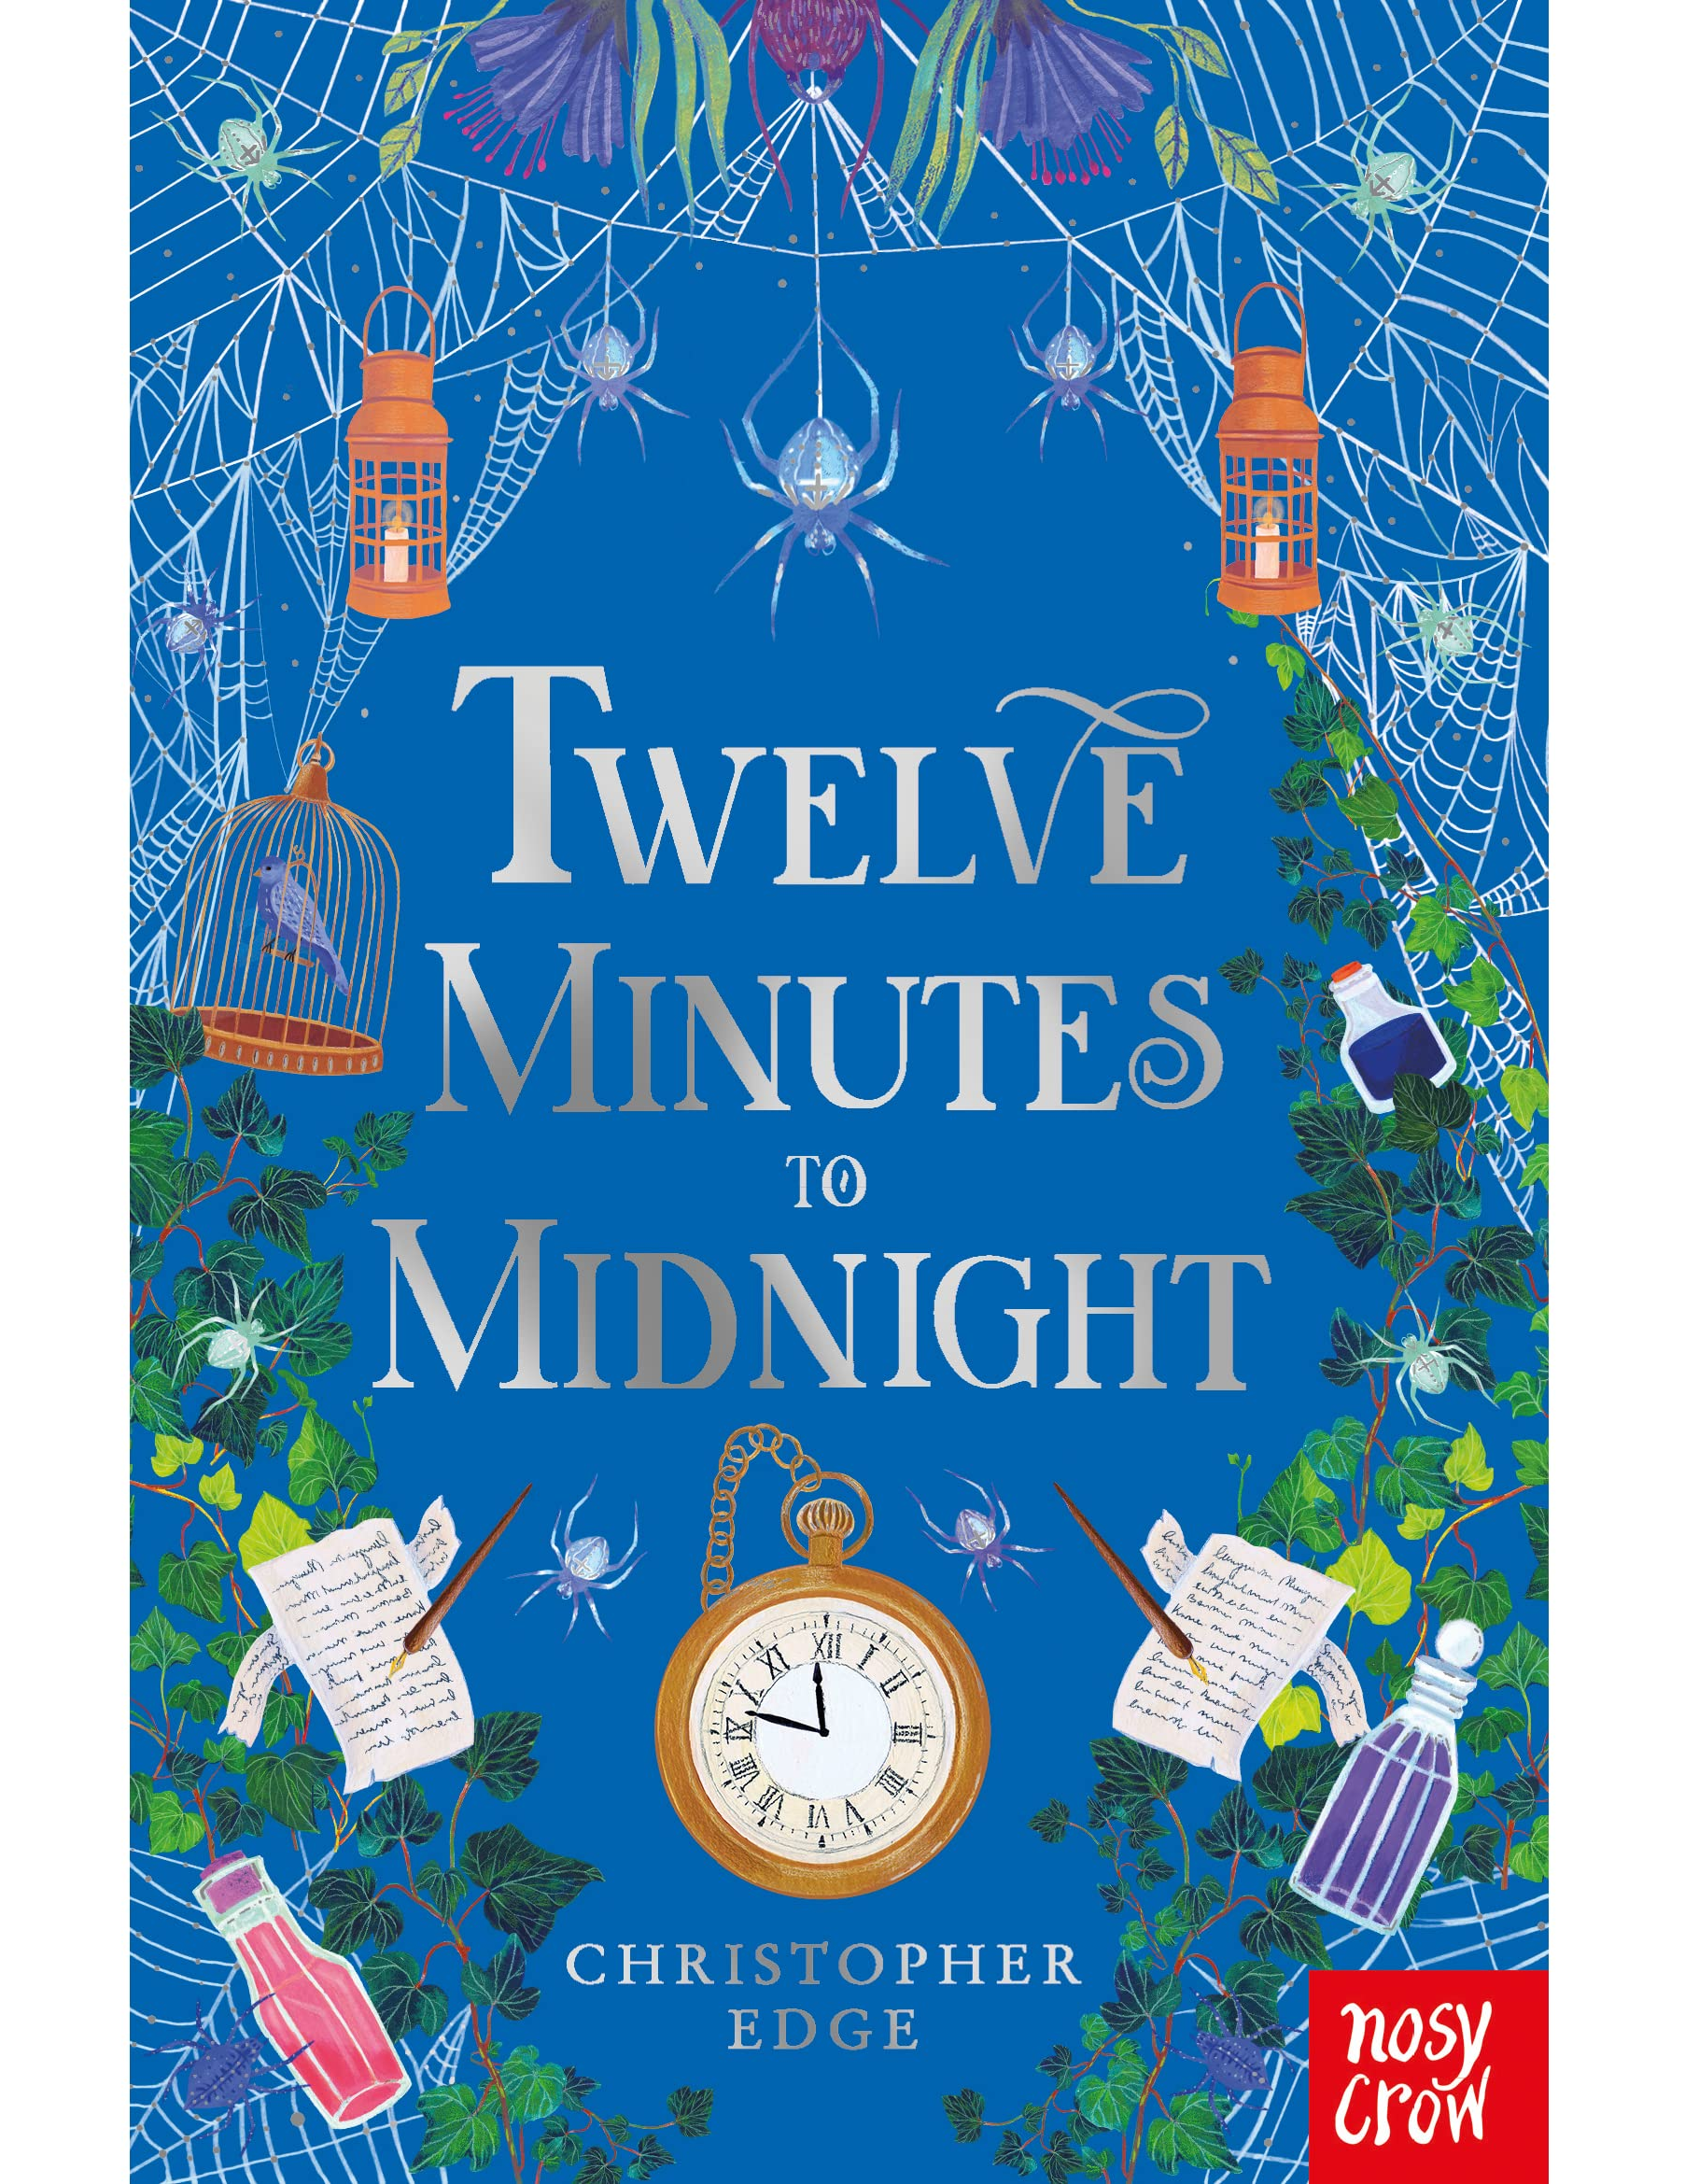
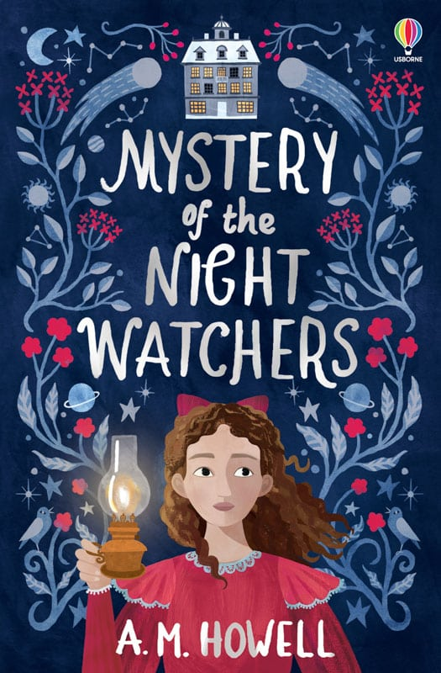
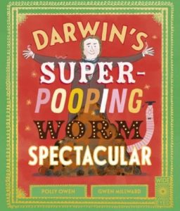
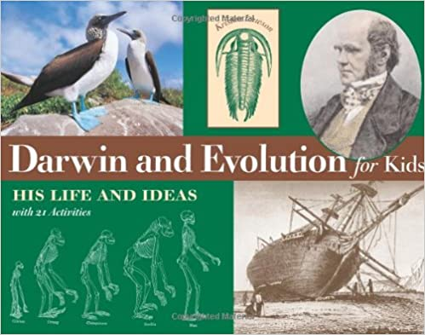
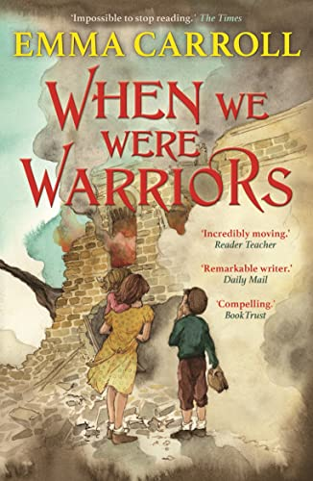
Year 6
Spring term
1
Ready Respectful Safe
Our Extended Book Spine
Penelope Tredwell is the feisty thirteen-year-old orphan heiress of the bestselling magazine, The Penny Dreadful. Her masterly tales of the macabre are gripping Victorian Britain, even if no one knows she's the author. One day, a letter she receives from the governor of the notorious Bedlam madhouse plunges her into an adventure more terrifying than anything she has ever imagined. Why are the patients of Bedlam waking every night at twelve minutes to midnight? What is the meaning of the strange messages they write? Who is the Spider Lady of South Kensington? Penelope is always seeking mysteries to fill the pages of her magazine. But this isn't any ordinary story, it's the future. And the future looks deadly...
We have plenty of copies of this book in Y6.
Mystery of the Night Watchers is a gripping historical adventure set in East Anglia. It’s May 1910 and the blazing Halley’s comet is drawing closer to the earth, when Nancy is uprooted to start a new life in Suffolk with a grandfather she has never met. Nancy is forbidden from leaving her grandfather’s house and discovers its secret observatory. As the mysteries begin to pile up Nancy must bring dark secrets from the past to light – even if doing so will put her own life at risk.
Set in World War Two, Emma Carroll explores the resilience, resourcefulness and inventiveness of children when their lives fall to pieces. Introducing some compelling new characters, as well as revisiting some familiar settings, these adventures are sure to win over new readers, as well as fans of old favourites such as Letters from the Lighthouse.

