Slide 1

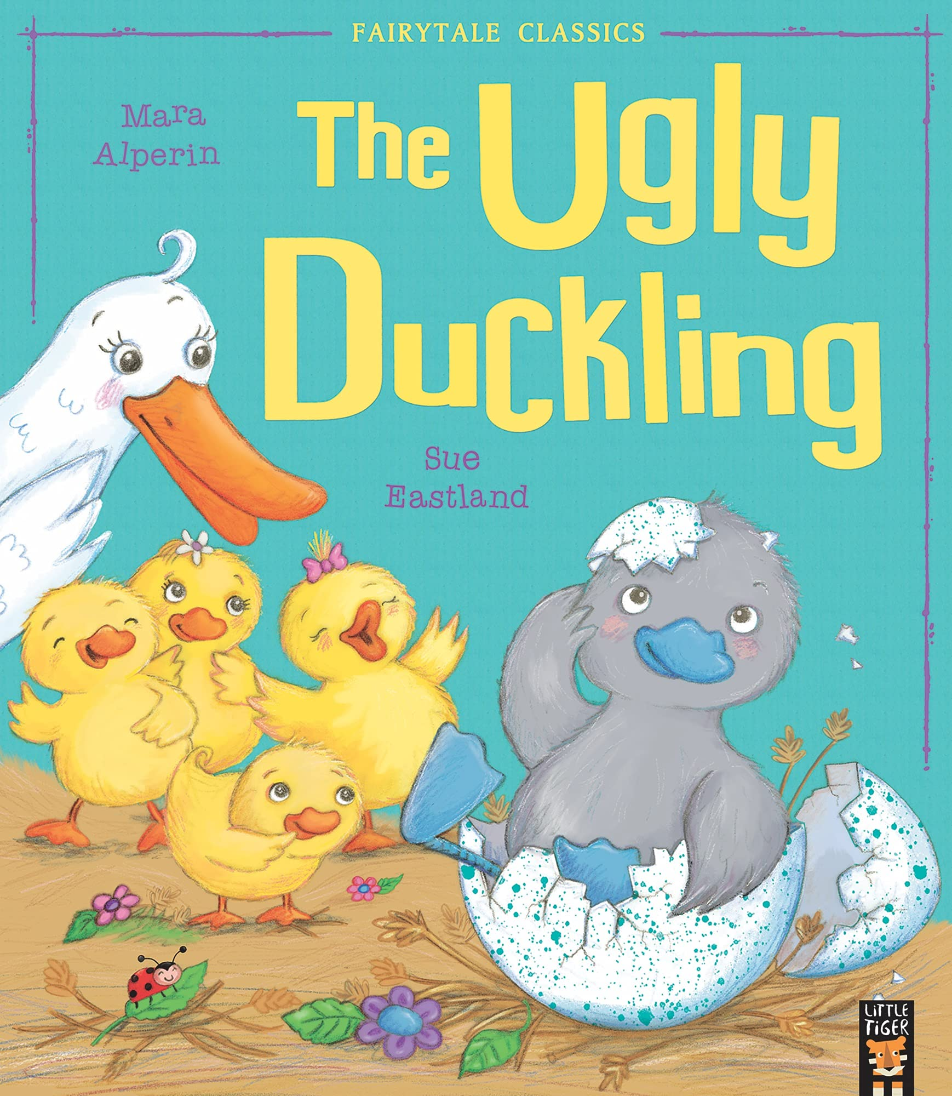





Year 1
Spring term
2
Ready Respectful Safe
The Ugly Duckling
Why this particular book and not something else?
The ducklings are coming – the ducklings are coming! This is such a magical time in Y1 and witnessing ducklings hatching from their eggs will certainly capture the children’s interest. In previous years, Year 1 children have explored lifecycles of animals but have used chicks as their focus. As a team, we wanted the children to have the same curriculum enrichment as in previous years but to also support children’s learning of our key values through our lead book.
In the Ugly Duckling we have an opportunity to develop the children’s understanding of differences and explore themes of empathy, tolerance and kindness alongside developing skills of reading and writing.
This story, by Mara Alperin, alongside our other leading texts, will provide excellent models for our own story telling. In a similar way to our previous unit, our writing focus continues to be on adapting known stories to support in the innovation of our own ‘new’ stories. Children can expect to develop their story telling skills through actions and words as well as develop their vocabulary.
But above all else, children will keep coming back to the moral message in this story: treat everyone with kindness and respect.
School values this book reinforces:
Kindness. This book exists to teach children about the importance of choosing kind – it really is that simple!
Key Question:
How did the ugly duckling feel at the start and at the end of the story?

Slide 2
Year 1
Spring term
1
Ready Respectful Safe
English Skills that will be developed through this unit:
There’s plenty to be learnt this half term. As always, we continue to reinforce and make concrete our understanding and use of basic punctuation including full stops, capital letters and finger spaces.
We teach how to retell stories using actions.
Ordering events is an important thread that runs through the half term.
We write sentences that are sequenced in the correct order.
With a focus on story dilemmas (the problem in a story), we begin to consider how we can add to or change a problem in a story to put our own stamp on our writing. That poor ugly duckling will have the weight of the world on his little shoulders by the time the Year 1 children invent their own ideas for problems he can encounter!
As we switch to non-fiction writing, sequencing events in the right order continues as a focus.
We look at diagrams and pictures and how they sometimes need to be followed in a correct order too.
Finally, Year 1 consider the features of an information booklet (including diagrams) and add some interesting facts.
Writing Composition in school:
Children will adapt the problem in The Ugly Duckling and will come up with their own ideas of problems that he might face that would fit with the existing story.
Children will create an information booklet, complete with diagrams, to explain the lifecycle of animals.
Children will write facts about dinosaurs and then explore fiction writing where they can create and describe their own dinosaur.
Help at Home:
Chatting about doing things in the correct order would be very helpful. What is the sequence of getting dressed in the morning? Can things be done in any order? Get the message across to your child that whilst some events can happen in any order, this is not always the case. Somethings have to be sequenced before others.
Writing Tasks:
Grab your favourite fairy tale. Read it through. Try to retell the story in your own words. You might even think of your own story actions with your hands to help you remember key words in the story.
What do you do before you come to school? Talk with your child about their routine. What do they do first? Do we do things in the same order? Draw pictures of your routine.
Tell those other ducklings how to be kind! Give them a list of instructions on what they should do. What would you tell them ‘First’? What ‘Next’?

Slide 3
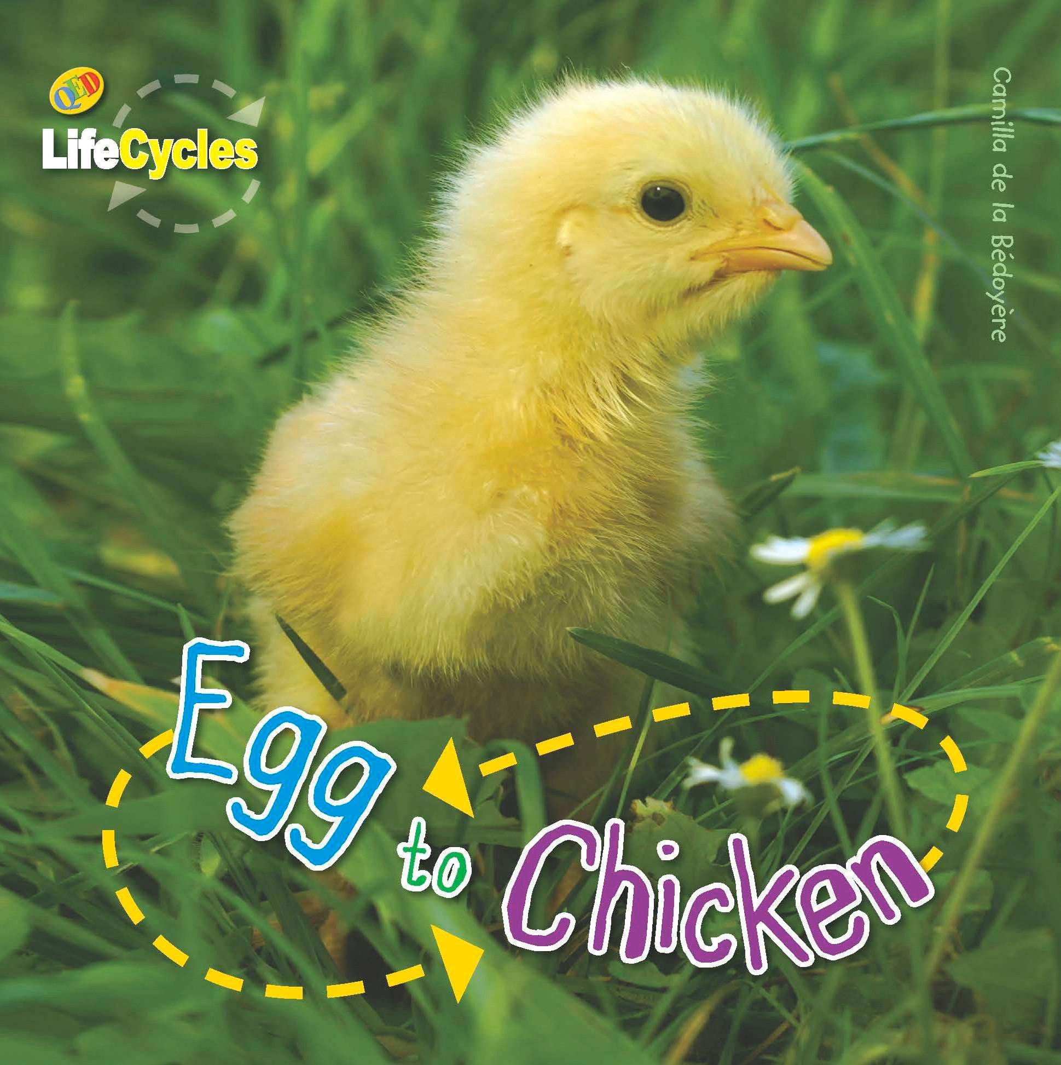
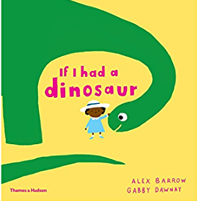
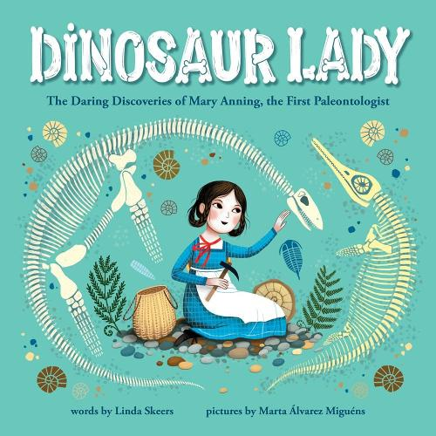
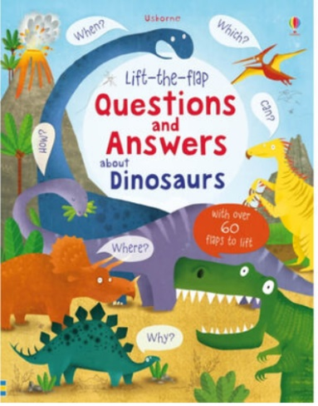
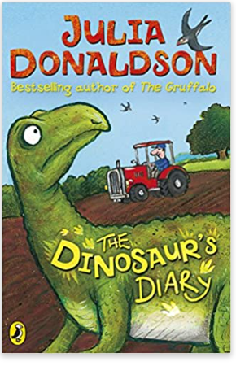

Year 1
Spring term
1
Ready Respectful Safe
Other texts we use in school:
Our Extended Book Spine
For children who are particularly interested in dinosaurs and dinosaur facts. This jam-packed book provides simple and friendly answers to questions such as “Why do dinosaurs have tricky names?”, “Could dinosaurs swim?”, “How big was the biggest dinosaur?” and lots more.
This book very cleverly identifies our similarities and differences and demonstrates how these enhance our every day lives. The sparse, rhyming text jogs along beautifully and the wonderfully funny, detailed illustrations are full of humour, joy and affection. This book provides a brilliantly simple way to explain the advantages of difference to young children in a warm and entertaining way.
Surviving and finding a safe place to lay her eggs is difficult for Hypsilophodon with dinosaurs like Tyrannosaurus Rex around. When she falls into a mysterious pool and finds herself on a modern farm there are still problems. Finally she finds a safe place to hatch her babies, but how can she keep thirteen baby dinosaurs safe and secret? When the farmer catches one - Hector - and plans to take him to the vet, it's up to Hypsilophodon and her fiesty daughter, Henrietta, to get him back. After a daring rescue, Hypsilophodon takes all her youngsters back through the mysterious pool to her own world.

