Slide 1
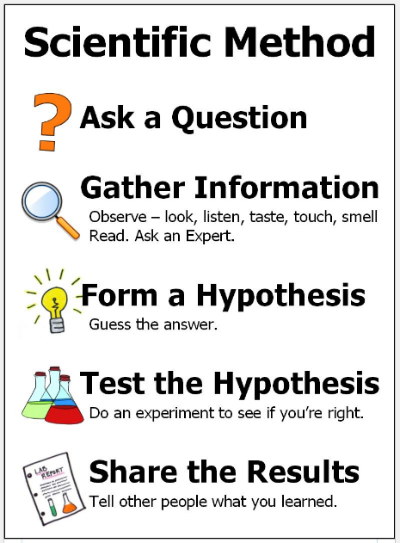
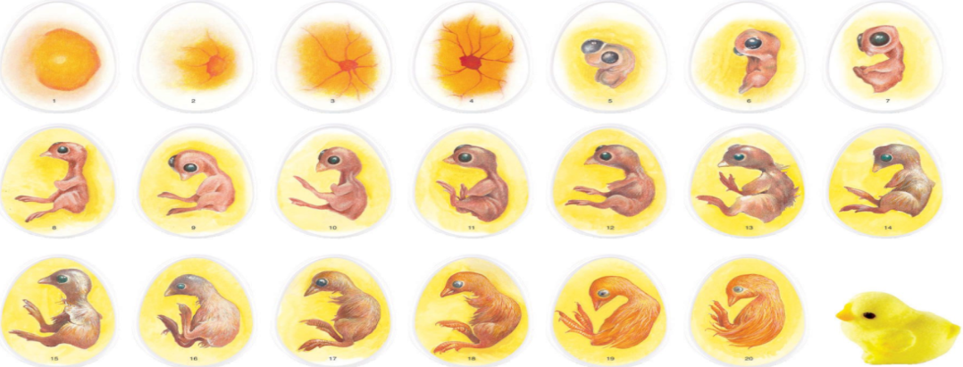

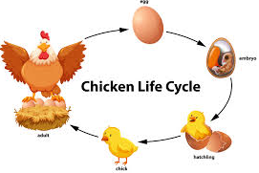
Science: From Egg to Chicken (Animals including humans)
Key concepts: We will be exploring how animals have offspring and how they then develop and grow into adults of their species. We will be relating this to what we know about our own growth and development. | We will be observing chicks hatching looking at; incubation and hatching conditions for growth fluff or feathers? how to tell male and female chicks apart | Which comes first, the chicken or the egg? By observing the hatching of live chicks in the classroom, we will be learning about how chicks develop before and after hatching and how important it is to provide the right conditions for them to thrive. | Think like a scientist: Making scientific observations. We will be observing the development of the chicks every day and carefully recording any changes through drawings/diagrams/notes.
Key Vocabulary
egg (noun) | chick (noun)
incubator (noun) | hatch (verb)
egg tooth (noun) | grow (verb)
hen (noun) | chicken (noun)
beak (noun) | feathers (noun)
peck (verb) | warm (adjective)
lamp (noun) | fluffy (adjective)
shell (noun) | wet (adjective)
Growth of a Chick
Incubation
Incubation
1609: The moon is observed for the first time by Galileo using a telescope
1687: Newton discovers the law of gravity and motion
1751: Benjamin Franklin establishes that lightening is electrical (kite).
1859: Charlies Darwin publishes Theory of Evolution
1905: Albert Einstein’s theory of relativity E=MC2
1927: Lemaître produces the Big Bang theory
1969: The moon is walked on for the first time by Neil Armstrong
1997: Dolly the sheep is cloned by the Roslin Institute
“Science is simply the word we use to describe the method of organising our curiosity.” – Tim Minchin

