Slide 1
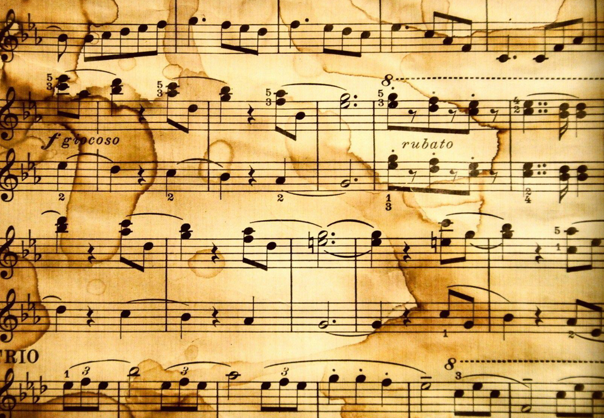
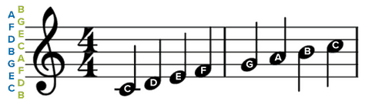
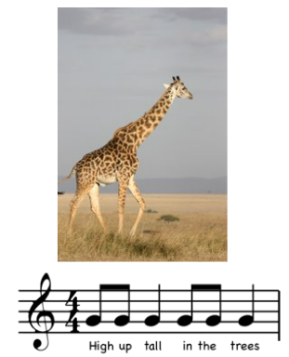
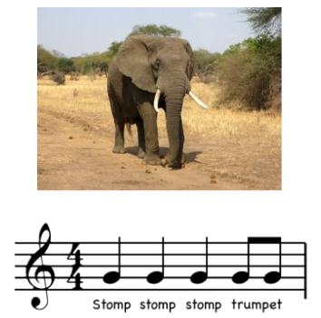
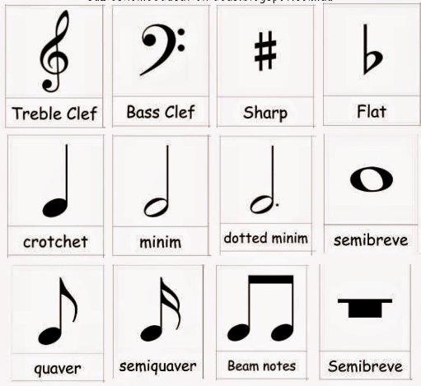
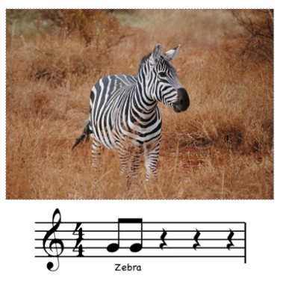
Music
Dynamics
Quiet
Loud
Fast
Slow
Percussion
Tempo
“Music can change the world.” – Beethoven
Music | Description
African Folk Music | Clapping and body percussion to different rhythms.
Animal Music | Making sound reflect the type of animal and it’s nature.
Instruments / programmes:
Percussion instruments (drums)
Medieval
(approx. 400-1400)
Renaissance
(approx. 1400-1600)
Baroque
(approx. 1600-1700)
Classical
(approx. 1700-1810s)
Romantic
(approx. 1810s-1900)
20th Century
(approx. 1900-2000)

