Slide 1
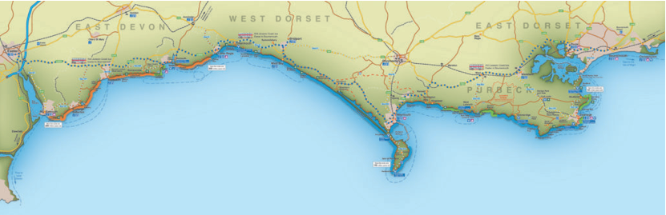
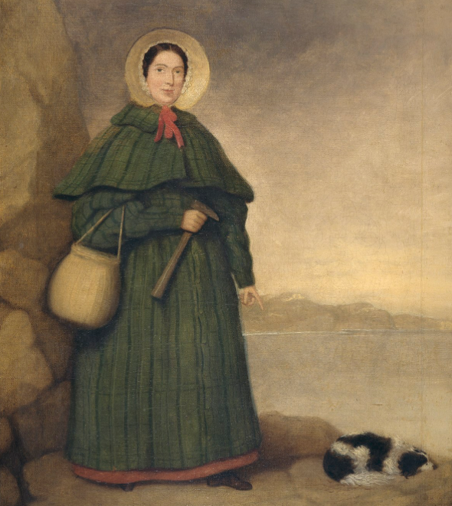
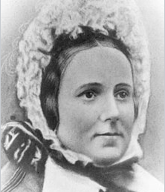

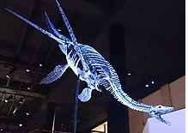
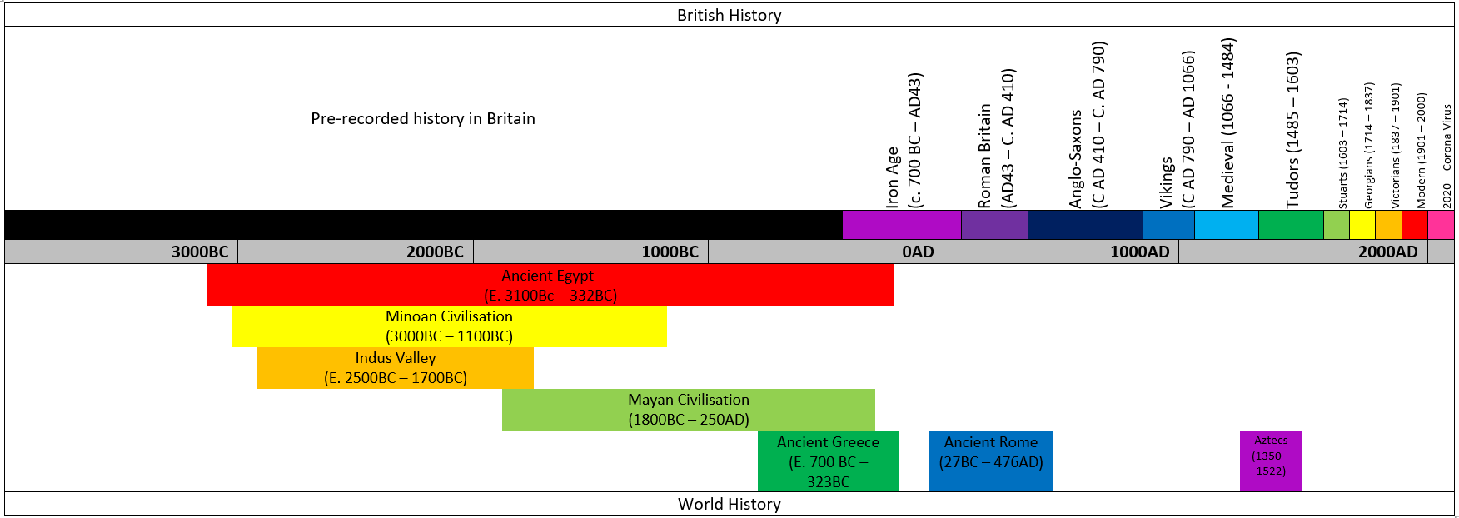
HISTORY: Mary Anning
Date | Triassic and Jurassic periods |  | 21st May 1799 |  | 1811 | 1823 | 1847
Event | Dinosaurs existed | Dinosaurs died and turned into fossils | Mary Anning was born | Made friends with Elizabeth Philpot who taught her about fossils | Found the first Ichthyosaur | Found a whole Plesiosaurus | Mary Anning Died | My Grandparents were born | My Parents were born | I was Born
Key Figures
Mary Anning | Elizabeth Philpot
Picture
Ichthyosaurus | Plesiosaur
Key facts
Mary Anning collected what she called “curiousities’’ She lived in Lyme Regis on the Jurassic coast Elizabeth Philpot taught her they were called fossils and were from creatures long ago Mary Anning was an amazing palaeontologist She was never recognised for her work because she was a woman.
Key Vocabulary
Term | Definition
Jurassic coast | A 95mile stretch of coast from Exmouth to Swanage in Dorset
palaeontologist | A scientist who studies fossils
Fossils | Preserved remains of ancient creatures
Ichthyosaur | A large marine reptile
Plesiosaurus | A large marine reptile
Dinosaurs | A large group of varied reptiles that lived in the Triassic/Jurassic Period
“History is a version of past events that people have decided to agree upon.” – Napoleon Bonaparte

