Slide 1

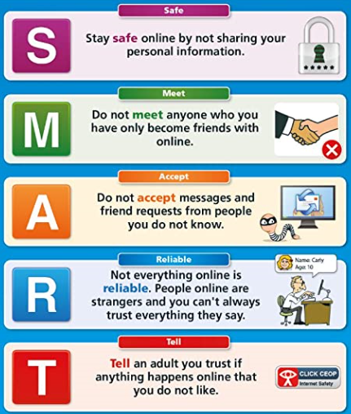

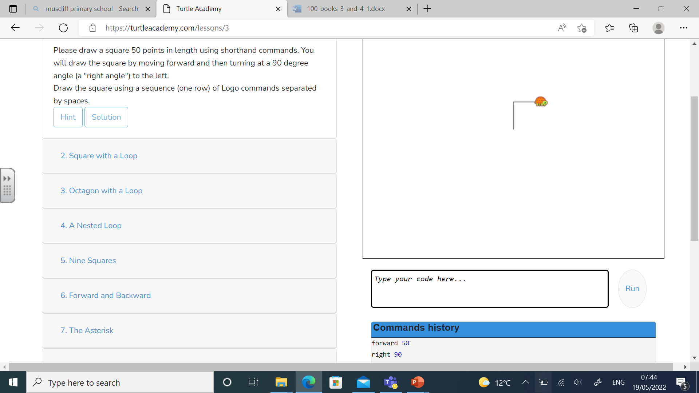


Computing
Simulation
reliability
command
Branching database
questionnaire
Search engine
Print screen
programming
document
Topic | What we are learning
Programming | On Logo, creating a group of commands such as forward, backward and repeat to draw a shape Algorithms on scratch can be used to complete specific tasks.
Communication | Understanding which functions manipulate a document on PowerPoint and Word by changing the font size, colour and style. Edit our work by adding or removing words.
Research | Navigate to a website via favourites and typing in address on the internet. Use key words to safely search for images Discuss the reliability of information on the internet
Multimedia | Use print screen to capture an image on a website. Paste an image into paint software. Zoom in and out of pictures effectively. Combine a set of photographs together to tell a story.
Data | Design a questionnaire to collect information, and display this in a graph or table. Create a branching database to sort and organise items. Filter and sort records in a database to answer questions .
Scratch
Turtle academy
PowerPoint
Word
“Man is still the most extraordinary computer of all.” – John F Kennedy

